Slide 1
Repentance & Its Works
Acts 17:30-31
³⁰ Truly, these times of ignorance God overlooked, but now commands all men everywhere to repent, ³¹ because He has appointed a day on which He will judge the world in righteousness by the Man whom He has ordained. He has given assurance of this to all by raising Him from the dead.
Acts 26:20
Repent and turn to God, doing works worthy of repentance.

Slide 2
Two Pictures of Repentance
Luke 15:17
Matthew 21:28-31
Prodigal Son
But when he came to himself he said, How many hired servants of my father’s have bread enough and to spare, and I perish here with hunger!
Contrast of Two Sons
A man had two sons; and he came to the first, and said, Son, go work to-day in the vineyard. And he answered and said, I will not: but afterward he repented himself, and went. And he came to the second, and said likewise. And he answered and said, I go, sir: and went not. Which of the two did the will of his father?

Slide 3
2 Corinthians 7:10-11
¹⁰ For godly sorrow produces repentance leading to salvation, not to be regretted; but the sorrow of the world produces death. ¹¹ For observe this very thing, that you sorrowed in a godly manner: What diligence it produced in you, what clearing of yourselves, what indignation, what fear, what vehement desire, what zeal, what vindication! In all things you proved yourselves to be clear in this matter.

Slide 4
Repentance & 2 Cor. 7
Godly sorrow precedes repentance
Comes from recognition of sin against God
Causes “diligence”
Causes “clearing”
Causes “indignation”
Causes “fear”
Causes “vehement desire” (“longing”)
Causes “zeal”
Causes “vindication”

Slide 5
What Kind Of works are worthy of repentance?
Acts 26:20
Repent and turn to God, doing works worthy of repentance.

Slide 6
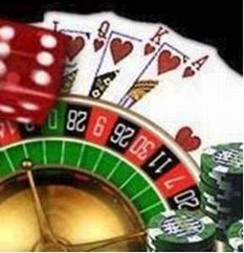
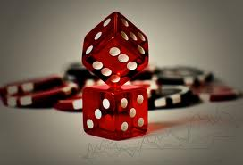
No Gambling

Slide 7
Gambling Is Condemned
God Authorizes Three Ways of Gain:
Labor - Eph. 4:28; 2 Thess. 3:l2; Luke 10:7
Investment (buy & sell) - Matt. 13:44; Matt. 25:27
Voluntary Gift - Eph. 4:28; Acts 2:45
Gambling is not authorized by any of these (it is lawless)
Sinful Traits of Gambling:
Covetousness - Luke 12:15; Ephesians 5:3, 5; Col. 3:5-6
Selfishness (no love of neighbor) - Romans 13:10
Wastefulness (poor stewardship) - Luke 16:10-12
Evil companions - James 3:11-12
Harms society - Proverbs 14:34; Matthew 5:13-16
Deceptiveness - James 1:15-16; Hebrews 11:25; 3:12-13

Slide 8
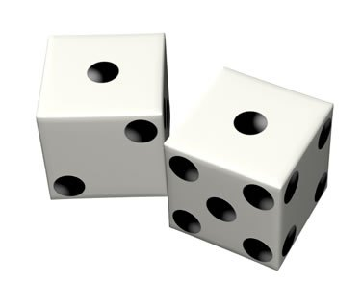
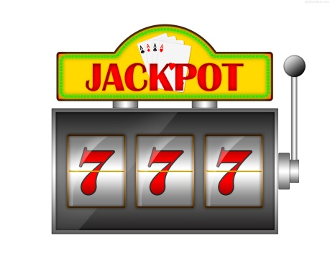
The Sin of Gambling
Encourages laziness, lust & selfishness
“The desire of the lazy man kills him, for his hands refuse to labor. He covets greedily all day long, but the righteous gives and does not spare” (Prov. 21:25-26).

Slide 9
The Sin of Gambling
Discourages productive labor
“In all labor there is profit, but idle chatter leads only to poverty” (Prov. 14:23).

Slide 10
The Sin of Gambling
Encourages the “get rich quick” mentality
“He who tills his land will have plenty of bread, but he who follows frivolity will have poverty enough! A faithful man will abound with blessings, but he who hastens to be rich will not go unpunished” (Prov. 28:19-20).

Slide 11
The Sin of Gambling
Encourages greed and discontent
Gambling thrives on constant desire for more (1 Tim. 6:9-10)
Be content, not covetous (Heb. 13:5)
Godliness with contentment should be our aim (1 Tim. 6:6-8)

Slide 12
The Sin of Gambling
Encourages love for wrong things
“Lovers of themselves” and “lovers of money” (2 Tim. 3:2-3)
“Lovers of pleasure” rather than “lovers of God” (2 Tim. 3:4)

Slide 13
The Sin of Gambling
Encourages reckless stewardship
Shows one is unworthy of the true riches (Luke 16:9-12)
Trust in money will leave one bankrupt on the Day of Judgment (Luke 16:13)

Slide 14
Beware of Gambling!
“A man with an evil eye hastens after riches, and does not consider that poverty will come upon him” (Prov. 28:22).

