Slide 1
A Man
Acquainted
with Grief
Isaiah 53:3-5
Psalm 69:19-21
Notes:
Welcome to Super Easy Templates: This is an 8 x 11 PowerPoint presentation that consists of one design slide or title page. We provide easy-to-use and customize templates for home and business use. Most of our templates are for PowerPoint 2007 and Word 2007. If you are interested in additional templates, visit our website: www.supereasytemplates.com. We specialize in creating and designing positive, multi-cultural presentations, posters, postcards, and other media for home and business use! If you require technical support on this specific presentation, email us: support@supereasytemplates.com. Also, check the Microsoft forums for specialized assistance. Although we try to respond to all support requests, please realize that this is a free service and we cannot guarantee a timely response. All questions and answers are usually posted on our FAQ pages.

Slide 2
Isaiah 53:3-5
He was despised and rejected by men, a Man of sorrows and acquainted with grief. And we hid, as it were, our faces from Him; He was despised, and we did not esteem Him. Surely He has borne our griefs and carried our sorrows; yet we esteemed Him stricken, smitten by God, and afflicted. But He was wounded for our transgressions, He was bruised for our iniquities; the chastisement for our peace was upon Him, and by His stripes we are healed.

Slide 3
Psalm 69:19-21
You know my reproach, my shame, and my dishonor; my adversaries are all before You. Reproach has broken my heart, and I am full of heaviness; I looked for someone to take pity, but there was none; and for comforters, but I found none. They also gave me gall for my food, and for my thirst they gave me vinegar to drink.

Slide 4
Jesus: Man of sorrows & Acquainted with Grief
Heb. 2:10 Suffering
Matt. 26:37 Sorrow
Luke 4:2 Hunger
Luke 9:58 Poverty
John 4:6 Weariness
Mark 8:12 Disappointment
John 11:33 Troubled mind
John 12:27 Distress
Luke 22:44 Agony of mind
Phil. 2:8 Death on cross

Slide 5
Despised & Rejected
Despised by world
Matt. 8:34
Mark 6:3
Luke 4:28-29; 16:14
Luke 23:18, 35-36
John 1:11; 10:20
Friends rejected Him
Mark 3:21
Luke 22:47-48, 54-61
Family rejected Him
John 7:5

Slide 6
Broken-hearted & Full of Heaviness
At a world lost in sin
At the rejection of His word
As Almighty suffering abuse
As All-Wise mocked by fools
Creator spurned by creation
God of love amidst hatred
Mourning a dying Jerusalem
Experiencing unbearable pain
Seeing devil’s destructiveness
Pitying us in our weaknesses
In all points tempted as we are,
Yet without sin!

Slide 7
No Matter What Our Sorrow, Grief or Rejection
No Matter Our Being Broken-Hearted, Despised & Betrayed
Jesus Knows Our Every Care & Cares for Us

Slide 8
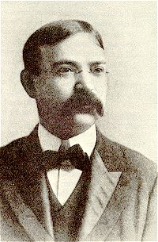
Frank Ellsworth Graeff (1860 – 1919)
Known for his generally cheerful attitude
Also had difficult trials -- deep depression, despondency, doubts and physical pain
As many people of professed faith in time of heartache, he questioned if Jesus really cared about him and others undergoing trials life
It was during one of those very low periods that he began to write,
Does Jesus care when my heart is pained Too deeply for mirth or song, As the burdens press, And the cares distress, And the way grows weary and long?

Slide 9
Frank Ellsworth Graeff (Does Jesus Care?)
Being one who regularly read God’s Word, he sought comfort from it
Struck with the obvious answer as he read words of 1 Peter 5:7 -- “He cares for you”
The words rang in his mind as if they were given in a resounding voice
After meditating on this truth, he wrote…
O yes, He cares, I know He cares, His heart is touched with my grief; When the days are weary, The long night dreary, I know my Savior cares.
With that beginning, more verses followed:

Slide 10
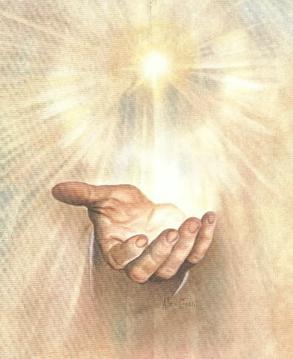
Does Jesus care when my way is dark With a nameless dread and fear? As the daylight fades
Into deep night shades, Does he care enough to be near?
Does Jesus care when I’ve tried and failed To resist some temptation strong; When for my deep grief
I find no relief, Though my tears flow all the night long?
Does Jesus care when I’ve said “goodbye” To the dearest on earth to me? And my sad heart aches
Till it nearly breaks, Is it aught to Him? Does He see?
Oh, YES, He cares! I know He cares, His heart is touched with my grief; When the days are weary,
The long nights dreary; I know my Saviour cares.

