Slide 1
Authorized Mission of the Church
Ephesians 4:11-16

Slide 2
Ephesians 4:11-16
¹¹ And He Himself gave some to be apostles, some prophets, some evangelists, and some pastors and teachers, ¹² for the equipping of the saints for the work of ministry, for the edifying of the body of Christ, ¹³ till we all come to the unity of the faith and of the knowledge of the Son of God, to a perfect man, to the measure of the stature of the fullness of Christ; ¹⁴ that we should no longer be children, tossed to and fro and carried about with every wind of doctrine, by the trickery of men, in the cunning craftiness of deceitful plotting, ¹⁵ but, speaking the truth in love, may grow up in all things into Him who is the head - Christ - ¹⁶ from whom the whole body, joined and knit together by what every joint supplies, according to the effective working by which every part does its share, causes growth of the body for the edifying of itself in love.

Slide 3
Church Has Spiritual Mission: Proclaim the Truth of the Gospel
Description of the church shows its purpose: 1 Timothy 3:15
Equipping of the church shows nature of its mission: Ephesians 4:11-16
Make known the manifold of God by the church: Ephesians 3:8-11
Record from book of Acts confirms this spiritual work

Slide 4
What Gospel Was Taught In The First Century? Romans 1:15-17
Paul’s coming to Rome was to be for the purpose of preaching the gospel
Paul kept this focus of attraction because he was not ashamed of gospel
Gospel seen as God’s power to salvation
Those attracted to gospel are drawn by the righteousness revealed therein
What is drawing power of any other focus?

Slide 5
What Gospel Was Taught In The First Century? 1 Corinthians 1:18 - 2:5
Paul acknowledged most would reject gospel when preached as authorized
Gospel was still seen as the power of God
1st century gospel was the wisdom of God
When presenting the gospel, power of gospel was stressed, not appeal to man
Gospel not changed to enhance appeal

Slide 6
What Gospel Was Taught In The First Century? 2 Corinthians 4:1-5
As Paul had obtained mercy though the gospel, even so he continued declaring it
Renounced crafty or deceitful handling of the word of God
Did not handle in a way to trick hearers
Did not draw with one & substitute another
No “bait & switch” tactics of advertising
If gospel veiled, image of God not seen
Attraction not in man, but in gospel

Slide 7
Pure Gospel Must Be Preached in Its Purity & Entirety
Example of Paul in Ephesus affirms such (Acts 20:20-27)
Charge to Timothy confirms the same thing (2 Timothy 4:1-5)
Why were those teaching first century Gospel persecuted if message could be altered to avoid offense?

Slide 8
History of Social Gospel
Darwin’s theories affected “elite clergy”
Faith lost in spiritual mission of church
Had “institution” seeking another purpose
Became place to address social ills
Had to attract large numbers to succeed
Done by entertainment & activities of popular appeal (“meeting man’s felt needs”)
Attracted people with popular methods & replaced the true gospel as focus of appeal

Slide 12
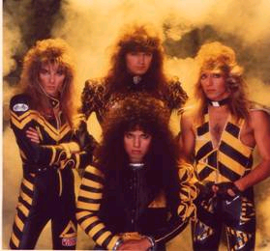
Stryper – “Christian Rock”

Slide 13
Power Team
Weightlifting Exhibition Group
“Testifying” to the power of Jesus in their lives

Slide 15
“Recreation Pastor”

Slide 18
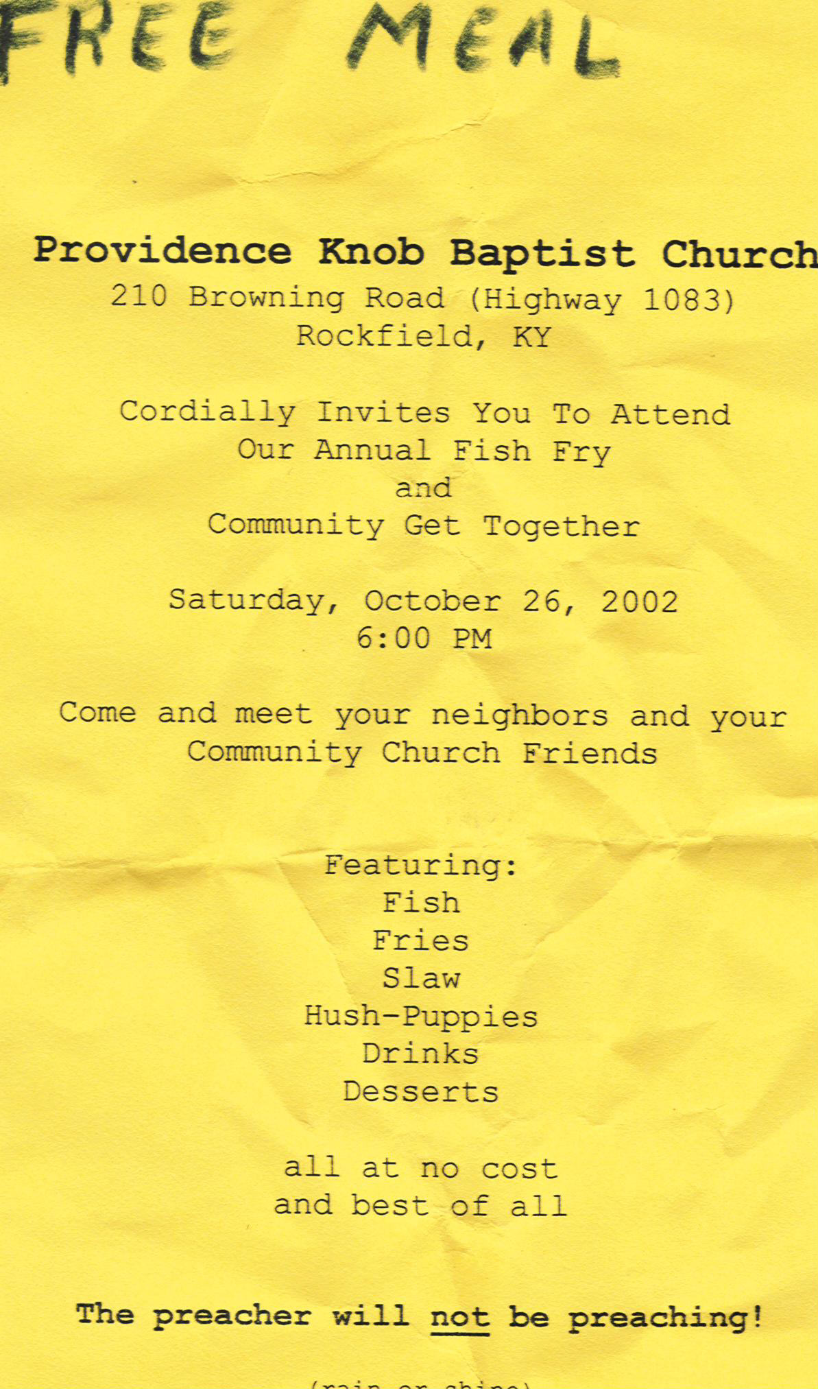
Free Meal!!!
Baptist Church
Annual Fish Fry
with
Hush-Puppies,
Fries & Slaw!!!
No Preaching!!!

Slide 19
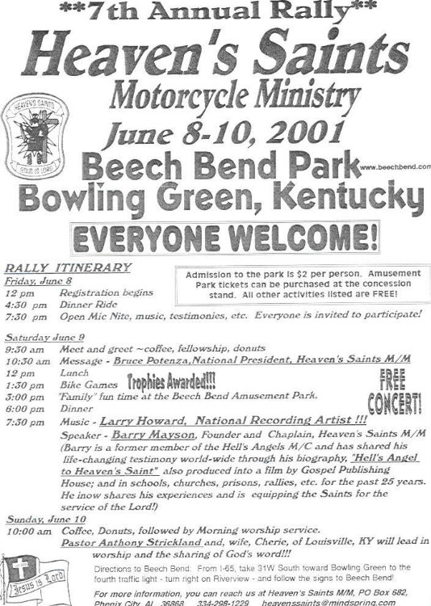

Slide 20
1st United Methodist Church – Hammond, IN

Slide 23
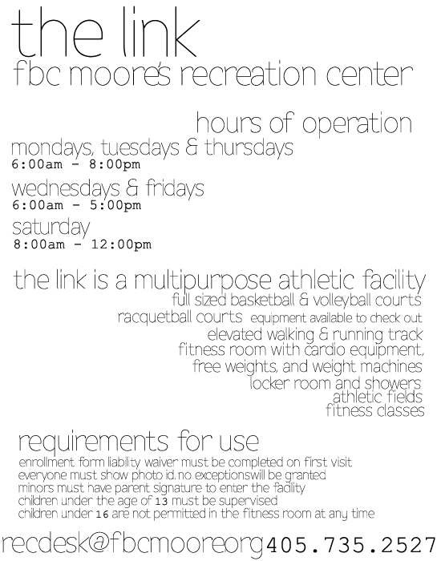

Slide 25
Quail Springs Baptist Church - OKC

Slide 27
Christian Women's Workshop Family Fun Night Friendship Luncheon Golden Age Banquet Homemaking Classes Meals On Wheels
Sunshine Baskets Tipton Fun Day Quilting Vacation Bible School Widow & Widower's Banquet Teacher Appreciation Dinner

Slide 30
Bering Drive - Houston, TX

Slide 31
Twickenham Church of Christ “Community Class Series” free to public
October 20: Woodcarving & Window Treatments
October 27: Wallpapering
November 3: Basket Making
For Men Only! Featuring Dr. James Flatt “Fun Facts About Your Prostate”

Slide 32
What Must We Do?
Preach the pure gospel of Christ
Practice only what is authorized by Scripture
Do not change gospel for popular appeal
Do not change the mission of the church away from the spiritual towards the social
Keep focus on the real need of all: SALVATION FROM SIN
Live in a way which shows our focus & the importance of the gospel to us

