Slide 1
409 - The Church's One Foundation - Title

Slide 2
409 - The Church's One Foundation - 1.1

Slide 3
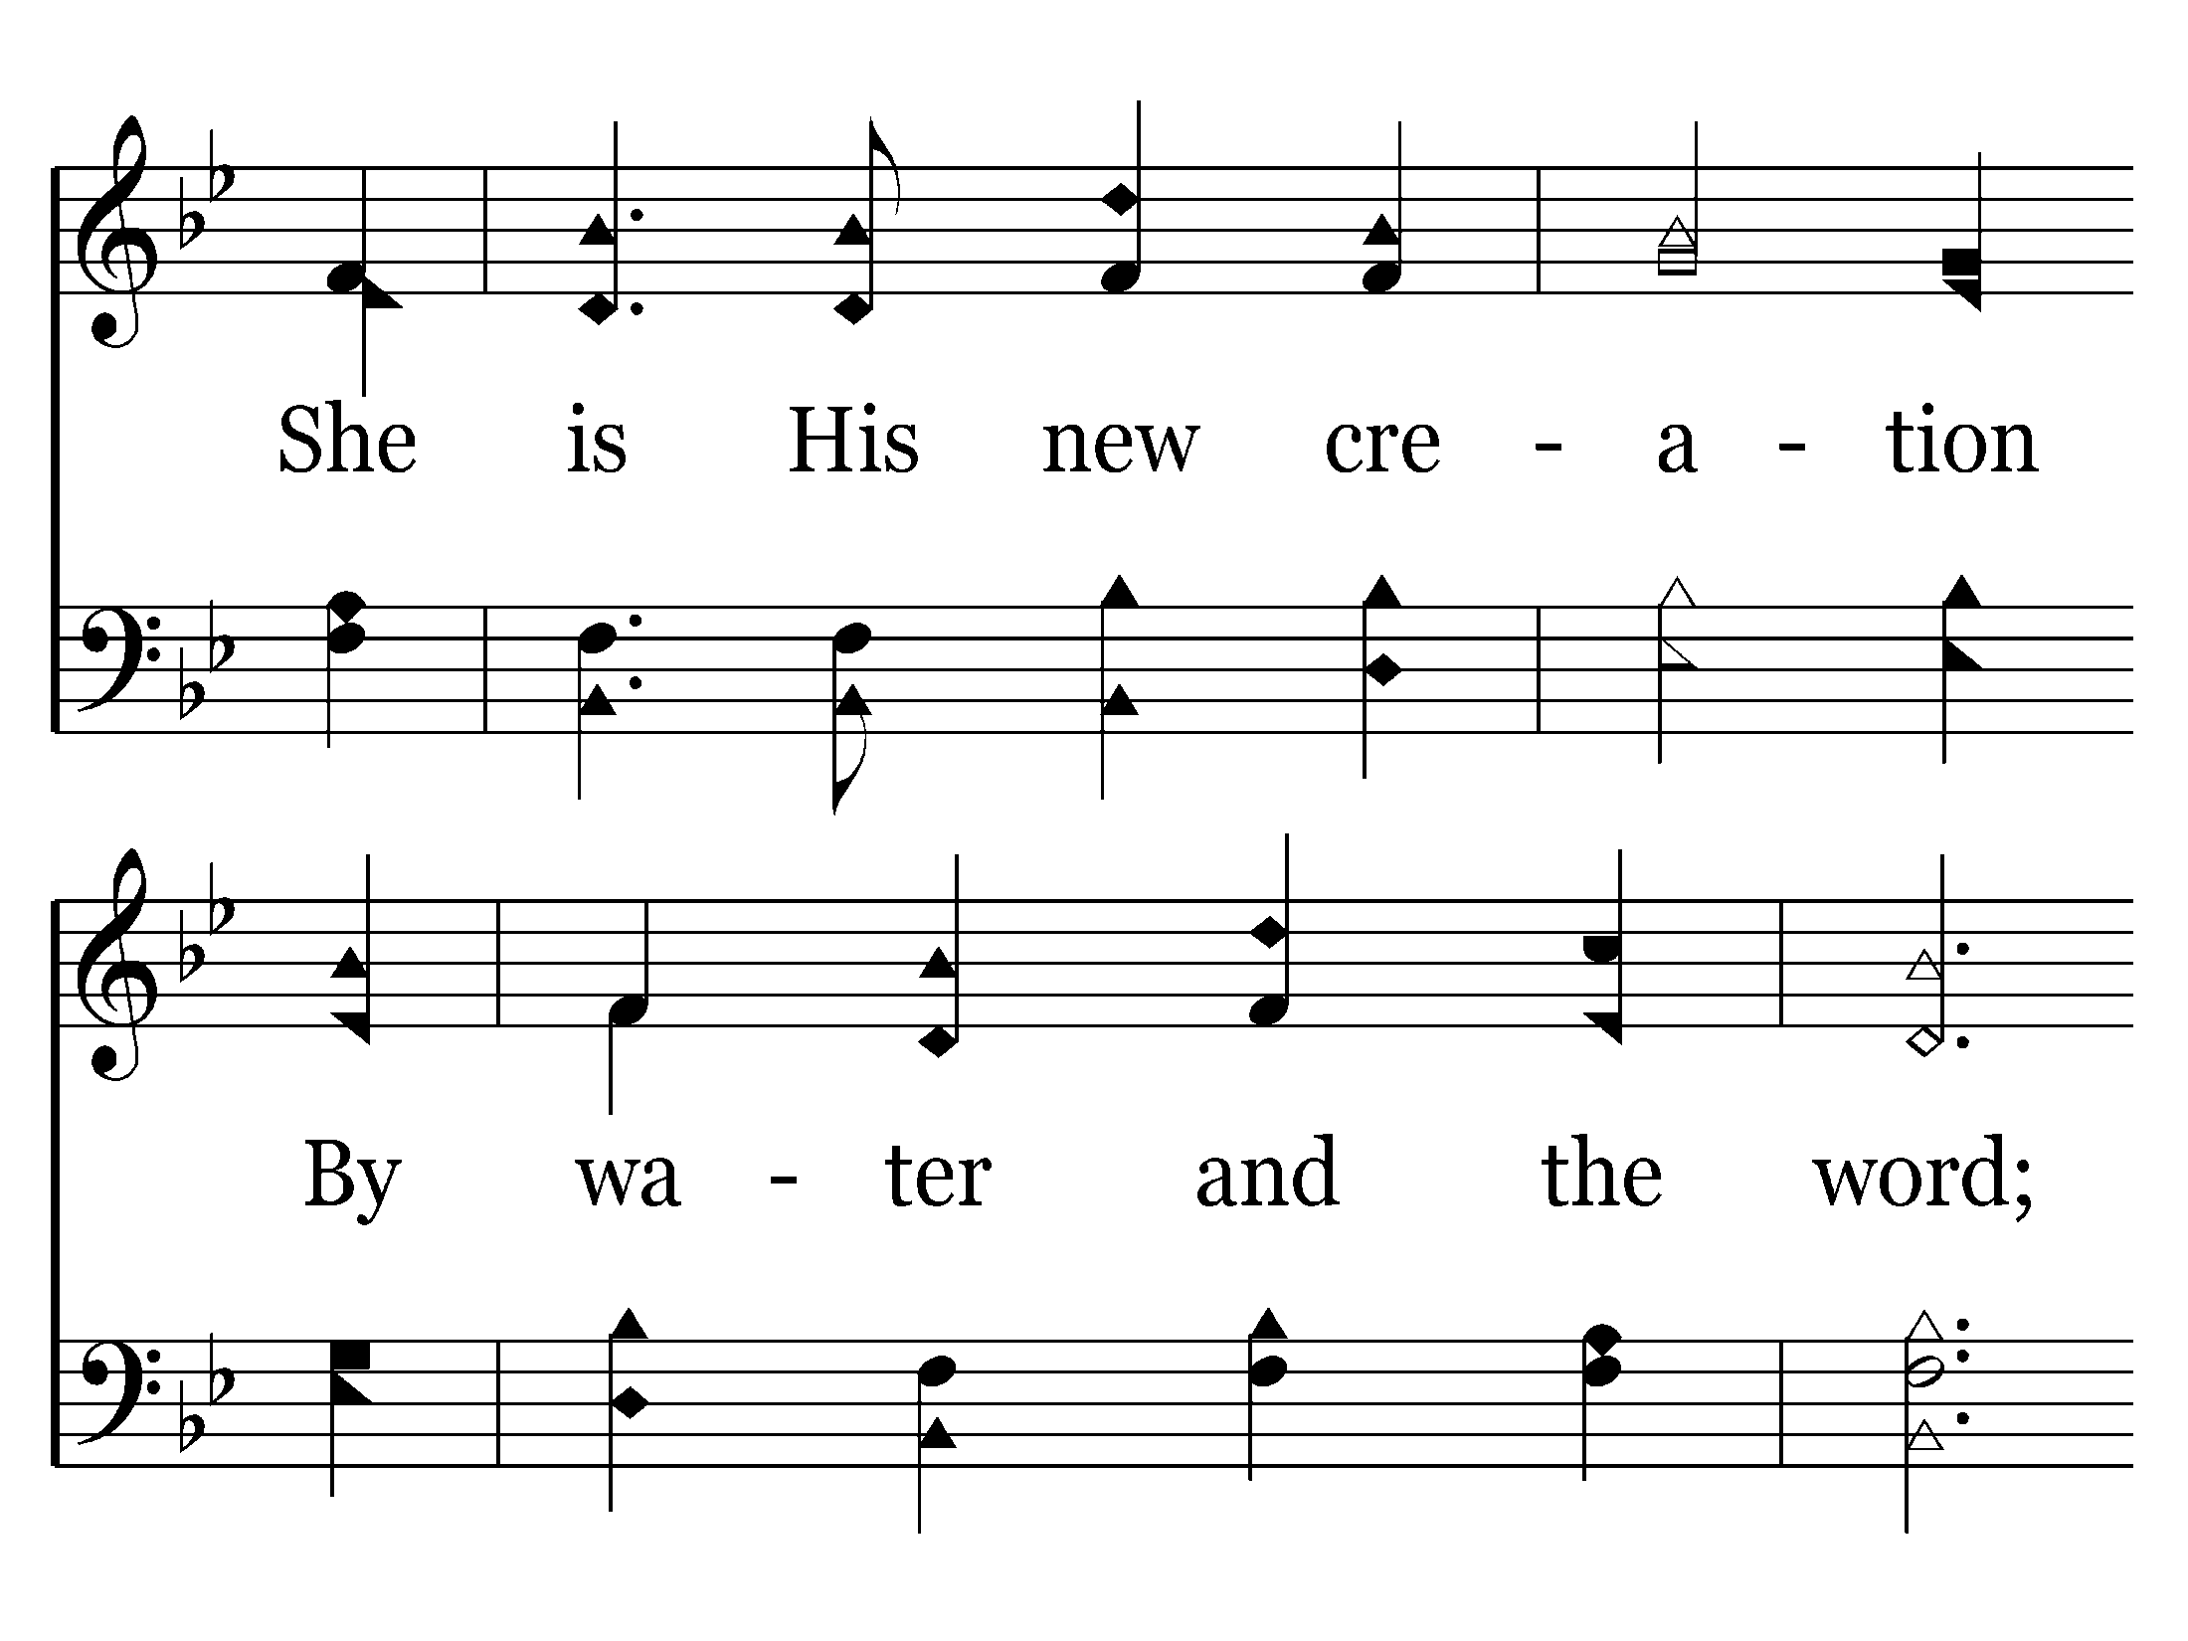
409 - The Church's One Foundation - 1.2

Slide 4
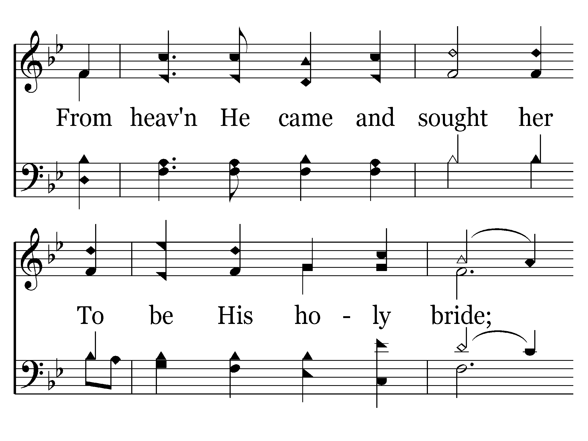
409 - The Church's One Foundation - 1.3

Slide 5
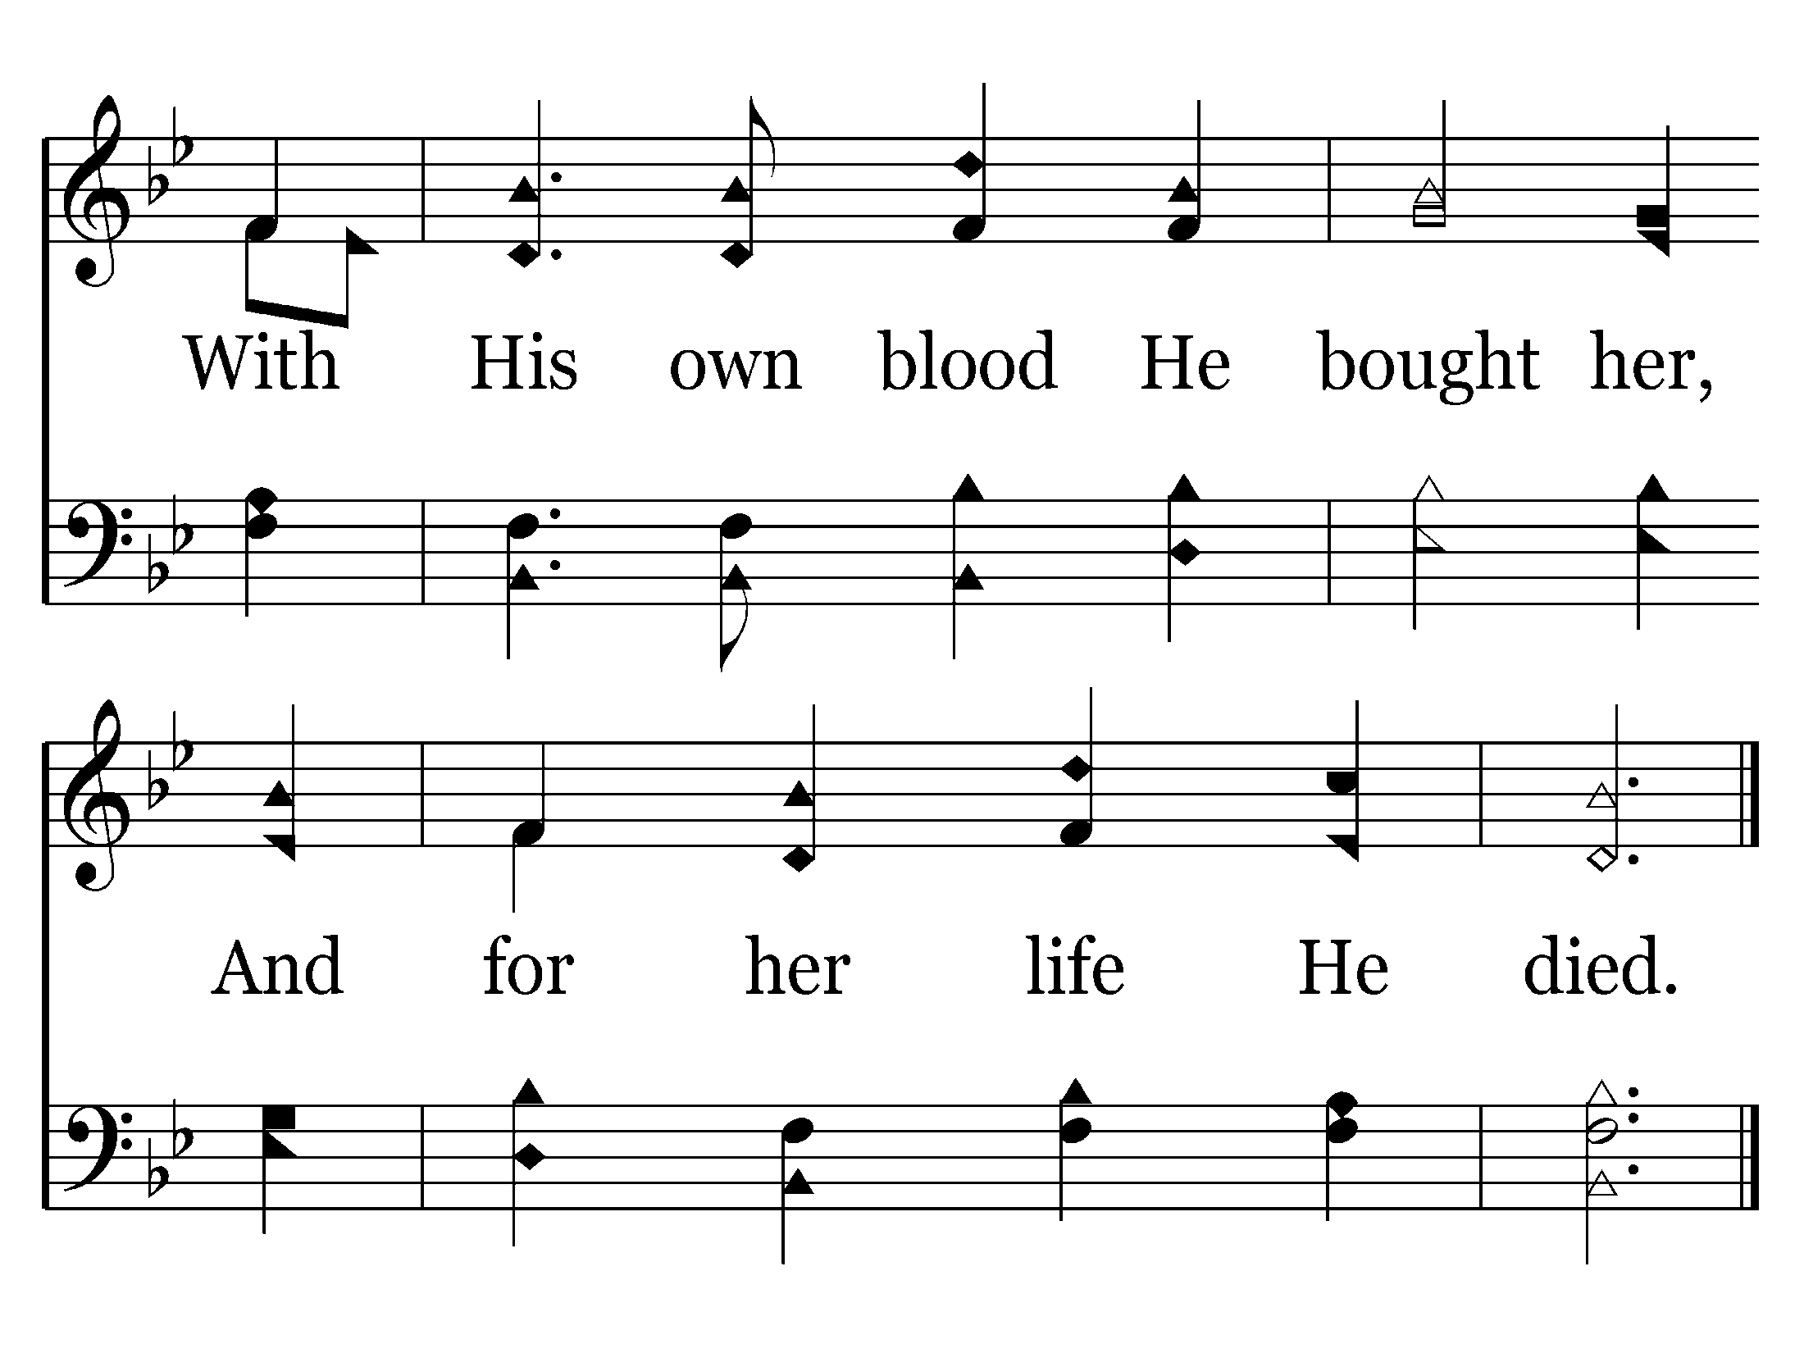
409 - The Church's One Foundation - 1.4
End of Verse 1

Slide 6
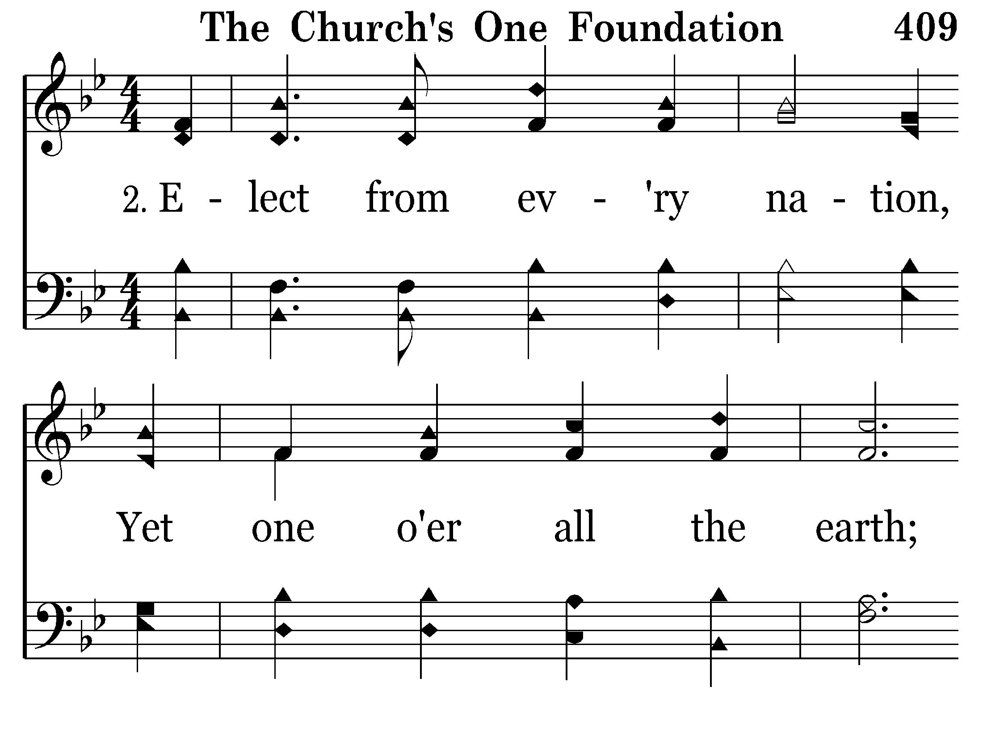
409 - The Church's One Foundation - 2.1

Slide 7
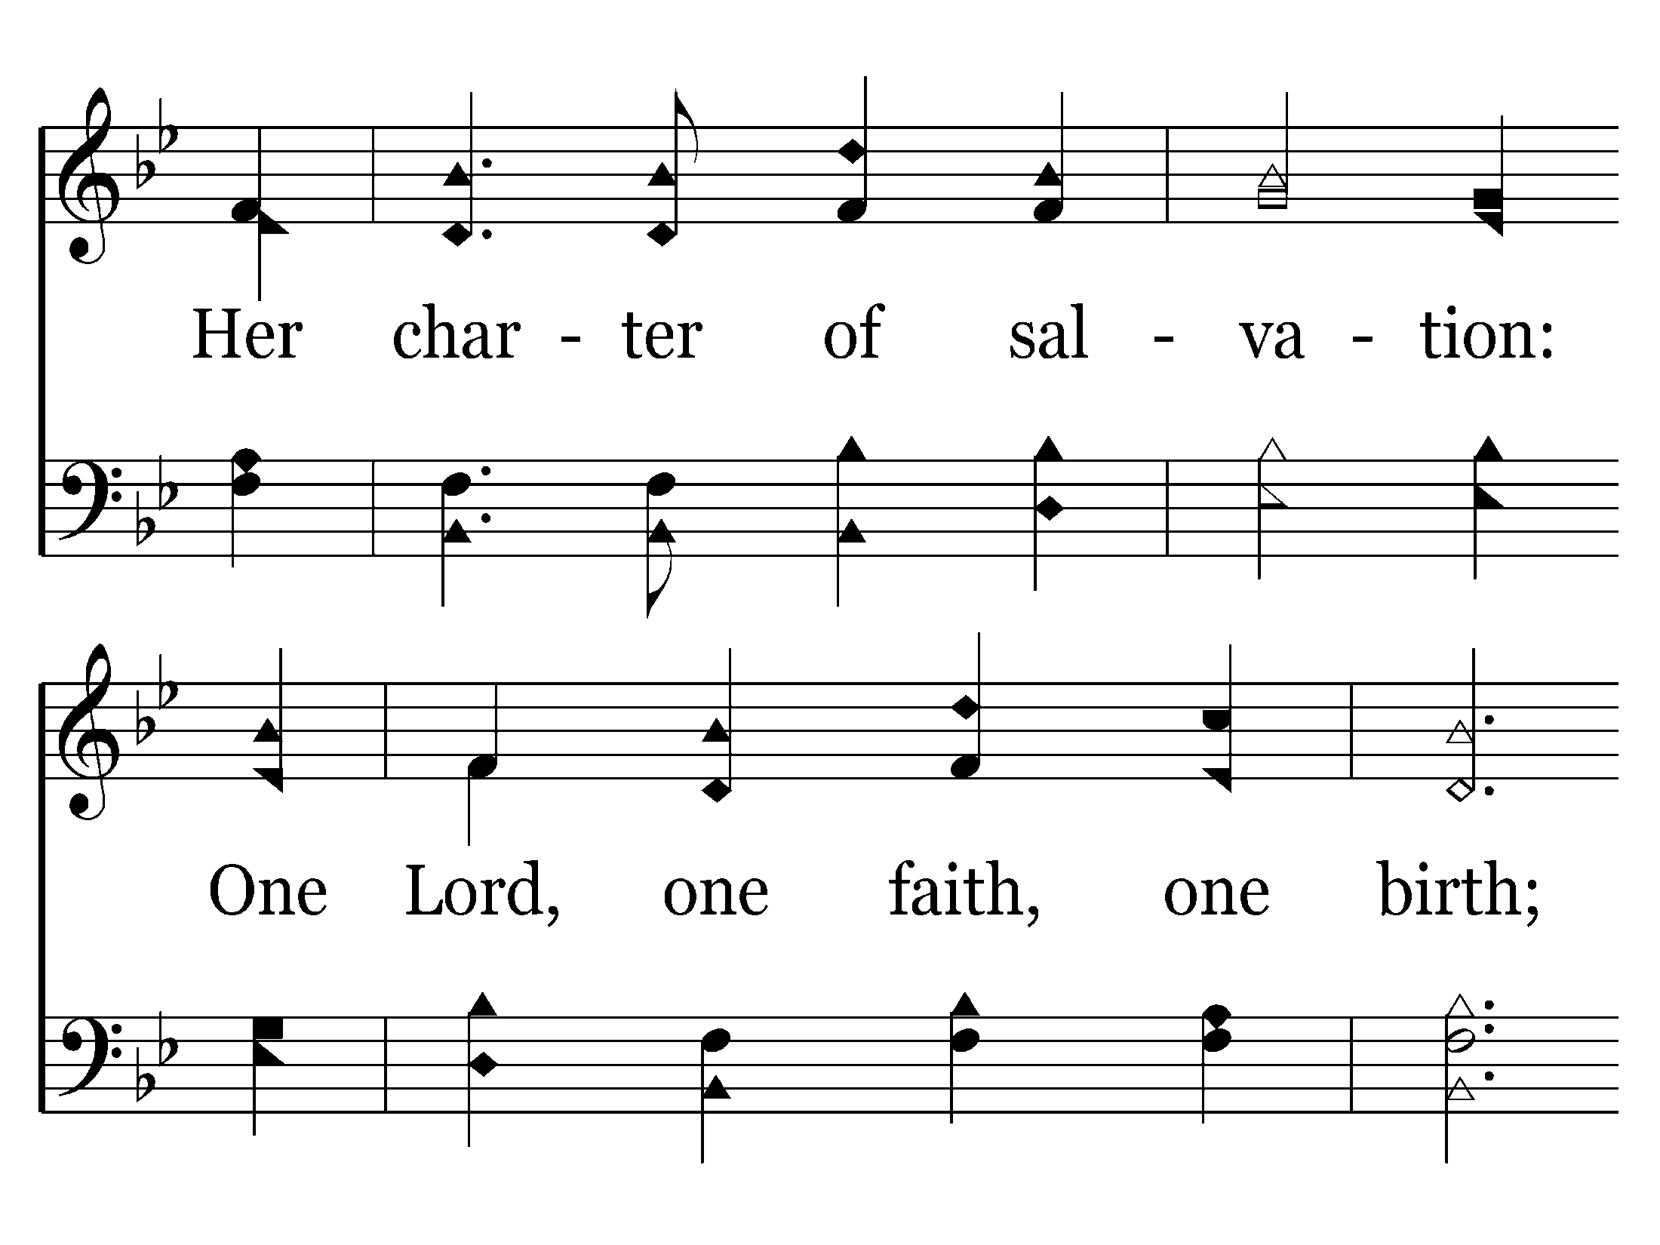
409 - The Church's One Foundation - 2.2

Slide 8
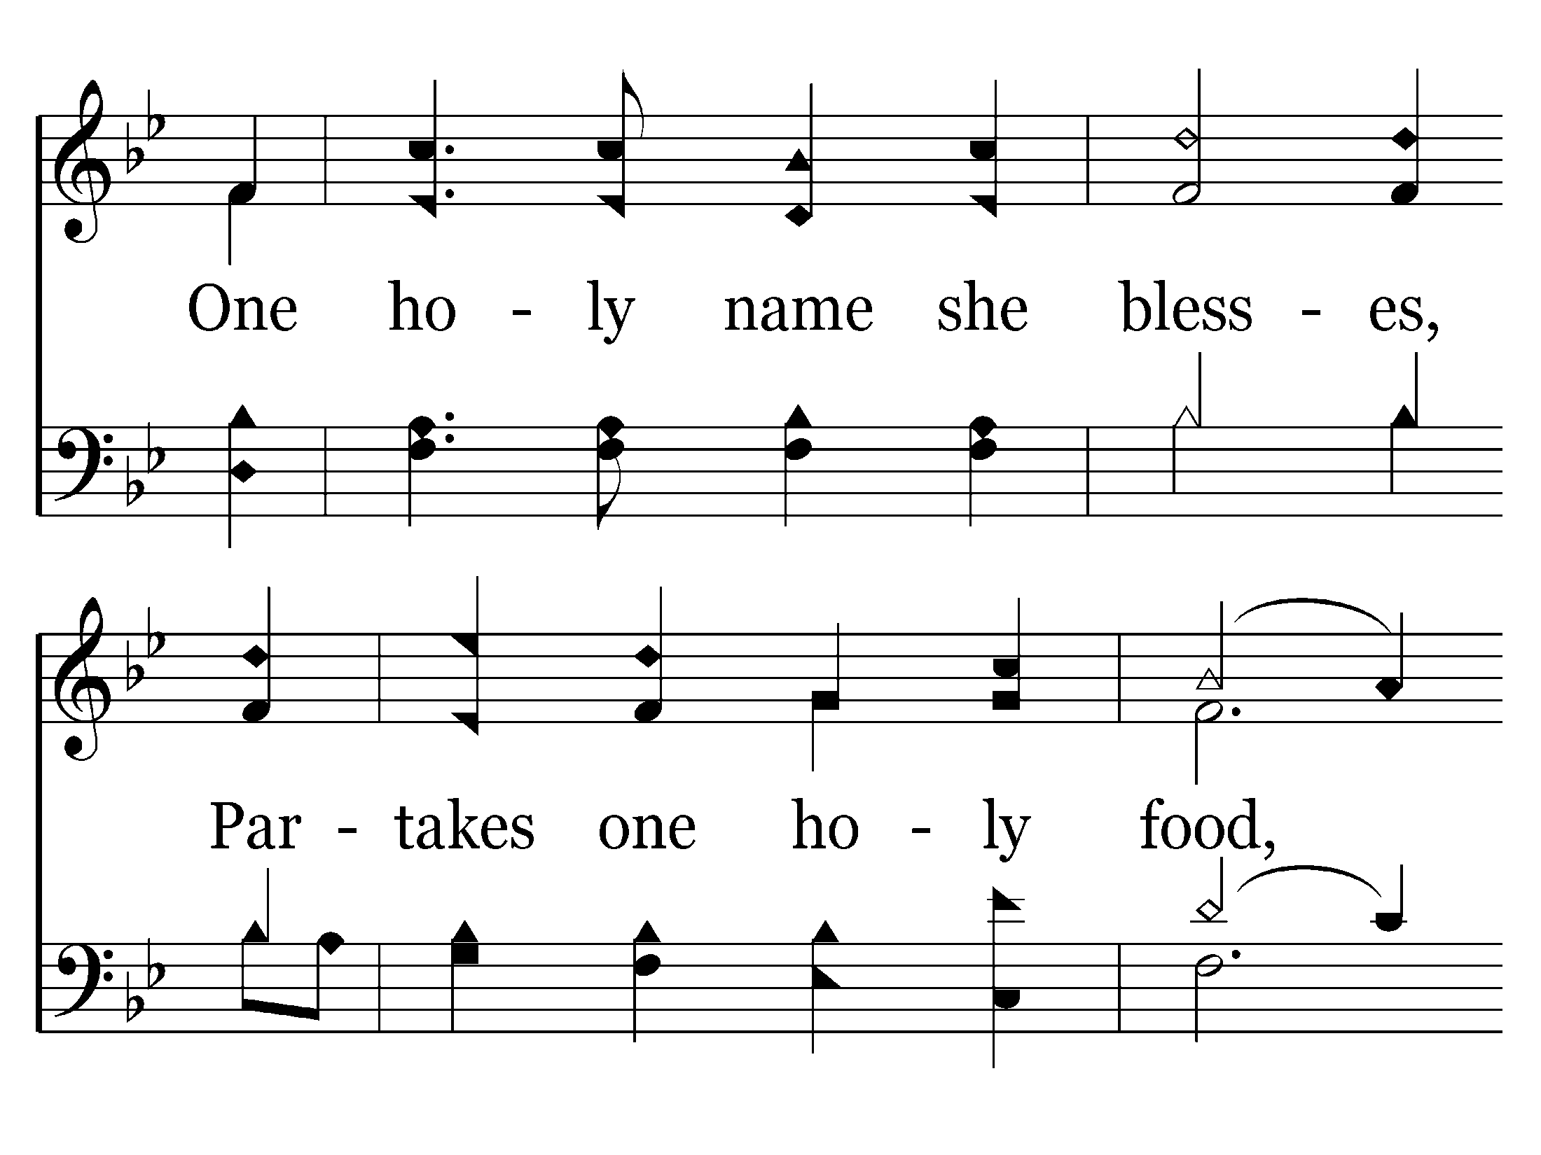
409 - The Church's One Foundation - 2.3

Slide 9
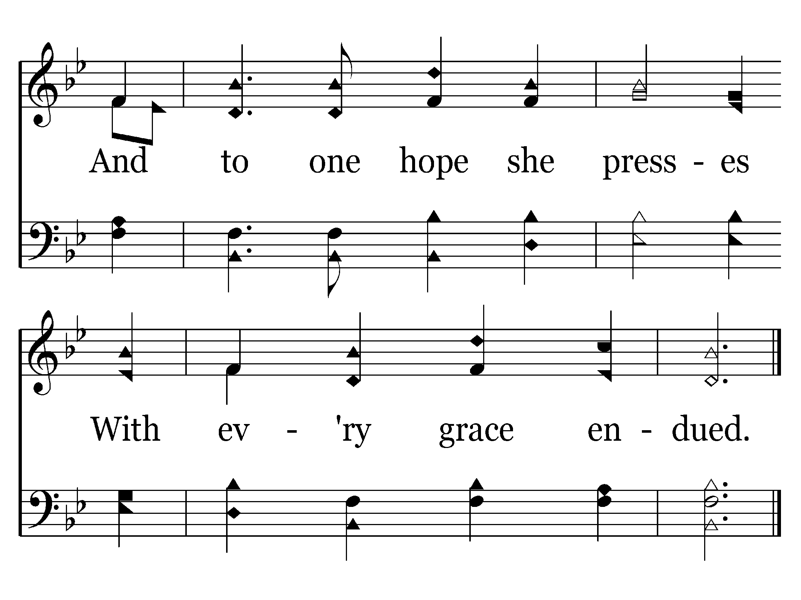
409 - The Church's One Foundation - 2.4
End of Verse 2

Slide 10
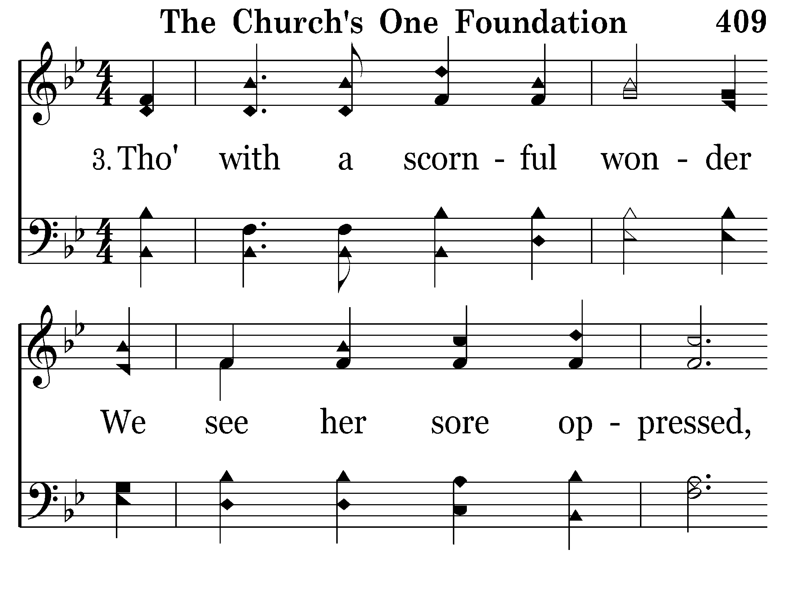
409 - The Church's One Foundation - 3.1

Slide 11
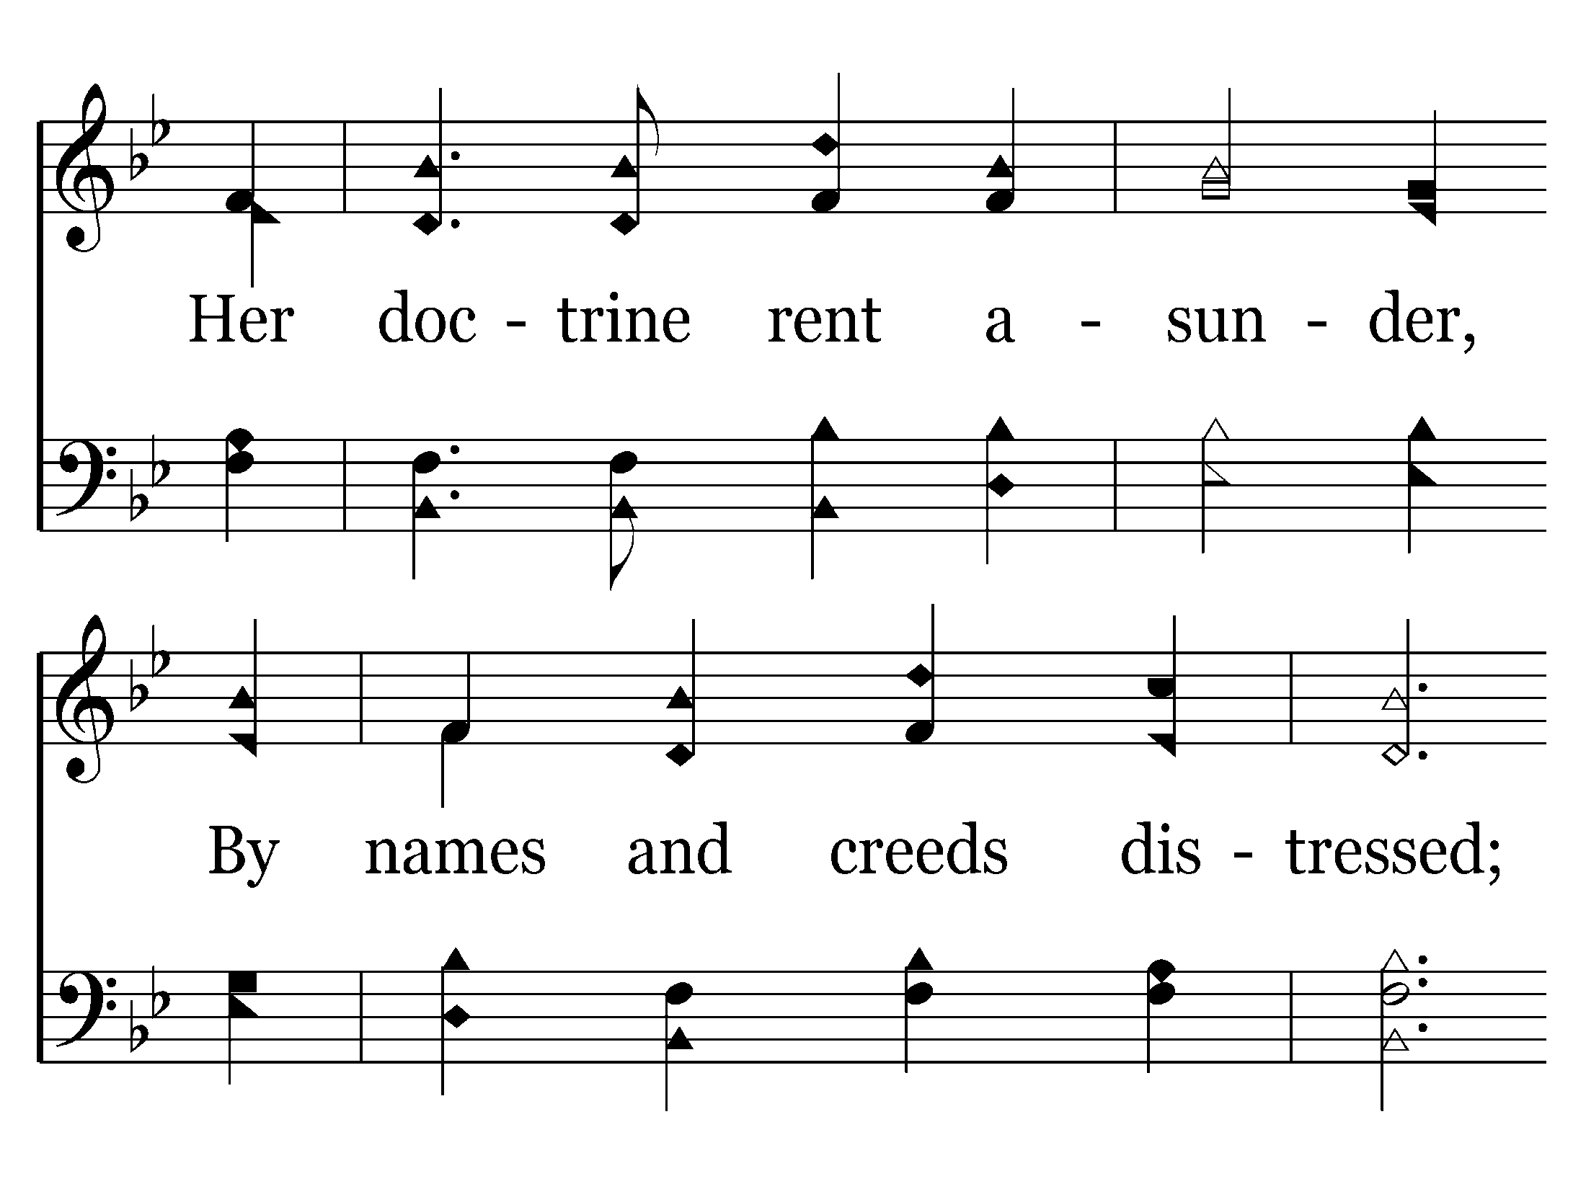
409 - The Church's One Foundation - 3.2

Slide 12
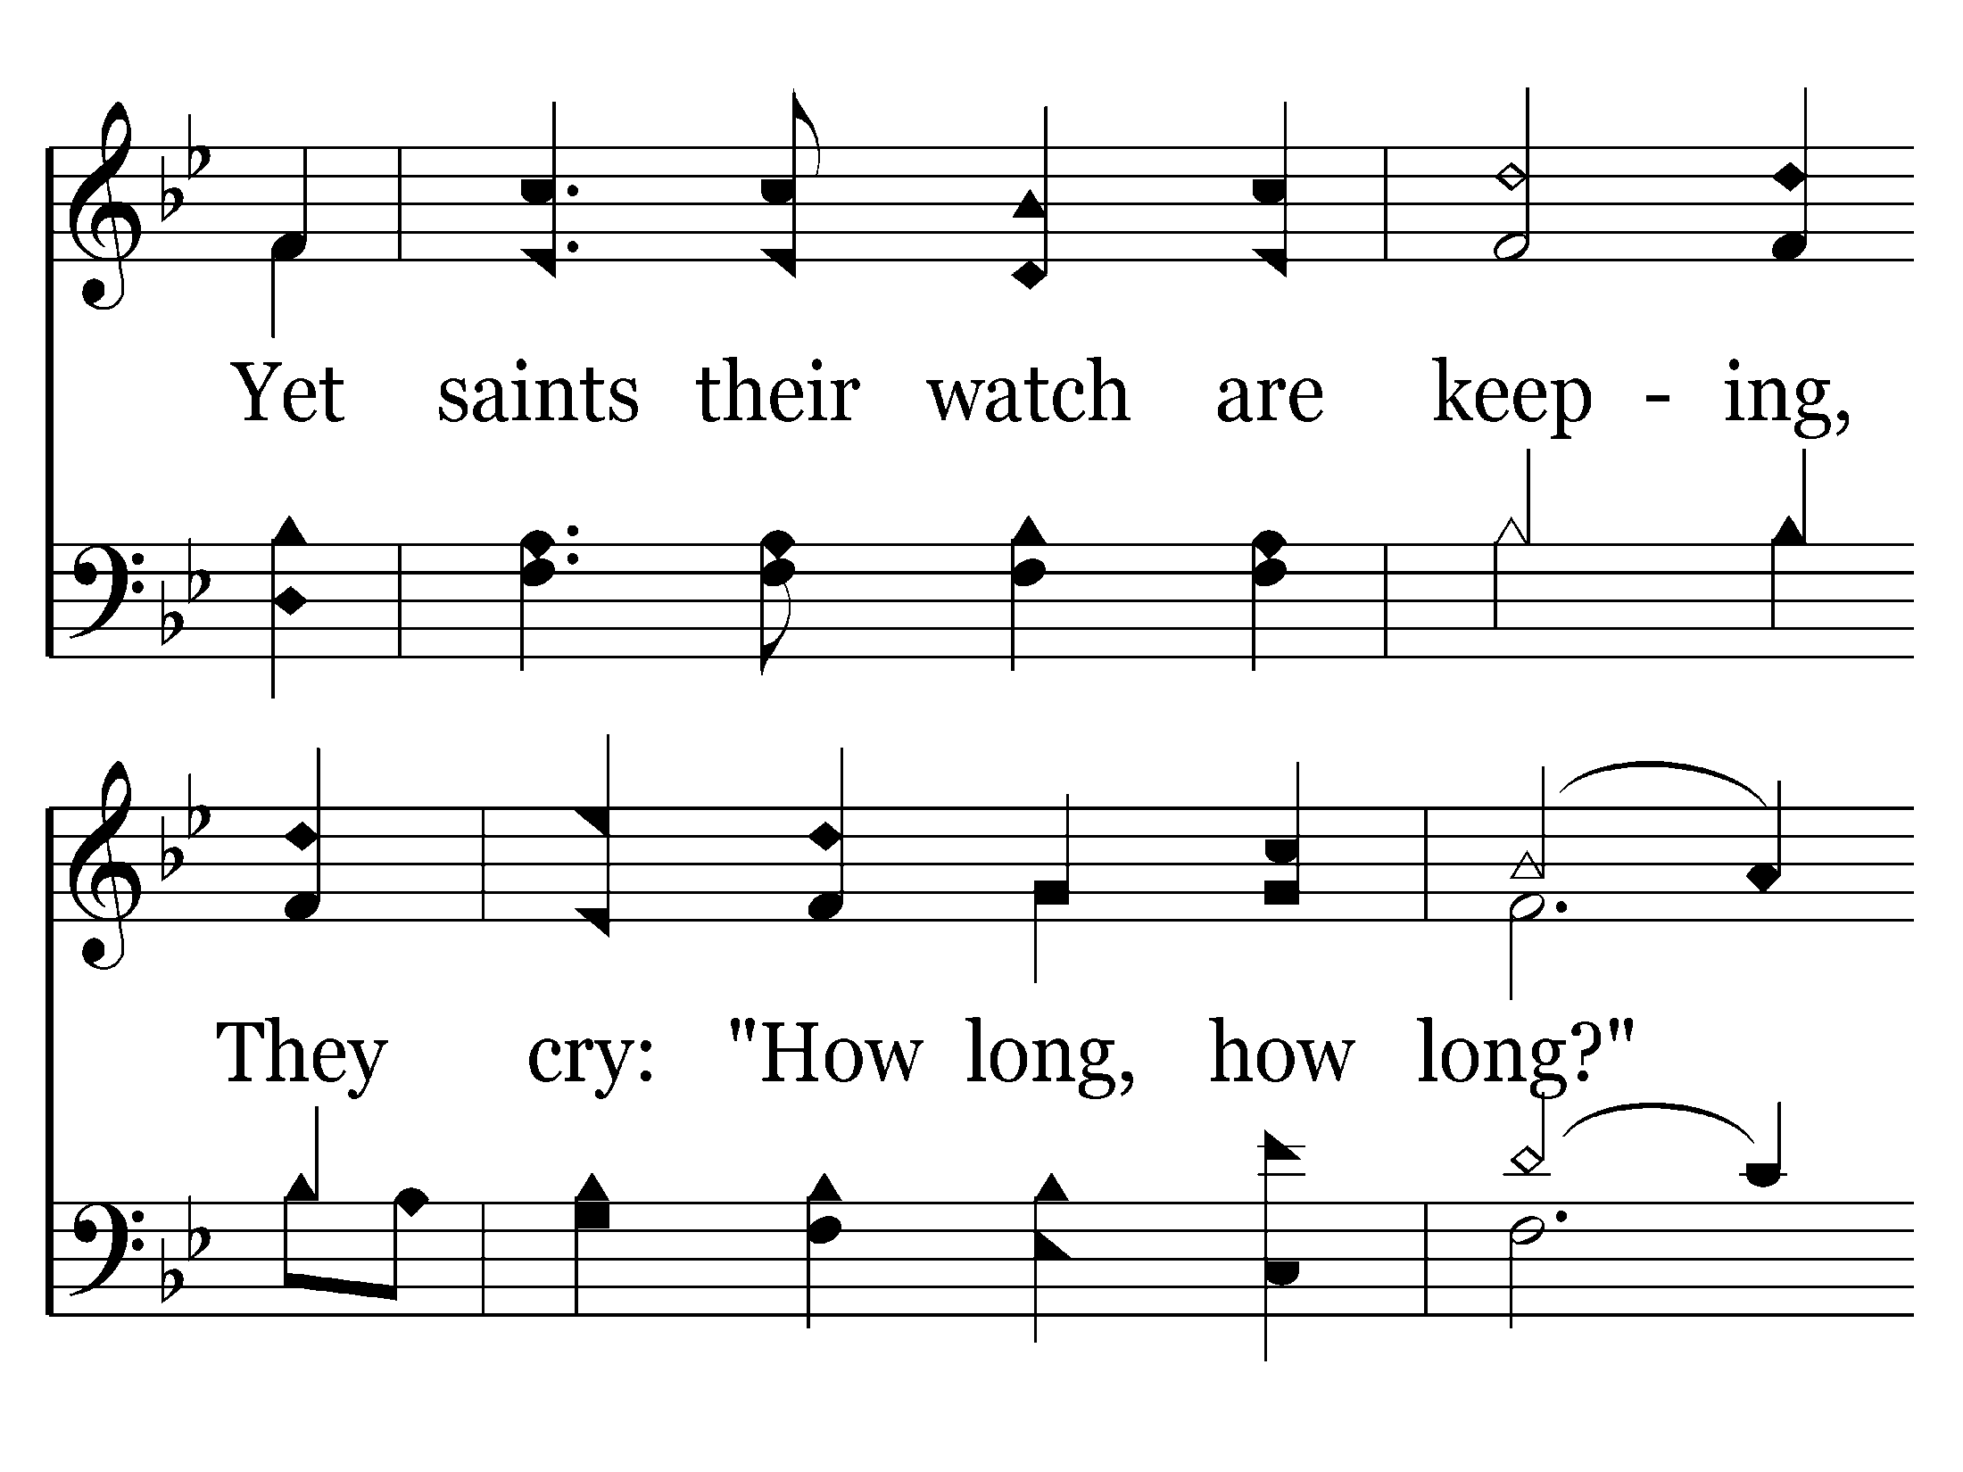
409 - The Church's One Foundation - 3.3

Slide 13
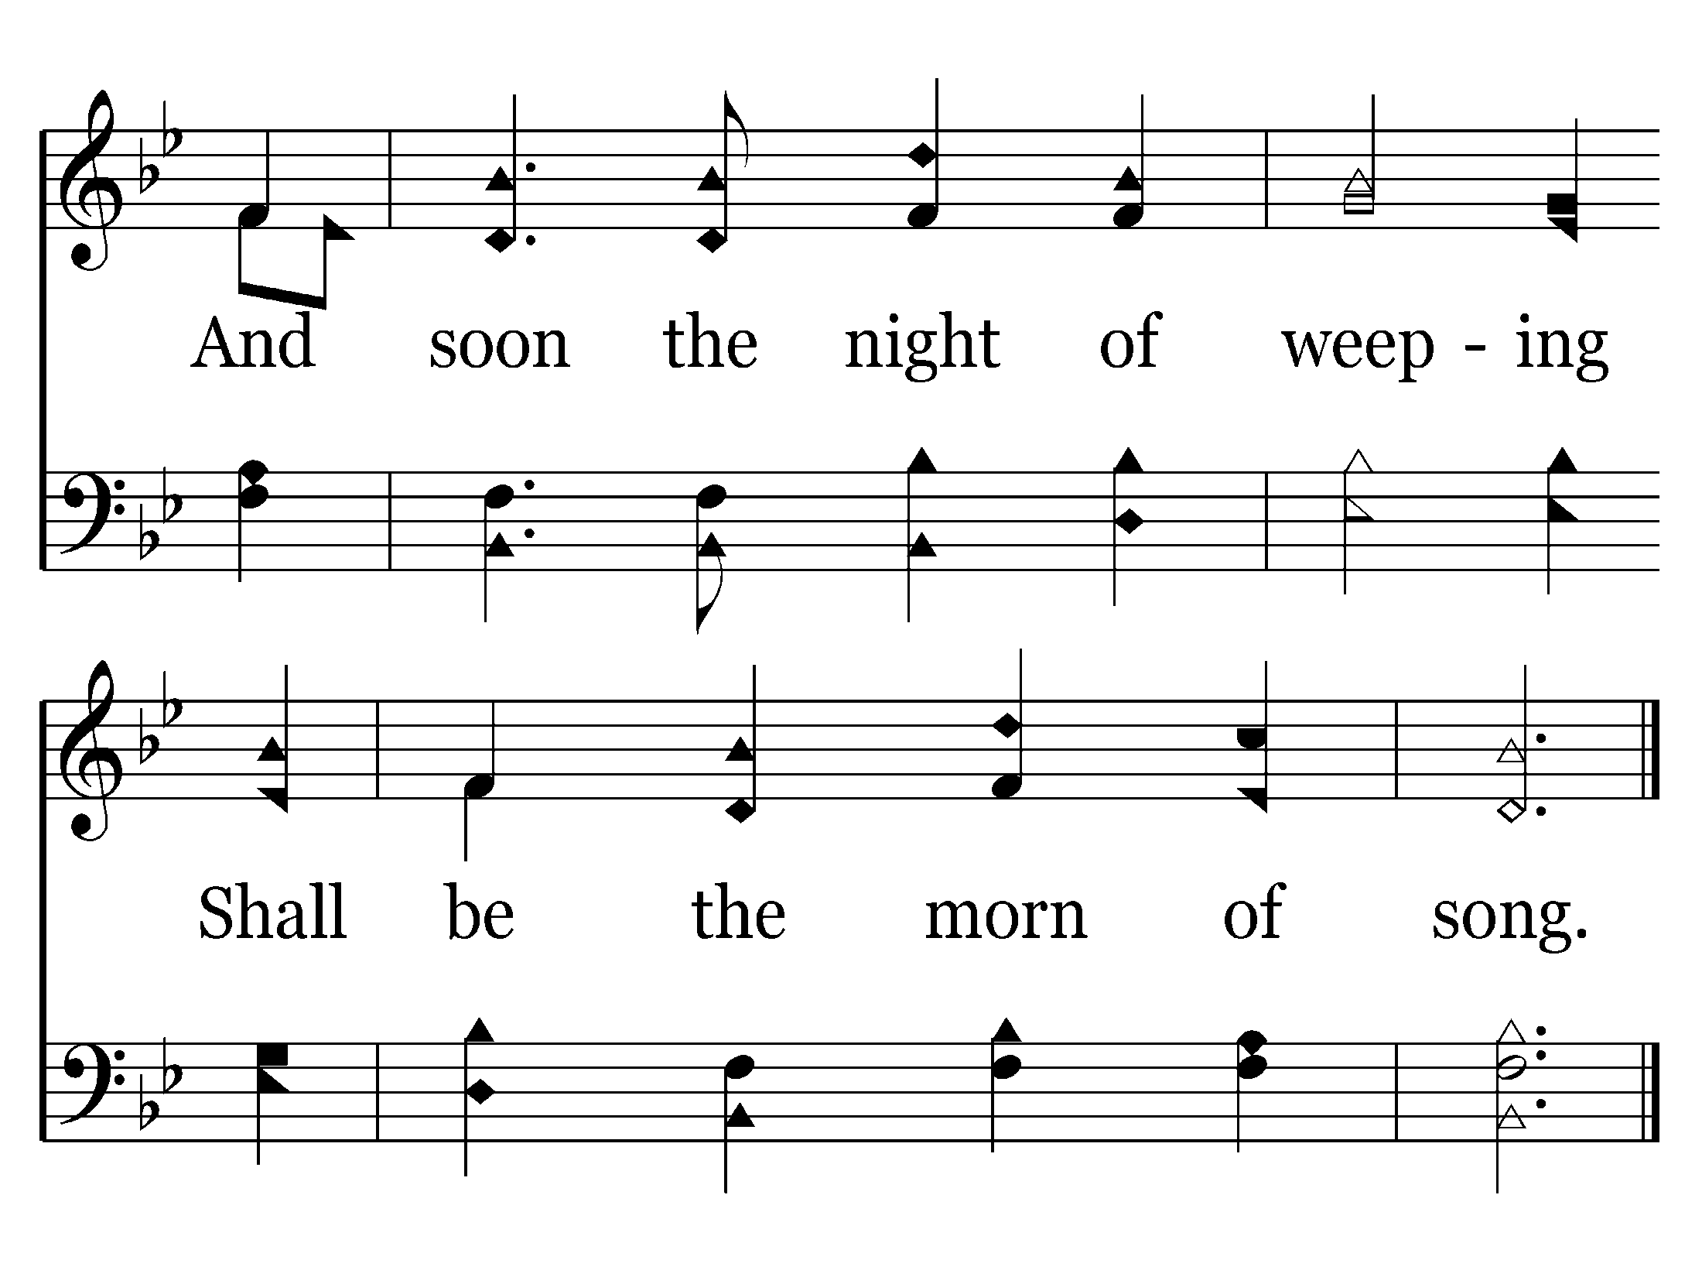
409 - The Church's One Foundation - 3.4
End of Song

Slide 14
What Paul Told the Ephesians about the Church
INTRODUCTION
Church is headed by Christ (Eph. 1:22; 4:15; 5:23)
Church is the fulness of Christ (Eph. 1:22-23)
Church is where we are reconciled to God (Eph. 2:14-16)
Church is according to eternal purpose of God (Eph. 3:9-11)
Church gives glory unto God (Eph. 3:21)
Church is one in number (Eph. 4:4)
Church is all-sufficient (Eph. 4:11-16)
Church is the saved (Eph. 5:23)
Church is subject unto Christ (Eph. 5:24)
CONCLUSION

Slide 15
287 - There's A Fountain Free - Title

Slide 16
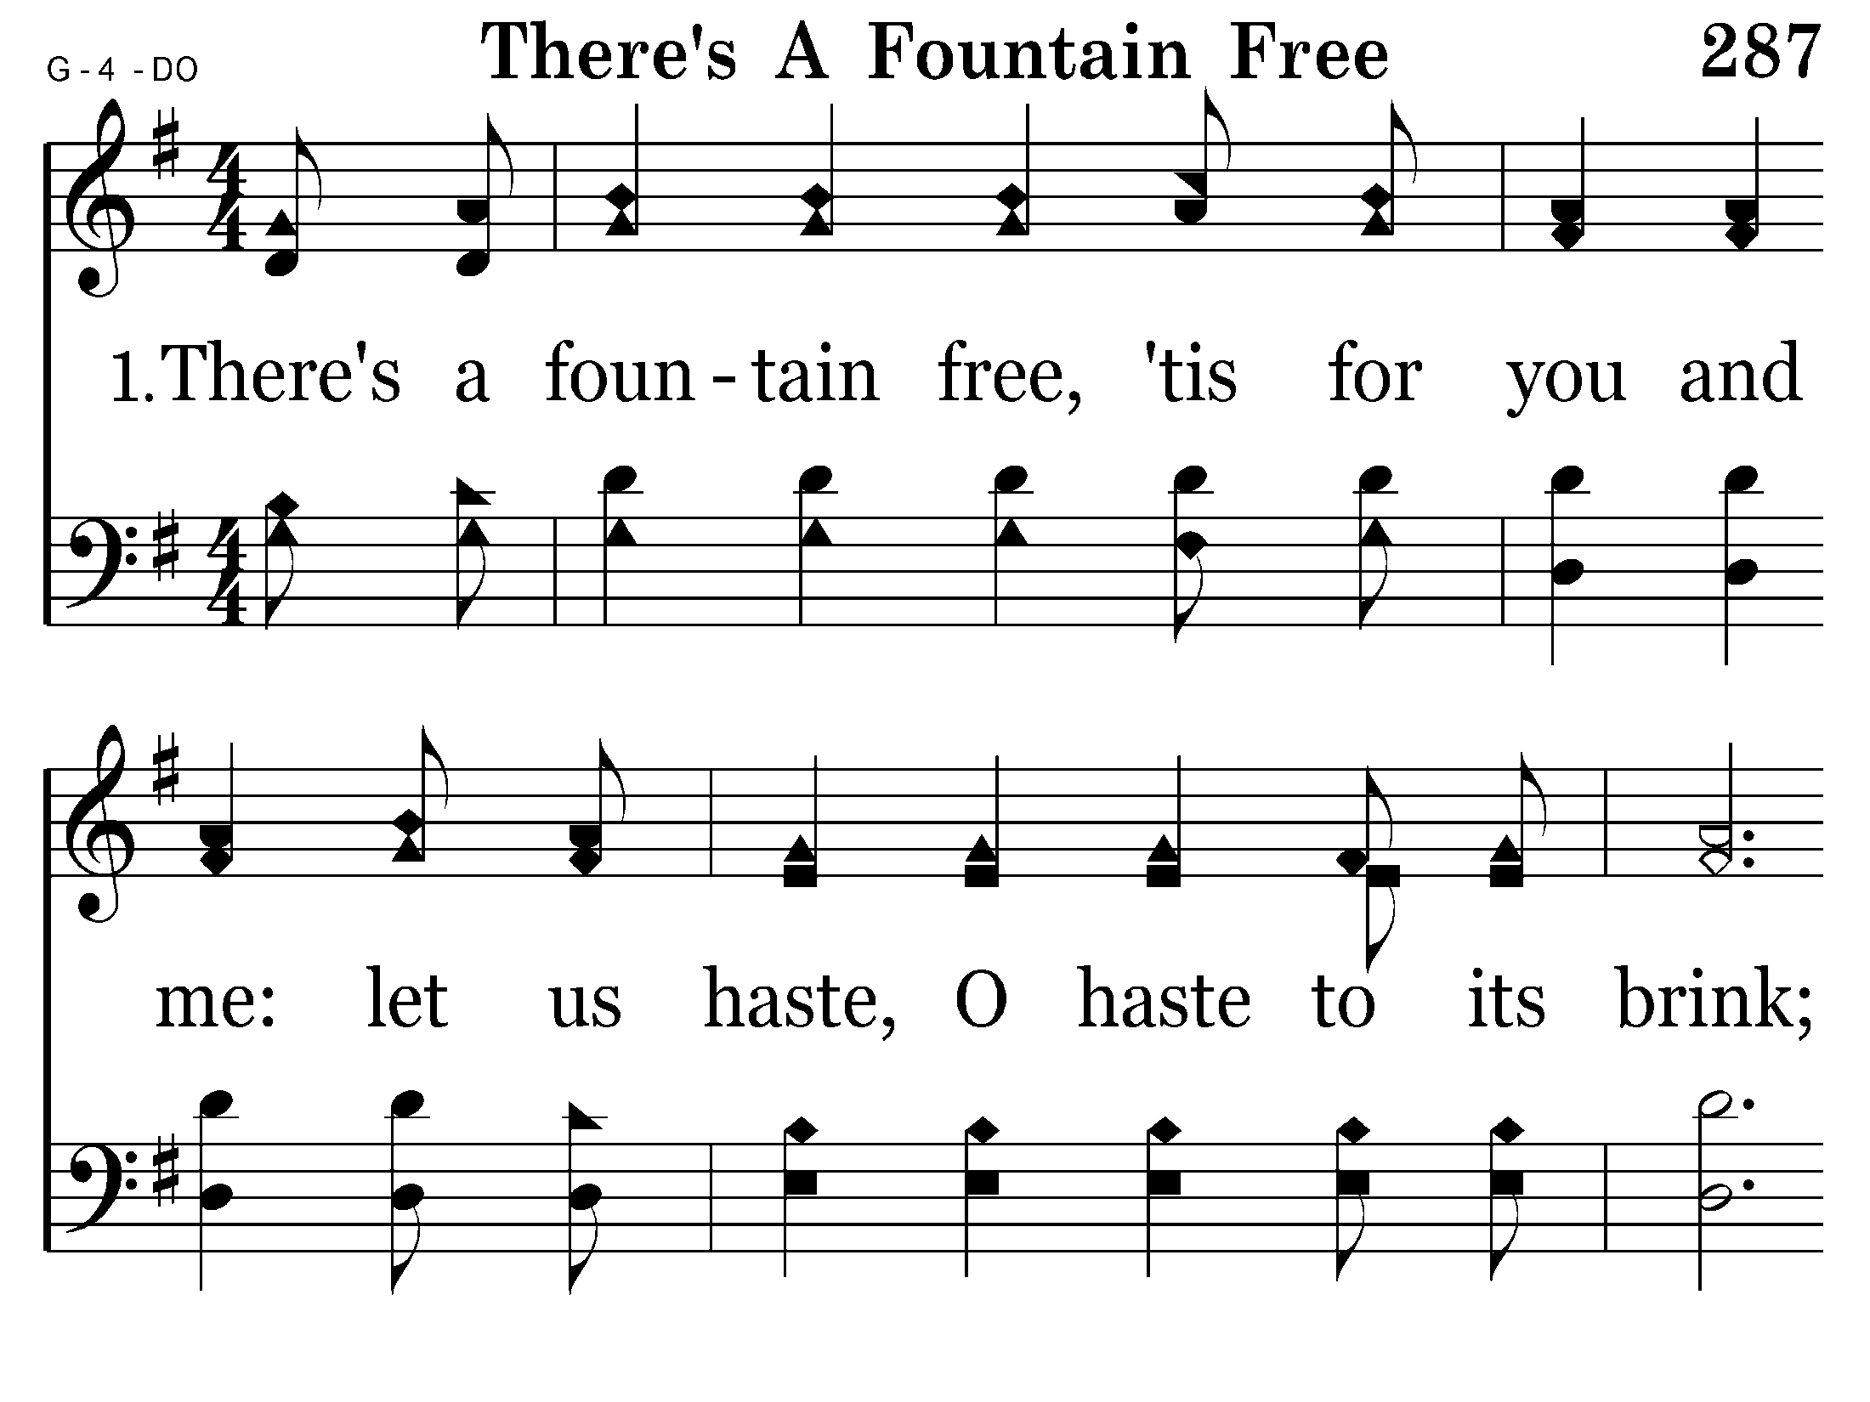
287 - There's A Fountain Free - 1.1

Slide 17
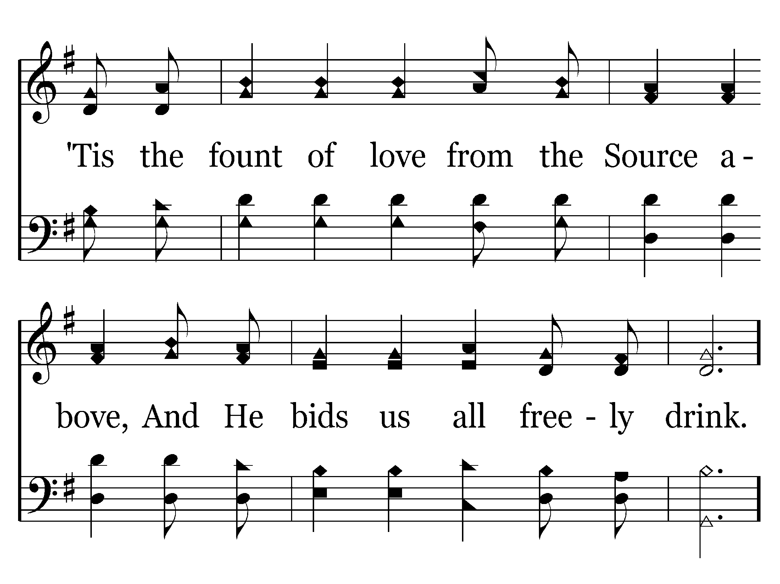
287 - There's A Fountain Free - 1.2

Slide 18
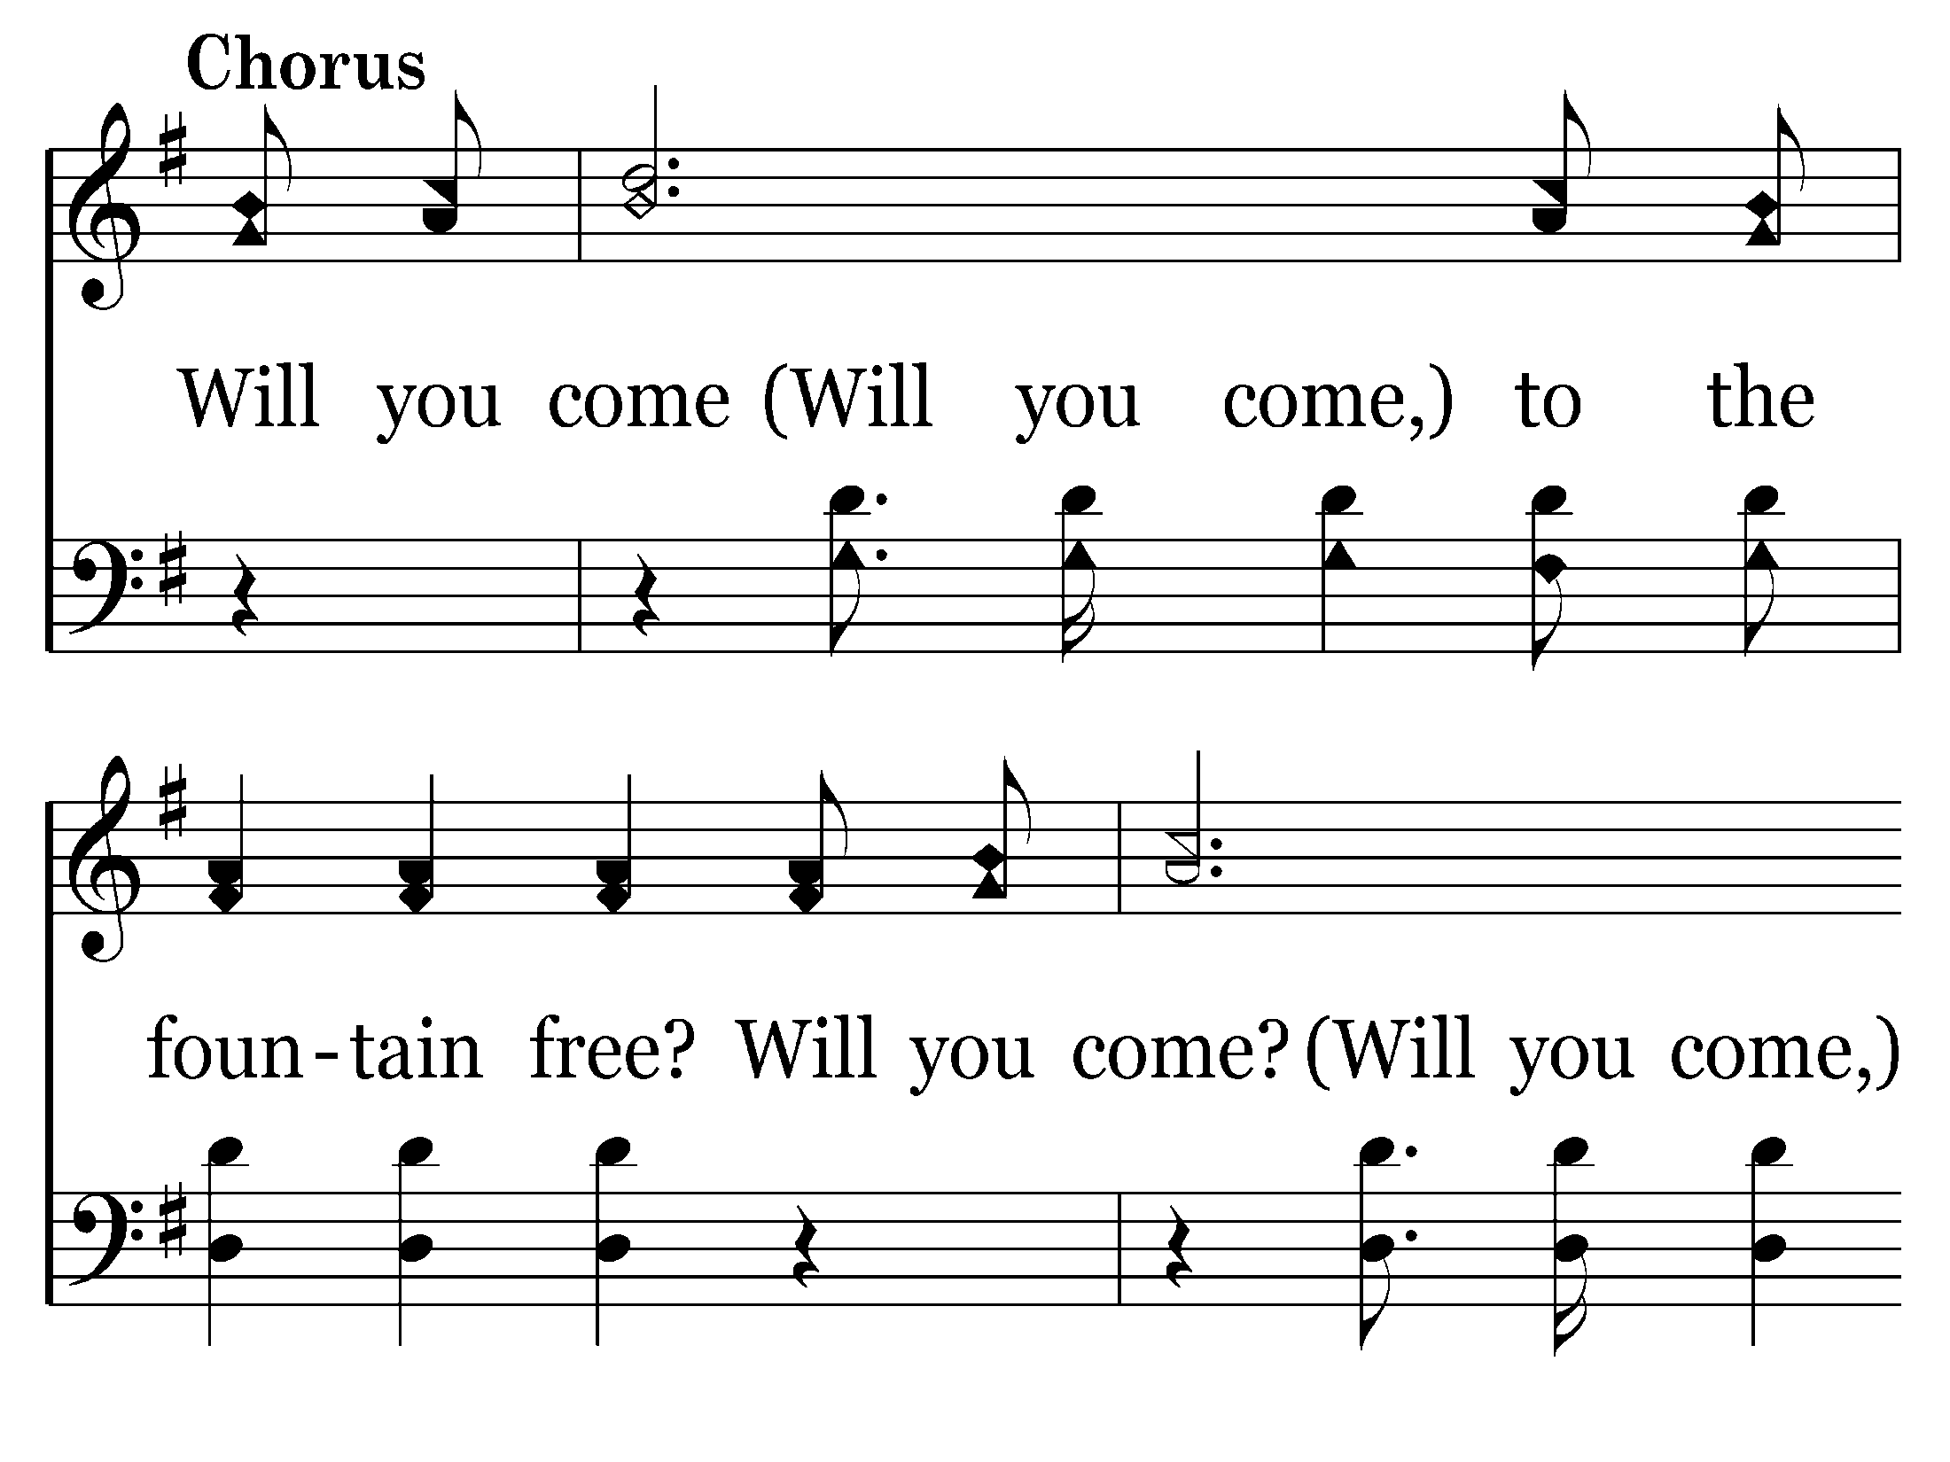
287 - There's A Fountain Free - C.1

Slide 19
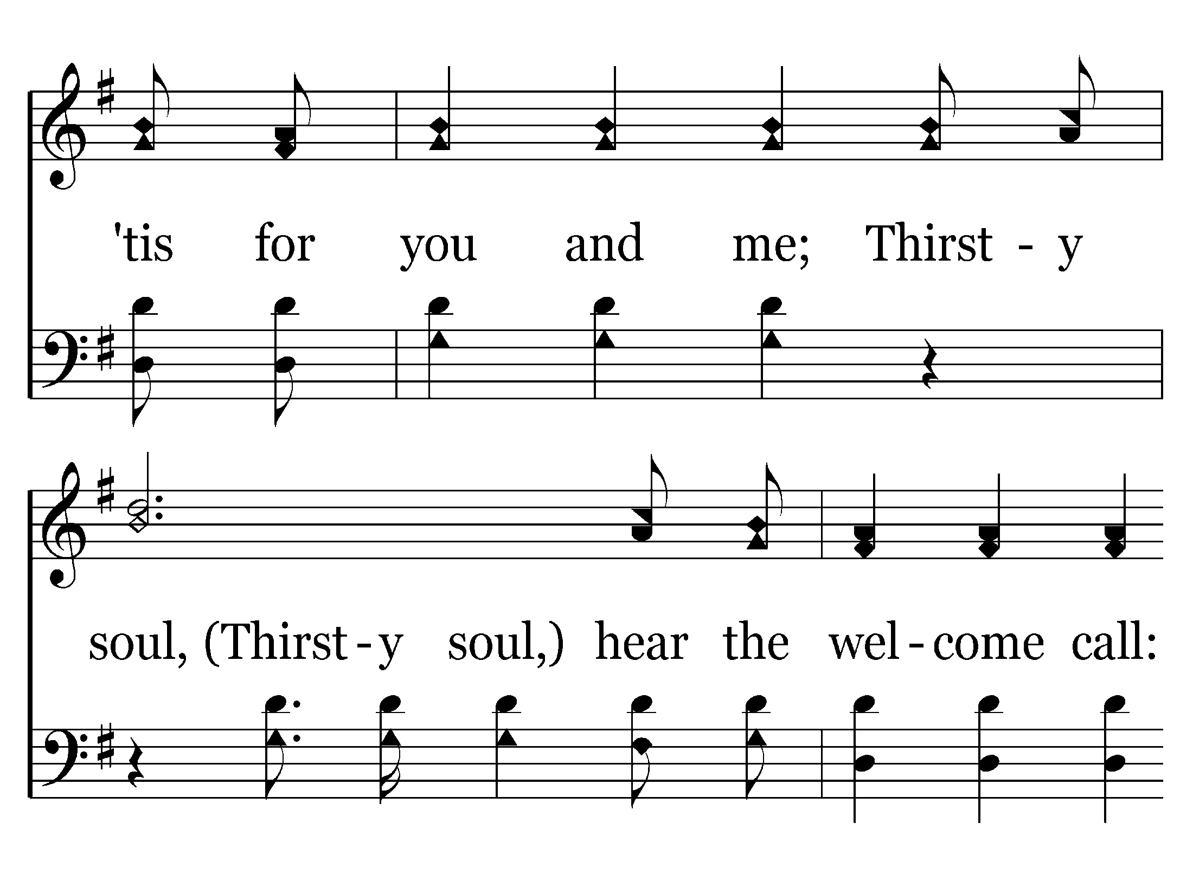
287 - There's A Fountain Free - C.2

Slide 20
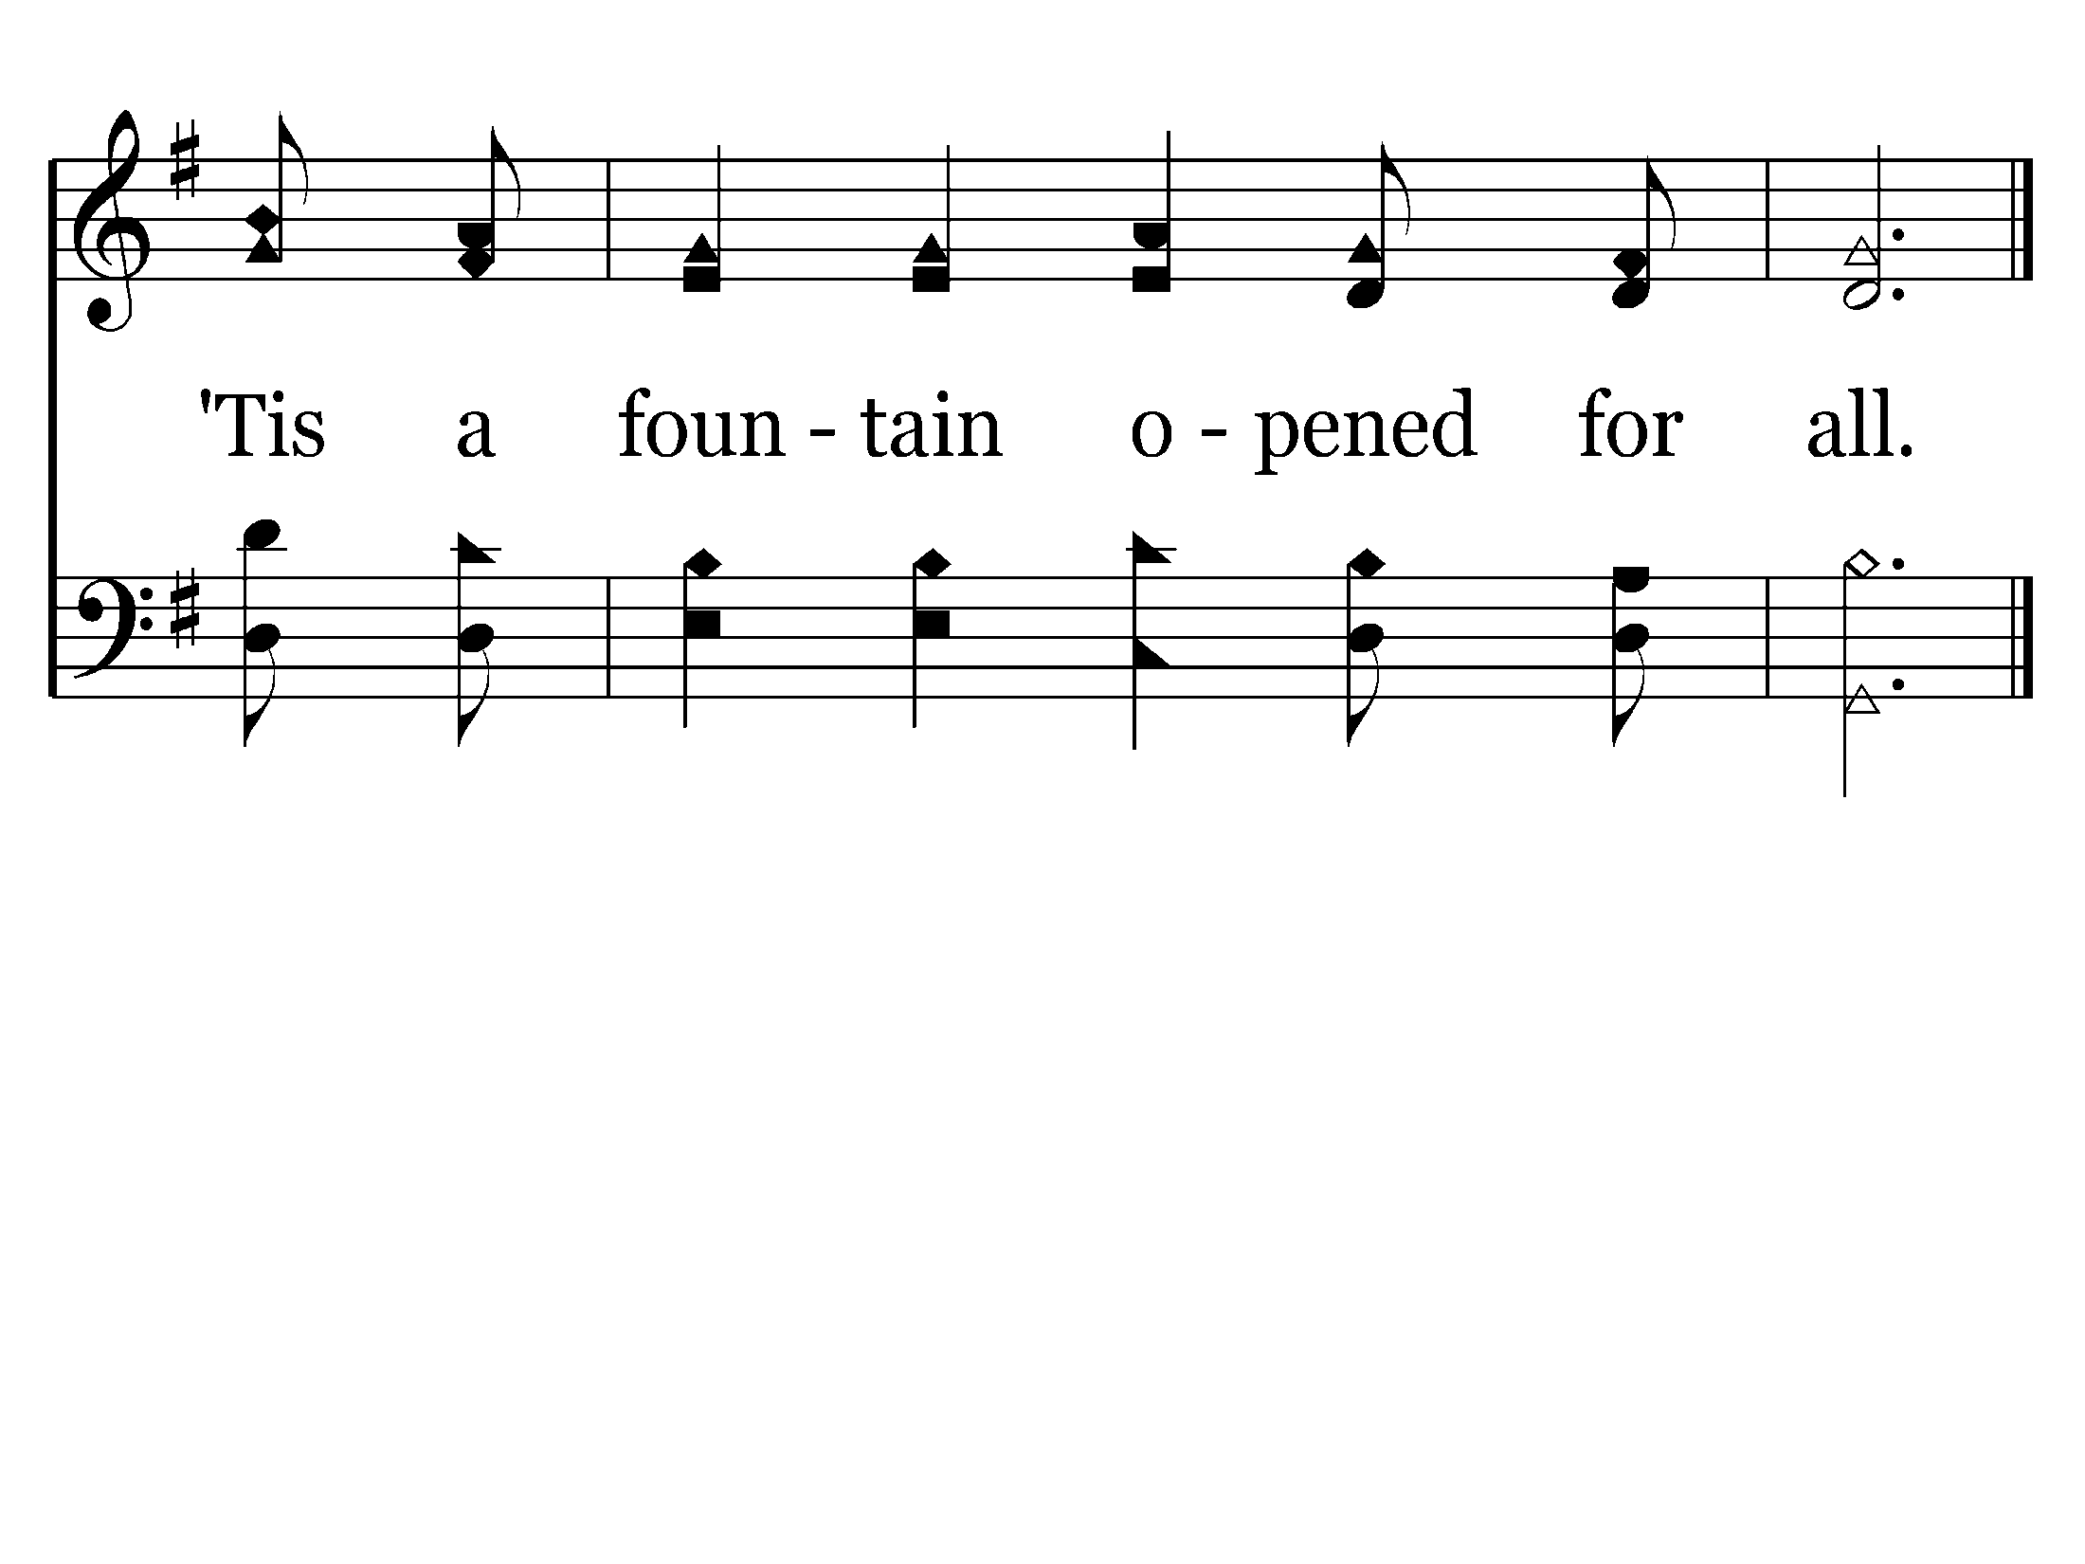
287 - There's A Fountain Free - C.3
End of Verse 1

Slide 21
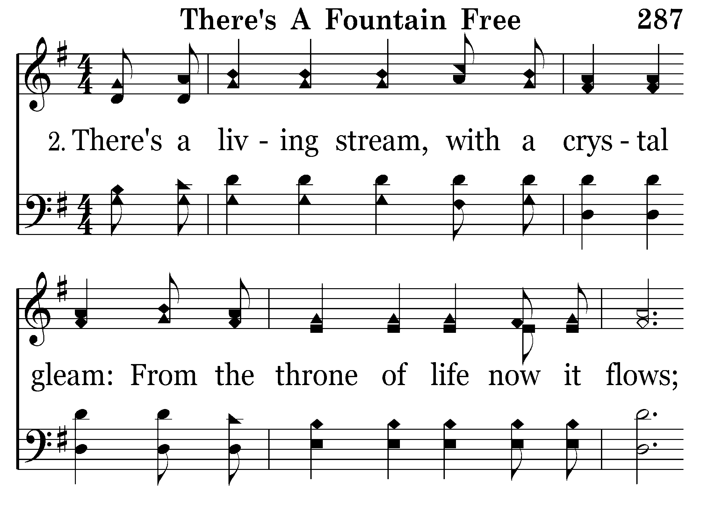
287 - There's A Fountain Free - 2.1

Slide 22
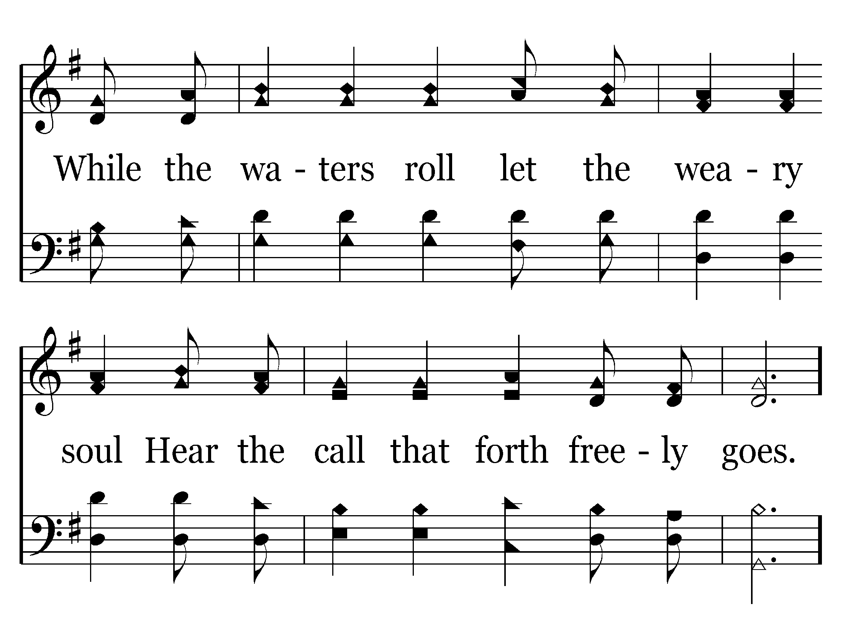
287 - There's A Fountain Free - 2.2

Slide 23
287 - There's A Fountain Free - C.1

Slide 24
287 - There's A Fountain Free - C.2

Slide 25
287 - There's A Fountain Free - C.3
End of Verse 2

Slide 26
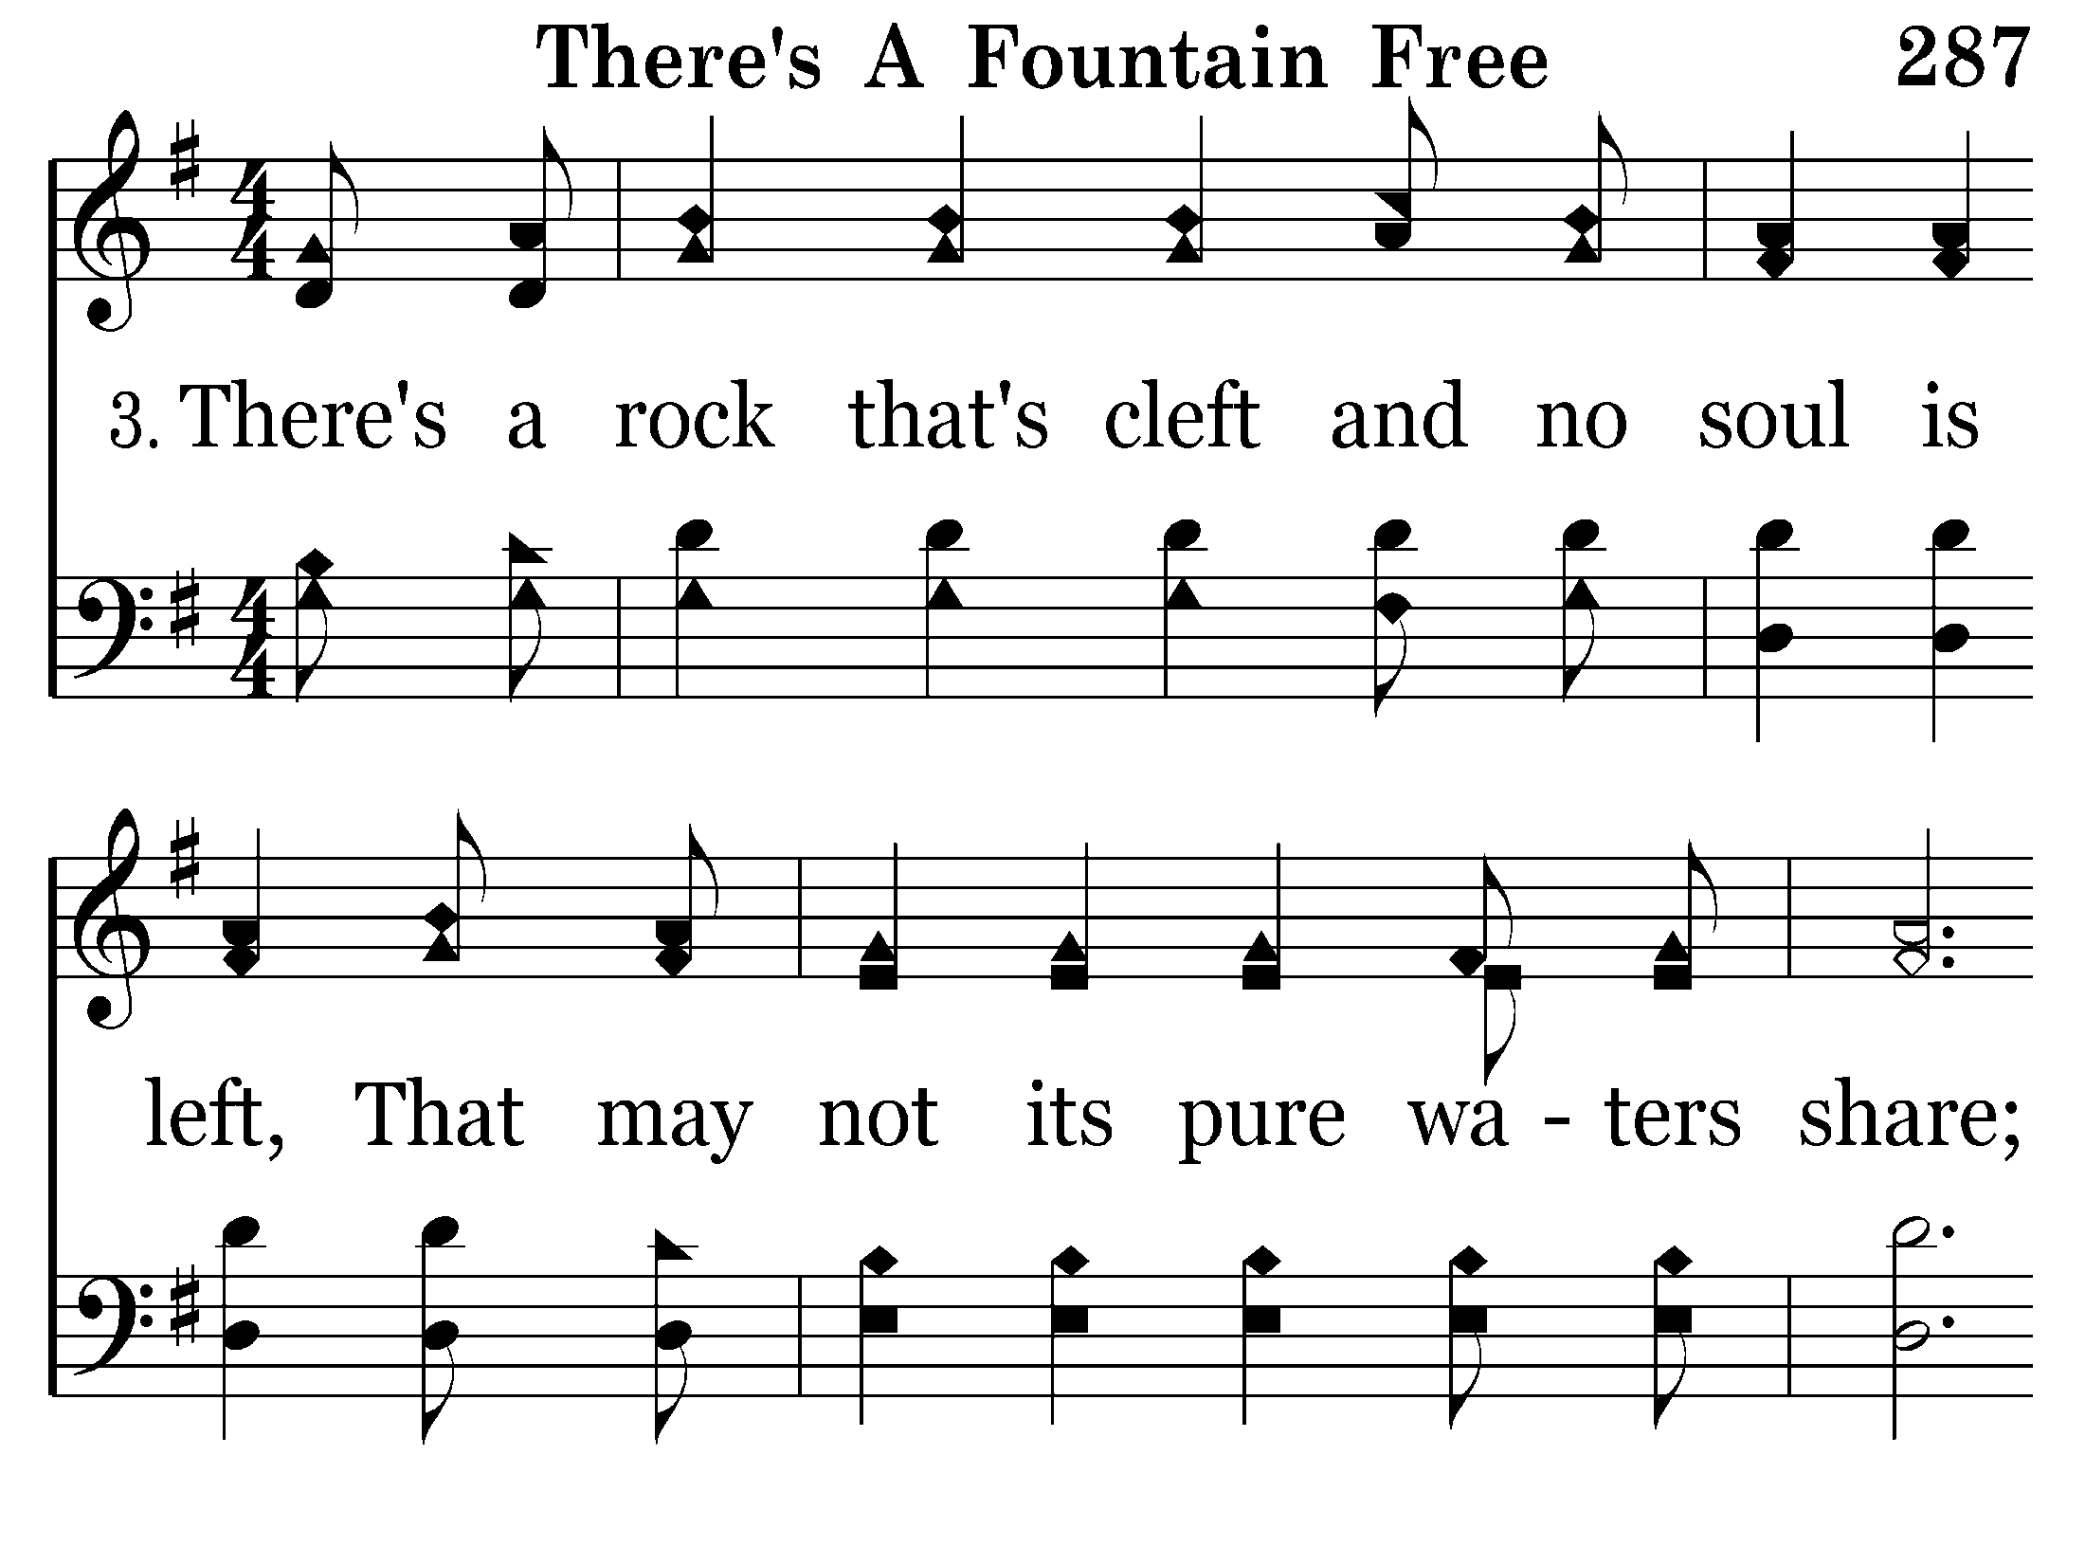
287 - There's A Fountain Free - 3.1

Slide 27
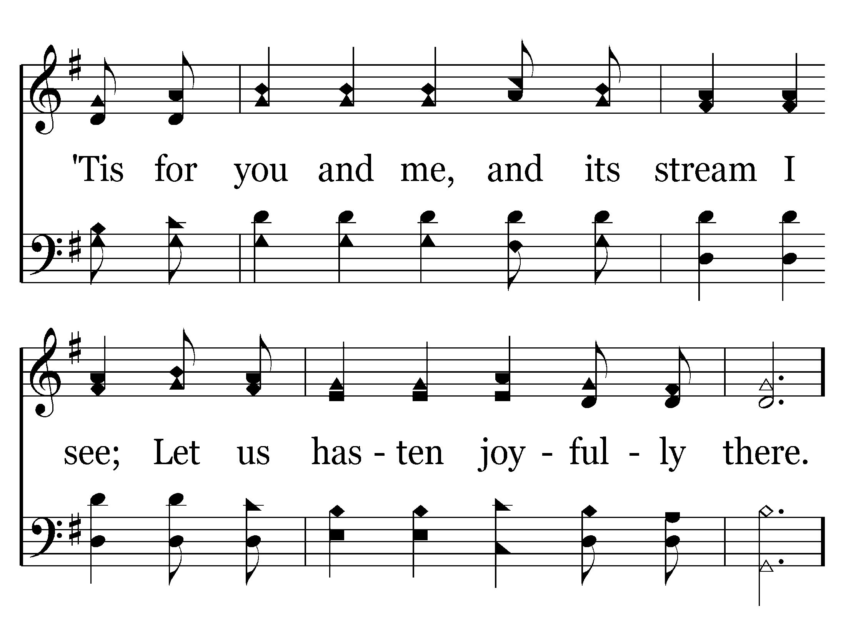
287 - There's A Fountain Free - 3.2

Slide 28
287 - There's A Fountain Free - C.1

Slide 29
287 - There's A Fountain Free - C.2

Slide 30
287 - There's A Fountain Free - C.3
End of Song

