Slide 1
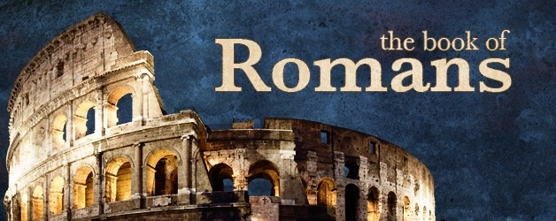
Romans 9

Slide 2
Romans 9:19-24
¹⁹ You will say to me then, “Why does He still find fault? For who has resisted His will?” ²⁰ But indeed, O man, who are you to reply against God? Will the thing formed say to him who formed it, “Why have you made me like this?” ²¹ Does not the potter have power over the clay, from the same lump to make one vessel for honor and another for dishonor? ²² What if God, wanting to show His wrath and to make His power known, endured with much longsuffering the vessels of wrath prepared for destruction, ²³ and that He might make known the riches of His glory on the vessels of mercy, which He had prepared beforehand for glory, ²⁴ even us whom He called, not of the Jews only, but also of the Gentiles?

Slide 3
Romans 9:25-29
²⁵ As He says also in Hosea: “I will call them My people, who were not My people, and her beloved, who was not beloved.” [Hosea 2:23] ²⁶ “And it shall come to pass in the place where it was said to them, ‘You are not My people,’ There they shall be called sons of the living God.” [Hosea 1:10] ²⁷ Isaiah also cries out concerning Israel:
“Though the number of the children of Israel be as the sand of the sea, the remnant will be saved. ²⁸ For He will finish the work and cut it short in righteousness, because the Lord will make a short work upon the earth.” [Isaiah 10:22-23] ²⁹ And as Isaiah said before:
“Unless the Lord of Sabaoth had left us a seed, we would have become like Sodom, and we would have been made like Gomorrah.” [Isaiah 1:9]

Slide 4
Romans 9:30-33
³⁰ What shall we say then? That Gentiles, who did not pursue righteousness, have attained to righteousness, even the righteousness of faith; ³¹ but Israel, pursuing the law of righteousness, has not attained to the law of righteousness. ³² Why? Because they did not seek it by faith, but as it were, by the works of the law. For they stumbled at that stumbling stone. ³³ As it is written: “Behold, I lay in Zion a stumbling stone and rock of offense, And whoever believes on Him will not be put to shame.” [Isaiah 8:14; 28:16]

Slide 5
Romans 10

Slide 6
Romans 10:1-4
¹ Brethren, my heart’s desire and prayer to God for Israel is that they may be saved. ² For I bear them witness that they have a zeal for God, but not according to knowledge. ³ For they being ignorant of God’s righteousness, and seeking to establish their own righteousness, have not submitted to the righteousness of God. ⁴ For Christ is the end of the law for righteousness to everyone who believes.

Slide 7
Romans 10:5-13
⁵ For Moses writes about the righteousness which is of the law, “The man who does those things shall live by them.” ⁶ But the righteousness of faith speaks in this way, “Do not say in your heart, ‘Who will ascend into heaven?’” (that is, to bring Christ down from above) ⁷ or, “‘Who will descend into the abyss?’” (that is, to bring Christ up from the dead). ⁸ But what does it say? “The word is near you, in your mouth and in your heart” (that is, the word of faith which we preach): ⁹ that if you confess with your mouth the Lord Jesus and believe in your heart that God has raised Him from the dead, you will be saved. ¹⁰ For with the heart one believes unto righteousness, and with the mouth confession is made unto salvation. ¹¹ For the Scripture says, “Whoever believes on Him will not be put to shame.” ¹² For there is no distinction between Jew and Greek, for the same Lord over all is rich to all who call upon Him. ¹³ For “whoever calls on the name of the Lord shall be saved.”

Slide 8
Romans 10:16-21
¹⁴ How then shall they call on Him in whom they have not believed? And how shall they believe in Him of whom they have not heard? And how shall they hear without a preacher? ¹⁵ And how shall they preach unless they are sent? As it is written: “How beautiful are the feet of those who preach the gospel of peace, Who bring glad tidings of good things!” ¹⁶ But they have not all obeyed the gospel. For Isaiah says, “Lord, who has believed our report?” ¹⁷ So then faith comes by hearing, and hearing by the word of God. ¹⁸ But I say, have they not heard? Yes indeed: “Their sound has gone out to all the earth, And their words to the ends of the world.” ¹⁹ But I say, did Israel not know? First Moses says: “I will provoke you to jealousy by those who are not a nation, I will move you to anger by a foolish nation.” ²⁰ But Isaiah is very bold and says: “I was found by those who did not seek Me; I was made manifest to those who did not ask for Me.” ²¹ But to Israel he says: “All day long I have stretched out My hands to a disobedient and contrary people.”

