Slide 1
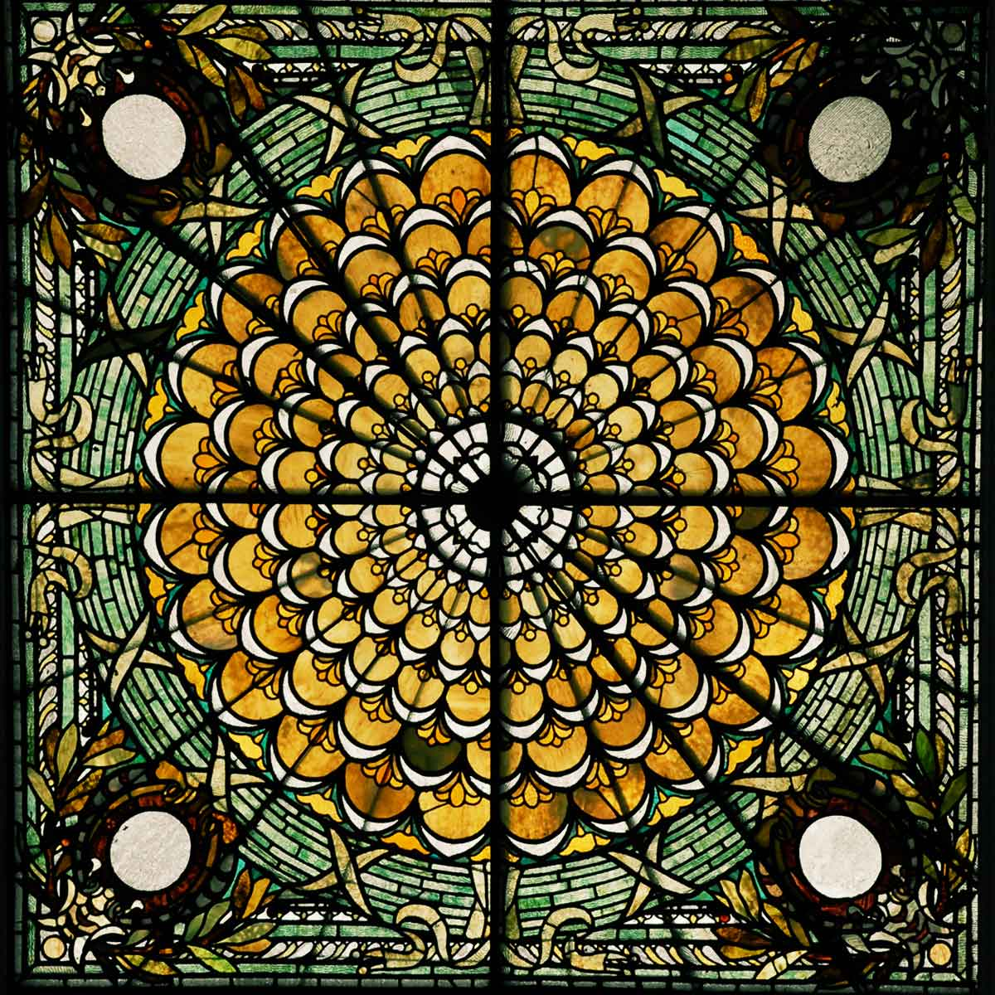
The Problem & Solution of Selfishness
Ezekiel 34:17-20

Slide 2
Ezekiel 34:17-20
¹⁷ And as for you, O My flock, thus says the Lord God: “Behold, I shall judge between sheep and sheep, between rams and goats. ¹⁸ Is it too little for you to have eaten up the good pasture, that you must tread down with your feet the residue of your pasture – and to have drunk of the clear waters, that you must foul the residue with your feet? ¹⁹ And as for My flock, they eat what you have trampled with your feet, and they drink what you have fouled with your feet.”
²⁰ Therefore thus says the Lord God to them: “Behold, I Myself will judge between the fat and the lean sheep.”

Slide 3
The Problem of Selfishness & Self-Gratification
Selfish person concentrates on own desires & gives highest priority to gratifying self
Example: spoiled by wealth, ease, beauty & flattery
We live in an age of instant gratification
When lusts & sinful desires arise, selfish person seeks instant gratification from sin
Romans 8:5-8
Romans 6:12-14, 16
Ephesians 2:1-3
James 4:1-3
¹ What is the source of quarrels and conflicts among you? Is not the source your pleasures that wage war in your members? ² You lust and do not have; so you commit murder. And you are envious and cannot obtain; so you fight and quarrel. You do not have because you do not ask. ³ You ask and do not receive, because you ask with wrong motives, so that you may spend it on your pleasures. NASB

Slide 4
How Do We Overcome Selfishness?

Slide 5
Overcoming Selfishness In Our Individual Lives
Sin hardens our heart to accept it
Hebrews 3:12-13
Hebrews 12:14-17
We must not let sinful passion direct our lives by finding entry point in sin
Romans 13:14
Galatians 5:24
Colossians 3:5-10
1 John 2:15-17
All sin has some element of selfishness

Slide 6
Overcoming Selfishness In Our Homes
World will instill director of “the flesh” in our children if we leave them to it
We must develop “mind of Spirit” or “mind of Christ” by instilling Word
Ephesians 6:4
Deuteronomy 6:4-9; 4:9-10; 32:46-47
Proverbs 22:6
2 Timothy 3:14-17
Failure to submit self to God’s will in all things will devastate the home
All must learn the honor of meeting responsibility
Teaching selflessness in home is foundation

Slide 7
Overcoming Selfishness In The Church
Starts with responsibility to love one another
John 13:34 Sign we are disciples of Jesus
1 Pet. 1:22f Based on our being born again
1 Jn. 3:11f Requires righteous action
1 Jn. 4:7-12 Imitation of God’s character
1 Thess. 4:9 Praised for exemplary love
The love demanded is selfless (1 Cor. 13:4-7)
Will be manifested in self-denial to serve
Mark 10:44 Greatest of all is servant of all
Phil. 2:1-5 Not look to own things, but of others

