Slide 1
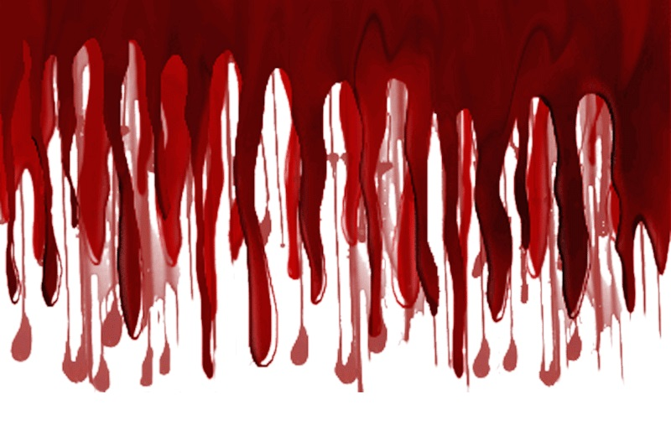
The Blood of Christ & Salvation of the Sinner
Hebrews 10:1-14

Slide 2
Hebrews 10:1-9
¹ For the law, having a shadow of the good things to come, and not the very image of the things, can never with these same sacrifices, which they offer continually year by year, make those who approach perfect. ² For then would they not have ceased to be offered? For the worshipers, once purified, would have had no more consciousness of sins. ³ But in those sacrifices there is a reminder of sins every year. ⁴ For it is not possible that the blood of bulls and goats could take away sins. ⁵ Therefore, when He came into the world, He said: “Sacrifice and offering You did not desire, but a body You have prepared for Me. ⁶ In burnt offerings and sacrifices for sin You had no pleasure. ⁷ Then I said, ‘Behold, I have come – In the volume of the book it is written of Me – to do Your will, O God.’” ⁸ Previously saying, “Sacrifice and offering, burnt offerings, and offerings for sin You did not desire, nor had pleasure in them” (which are offered according to the law), ⁹ then He said, “Behold, I have come to do Your will, O God.” He takes away the first that He may establish the second.

Slide 3
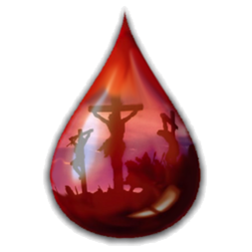
The Connection between Sin & Blood
Death has always been the penalty for sin
Genesis 2:17 You will surely die → 3:1-6
Romans 3:23 All have sinned
Romans 6:23 Wages of sin is death
Without the shedding of blood, there is no remission of sin
Hebrews 9:22 “According to the law…”
What is connection between shedding of blood & remission of sins?

Slide 4
Why Is Shedding of Blood Needed?
From the beginning, the blood has symbolized the life (metonymy)
Genesis 4:10 Abel’s blood cried out
Genesis 9:4 Blood is the life
Deuteronomy 12:23 Blood is life
Acts 15:28-29 NT: Same seen of blood
Leviticus 17:10-12 Blood in sacrifice
Since sin demands death as penalty…
Shedding of blood is the necessary consequence of sin

Slide 5
Blood Sacrifices in the Mosaic Law
Law about blood in burnt offerings (Leviticus 1)
1:5, 11, 15 Kill it; blood on altar
Law about blood in peace offerings (Leviticus 3)
3:2, 8, 13 Kill it; blood sprinkled
Law about blood in sin & trespass offerings (Leviticus 4–6)
4:4-7, 15-18, 24-25, 29-30, 33-34… Kill it, blood on horn, pour all blood out at altar
Think of all the blood (death) required!
Still knew not sufficient (Micah 6:6-7)

Slide 6
What Was Purpose of Animal Sacrifice?
Sacrifices of the Law were shadow of good things to come (Hebrews 10:1)
10:1 Could not make sinner perfect
10:2 Consciousness of sin maintained
10:3 Blood offered continually, but…
10:4 Sin not taken away by sacrifices
Rom. 7:13 Sin seen exceedingly sinful
Blood (life) of sacrifices not equal to value of blood (life) of sinner
O.T. sacrifices made clear need for life of greater value to justly forgive

Slide 7
The Need for Greater Sacrifice in New Law
Hebrews 10:9-14
…He takes away the first that He may establish the second. ¹⁰ By that will we have been sanctified through the offering of the body of Jesus Christ once for all. ¹¹ And every priest stands ministering daily and offering repeatedly the same sacrifices, which can never take away sins. ¹² But this Man, after He had offered one sacrifice for sins forever, sat down at the right hand of God, ¹³ from that time waiting till His enemies are made His footstool. ¹⁴ For by one offering He has perfected forever those who are being sanctified.

