Slide 1
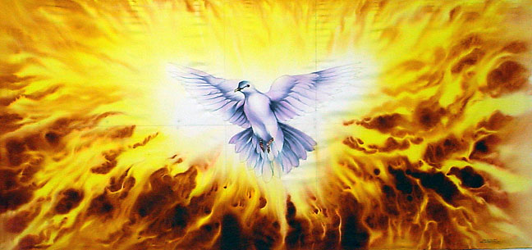
The Person & Work of the Holy Spirit
Holy Spirit in the Old Testament

Slide 2
Holy Spirit’s Work Is:
Instructing & Blessing

Slide 3
Blessings Brought by Spirit
Holy Spirit is said to have brought blessings upon Israel from beginning
  Haggai 2:4-5 Spirit with Israel in exodus
  Isaiah 63:7-14 Spirit blesses in days of old
  Isaiah 32:13-15 Spirit blesses in restoration
  Isaiah 44:1-5 “Spirit” parallel to “blessing”
  Psalm 143:4-10 “My spirit” vs. “Thy Spirit”

Slide 4
Holy Spirit & Instruction to Israel

Slide 5
Spirit: Source of Instruction
Instruction to Israel is attributed to Holy Spirit
  Nehemiah 9:5f God directs Israel in history
  Nehemiah 9:16f Spirit instructed Israel
  Micah 3:7-8 Spirit revealed, not diviners
  Isaiah 63:10 Rebel at word = Spirit grieved
    compare Ephesians 4:30
  Zechariah 7:11-12 Law spurned of Spirit
Charge of Stephen confirms (Acts 7:51-53)
NT says OT revelation of Spirit (2 Pet. 1:21)

Slide 6
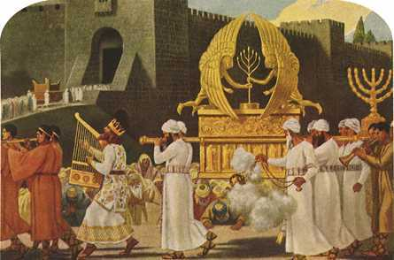
Holy Spirit & The Temple

Slide 7
Holy Spirit: Tabernacle to Temple
Spirit’s preparations for tabernacle
  Exodus 31:1-5 Bezalel & Holy Spirit
  Exodus 35:30 - 39:43
    Work done as shown by Spirit of God
  Exodus 40:34f Cloud filled tabernacle
Note: Blessing came after instruction kept
Later under Solomon, temple built as permanent dwelling place (1 Kings 8)

Slide 8
Dedication of Temple in 1 Kings 8
All had been built according to plan
Cloud filled the house (vs. 10-11)
Solomon prays in dedication (vs. 12-53)
Repeatedly calls it God’s house or dwelling
Yet, not literal dwelling place (vs. 27-30)
What is meant by God “dwelling” in temple?
Place symbolized God’s abiding with Israel through blessings & instruction (vs. 31-53)

Slide 9
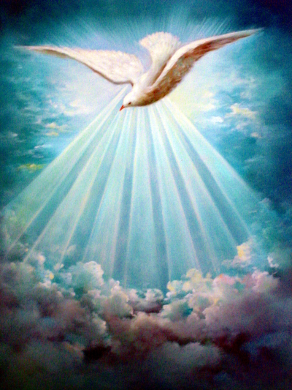
Holy Spirit Works with People

Slide 10
Not Always Miraculous
Spirit came on leaders = Appointed to work
  Judges 3:10 Spirit came on Othniel
  Judges 6:34 Spirit came on Gideon
  Judges 11:29 Spirit came on Jephthah
  Judges 14:6 Spirit came on Samson
  1 Samuel 11:6 Spirit came on Saul
  1 Samuel 16:13 Spirit came on David
None of these implies miraculous power

Slide 11
Miracles May Be Temporary
Example – selection of 70 elders to help Moses (Numbers 11)
Spirit to be put upon them (vs. 16-17)
70 are chosen & presented (vs. 24-25)
  “…when the spirit rested upon them, they prophesied, and did not cease” (KJV)
  “…when the Spirit rested upon them… they prophesied, although they never did so again” (NKJV)
  “…when the Spirit rested upon them, they prophesied, but they did so no more” (ASV)
  “…when the Spirit rested upon them, they prophesied. But they did not do it again” (NASB)
Once place confirmed, no need for more miraculous action

Slide 12

Holy Spirit & Messianic Promise

Slide 13
Spirit “With” & “Upon” Messiah
Isaiah 61:1f Spirit to anoint Messiah
  Fulfillment seen in Luke 4:16-20
Isaiah 11:1-2 Spirit of Jehovah on Him
Isaiah 42:1f Spirit to be upon Messiah
  Fulfillment declared in Matthew 12:15-28
Isaiah 59:20-21 Spirit evidenced by words
Point of prophecy speaks to divine unity in purpose & action in Messiah’s work

Slide 14
Holy Spirit Evidenced by Coming of the New Kingdom
Beginning at the baptism of Jesus, Spirit gave testimony of Jesus as the Christ
Perfect divine unity in purpose and action seen throughout Jesus’ earthly ministry
Zenith reached in resurrection & ascension of Christ to rule on throne in heaven
Pouring forth of Spirit to be evidence for all
  Joel 2:28-32 fulfilled in Acts 2:16f

Slide 15
Pouring Forth of Spirit on Pentecost
How do we know kingdom & salvation promised in OT are present reality?
“THIS (actions recorded on Pentecost)
IS
THAT” (promise given in Joel 2)
If “this is that”
Then “that is this”
So, time for coming of salvation & kingdom of Christ is identified!

Slide 16
Salvation & Kingdom of Christ Now Present Reality
Salvation & Kingdom to Come with Spirit
Spirit Came on Pentecost
Spirit’s Coming Proved Present Reality of
Salvation & Kingdom

