Slide 1
The Person & Work of the Holy Spirit
Miraculous Action of Holy Spirit in Apostolic Time

Slide 2
The Holy Spirit’s Work Is:
Instructing
  Anointing - appoint to a work
  Revealing - inspire word taught
  Confirming - show divine origin
Blessing

Slide 3
Direct & Indirect Action
People directly empowered by Holy Spirit twice:
  Acts 2 - confirm salvation available in Christ
  Acts 10 - confirm salvation open to Gentiles
  Acts 11:15 - not ordinary occurrence with all
Gifts of Spirit came indirectly by laying on of the apostles’ hands
  Acts 8:14-21 - apostles required to impart gifts
No continuing promise of Holy Spirit gifts or baptism given to all Christians

Slide 4
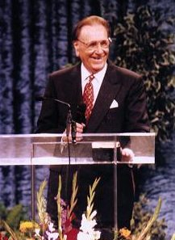
Arguments for Miracles Today

Slide 5
Pentecostal & Charismatics Say:
“Jesus is same yesterday, today & forever”
“Miracles needed to produce faith today”
“Miracles needed to confirm truth today”
“Gifts of Spirit needed to show who are God’s people today”
“Gifts needed as evidence of our salvation”
“Spirit must be working miracles today - just look at Oral Roberts, Tilton, Angley or …”
However, need to compare with Bible time

Slide 6
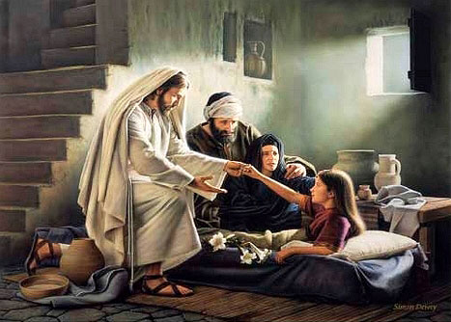
Purpose of Miracles in Bible

Slide 7
Plain Statements of Purpose
Mark 16:17-20
  Word confirmed by accompanying signs

Slide 8
Mark 16:17-20
¹⁷ And these signs will follow those who believe: In My name they will cast out demons; they will speak with new tongues; ¹⁸ they will take up serpents; and if they drink anything deadly, it will by no means hurt them; they will lay hands on the sick, and they will recover.” ¹⁹ So then, after the Lord had spoken to them, He was received up into heaven, and sat down at the right hand of God. ²⁰ And they went out and preached everywhere, the Lord working with them and confirming the word through the accompanying signs. Amen.

Slide 9
Plain Statements of Purpose
Mark 16:17-20
  Word confirmed by accompanying signs
John 15:24-27
  Witness of apostles & witness of Spirit
  Principle upheld of plurality of witnesses

Slide 10
John 15:24-27
²⁴ “If I had not done among them the works which no one else did, they would have no sin; but now they have seen and also hated both Me and My Father. ²⁵ But this happened that the word might be fulfilled which is written in their law, ‘They hated Me without a cause.’ ²⁶ But when the Helper comes, whom I shall send to you from the Father, the Spirit of truth who proceeds from the Father, He will testify of Me. ²⁷ And you also will bear witness, because you have been with Me from the beginning.”
Therefore they stayed there a long time, speaking boldly in the Lord, who was bearing witness to the word of His grace, granting signs and wonders to be done by their hands.
--- Acts 14:3 ---

Slide 11
Plain Statements of Purpose
Mark 16:17-20
  Word confirmed by accompanying signs
John 15:24-27
  Witness of apostles & witness of Spirit
  Principle upheld of plurality of witnesses
Hebrews 2:1-4
  Signs, wonders, powers & gifts of Spirit were witness of God to revealed message

Slide 12
Hebrews 2:1-4
¹ Therefore we must give the more earnest heed to the things we have heard, lest we drift away. ² For if the word spoken through angels proved steadfast, and every transgression and disobedience received a just reward, ³ how shall we escape if we neglect so great a salvation, which at the first began to be spoken by the Lord, and was confirmed to us by those who heard Him, ⁴ God also bearing witness both with signs and wonders, with various miracles, and gifts of the Holy Spirit, according to His own will?

Slide 13
Summary of Purpose
(1) Reveal message under divine control
(2) Confirm truth revealed by apostles
(3) Evidence divine origin of message
__________________________________________
CONFIRM THE WORD

Slide 14
Case Study of Corinthian Church
(1st Cor. 12 – 14)

Slide 15
1st Corinthians 12:4-11
⁴ There are diversities of gifts, but the same Spirit. ⁵ There are differences of ministries, but the same Lord. ⁶ And there are diversities of activities, but it is the same God who works all in all. ⁷ But the manifestation of the Spirit is given to each one for the profit of all: ⁸ for to one is given the word of wisdom through the Spirit, to another the word of knowledge through the same Spirit,⁹ to another faith by the same Spirit, to another gifts of healings by the same Spirit, ¹⁰ to another the working of miracles, to another prophecy, to another discerning of spirits, to another different kinds of tongues, to another the interpretation of tongues. ¹¹ But one and the same Spirit works all these things, distributing to each one individually as He wills.

Slide 16
Gifts of Spirit Identified
(1st Corinthians 12:4-11)

Slide 17
Revelation & Confirmation
Word of wisdom
Word of knowledge
Prophecy
Discerning spirits
Tongues
Interpret. tongues
Faith
Gifts of healings
Workings of miracles

Slide 18
Why Differing Gifts Given?
Illustration of body with many members, but all work together (1 Cor. 12)
Body cannot function if all members same
“God set the members each one of them in the body even as it pleased Him”
To bring unity, not division in body
Gifts intend to bring honor to God, not man
Loving service lasts after present gifts (1 Cor. 13)

Slide 19
Prophecy vs. Tongues
(1st Corinthians 14)
Tongues are languages (Acts 2:4-11)
Tongue = Revelation in another language
Prophecy = Revelation in same language
Prophecy has priority in edifying church
One of same language learns by prophecy
Tongues designed to reach unbelievers
If use tongues in church, must interpret
Principle: All must be done unto edifying

Slide 20
Obvious Nature of Problem
Gifts which should have aided unity had become source of division
Gift of tongues was thought by some to be most valuable
Desire for personal glory guided their view of gifts, rather than spiritual aim
Had to understand purpose & place of gifts
Chapter 13 imparts needed understanding by showing gifts were only temporary

Slide 21
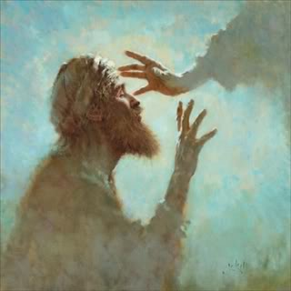
Duration of Miraculous Action

Slide 22
1st Corinthians 13:11-15
⁸ Love never fails. But whether there are prophecies, they will fail; whether there are tongues, they will cease; whether there is knowledge, it will vanish away. ⁹ For we know in part and we prophesy in part. ¹⁰ But when that which is perfect has come, then that which is in part will be done away. ¹¹ When I was a child, I spoke as a child, I understood as a child, I thought as a child; but when I became a man, I put away childish things. ¹² For now we see in a mirror, dimly, but then face to face. Now I know in part, but then I shall know just as I also am known. ¹³ And now abide faith, hope, love, these three; but the greatest of these is love.

Slide 23
1st Corinthians 13:11-15
Love is always required as motivation for all acceptable action (see Matt. 22:34f)
Love distinguished from gifts in that “love never fails” but gifts will be “done away”
When are gifts to be done away?
“When that which is perfect (whole) has come, then that which is in part (partial) will be done away”
What are the parts & the whole?

Slide 24
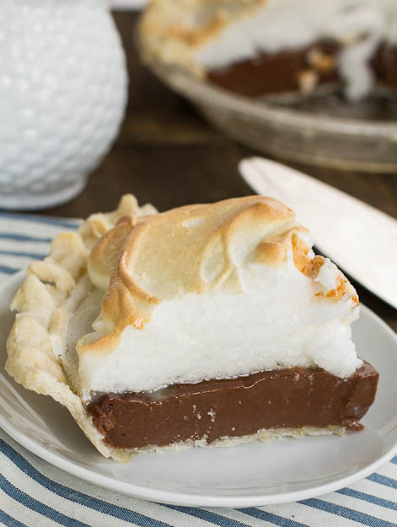
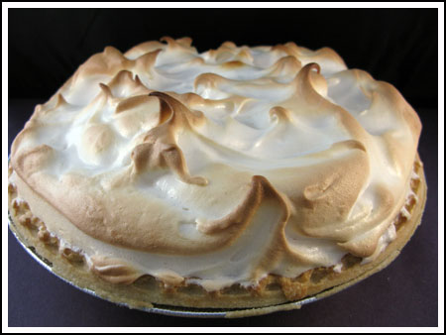
Part (Partial) & Perfect (Whole)

Slide 25
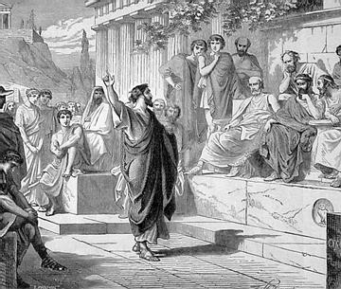
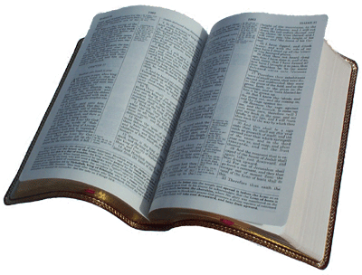
Part (Partial) & Perfect (Whole)

Slide 26
When Partial Revelation Ceases, Product of Revelation Continues
If “part” is one form of revelation, then “perfect” is complete or full revelation
Complete revelation instructs & requires that we be motivated by love
At the completion of revelation, faith & hope also abide on foundation of truth
Full revelation merely compiled the same truth given orally in parts by inspired men
No provision or requirement was changed

Slide 27
“That Which Is Perfect” Could Not Be Second Coming of Christ
Makes no correlation between “part” (partial) & “perfect” (whole)
Would be insertion into text of a subject neither introduced nor explained in text
Would contradict other Scripture in that “faith” & “hope” cease at 2nd coming
If “faith, hope & love” continue after end of gifts, must be before 2nd coming

Slide 28
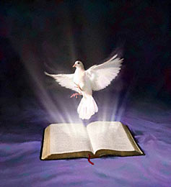
Conclusions

Slide 29
Miraculous Action Has Ceased
No miracles of the nature recorded in Bible are taking place now
Purpose was completed when all truth was revealed & confirmed
We have complete & final revelation from God, needing no further confirmation
At death of last person empowered by laying on of apostles’ hands, miraculous action ceased

