Slide 1
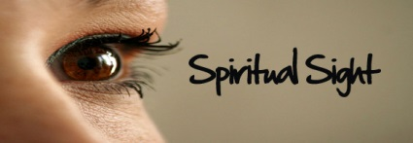
“Turn away my eyes from looking at vanity, and revive me in Your ways. Establish Your word to Your servant, as that which produces reverence for You.”
Psalm 119:37-38, NASB

Slide 2
How Is It Developed?
Do not look to lust
Matthew 5:27-28 Many wrong actions start with the eyes
2 Samuel 11:2-5 David’s sin with Bathsheba started so
Job 31:1 “I made a covenant with my eyes…”
Same point is true for women
Do not look on intoxicants
Proverbs 23:31-32; 20:1; 23:33-35 Advice of wisdom
1 Peter 4:1-3 “…drunkenness, revelries, drinking parties…”
Do not focus on things behind – the past
Genesis 19:17, 26 Lot’s wife “looked” back – with longing
Phil. 3:12-14 Must look forward, not back (Heb. 11:13-16)
Hebrews 12:1-2 “Looking unto Jesus…”

Slide 3
^{“Looking unto Jesus…”}

