Slide 1
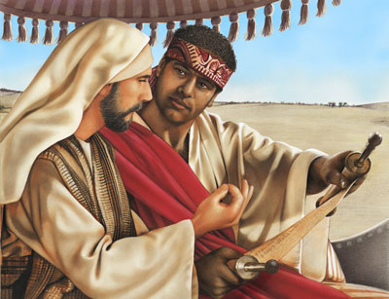
What Hinders Me from Being Baptized?
Acts 8:26-38

Slide 2
Acts 8:26-38
²⁶ Now an angel of the Lord spoke to Philip, saying, “Arise and go toward the south along the road which goes down from Jerusalem to Gaza.” This is desert.²⁷ So he arose and went. And behold, a man of Ethiopia, a eunuch of great authority under Candace the queen of the Ethiopians, who had charge of all her treasury, and had come to Jerusalem to worship, ²⁸ was returning. And sitting in his chariot, he was reading Isaiah the prophet. ²⁹ Then the Spirit said to Philip, “Go near and overtake this chariot.” ³⁰ So Philip ran to him, and heard him reading the prophet Isaiah, and said, “Do you understand what you are reading?” ³¹ And he said, “How can I, unless someone guides me?” And he asked Philip to come up and sit with him.

Slide 3
³² The place in the Scripture which he read was this: “He was led as a sheep to the slaughter; and as a lamb before its shearer is silent, so He opened not His mouth. ³³ In His humiliation His justice was taken away, and who will declare His generation? For His life is taken from the earth.” ³⁴ So the eunuch answered Philip and said, “I ask you, of whom does the prophet say this, of himself or of some other man?” ³⁵ Then Philip opened his mouth, and beginning at this Scripture, preached Jesus to him. ³⁶ Now as they went down the road, they came to some water. And the eunuch said, “See, here is water. What hinders me from being baptized?” ³⁷ Then Philip said, “If you believe with all your heart, you may.” And he answered and said, “I believe that Jesus Christ is the Son of God.” ³⁸ So he commanded the chariot to stand still. And both Philip and the eunuch went down into the water, and he baptized him.

Slide 4
³² The place in the Scripture which he read was this: “He was led as a sheep to the slaughter; and as a lamb before its shearer is silent, so He opened not His mouth. ³³ In His humiliation His justice was taken away, and who will declare His generation? For His life is taken from the earth.” ³⁴ So the eunuch answered Philip and said, “I ask you, of whom does the prophet say this, of himself or of some other man?” ³⁵ Then Philip opened his mouth, and beginning at this Scripture, preached Jesus to him. ³⁶ Now as they went down the road, they came to some water. And the eunuch said, “See, here is water. What hinders me from being baptized?” ³⁷ Then Philip said, “If you believe with all your heart, you may.” And he answered and said, “I believe that Jesus Christ is the Son of God.” ³⁸ So he commanded the chariot to stand still. And both Philip and the eunuch went down into the water, and he baptized him.

Slide 5
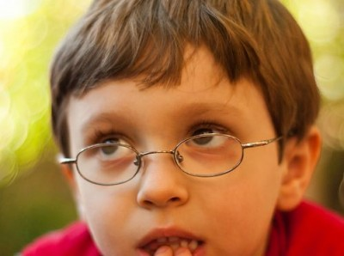
What Hinders Me from Being Baptized?
Acts 8:26-38
A Question for All to Consider

Slide 6
Considering the Need for Baptism
Baptism is necessary in order to forgive sins
Romans 6:3-6
There is a point when one is not guilty of sin, but alive before God as one not accountable to His law
Romans 7:9 “I was alive once without the law…”
Before one is accountable to God’s law, one must be able to knowingly choose between right & wrong
Isaiah 7:14-16 “Before the child shall know to refuse the evil and do the good”
Before one is accountable to make that choice & has sinned, no need to be “saved” (cf. 1 Pet. 3:21)
At that point, one is “SAFE” without stain of sin

Slide 7
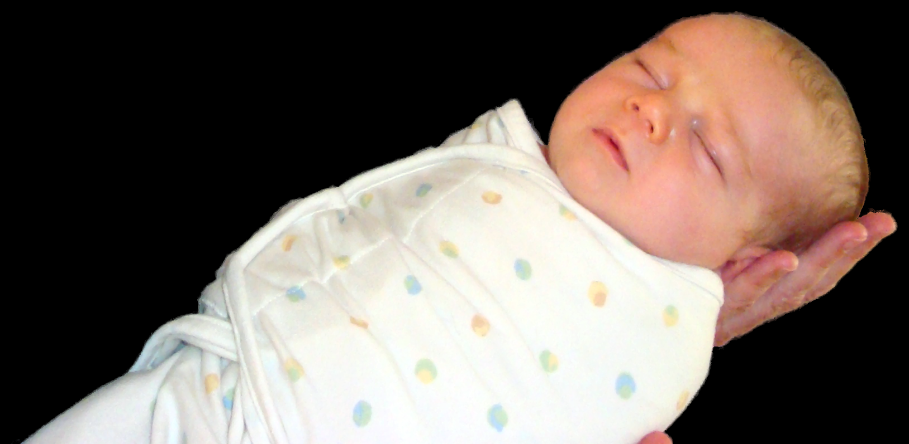
Hindered in Infancy
“Arise and be baptized, and wash away your sins, calling on the name of the Lord” (Acts 22:16).

Slide 8
Hindered in Infancy
No Sin
No Need

Slide 9
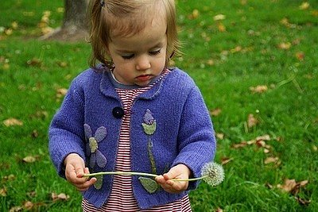
Hindered as a Toddler
“Repent, and let every one of you be baptized in the name of Jesus Christ for the remission of sins…” (Acts 2:38).

Slide 10
Hindered as a Toddler
No Sin
No Need

Slide 11
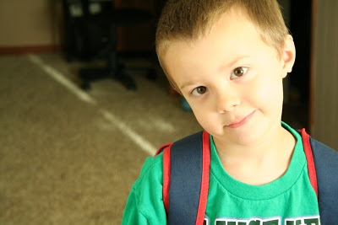
Hindered as Start School
“Knowing this, that our old man was crucified with Him, that the body of sin might be done away with, that we should no longer be slaves of sin” (Romans 6:6).

Slide 12
Hindered as Start School
No Sin
No Need

Slide 13
But by Time Graduates School…
What Is Situation Now?
Has Sinned
Is A Need

Slide 14
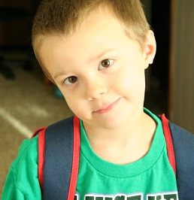
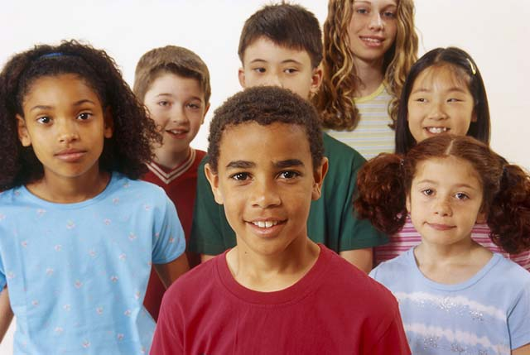
At what point did he/she become accountable?
How Does One Know?

Slide 15
How Can One Know When It Is Time?

Slide 16
How Can One Know When It Is Time?
Must be guilty of sin - Baptism is for remission of sins

Slide 17
How Can One Know When It Is Time?
Must be guilty of sin - Baptism is for remission of sins
“Can you identify specific sins present in your life?”

Slide 18
How Can One Know When It Is Time?
Must be guilty of sin - Baptism is for remission of sins
“Can you identify specific sins present in your life?”
“Do you think you would go to heaven or hell if died now?”

Slide 19
How Can One Know When It Is Time?
Must be guilty of sin - Baptism is for remission of sins
Must have general understanding of who Jesus is

Slide 20
How Can One Know When It Is Time?
Must be guilty of sin - Baptism is for remission of sins
Must have general understanding of who Jesus is
Messiah – the Christ (John 4:24-26)

Slide 21
How Can One Know When It Is Time?
Must be guilty of sin - Baptism is for remission of sins
Must have general understanding of who Jesus is
Messiah – the Christ (John 4:24-26)
Son of God – Divine (Romans 1:4)

Slide 22
How Can One Know When It Is Time?
Must be guilty of sin - Baptism is for remission of sins
Must have general understanding of who Jesus is
Messiah – the Christ (John 4:24-26)
Son of God – Divine (Romans 1:4)
Lived life without sin (Hebrews 4:15)

Slide 23
How Can One Know When It Is Time?
Must be guilty of sin - Baptism is for remission of sins
Must have general understanding of who Jesus is
Messiah – the Christ (John 4:24-26)
Son of God – Divine (Romans 1:4)
Lived life without sin (Hebrews 4:15)
Died for our sins (Romans 5:6-9)

Slide 24
How Can One Know When It Is Time?
Must be guilty of sin - Baptism is for remission of sins
Must have general understanding of who Jesus is
Messiah – the Christ (John 4:24-26)
Son of God – Divine (Romans 1:4)
Lived life without sin (Hebrews 4:15)
Died for our sins (Romans 5:6-9)
Raised from the dead to give us life (1 Peter 1:3)

Slide 25
How Can One Know When It Is Time?
Must be guilty of sin - Baptism is for remission of sins
Must have general understanding of who Jesus is
Must understand the steps in the plan of salvation

Slide 26
How Can One Know When It Is Time?
Must be guilty of sin - Baptism is for remission of sins
Must have general understanding of who Jesus is
Must understand the steps in the plan of salvation
Hear the Gospel (Romans 10:17)

Slide 27
How Can One Know When It Is Time?
Must be guilty of sin - Baptism is for remission of sins
Must have general understanding of who Jesus is
Must understand the steps in the plan of salvation
Hear the Gospel (Romans 10:17)
Believe that Jesus is Christ, the Son of God (John 8:24)

Slide 28
How Can One Know When It Is Time?
Must be guilty of sin - Baptism is for remission of sins
Must have general understanding of who Jesus is
Must understand the steps in the plan of salvation
Hear the Gospel (Romans 10:17)
Believe that Jesus is Christ, the Son of God (John 8:24)
Repent of past sins (Acts 17:30)

Slide 29
How Can One Know When It Is Time?
Must be guilty of sin - Baptism is for remission of sins
Must have general understanding of who Jesus is
Must understand the steps in the plan of salvation
Hear the Gospel (Romans 10:17)
Believe that Jesus is Christ, the Son of God (John 8:24)
Repent of past sins (Acts 17:30)
Confess faith in Jesus as Christ, Son of God (Romans 10:9-10)

Slide 30
How Can One Know When It Is Time?
Must be guilty of sin - Baptism is for remission of sins
Must have general understanding of who Jesus is
Must understand the steps in the plan of salvation
Hear the Gospel (Romans 10:17)
Believe that Jesus is Christ, the Son of God (John 8:24)
Repent of past sins (Acts 17:30)
Confess faith in Jesus as Christ, Son of God (Romans 10:9-10)
Baptized in water for remission of sins (Acts 2:38)

Slide 31
How Can One Know When It Is Time?
Must be guilty of sin - Baptism is for remission of sins
Must have general understanding of who Jesus is
Must understand the steps in the plan of salvation
Hear the Gospel (Romans 10:17)
Believe that Jesus is Christ, the Son of God (John 8:24)
Repent of past sins (Acts 17:30)
Confess faith in Jesus as Christ, Son of God (Romans 10:9-10)
Baptized in water for remission of sins (Acts 2:38)
“Can you explain these steps in your own words?”

Slide 32
How Can One Know When It Is Time?
Must be guilty of sin - Baptism is for remission of sins
Must have general understanding of who Jesus is
Must understand the steps in the plan of salvation
Must be ready to accept responsibilities of a Christian

Slide 33
How Can One Know When It Is Time?
Must be guilty of sin - Baptism is for remission of sins
Must have general understanding of who Jesus is
Must understand the steps in the plan of salvation
Must be ready to accept responsibilities of a Christian
To stop sin and live the life of a Christian? (Col. 3:5-17)

Slide 34
How Can One Know When It Is Time?
Must be guilty of sin - Baptism is for remission of sins
Must have general understanding of who Jesus is
Must understand the steps in the plan of salvation
Must be ready to accept responsibilities of a Christian
To stop sin and live the life of a Christian? (Col. 3:5-17)
Study and grow daily as a Christian? (Col. 1:9-12)

Slide 35
How Can One Know When It Is Time?
Must be guilty of sin - Baptism is for remission of sins
Must have general understanding of who Jesus is
Must understand the steps in the plan of salvation
Must be ready to accept responsibilities of a Christian
To stop sin and live the life of a Christian? (Col. 3:5-17)
Study and grow daily as a Christian? (Col. 1:9-12)
Worship acceptably to God & edify brethren?

Slide 36
How Can One Know When It Is Time?
Must be guilty of sin - Baptism is for remission of sins
Must have general understanding of who Jesus is
Must understand the steps in the plan of salvation
Must be ready to accept responsibilities of a Christian
To stop sin and live the life of a Christian? (Col. 3:5-17)
Study and grow daily as a Christian? (Col. 1:9-12)
Worship acceptably to God & edify brethren?
Partaking the Lord’s Supper, thinking about the death of Jesus

Slide 37
How Can One Know When It Is Time?
Must be guilty of sin - Baptism is for remission of sins
Must have general understanding of who Jesus is
Must understand the steps in the plan of salvation
Must be ready to accept responsibilities of a Christian
To stop sin and live the life of a Christian? (Col. 3:5-17)
Study and grow daily as a Christian? (Col. 1:9-12)
Worship acceptably to God & edify brethren?
Partaking the Lord’s Supper, thinking about the death of Jesus
Singing, paying attention to the words and understanding them

Slide 38
How Can One Know When It Is Time?
Must be guilty of sin - Baptism is for remission of sins
Must have general understanding of who Jesus is
Must understand the steps in the plan of salvation
Must be ready to accept responsibilities of a Christian
To stop sin and live the life of a Christian? (Col. 3:5-17)
Study and grow daily as a Christian? (Col. 1:9-12)
Worship acceptably to God & edify brethren?
Partaking the Lord’s Supper, thinking about the death of Jesus
Singing, paying attention to the words and understanding them
Praying, following the words and joining in as a participant

Slide 39
How Can One Know When It Is Time?
Must be guilty of sin - Baptism is for remission of sins
Must have general understanding of who Jesus is
Must understand the steps in the plan of salvation
Must be ready to accept responsibilities of a Christian
To stop sin and live the life of a Christian? (Col. 3:5-17)
Study and grow daily as a Christian? (Col. 1:9-12)
Worship acceptably to God & edify brethren?
Partaking the Lord’s Supper, thinking about the death of Jesus
Singing, paying attention to the words and understanding them
Praying, following the words and joining in as a participant
Hearing the word, paying attention to sermons & Scripture used

Slide 40
How Can One Know When It Is Time?
Must be guilty of sin - Baptism is for remission of sins
Must have general understanding of who Jesus is
Must understand the steps in the plan of salvation
Must be ready to accept responsibilities of a Christian
To stop sin and live the life of a Christian? (Col. 3:5-17)
Study and grow daily as a Christian? (Col. 1:9-12)
Worship acceptably to God & edify brethren?
Partaking the Lord’s Supper, thinking about the death of Jesus
Singing, paying attention to the words and understanding them
Praying, following the words and joining in as a participant
Hearing the word, paying attention to sermons & Scripture used
Giving, thanking for God’s blessings – physical & spiritual

Slide 41
Is It Time For You?
Is there sin in your life?
Do you understand about Jesus?
Do you believe Jesus is Christ & Son of God?
Have you repented & ready to confess?
Seriously thinking about your soul?
Ready for the responsibility?

