Slide 3
Death from leaving the first works (2:4-5)
    The Ephesians had left their first love
    We have a collective responsibility
  Death from false doctrine (2:14-16)
    Brethren at Pergamos tolerated false doctrine
    The New Testament warns of false doctrine

Slide 4
Death from public sin (2:20-21)
    Jezebel encouraged sin among Christians
    Need to feel the keenness of sin’s tragedy
  Death from weakness (3:2)
    They needed to strengthen what remained
    People need to be truly transformed

Slide 5
Death from failing to evangelize (3:8)
    Brethren at Philadelphia had an open door
    There will be no harvest if we do not plant
  Death from indifference (3:15-17)
    Lukewarmness will be utterly rejected
    Strength has very little to do with size

Slide 6
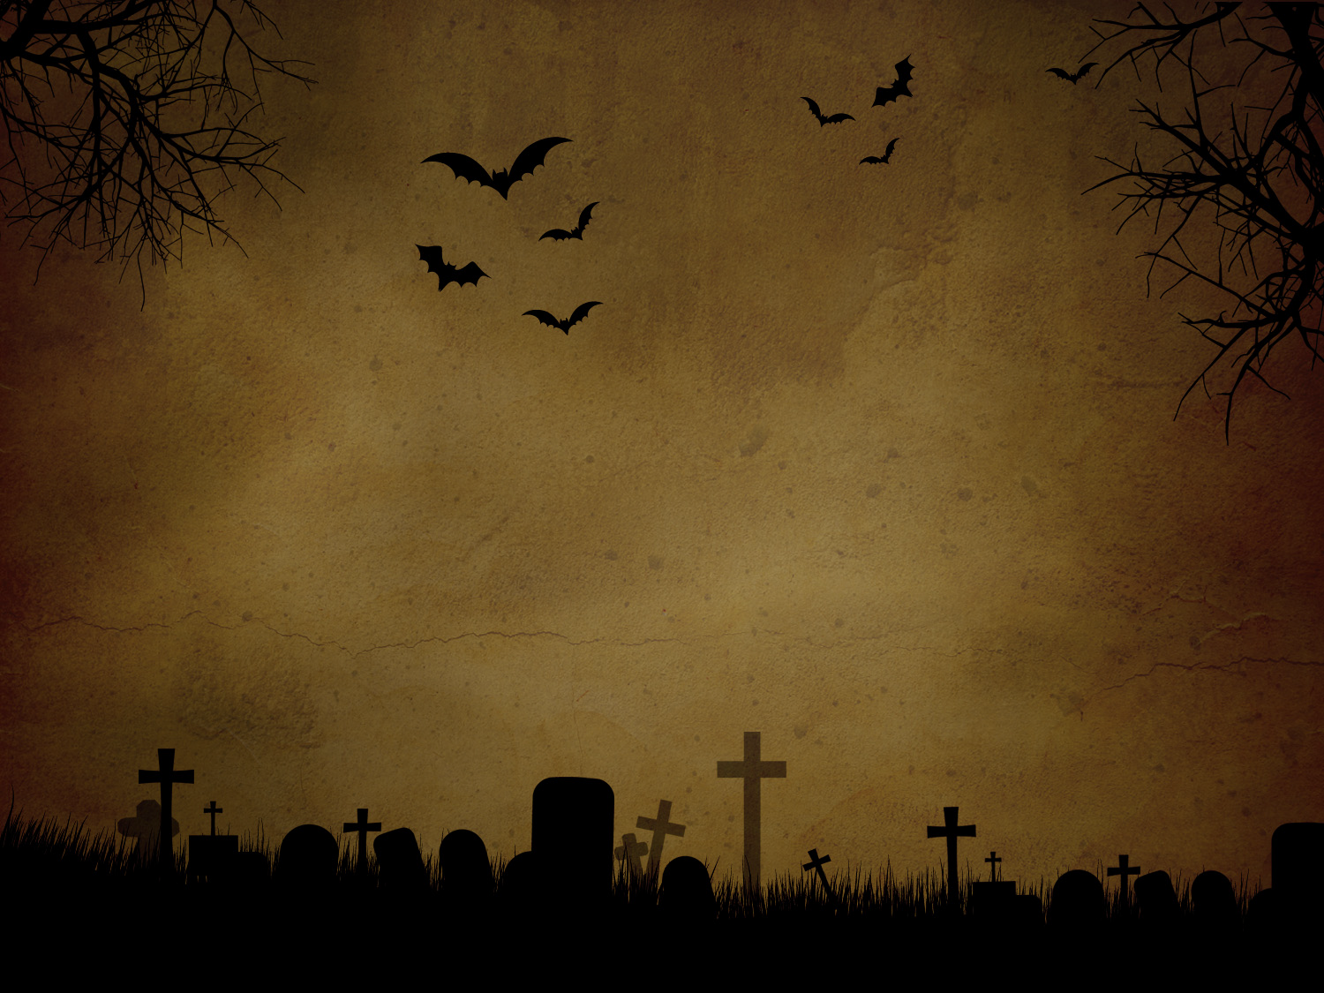
Sadly, all churches eventually die

