Slide 2
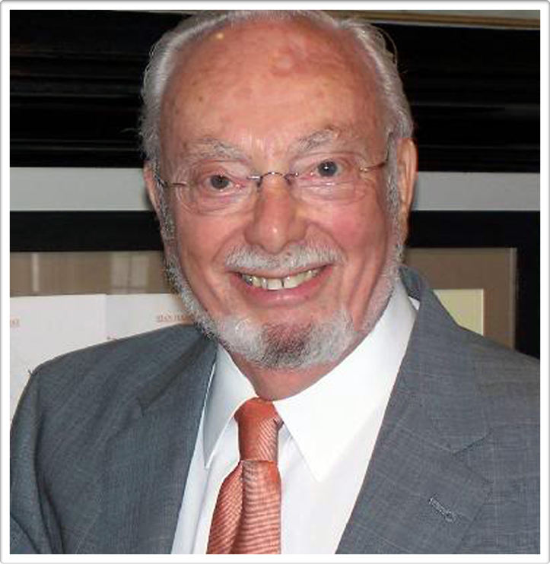

Slide 4
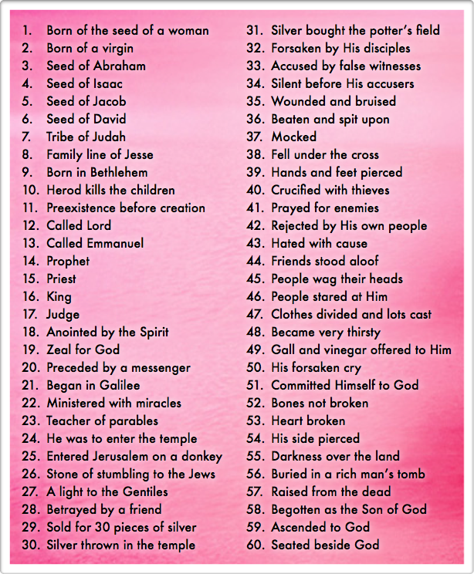
Andrew knew this was the Messiah
The law brought us to Christ
Over 60 specific prophecies about Jesus …
We Have Found The Fulfillment Of Prophecy

Slide 5
38 declarations that Jesus is the Son of God
Several notable “great confessions” …
Centurion saw authority through miracles
We Have Found The Son Of God

Slide 6
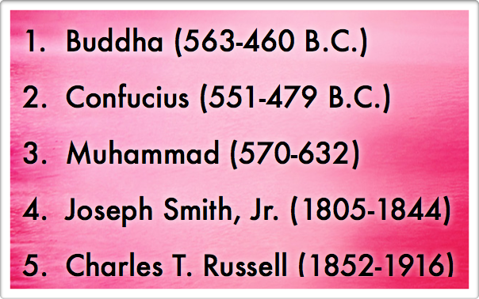
Our blessings are “in Him”
Many have claimed spiritual blessings …
Isaiah should have been able to foretell them
We Have Found The Source Of All Blessings

Slide 7
Israelites could have made themselves clean
Our cleansing is through Jesus Christ
God calls for purity from His children
We Have Found The Cleansing Of Our Sins

Slide 8
Jesus instituted a new way through His blood
God promised eternal life to us long ago
Pathway to sanctification is in the word
We Have Found Eternal Life

Slide 9
When Andrew and Peter found the Messiah, their lives were never the same; what about you?

