Slide 3
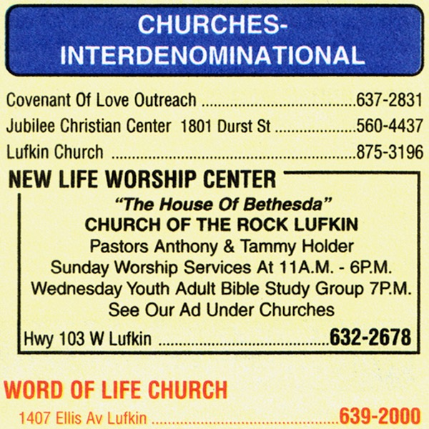
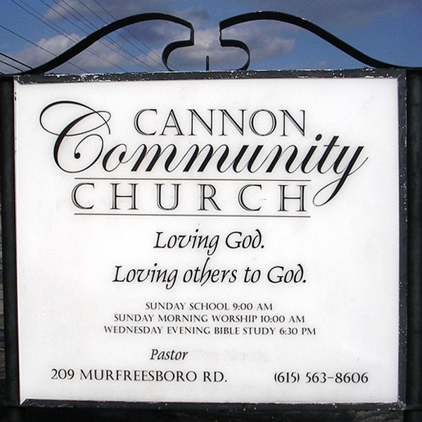
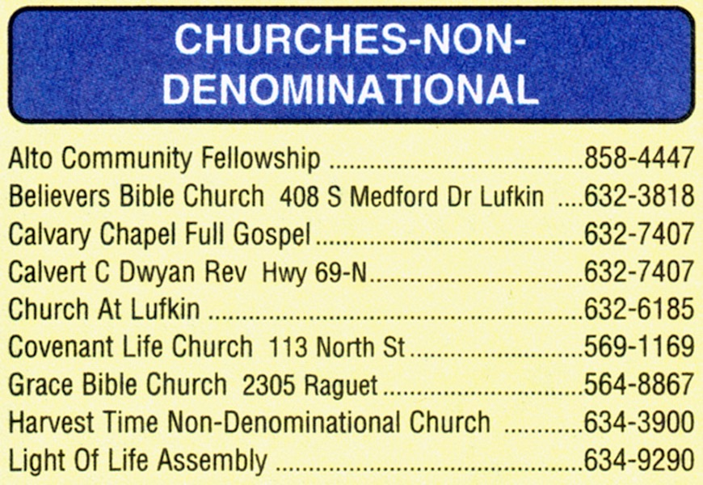

Slide 4
“If we must ‘restore’ something, then let’s restore spirituality and a love for the Lord. Let’s restore a spirit of honest inquiry and a sacrificial devotion to evangelism and benevolence. Let’s restore biblical principles, which can unite us if embraced, but not some elusive pattern, which can only lead to further fragmentation of the one body. I see nothing in Scripture that even remotely suggests God expects the universe to revolve around 1st century Palestine.”
Al Maxey

Slide 5
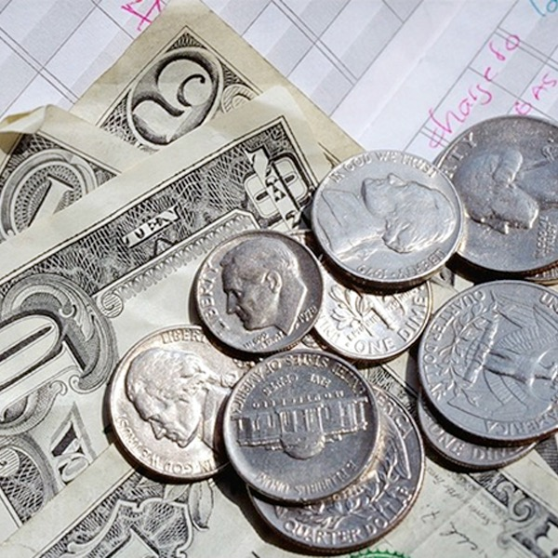
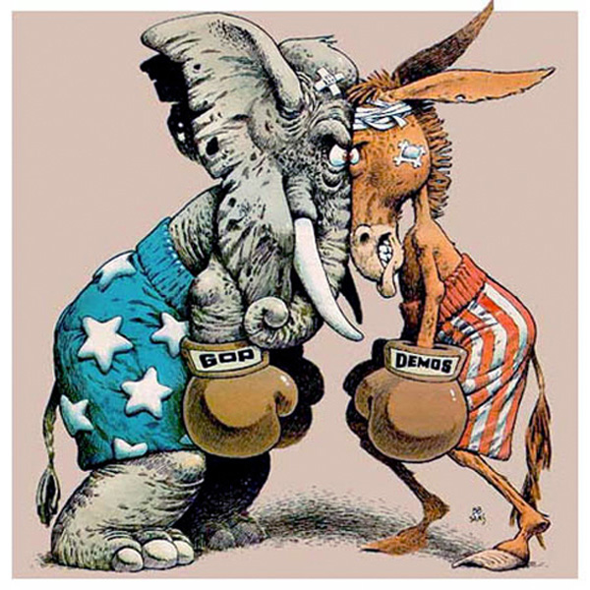
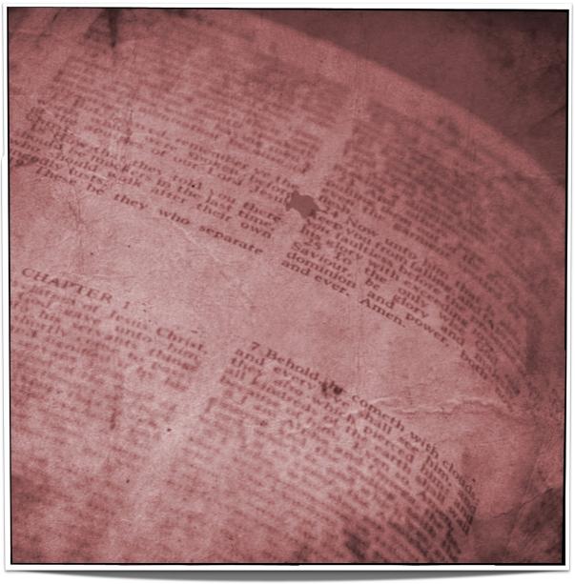
It Means You Are Not A Member Of A Sect Or Party
“Christian Church”
All Christians or local Christians
Stands between and therefore unknown
Two illustrations of denominations …
“A part, division or a segment, a sect”
E
M
P
L
B

Slide 6
It Means That You Are Aligned With The Lord
Did not align Himself with any party
Pharisee, Sadducee, Herodian, Essene
Interested in religious unity …
Antidenominational/undenominational

Slide 7
It Means That You Are Neither Catholic, Protestant or Jewish
Catholicism came into existence in 606
Denominations came even later
The Old Testament has been done away

Slide 8
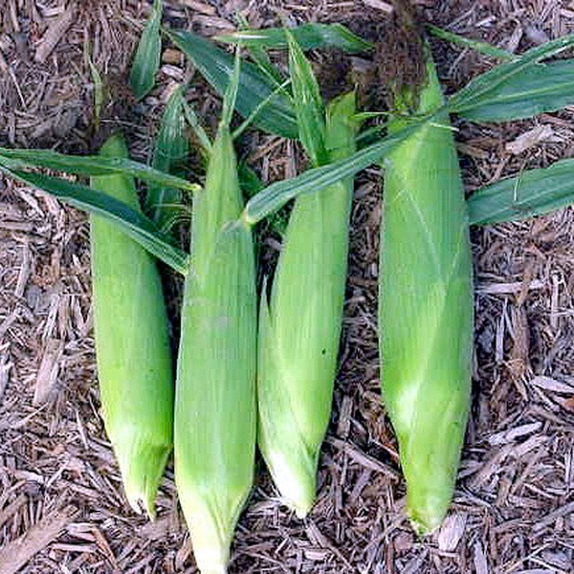
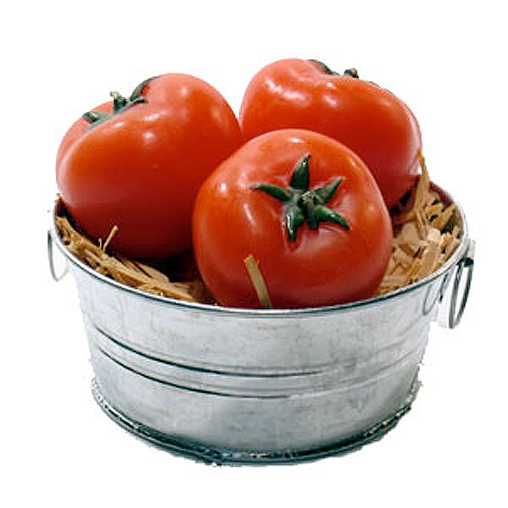
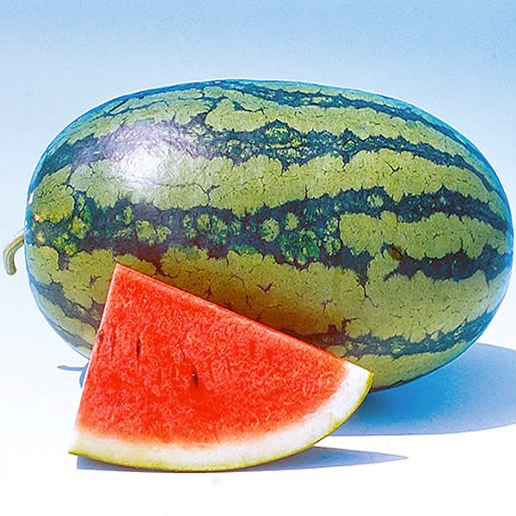
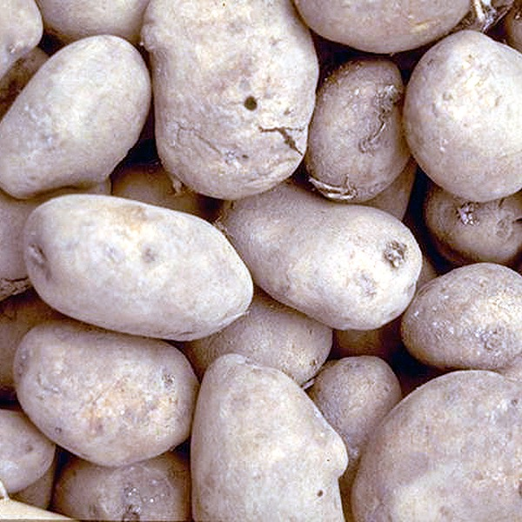
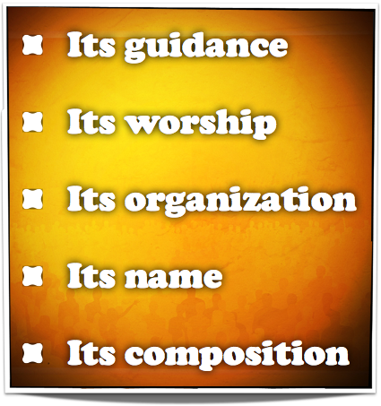
It Means That You Are A Member Of The Lord’s Church
We do not need “church succession”
We do not need an “unbroken chain”
We need the same seed
Identifying marks of the church …

