Slide 1
Preaching, Progress, & Problems
1 Cor. 15:58
Therefore, my beloved brethren, be steadfast, immovable, always abounding in the work of the Lord, knowing that your labor is not in vain in the Lord.

Slide 2
Preaching…
When Paul preached to those in Corinth, what was involved in that work?
Since his work serves as an apostolic example, by it, we are taught what we must do
Foundation found in the message Paul preached
1 Cor. 2:1-2
¹ And I, brethren, when I came to you, did not come
with excellence of speech or of wisdom declaring to you
the testimony of God. ² For I determined not to know
anything among you except Jesus Christ and Him
crucified.

Slide 3
Preaching…
When Paul preached to those in Corinth, what was involved in that work?
Since his work serves as an apostolic example, by it, we are taught what we must do
Foundation found in the message Paul preached
1 Cor. 9:16
For if I preach the gospel, I have nothing
to boast of, for necessity is laid upon me;
yes, woe is me if I do not preach the gospel!

Slide 4
Preaching…
Corinth was not the only place with work to do
Gospel was also needed in Ephesus
Everywhere a door of opportunity exists, so do problems
1 Cor. 16:5-9
⁵ Now I will come to you when I pass through Macedonia
(for I am passing through Macedonia). ⁶ And it may be that
I will remain, or even spend the winter with you, that you
may send me on my journey, wherever I go. ⁷ For I do not
wish to see you now on the way; but I hope to stay a while
with you, if the Lord permits. ⁸ But I will tarry in Ephesus
until Pentecost. ⁹ For a great and effective door has opened
to me, and there are many adversaries.

Slide 5
Preaching…
The work of preaching was not up to Paul alone
He needed to work with others for the truth to be successfully spread
All men are helpers in work of the Lord
It is God alone who gives the increase
1 Cor. 3:6-7
⁶ I planted, Apollos watered, but God gave the increase.
⁷ So then neither he who plants is anything, nor he who
waters, but God who gives the increase.

Slide 6
Preaching…
As gospel was spread in Corinth, problems arose
Those problems were addressed as work went on
1 Cor. 1:10-11
¹⁰ Now I plead with you, brethren, by the name of our
Lord Jesus Christ, that you all speak the same thing,
And that there be no divisions among you, but that
you be perfectly joined together in the same mind and
in the same judgment. ¹¹ For it has been declared to me
concerning you, my brethren, by those of Chloe’s
household, that there are contentions among you.

Slide 7
Preaching…
As gospel was spread in Corinth, problems arose
Those problems were addressed as work went on
1 Cor. 3:1-3
¹ And I, brethren, could not speak to you as to spiritual
people but as to carnal, as to babes in Christ. ² I fed you
with milk and not with solid food; for until now you
were not able to receive it, and even now you are still
not able; ³ for you are still carnal. For where there are
envy, strife, and divisions among you, are you not
carnal and behaving like mere men?

Slide 8
Preaching…
As gospel was spread in Corinth, problems arose
Those problems were addressed as work went on
1 Cor. 15:1-3, 2
Now I make known to you, brethren, the gospel which
I preached unto you, which also you received, wherein
also you stand, by which also you are saved, if you
hold fast the word which I preached unto you, except
you believed in vain. For I delivered unto you first of
all that which I also received… Now if Christ is
preached that He has been raised from the dead, how do
some among you say that there is no resurrection from
the dead?

Slide 9
Preaching…
The same opportunities, challenges & problems will be faced by every generation doing Lord’s work in every place

Slide 10
Preaching… In The Philippines
Work of spreading the gospel in the Philippines is being done using the N.T. examples as pattern
The word of the gospel must go to all men
Matt. 28:18-20 Teach based on Christ’s authority
Mark 16:15-16 Preach gospel to every creature
1 Pet. 1:23-25 Word brings purity & new birth
2 Cor. 5:18-21 Word & ministry of reconciliation
Rom. 10:13-15 How hear without a preacher?
This congregation should be commended for good work done in helping spread the gospel

Slide 11
Progress… In The Philippines
“Progress” is moving toward goal; improvement
Man focuses on outward; visible; physical
God emphasizes true, inward, spiritual progress (Rev. 2:2, 9, 13, 19; 3:1-2, 8, 15 - “I know your works…”)
Isa. 6:9-13 Must teach truth even if rejected
Isa. 55:8-9 God promises word will not return void
Changed hearts & lives is progress (2 Cor. 5:17)
2 Pet. 1:5-11 Takes diligence to grow in graces
1 Thess. 2-7 Work of faith. labor of love, patience…
While baptisms are great, not only sign of progress
2 Tim. 2:2 Many Filipino brethren growing & working

Slide 12
Problems… In The Philippines
All problems are from Satan’s attack through sin
1 Jn. 2:15-16 Avenues of temptation
2 Pet. 2:1 False teachers lead souls away
Gal. 2:11-13 Some compromise the faith to get along
1 Pet. 2:11-12 Worldly lust war against soul
1 Tim. 6:9-12 Love of money is a root of evils
Phil. 1:15-17 Envy & strife cause division of man
All of these problems exist in the Philippine work just as they do in this country
In some cases, reporters of evil have spread lies
Problems addressed on this trip as in others…

Slide 13
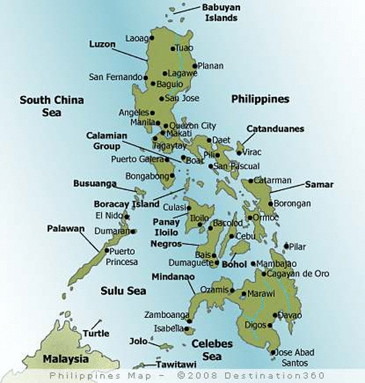
Luzon
Visayas
Mindanao

Slide 14
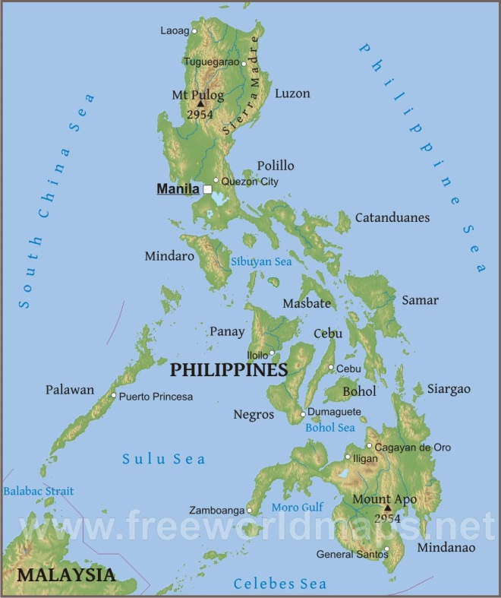

Slide 15
