Slide 1
TH

Slide 2
“Work Out Your Own Salvation” Philippians 2:12

Slide 3
Ephesians 2:8-9
For by grace you have been saved through faith, and that not of yourselves; it is the gift of God, not of works, lest anyone should boast.
2 Timothy 1:8-9
Therefore do not be ashamed of the testimony of our Lord, nor of me His prisoner, but share with me in the sufferings for the gospel according to the power of God, who has saved us and called us with a holy calling, not according to our works, but according to His own purpose and grace which was given to us in Christ Jesus before time began,

Slide 4
Proverbs 14:12
There is a way that seems right to a man,
But its end is the way of death.
Proverbs 19:21
There are many plans in a man's heart,
Nevertheless the Lord's counsel—that will stand.
Jeremiah 10:23
O Lord, I know the way of man is not in himself;
It is not in man who walks to direct his own steps.
Judges 21:25
In those days there was no king in Israel; everyone did what was right in his own eyes.

Slide 5
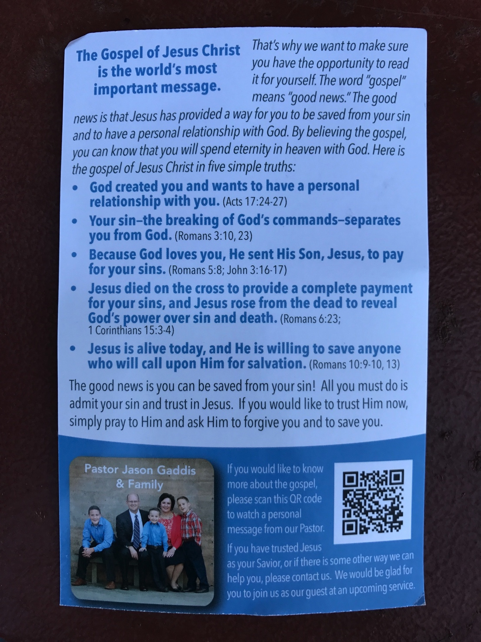

Slide 6
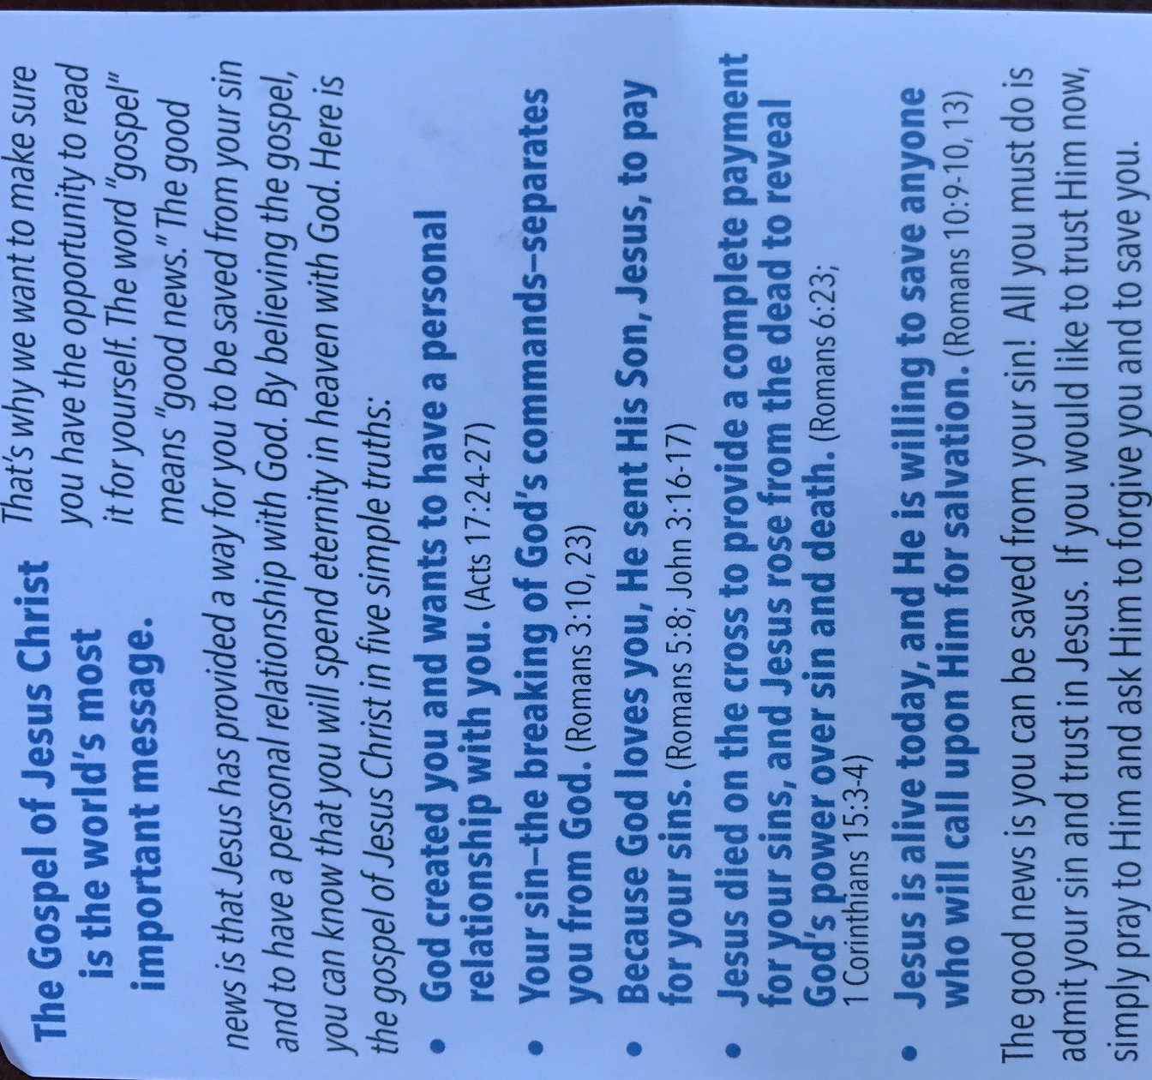

Slide 7
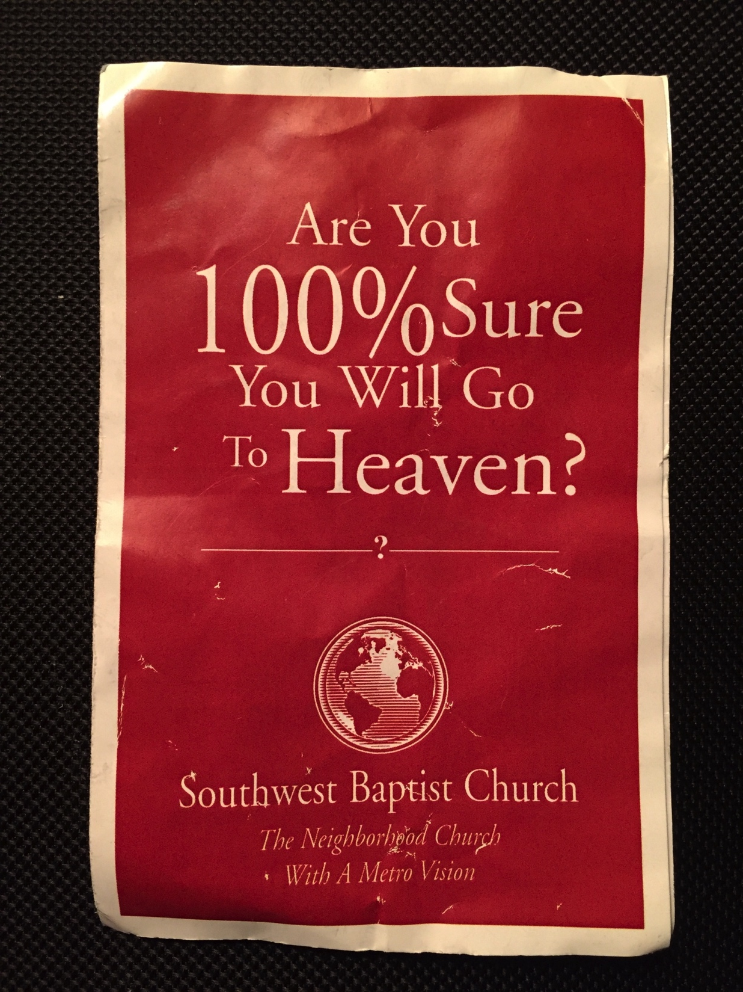

Slide 9
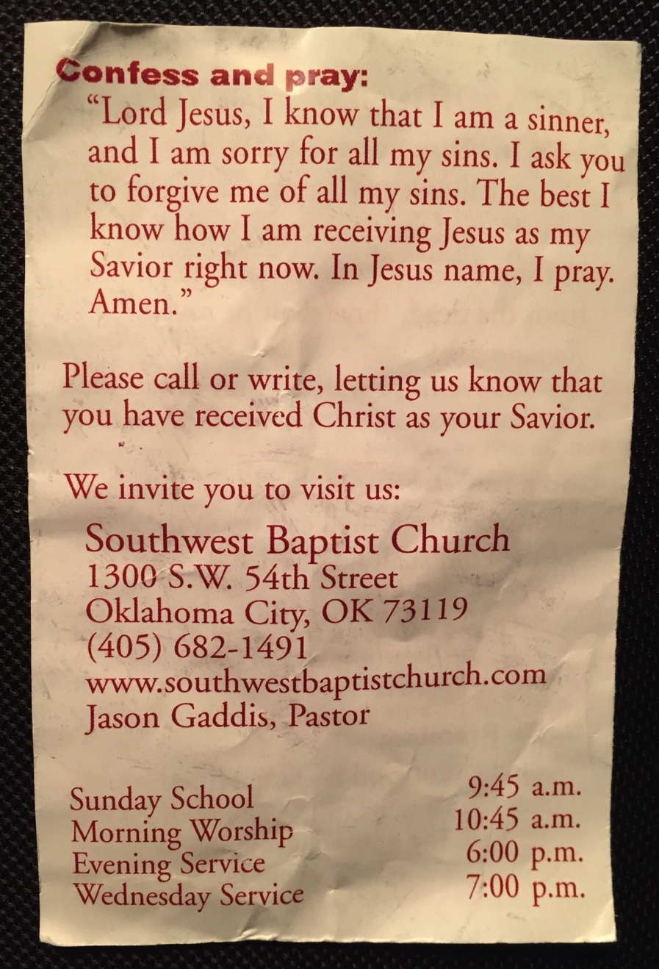

Slide 10
Luke 6:46
But why do you call Me ‘Lord, Lord,’ and not do the things which I say?
Matthew 7:21
Not everyone who says to Me, ‘Lord, Lord,’ shall enter the kingdom of heaven, but he who does the will of My Father in heaven.
2 Corinthians 5:10
For we must all appear before the judgment seat of Christ, that each one may receive the things done in the body, according to what he has done, whether good or bad.

Slide 11
Ephesians 4:15-16
but, speaking the truth in love, may grow up in all things into Him who is the head—Christ— from whom the whole body, joined and knit together by what every joint supplies, according to the effective working by which every part does its share, causes growth of the body for the edifying of itself in love.
Hebrews 5:12
For though by this time you ought to be teachers, you need someone to teach you again the first principles of the oracles of God; and you have come to need milk and not solid food.
Romans 6:17
But God be thanked that though you were slaves of sin, yet you obeyed from the heart that form of doctrine to which you were delivered.

Slide 12
Acts 2:37-38
Now when they heard this, they were cut to the heart, and said to Peter and the rest of the apostles, “Men and brethren, what shall we do?”
Then Peter said to them, “Repent, and let every one of you be baptized in the name of Jesus Christ for the remission of sins; and you shall receive the gift of the Holy Spirit.
1 Thessalonians 2:13
For this reason we also thank God without ceasing, because when you received the word of God which you heard from us, you welcomed it not as the word of men, but as it is in truth, the word of God, which also effectively works in you who believe.

Slide 13
Acts 17:11-12
These were more fair-minded than those in Thessalonica, in that they received the word with all readiness, and searched the Scriptures daily to find out whether these things were so. Therefore many of them believed, and also not a few of the Greeks, prominent women as well as men.
Acts 19:18-20
And many who had believed came confessing and telling their deeds. Also, many of those who had practiced magic brought their books together and burned them in the sight of all. And they counted up the value of them, and it totaled fifty thousand pieces of silver. So the word of the Lord grew mightily and prevailed.

Slide 14
phobos:
-fear, dread, terror, that which strikes terror

Slide 15
1 Peter 2:17
Honor all people. Love the brotherhood. Fear (phobeō) God. Honor the king.
Ephesians 5:20-21
...giving thanks always for all things to God the Father in the name of our Lord Jesus Christ, submitting to one another in the fear (phobos) of God.
Matthew 14:25-26
And when the disciples saw Him walking on the sea, they were troubled, saying, “It is a ghost!” And they cried out for fear (phobos).
But immediately Jesus spoke to them, saying, “Be of good cheer! It is I; do not be afraid (phobeō)”

Slide 16
Revelation 2:10
Do not fear (phobeō) any of those things which you are about to suffer. Indeed, the devil is about to throw some of you into prison, that you may be tested, and you will have tribulation ten days. Be faithful until death, and I will give you the crown of life.
Matthew 10:28
And do not fear (phobeō) those who kill the body but cannot kill the soul. But rather fear (phobeō) Him who is able to destroy both soul and body in hell.
Hebrews 10:31
It is a fearful (phoberos) thing to fall into the hands of the living God.

Slide 17
phobos:
-fear, dread, terror, that which strikes terror
tromos:
-not trusting oneself; not being adequate; “one who distrusts his ability completely to meet all requirements, but religiously does his utmost to fulfill his duty

Slide 18
1 Corinthians 1:3
I was with you in weakness, in fear (phobos), and in much trembling.
2 Corinthians 7:15
And his affections are greater for you as he remembers the obedience of you all, how with fear (phobos) and trembling you received him.
Ephesians 6:5
Bondservants, be obedient to those who are your masters according to the flesh, with fear (phobos) and trembling, in sincerity of heart, as to Christ;

Slide 19
Hebrews 13:20-21
Now may the God of peace who brought up our Lord Jesus from the dead, that great Shepherd of the sheep, through the blood of the everlasting covenant, make you complete in every good work to do His will, working in you what is well pleasing in His sight, through Jesus Christ, to whom be glory forever and ever. Amen.
Ephesians 3:20-21
Now to Him who is able to do exceedingly abundantly above all that we ask or think, according to the power that works in us, to Him be glory in the church by Christ Jesus to all generations, forever and ever. Amen.

Slide 20
goggusmosos:
-a grumbling, grudging, murmuring. a secret debate, a secret displeasure not openly avowed
dialogismos:
-a deliberating, questioning about what is true; hesitation, doubting…arguing

Slide 21
Matthew 5:14-15
You are the light of the world. A city that is set on a hill cannot be hidden. Nor do they light a lamp and put it under a basket, but on a lampstand, and it gives light to all who are in the house.
2 Timothy 2:2
And the things that you have heard from me among many witnesses, commit these to faithful men who will be able to teach others also.
Romans 12:1-2
I beseech you therefore, brethren, by the mercies of God, that you present your bodies a living sacrifice, holy, acceptable to God, which is your reasonable service. And do not be conformed to this world, but be transformed by the renewing of your mind, that you may prove what is that good and acceptable and perfect will of God.

Slide 22
2 Peter 1:5-11
But also for this very reason, giving all diligence, add to your faith virtue, to virtue knowledge, to knowledge self-control, to self-control perseverance, to perseverance godliness, to godliness brotherly kindness, and to brotherly kindness love. For if these things are yours and abound, you will be neither barren nor unfruitful in the knowledge of our Lord Jesus Christ. For he who lacks these things is shortsighted, even to blindness, and has forgotten that he was cleansed from his old sins.
Therefore, brethren, be even more diligent to make your call and election sure, for if you do these things you will never stumble; for so an entrance will be supplied to you abundantly into the everlasting kingdom of our Lord and Savior Jesus Christ.

Slide 23
2 Peter 3:18
but grow in the grace and knowledge of our Lord and Savior Jesus Christ.
To Him be the glory both now and forever. Amen.
James 4:17
Therefore, to him who knows to do good and does not do it, to him it is sin.

Slide 24
For you have need of endurance, so that after you have done the will of God, you may receive the promise:
“For yet a little while,
And He who is coming will come and will not tarry.
Now the just shall live by faith;
But if anyone draws back,
My soul has no pleasure in him.”
But we are not of those who draw back to perdition, but of those who believe to the saving of the soul.
Hebrews 10:36-39

