Slide 1
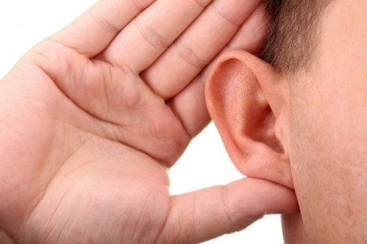
Traits of a Commendable Hearer
Acts 17:10-13

Slide 2
Acts 17:10-13
¹⁰ Then the brethren immediately sent Paul and Silas away by night to Berea. When they arrived, they went into the synagogue of the Jews. ¹¹ These were more fair-minded than those in Thessalonica, in that they received the word with all readiness, and searched the Scriptures daily to find out whether these things were so. ¹² Therefore many of them believed, and also not a few of the Greeks, prominent women as well as men. ¹³ But when the Jews from Thessalonica learned that the word of God was preached by Paul at Berea, they came there also and stirred up the crowds.
noble-minded (NASB)
noble (ASV)
Two types of hearers – Two different results

Slide 3
Traits of a Commendable Hearer
Focus on Scripture as proper origin of message
Deut. 6:4-7 (all of the people) → Deut. 17:19 (king)
Isa. 34:16 “Search from the book of the Lord...”
Jn. 5:39 “Search the Scriptures” to find who is Christ
1 Thess. 2:13 Not the word of men, but word of God
Continue diligently in examining the Scripture
Prov. 2:2-5 “Incline your ear… apply… seek… search”
Prov. 8:32-34 Listening & watching daily needed
2 Tim. 2:14-15 Diligence needed to handle it correctly
Be determined to find the truth affirmed by Scripture
Matt. 4:5-7 Jesus always showed truth taught by word
2 Tim. 3:14-17 Purpose of inspired word is to teach truth

