Slide 1
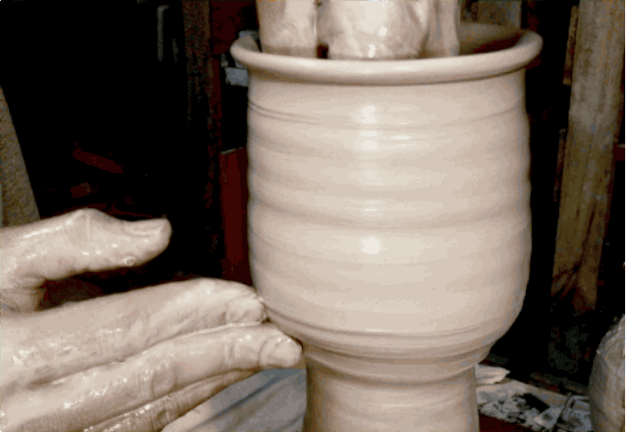
“But now, O Lord, You are our Father; we are the clay, and You our potter; and all we are the work of Your hand” (Isa. 64:4).
“…he will be a vessel for honor, sanctified and useful for the Master, prepared for every good work” (2 Tim. 2:21).

Slide 2
Like Clay in the Potter’s Hands
Your hands have made me and fashioned me, an intricate unity; yet You would destroy me. Remember, I pray, that You have made me like clay. And will You turn me into dust again? (Job 10:8-9)
Jeremiah 18:1-11

Slide 3
Jeremiah 18:1-11
¹ The word which came to Jeremiah from the Lord, saying: ² “Arise and go down to the potter’s house, and there I will cause you to hear My words.” ³ Then I went down to the potter’s house, and there he was, making something at the wheel. ⁴ And the vessel that he made of clay was marred in the hand of the potter; so he made it again into another vessel, as it seemed good to the potter to make. ⁵ Then the word of the Lord came to me, saying: ⁶ “O house of Israel, can I not do with you as this potter?” says the Lord. “Look, as the clay is in the potter’s hand, so are you in My hand, O house of Israel! ⁷ The instant I speak concerning a nation and concerning a kingdom, to pluck up, to pull down, and to destroy it, ⁸ if that nation against whom I have spoken turns from its evil, I will relent of the disaster that I thought to bring upon it. ⁹ And the instant I speak concerning a nation and concerning a kingdom, to build and to plant it, ¹⁰ if it does evil in My sight so that it does not obey My voice, then I will relent concerning the good with which I said I would benefit it. ¹¹ Now therefore, speak to the men of Judah and to the inhabitants of Jerusalem, saying, ‘Thus says the Lord: “Behold, I am fashioning a disaster and devising a plan against you. Return now every one from his evil way, and make your ways and your doings good.”’”

Slide 4
God Shapes Lives Put in His Hands
God shapes lives by His will & our willingness
  “Arise and go down to the potter’s house, and there I will cause you to hear My words” – God’s word shapes & directs
  God also brings circumstances to help mold us for good
God worked to shape Israel into vessel for good
  Deut. 8:2-3 Israel shaped by God’s word & 40 years of trials
God works to shape individuals for good
  1 Pet. 1:22-23 Purified & born again in obedience to truth
  Rom. 6:3-11 New birth takes place by power of blood
  Titus 3:3-7 Regeneration & renewal from old man to new
  2 Cor. 3:18 We continue being transformed by the gospel
  2 Cor. 4:16-18 Afflictions & trials also help to transform us

Slide 5
God’s Power as Potter Is Great
Onesimus (Philemon 11)
John Mark (Acts 13:13 → 2 Tim. 4:11)
Apostles as a group
  Filled with selfish ambition and weakness (Lk. 22:24)
  Yet Jesus would make them fishers of men (Mk. 1:17)
Peter
  Was he a “rock” at first? (Matt. 16:21-23; 26:69-74)
  Satan wanted Peter to turn away from Lord (Luke 22:31-32)
  But he came to be a true “rock” of strength for Master’s use
Paul
  Started out as a blasphemer & persecutor
  Lord used trials to help shape Paul (2 Cor. 12:8-10)
Lord can reshape us –
Will we let Him?

Slide 6
“But now, O Lord, You are our Father; we are the clay, and You our potter; and all we are the work of Your hand” (Isa. 64:4).
“…he will be a vessel for honor, sanctified and useful for the Master, prepared for every good work” (2 Tim. 2:21).

Slide 7
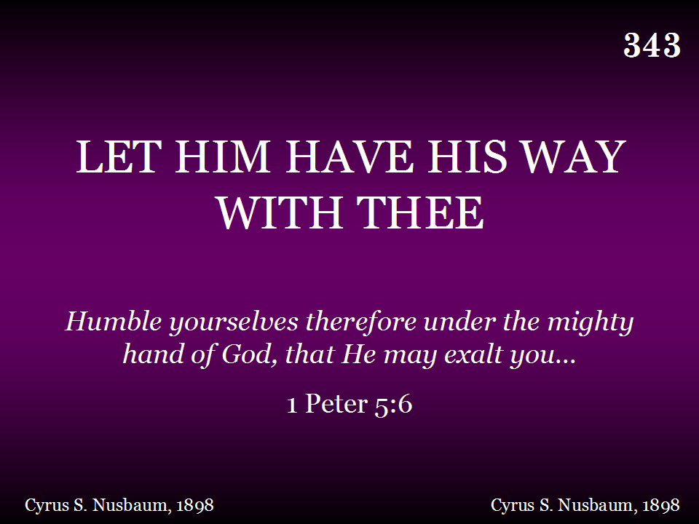
343 - Let Him Have His Way With Thee - Title

Slide 8
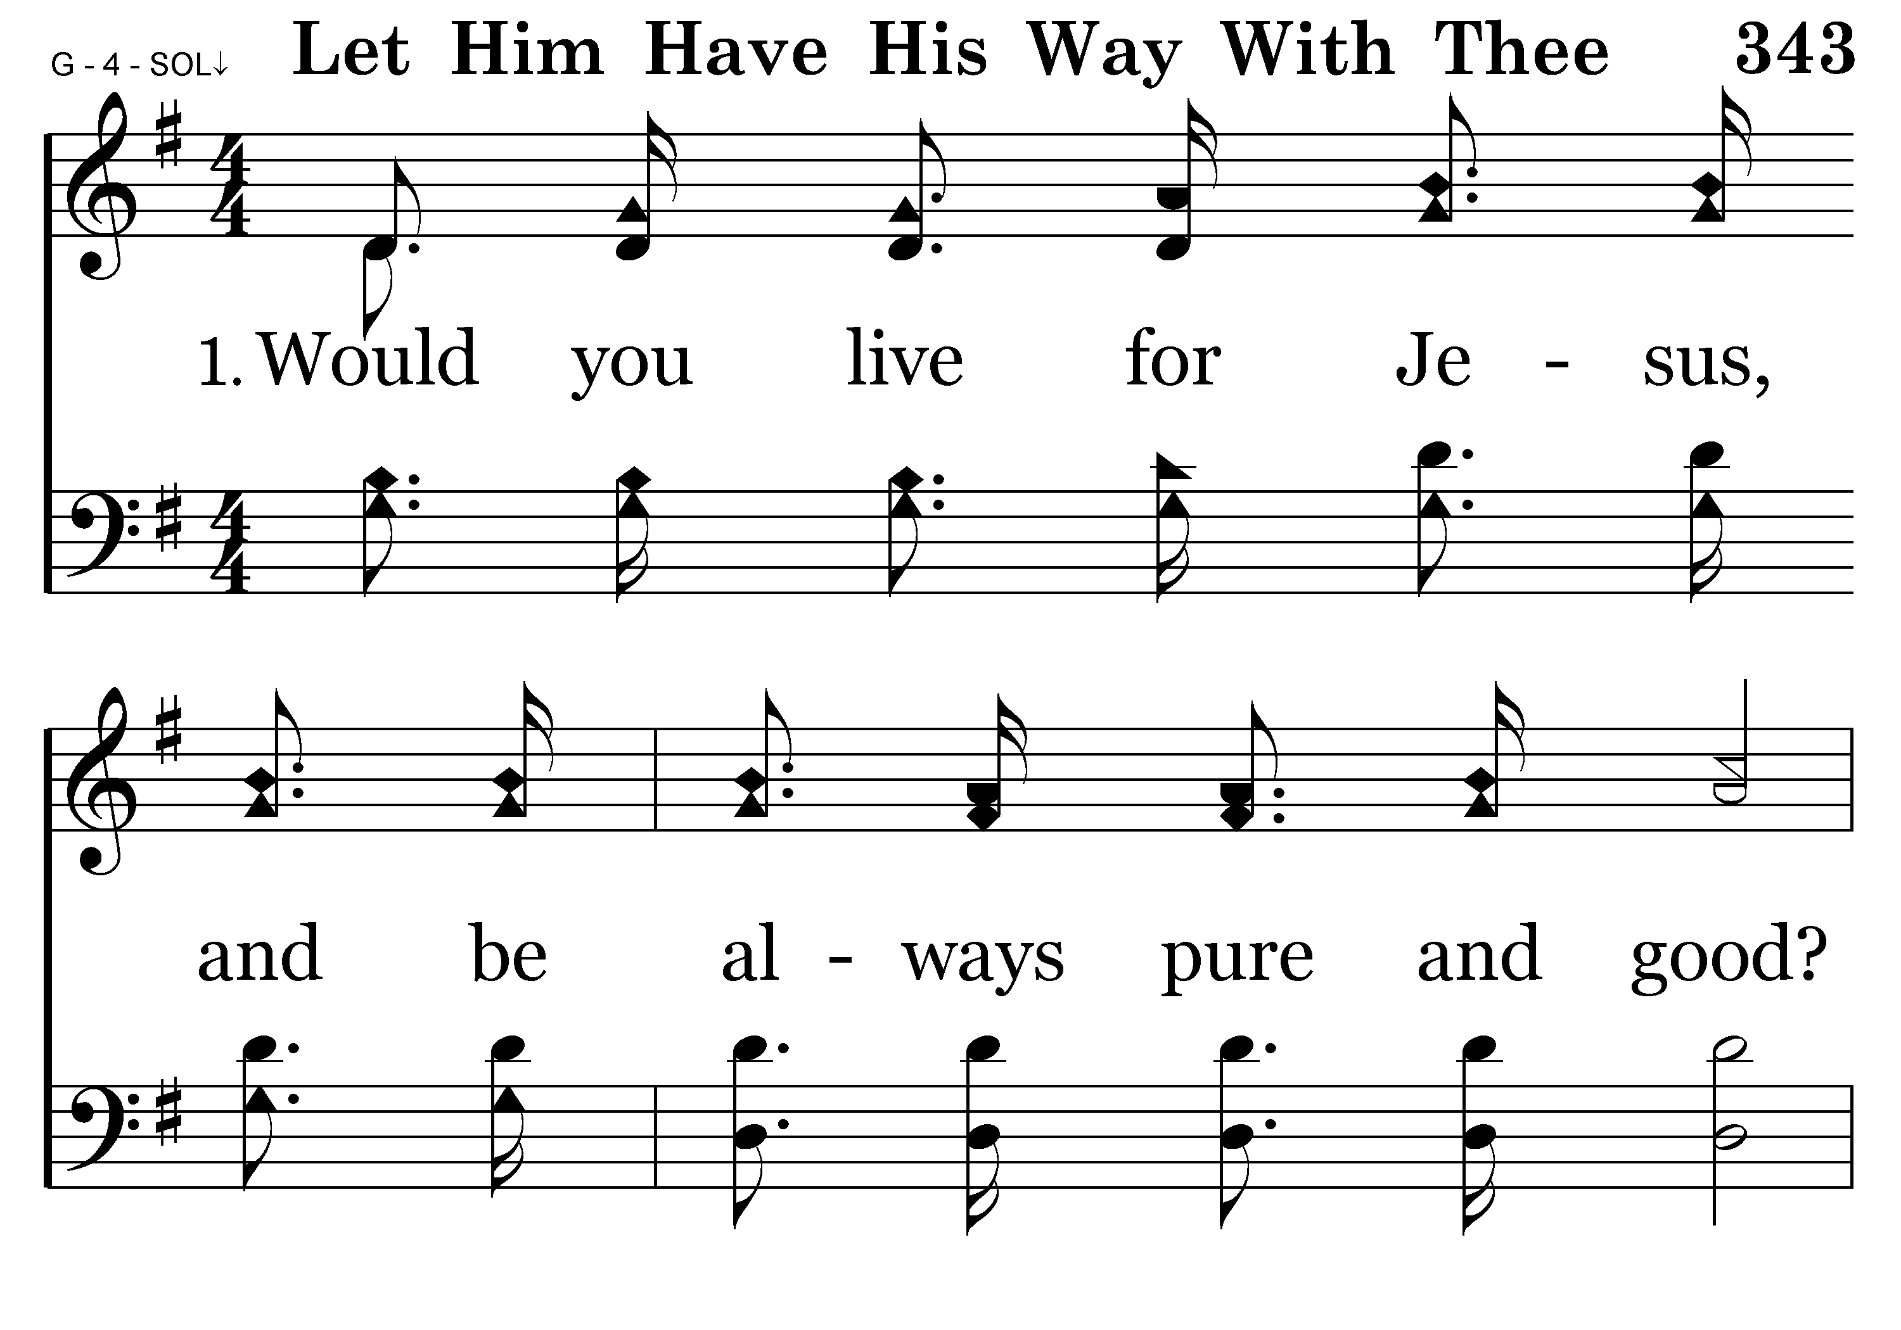
343 - Let Him Have His Way With Thee - 1.1

Slide 9
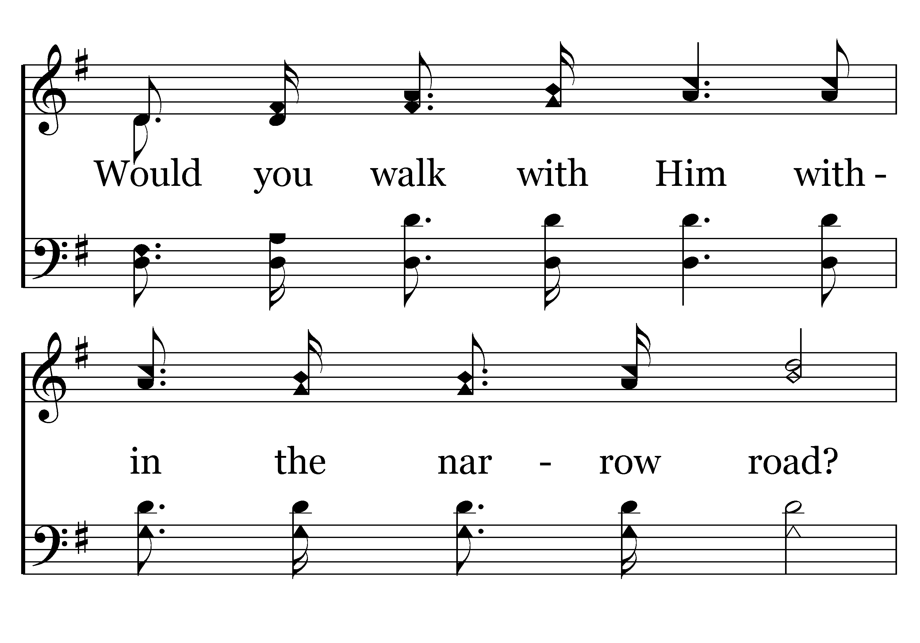
343 - Let Him Have His Way With Thee - 1.2

Slide 10
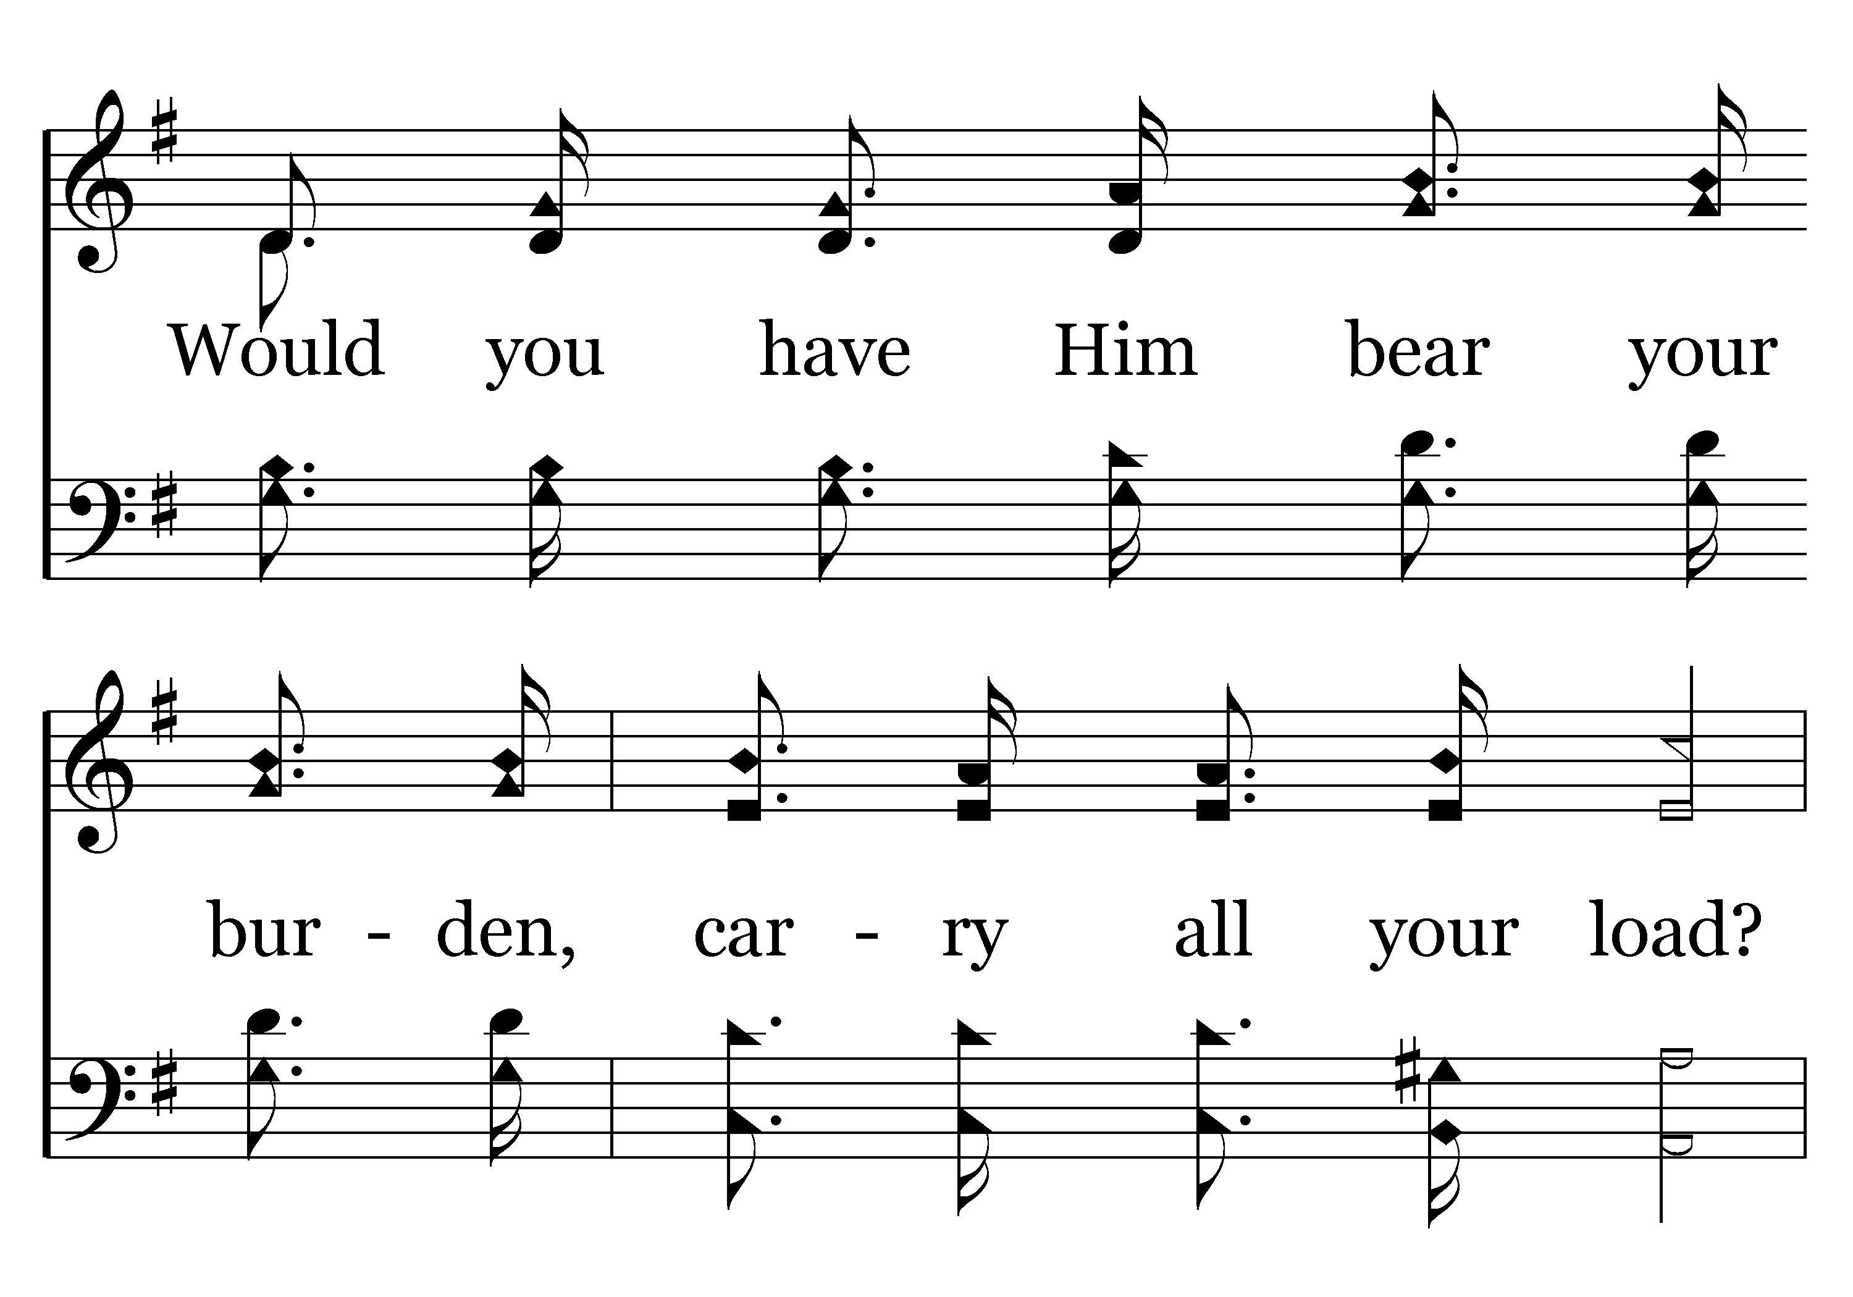
343 - Let Him Have His Way With Thee - 1.3

Slide 11
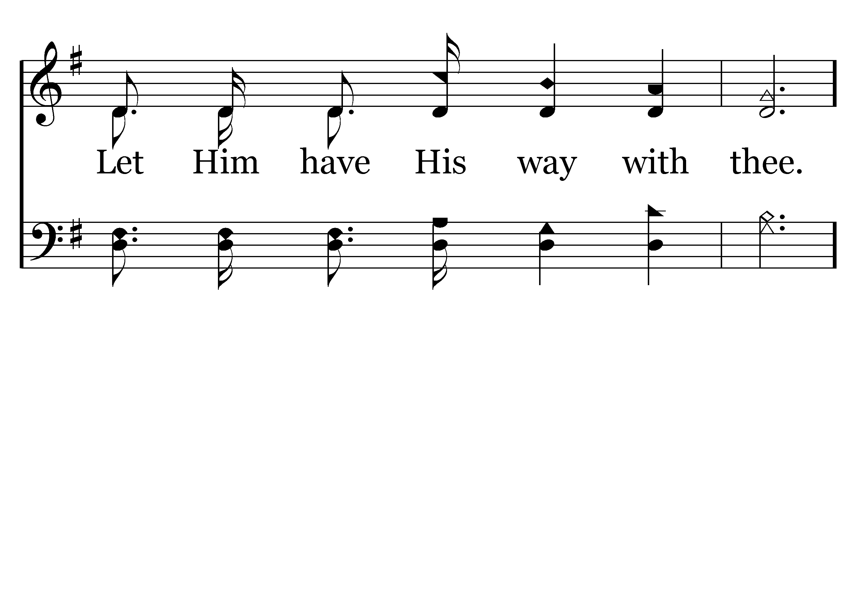
343 - Let Him Have His Way With Thee - 1.4

Slide 12
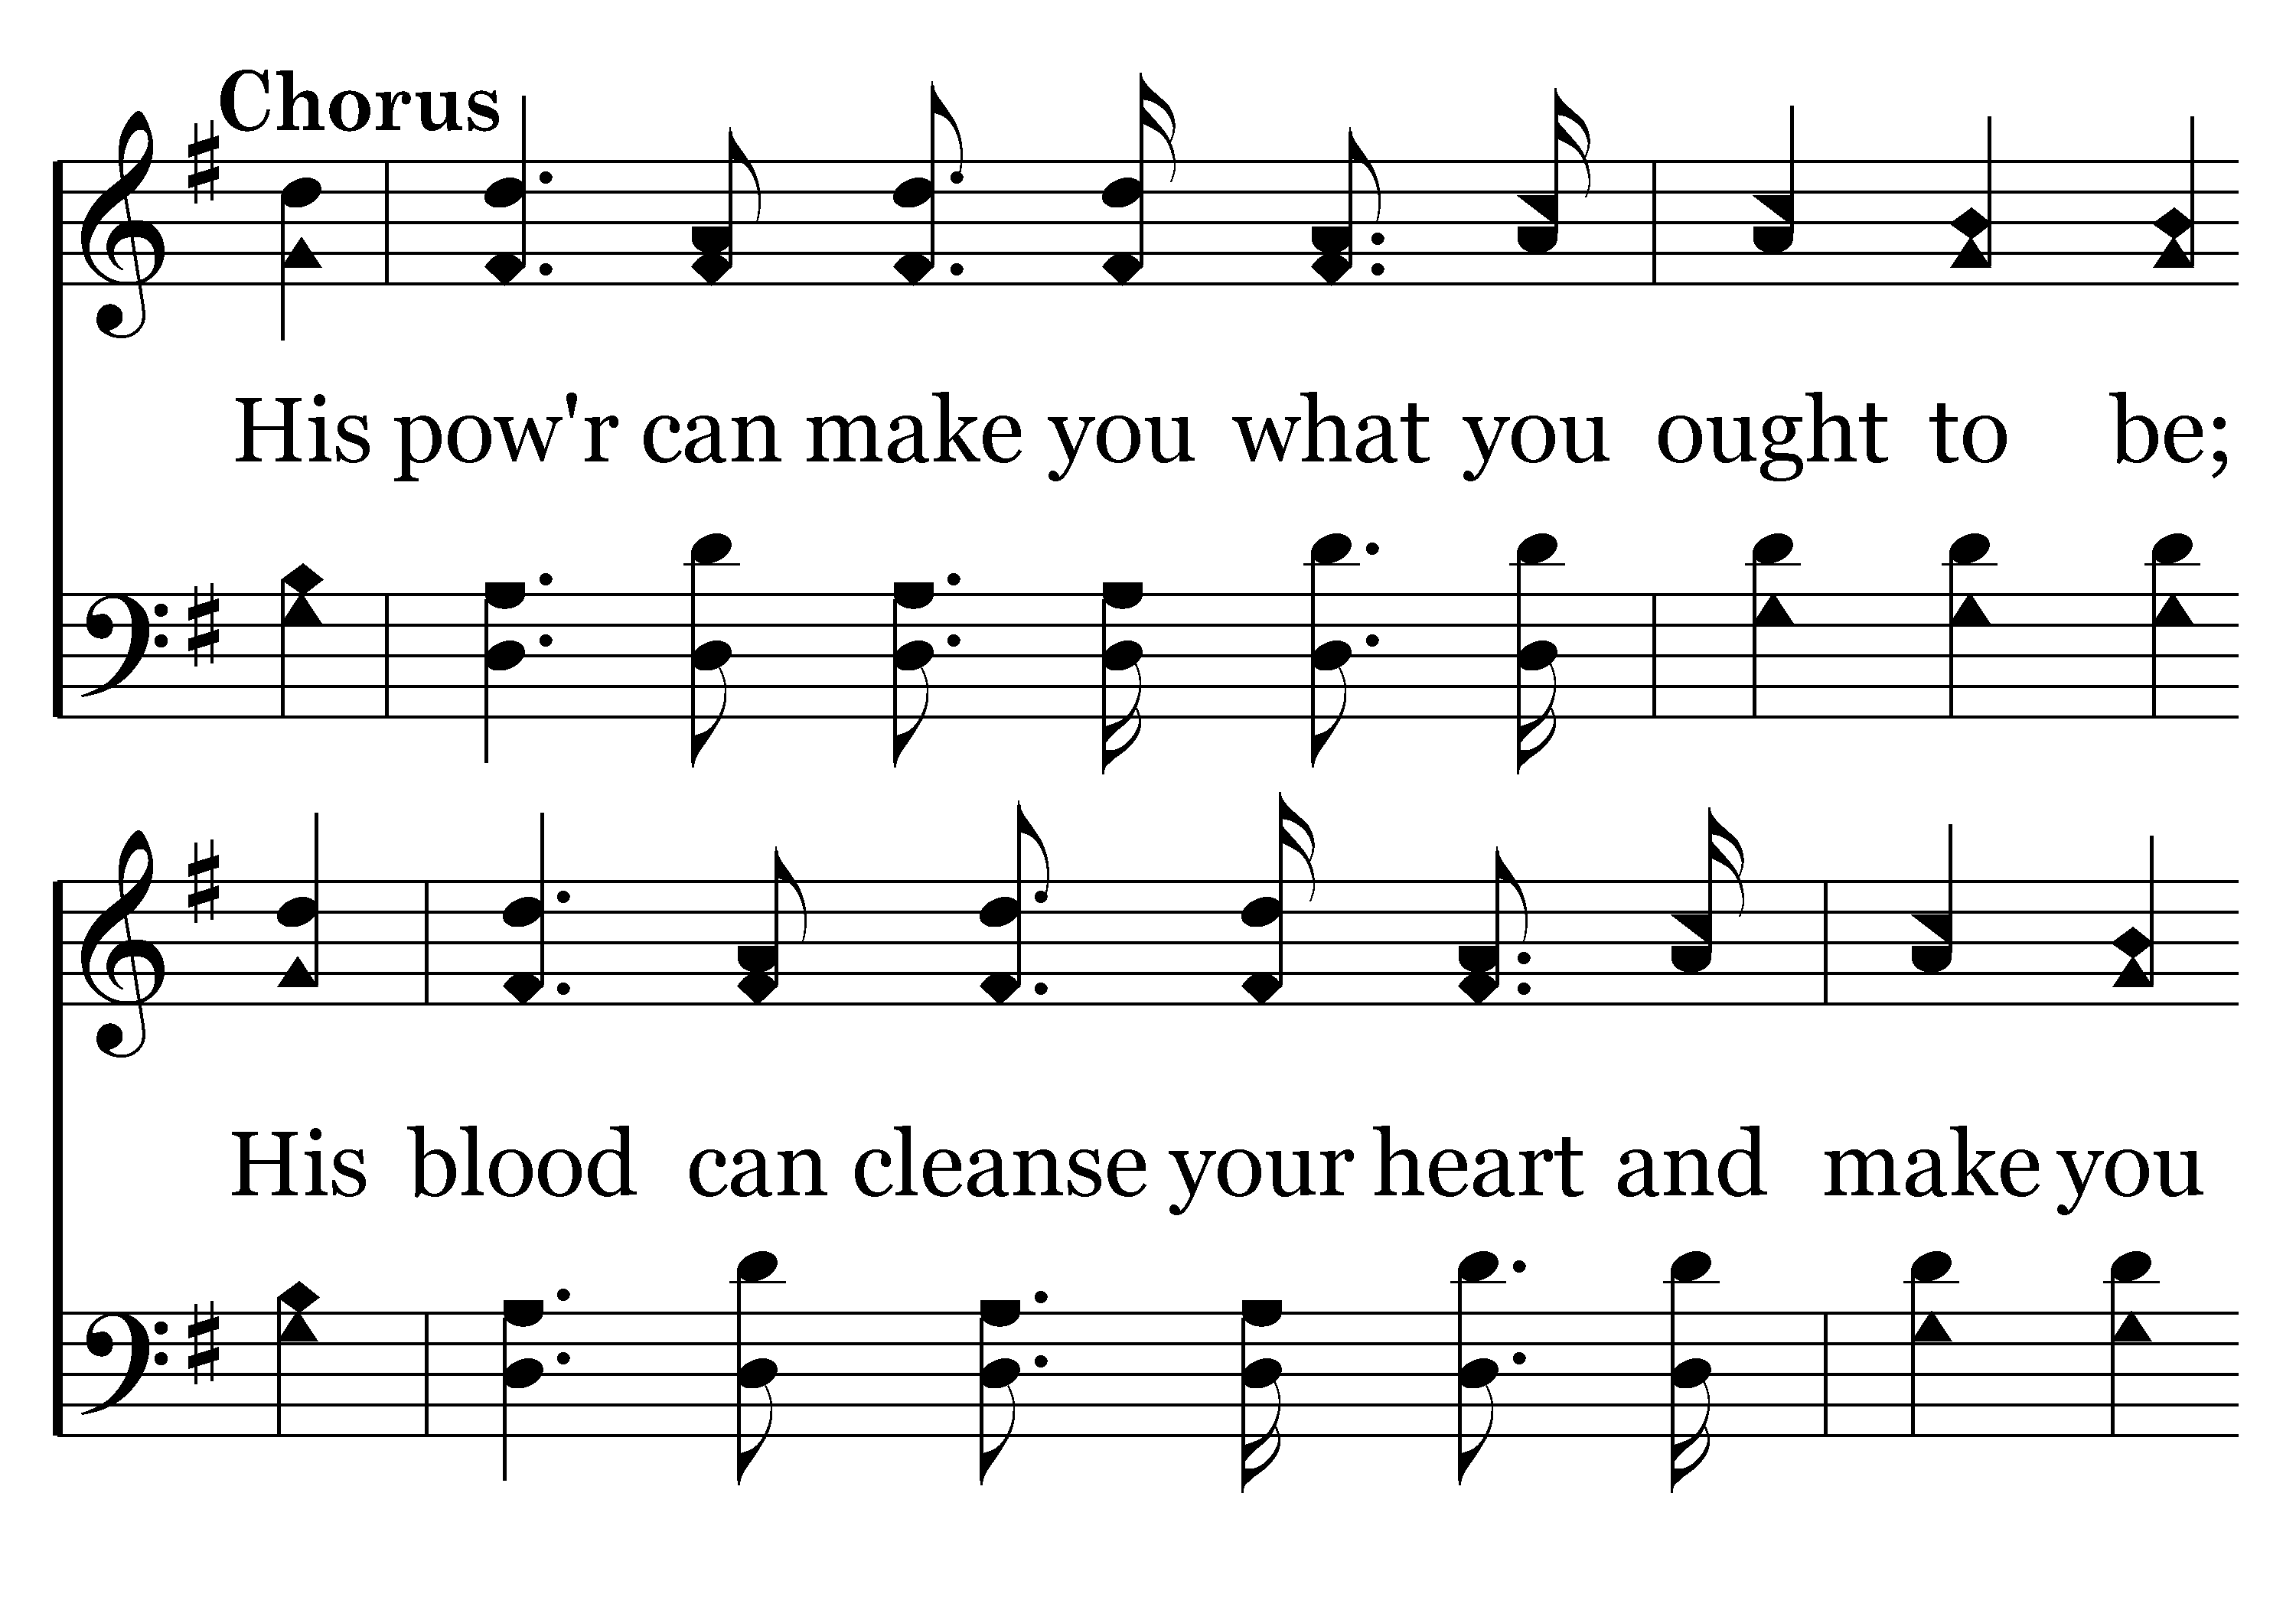
343 - Let Him Have His Way With Thee - C.1

Slide 13
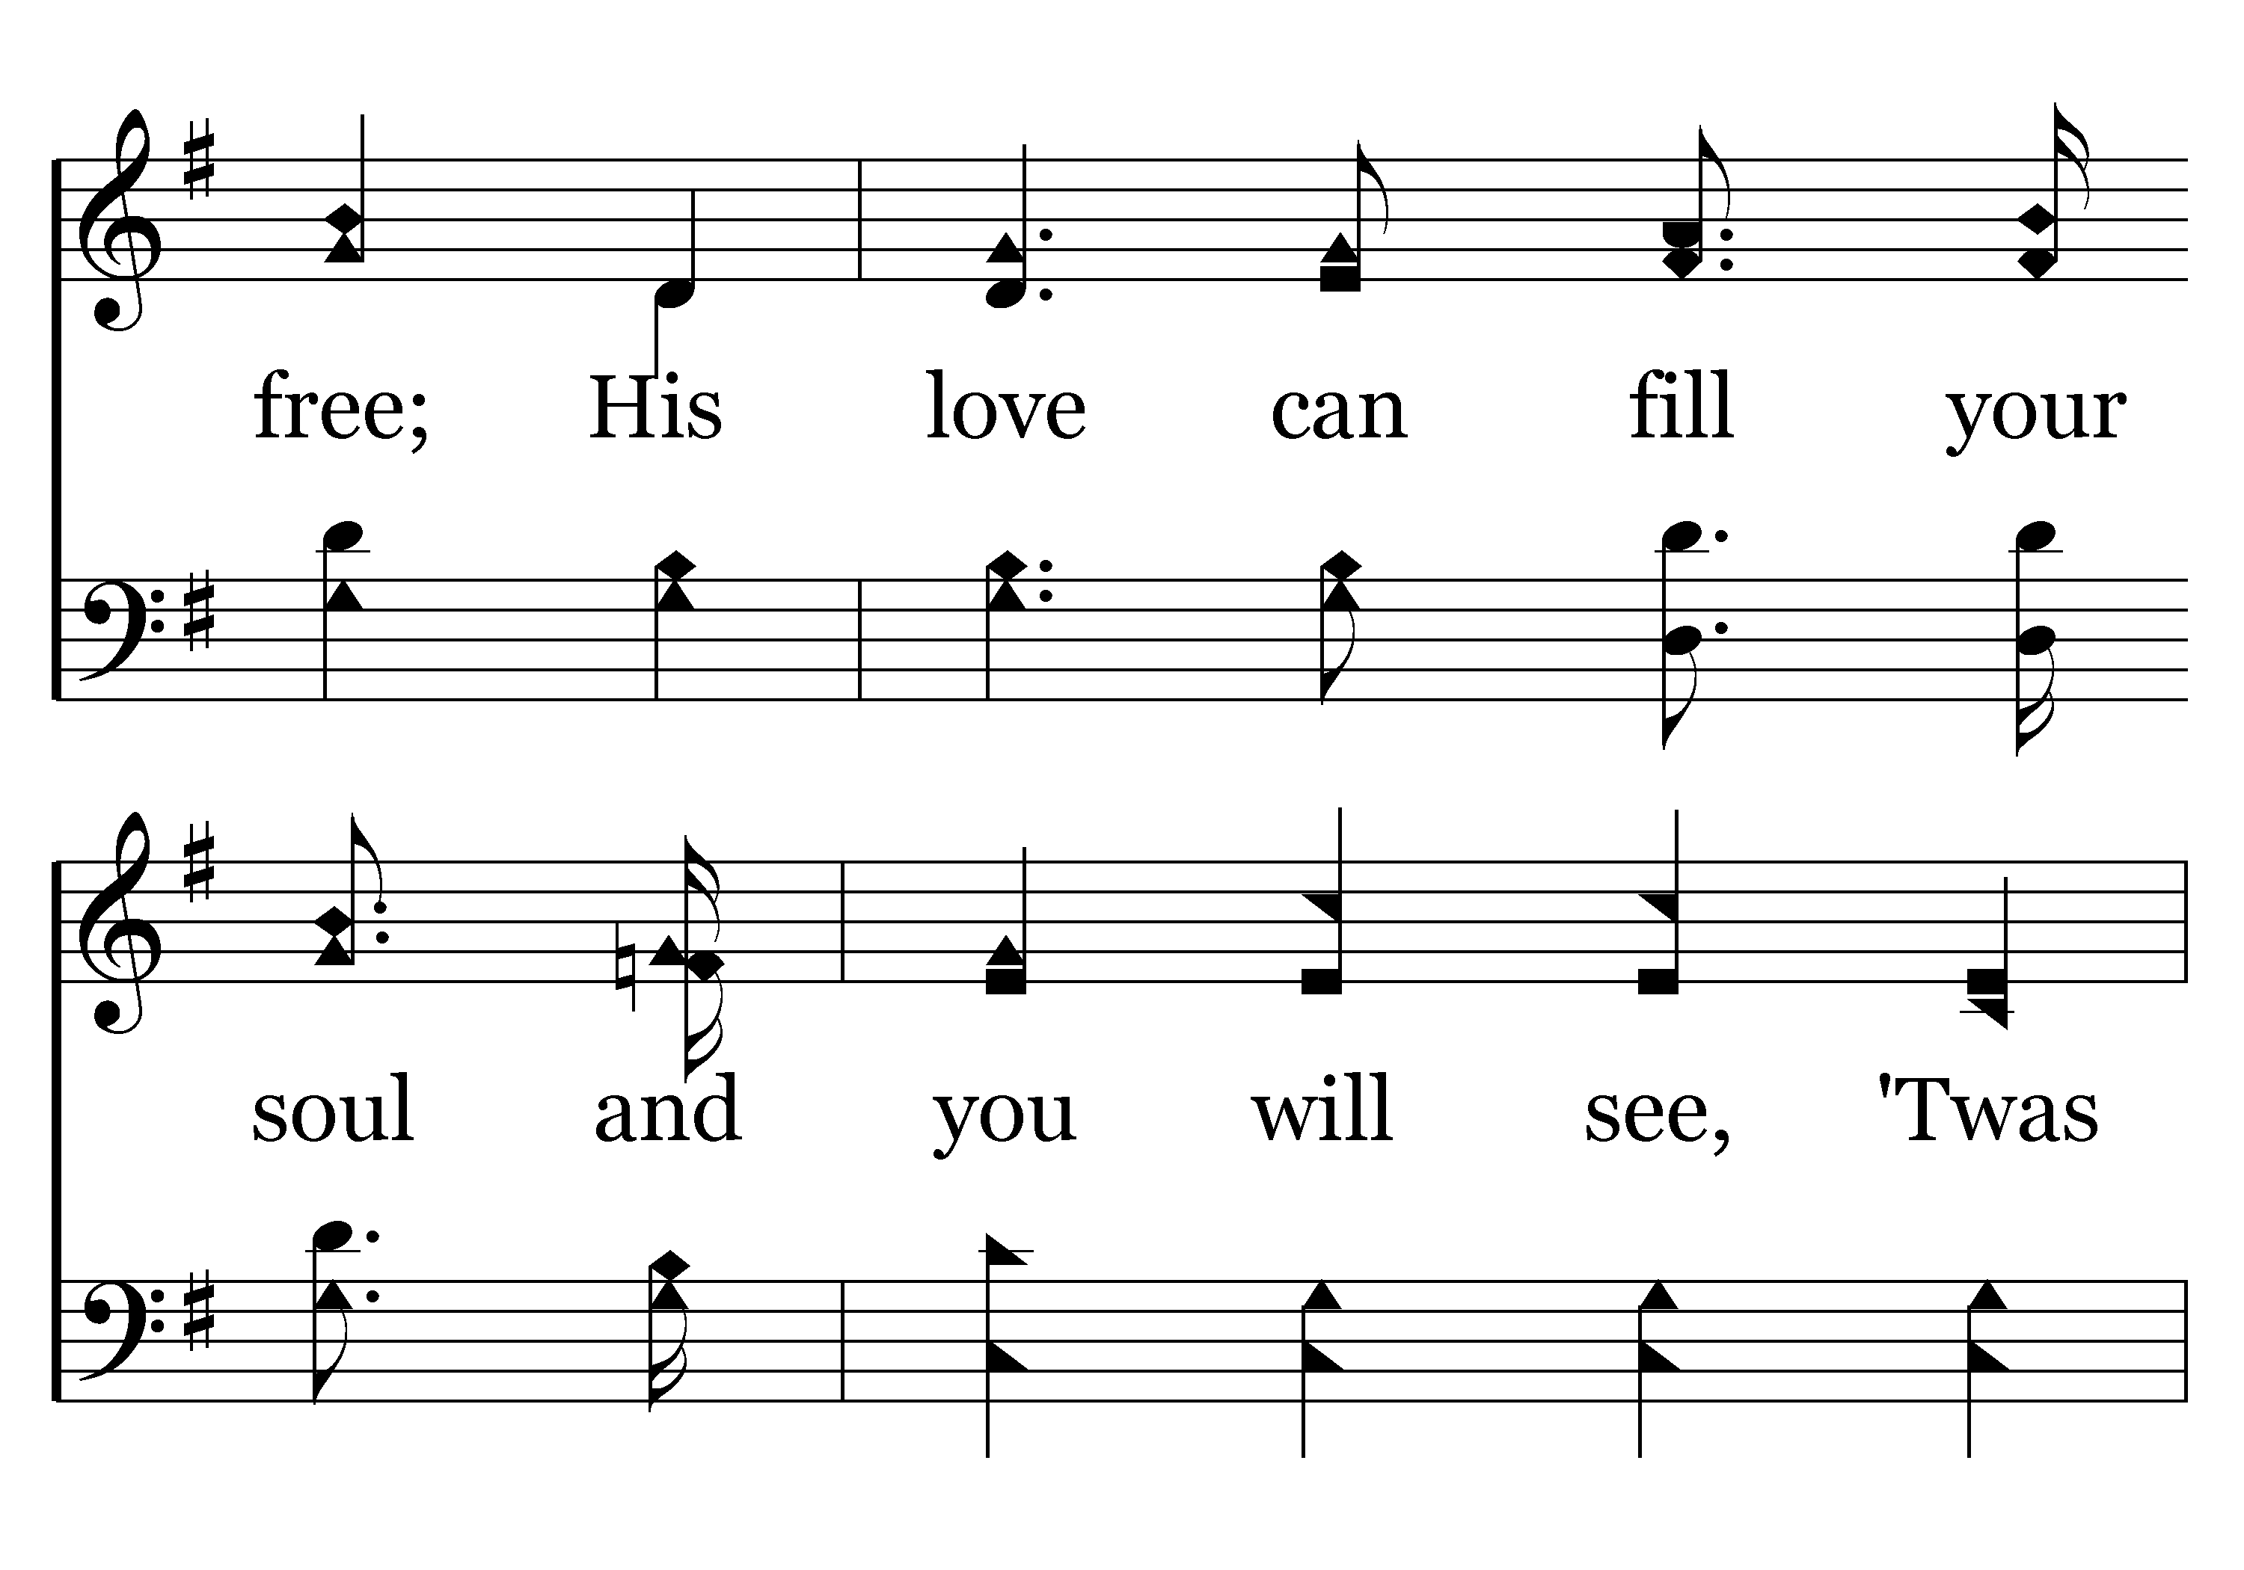
343 - Let Him Have His Way With Thee - C.2

Slide 14
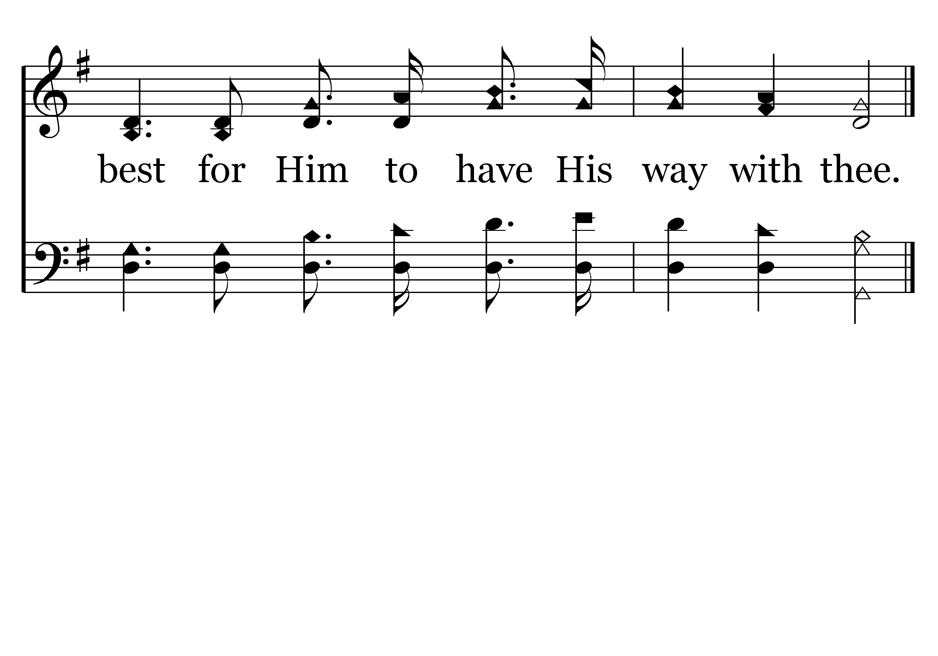
343 - Let Him Have His Way With Thee - C.3
End of Verse 1

Slide 15
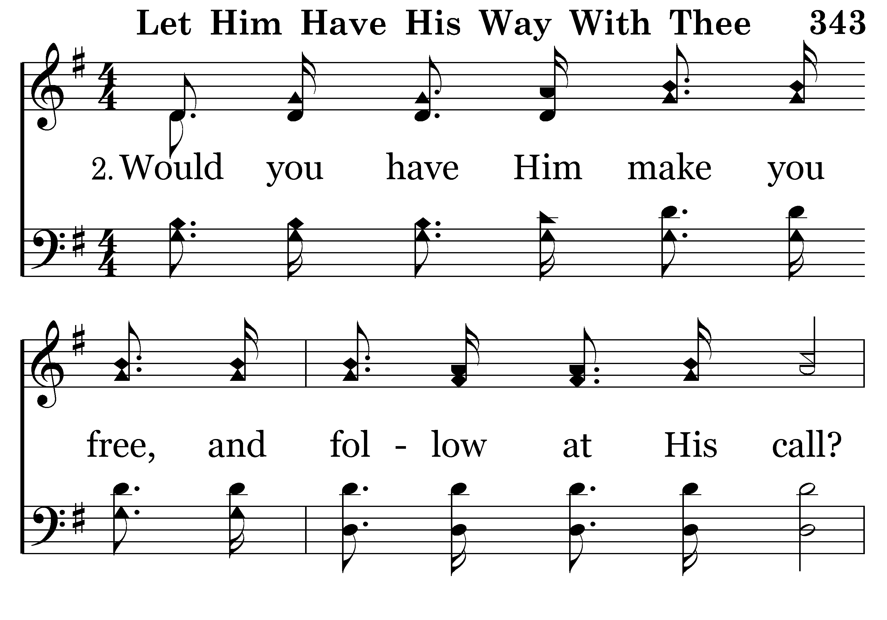
343 - Let Him Have His Way With Thee - 2.1

Slide 16
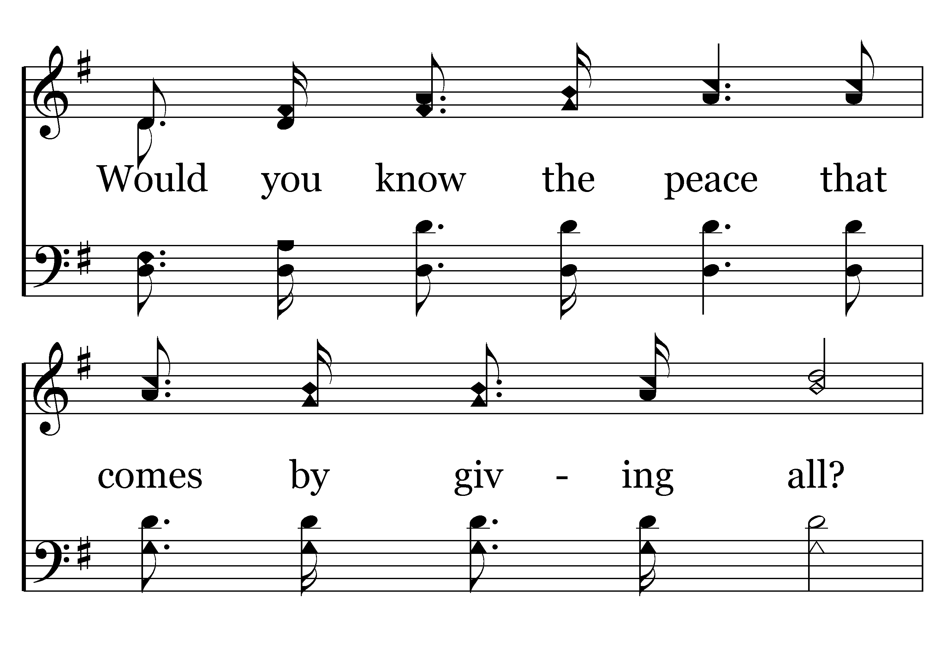
343 - Let Him Have His Way With Thee - 2.2

Slide 17
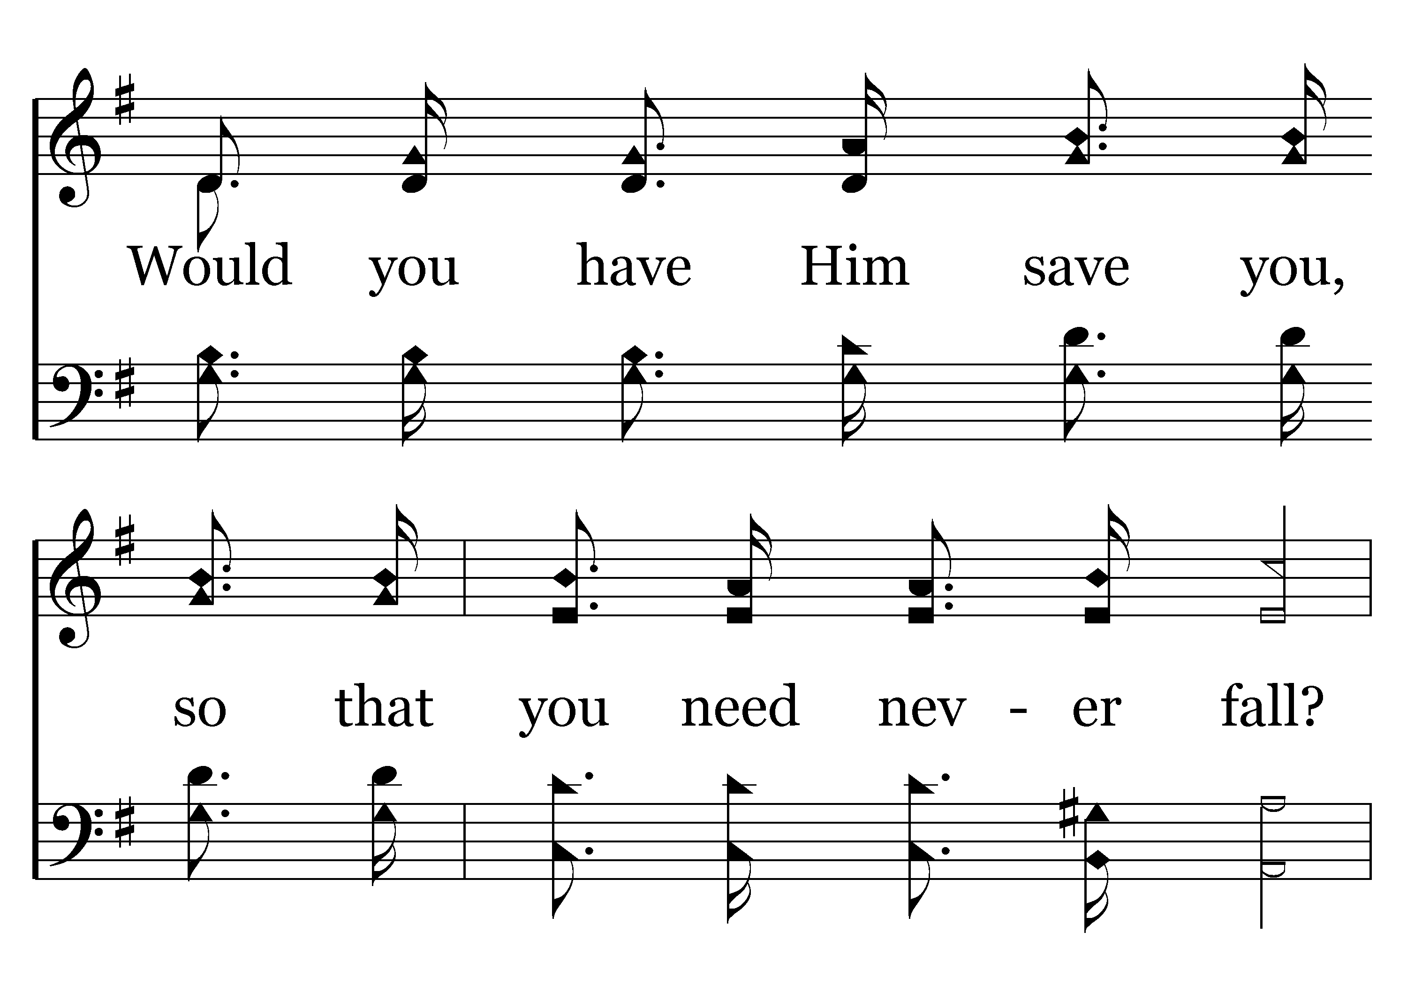
343 - Let Him Have His Way With Thee - 2.3

Slide 18
343 - Let Him Have His Way With Thee - 2.4

Slide 19
343 - Let Him Have His Way With Thee - C.1

Slide 20
343 - Let Him Have His Way With Thee - C.2

Slide 21
343 - Let Him Have His Way With Thee - C.3
End of Verse 2

Slide 22
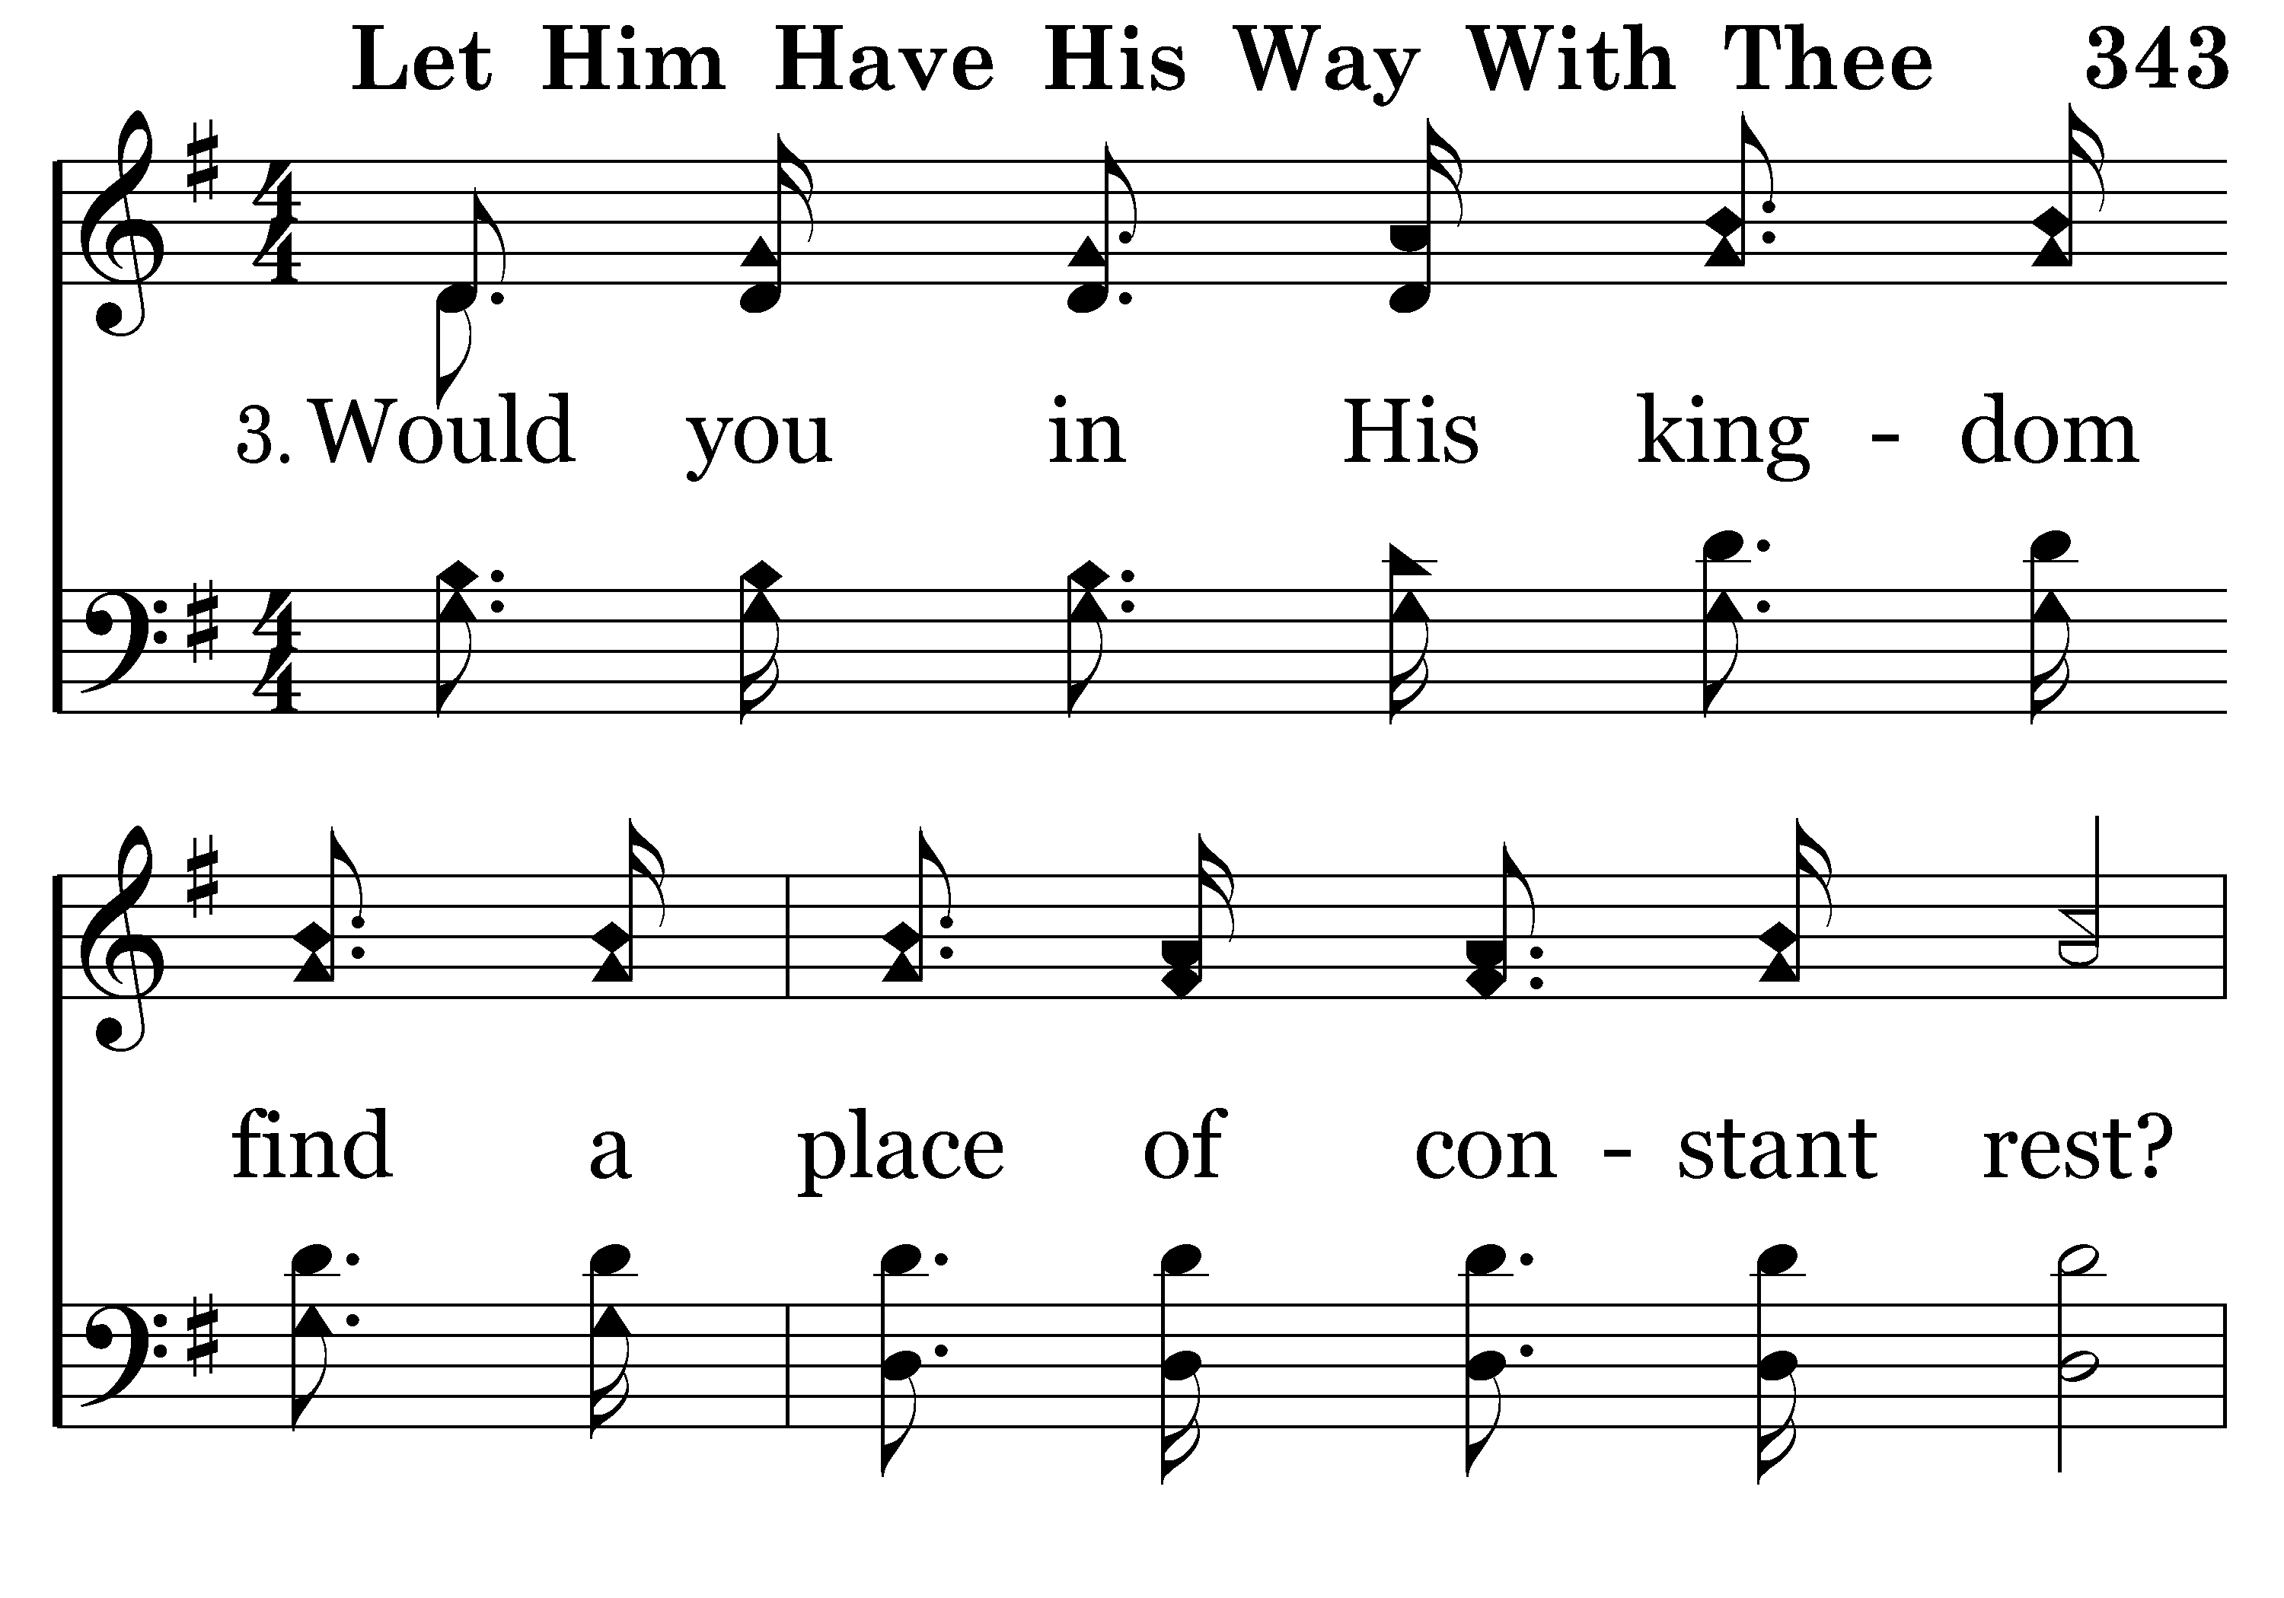
343 - Let Him Have His Way With Thee - 3.1

Slide 23
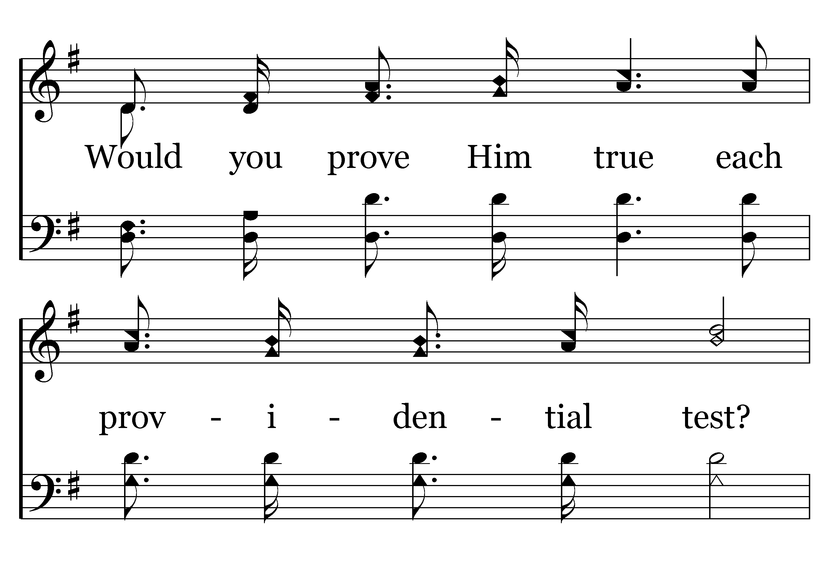
343 - Let Him Have His Way With Thee - 3.2

Slide 24
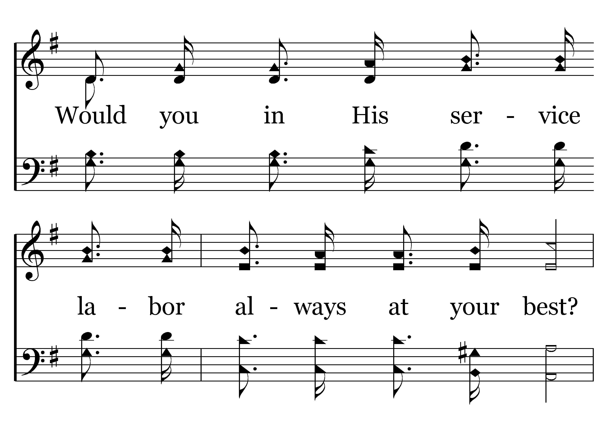
343 - Let Him Have His Way With Thee - 3.3

Slide 25
343 - Let Him Have His Way With Thee - 3.4

Slide 26
343 - Let Him Have His Way With Thee - C.1

Slide 27
343 - Let Him Have His Way With Thee - C.2

Slide 28
343 - Let Him Have His Way With Thee - C.3
End of Song

