Slide 2
John 5:1-4
After this there was a feast of the Jews, and Jesus went up to Jerusalem. Now there is in Jerusalem by the Sheep Gate a pool, which is called in Hebrew, Bethesda, having five porches. In these lay a great multitude of sick people, blind, lame, paralyzed, waiting for the moving of the water. For an angel went down at a certain time into the pool and stirred up the water; then whoever stepped in first, after the stirring of the water, was made well of whatever disease he had.
John 5:1-4
After this there was a feast of the Jews, and Jesus went up to Jerusalem. Now there is in Jerusalem by the Sheep Gate a pool, which is called in Hebrew, Bethesda, having five porches. In these lay a great multitude of sick people, blind, lame, paralyzed, waiting for the moving of the water. For an angel went down at a certain time into the pool and stirred up the water; then whoever stepped in first, after the stirring of the water, was made well of whatever disease he had.
Pool of Bethesda

Slide 3
John 5:5-6
Now a certain man was there who had an infirmity thirty-eight years. When Jesus saw him lying there, and knew that he already had been in that condition a long time, He said to him,
“Do you want to be made well?”
The sick man answered Him, Sir, I have no man to put me into the pool when the water is stirred up; but while I am coming, another steps down before me. (Vs 7).
What did the man answer?
Yes, I want to be healed.
Yes, I want to be made new.
Yes, I want to walk, jump and run.

Slide 4
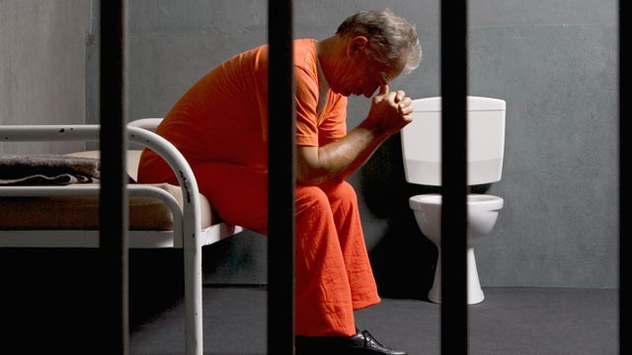
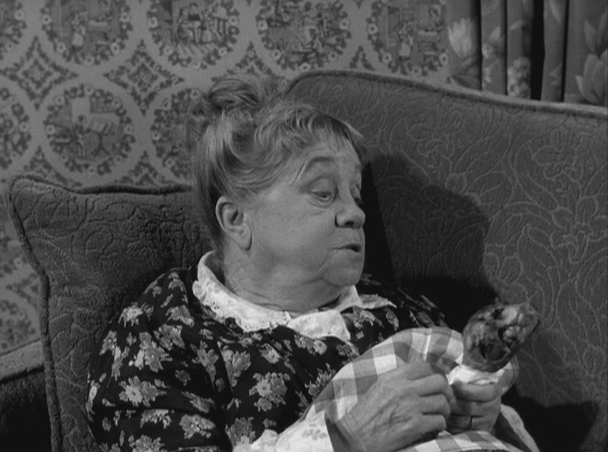
“She enjoys poor health”
“Men are anxious to improve their circumstances, but are unwilling to improve themselves; they therefore remain bound.” James Allen, British Philosopher and Poet

Slide 5
John 5:5-6
Now a certain man was there who had an infirmity thirty-eight years. When Jesus saw him lying there, and knew that he already had been in that condition a long time, He said to him,
“Do you want to be made well?”
The sick man answered Him, Sir, I have no man to put me into the pool when the water is stirred up; but while I am coming, another steps down before me. (Vs 7).

Slide 6
Answering Jesus:
Do You Want To Get Well?
Or do you secretly enjoy victimhood?
Or do you keep blaming someone else for your difficulties?
Or are you afraid to “get well?”
Or do you just want relief—instead of a cure?

Slide 7
Answering Jesus:
Do You Want To Get Well?
Do you really want your marriage to become better?
Do you really want to break your addictions / habits?
Do you really want to become more spiritual?
Do you really want your children to be more devout?
Do you really want to be saved?

