Slide 1
“Cut to the Heart”
Difference in Attitude & Action
Acts 2 -vs- Acts 7

Slide 2
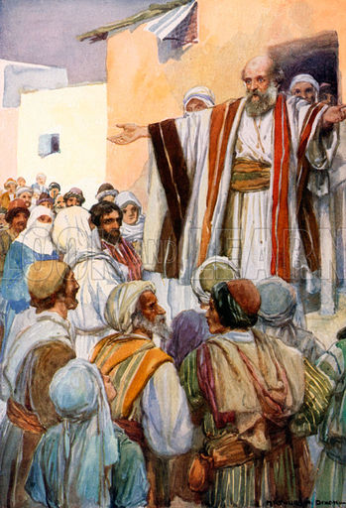
Positive Response To Peter’s Sermon
Now when they heard this, they were cut to the heart, and said to Peter and the rest of the apostles, “Men and brethren, what shall we do?”
--- Acts 2:37 ---

Slide 3
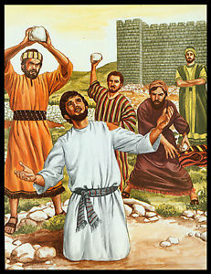
Negative Response To Sermon of Stephen
When they heard these things they were cut to the heart, and they gnashed at him with their teeth.
--- Acts 7:54 ---

Slide 4
Comparing the Passages
Now when they heard this, they were cut to the heart, and said to Peter and the rest of the apostles, “Men and brethren, what shall we do?” (Acts 2:37).
When they heard these things they were cut to the heart, and they gnashed at him with their teeth (Acts 7:54).

Slide 5
Same Message Preached
Acts 2
“You… crucified and put to death” Jesus
Showed evil of their action
They asked how to correct their sin
Acts 7
“You… have become betrayers and murderers”
Associated with previous evil
Did not wait to hear solution

Slide 6
Difference Was Not
In The Message
Difference Was In
The Hearts

Slide 7
Other Examples
Difference between Thessalonica & Berea (Acts 17:1-12)
This is point of parable of the sower (Matt. 13:1-9, 18-23)
Same principle holds true today
Same sermon will cause humble to repent and prideful to stiffen resolve in rebellion
One teaching truth will be thanked by obedient & hated by lover of sin

Slide 8
Our Response to Correction
How do we respond to gospel when taught?
As word of man or God (1 Thess. 2:13)
Ready to hear or prevent it (Acts 13:44-46)?
Attitude & action distinguish (Jn. 3:20-21)
Proverbs 1:7
Proverbs 3:11-12
Proverbs 5:7-13
Proverbs 29:1
Psalm 34:18

