Slide 1
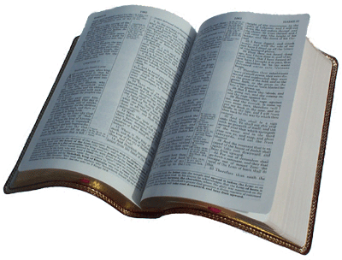
Why Religious Differences?
2nd Timothy 3:16-17
Differing Views of Inspiration

Slide 2
2 Timothy 3:16-17
¹⁶ All Scripture is given by inspiration of God, and is profitable for doctrine, for reproof, for correction, for instruction in righteousness, ¹⁷ that the man of God may be complete, equipped completely for every good work.

Slide 3
GOD
Thoughts
Words chosen by man

Slide 4
GOD
Words chosen by God

Slide 5
How Does Inspiration Work?

Slide 6
Jeremiah 1:4-9
⁴ Then the word of the LORD came to me, saying: ⁵ “Before I formed you in the womb I knew you; before you were born I sanctified you; I ordained you a prophet to the nations.” ⁶ Then said I: “Ah, Lord GOD! Behold, I cannot speak, for I am a youth.” ⁷ But the LORD said to me: “Do not say, ‘I am a youth,’ for you shall go to all to whom I send you, and whatever I command you, you shall speak. ⁸ Do not be afraid of their faces, for I am with you to deliver you,” says the LORD. ⁹ Then the LORD put forth His hand and touched my mouth, and the LORD said to me: “Behold, I have put My words in your mouth.”

Slide 7
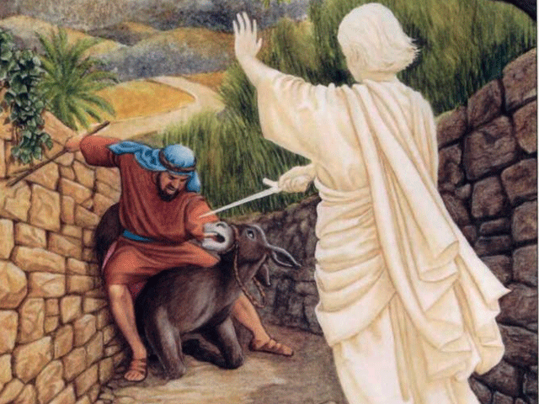
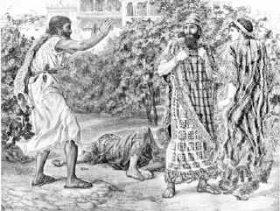
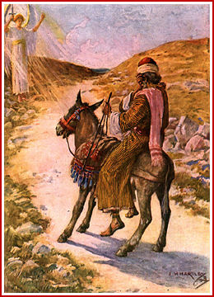
Story of Balaam & Balak
“Though Balak were to give me his house full of silver and gold, I could not go beyond the word of the Lord my God, to do less or more. ” (Num. 22:18)

Slide 8
Divine Protection of Message
(Numbers 22 – 24)
“Look, I have come to you! Now, have I any power at all to say any thing? The word that God puts in my mouth, that I must speak” (22:38)
“The Lord put a word in Balaam’s mouth” (23:5)
“The Lord met Balaam, and put a word in his mouth, and said…” (23:16)
Went to wilderness – “Spirit of God came on him”
“Balak’s anger was aroused against Balaam…” (24:10)
“I could not go beyond the word of the Lord, to do either good or bad of mine own will (“mind ” - ASV). What the Lord says, that I must speak” (24:13)

Slide 9
1 Peter 1:10-12
¹⁰ Of this salvation the prophets have inquired and searched carefully, who prophesied of the grace that would come to you, ¹¹ searching what, or what manner of time, the Spirit of Christ who was in them was indicating when He testified beforehand the sufferings of Christ and the glories that would follow. ¹² To them it was revealed that, not to themselves, but to us they were ministering the things which now have been reported to you through those who have preached the gospel to you by the Holy Spirit sent from heaven — things which angels desire to look into.
Inspired Message Did Not Depend on the Understanding of the Speaker (Writer)

Slide 10
God Fully Controls the Revelation of His Word

Slide 11
1 Corinthians 2:10-13
¹⁰ But God has revealed them to us through His Spirit. For the Spirit searches all things, yes, the deep things of God. ¹¹ For what man knows the things of a man except the spirit of the man which is in him? Even so no one knows the things of God except the Spirit of God. ¹² Now we have received, not the spirit of the world, but the Spirit who is from God, that we might know the things that have been freely given to us by God. ¹³ These things we also speak, not in words which man’s wisdom teaches but which the Holy Spirit teaches, comparing spiritual things with spiritual words.

Slide 12
Ephesians 3:3-7
³ How that by revelation He made known to me the mystery (as I have briefly written already, ⁴ by which, when you read, you may understand my knowledge in the mystery of Christ), ⁵ which in other ages was not made known to the sons of men, as it has now been revealed by the Spirit to His holy apostles and prophets: ⁶ that the Gentiles should be fellow heirs, of the same body, and partakers of His promise in Christ through the gospel, ⁷ of which I became a minister according to the gift of the grace of God given to me by the effective working of His power.

Slide 13
If Words Are Chosen
By God, We Can Be
Confident in Words

Slide 14
If Words Are of God,
May Be Sure They
Can Be Understood

Slide 15
If Words Are of God,
Scripture’s Message
May Not Be Altered

Slide 16
Gospel Message Given Perfectly - Cannot Be Changed Concerning...
Morality Required to Please God
Reality of Heaven & Hell
Plan of Salvation
One True Church
Work, Organization & Worship of Church
Any Statement or Instruction Given

Slide 17
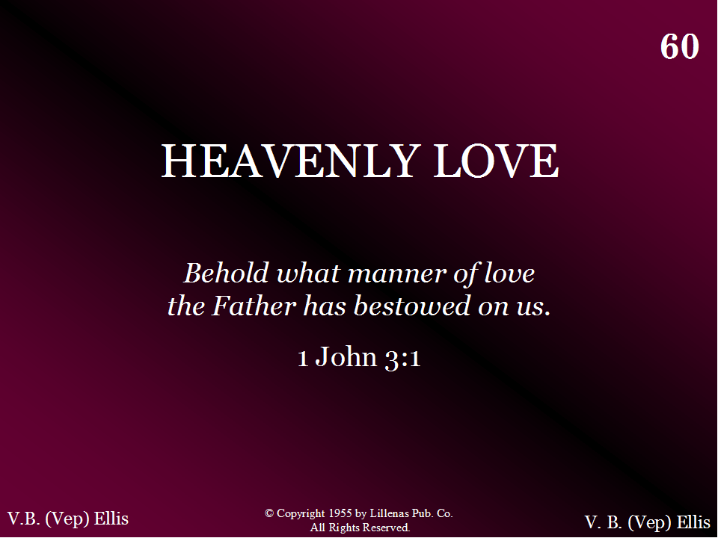
060 - Heavenly Love - Title

Slide 18
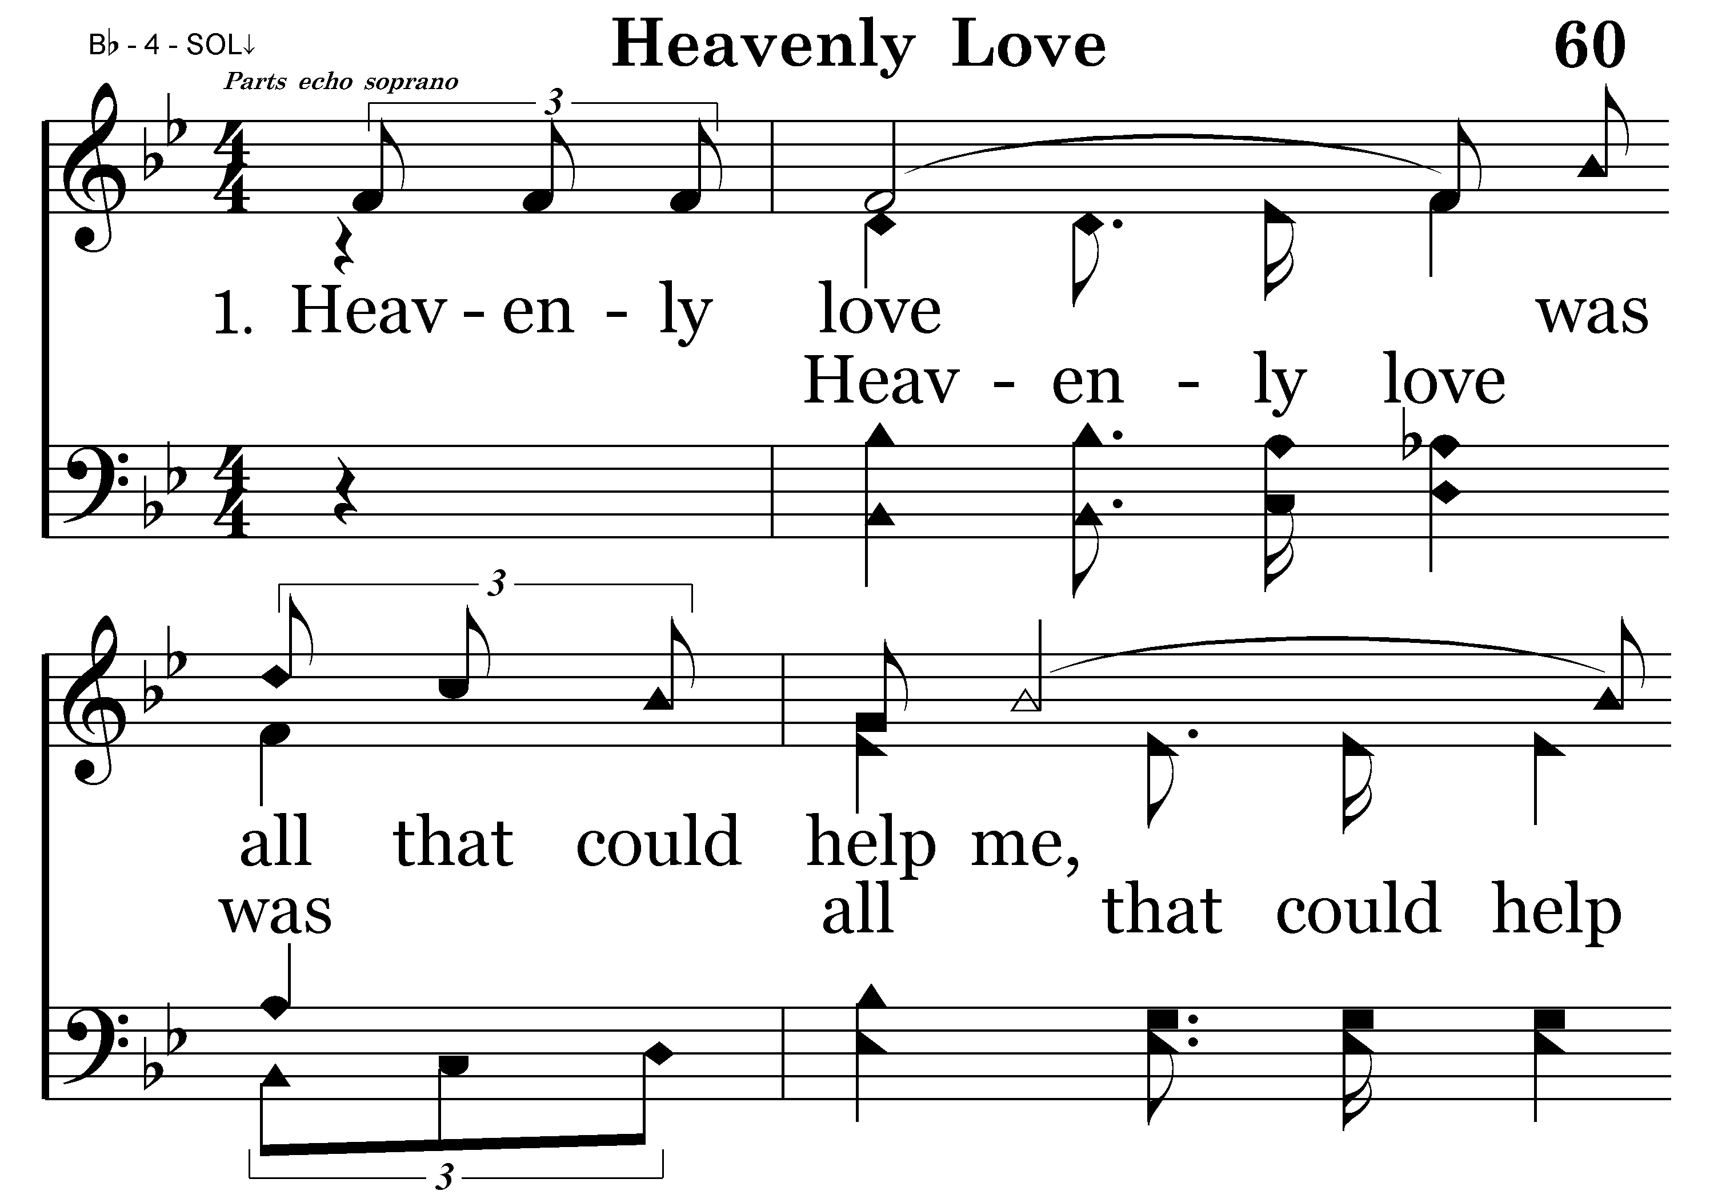
060 - Heavenly Love - 1.1

Slide 19
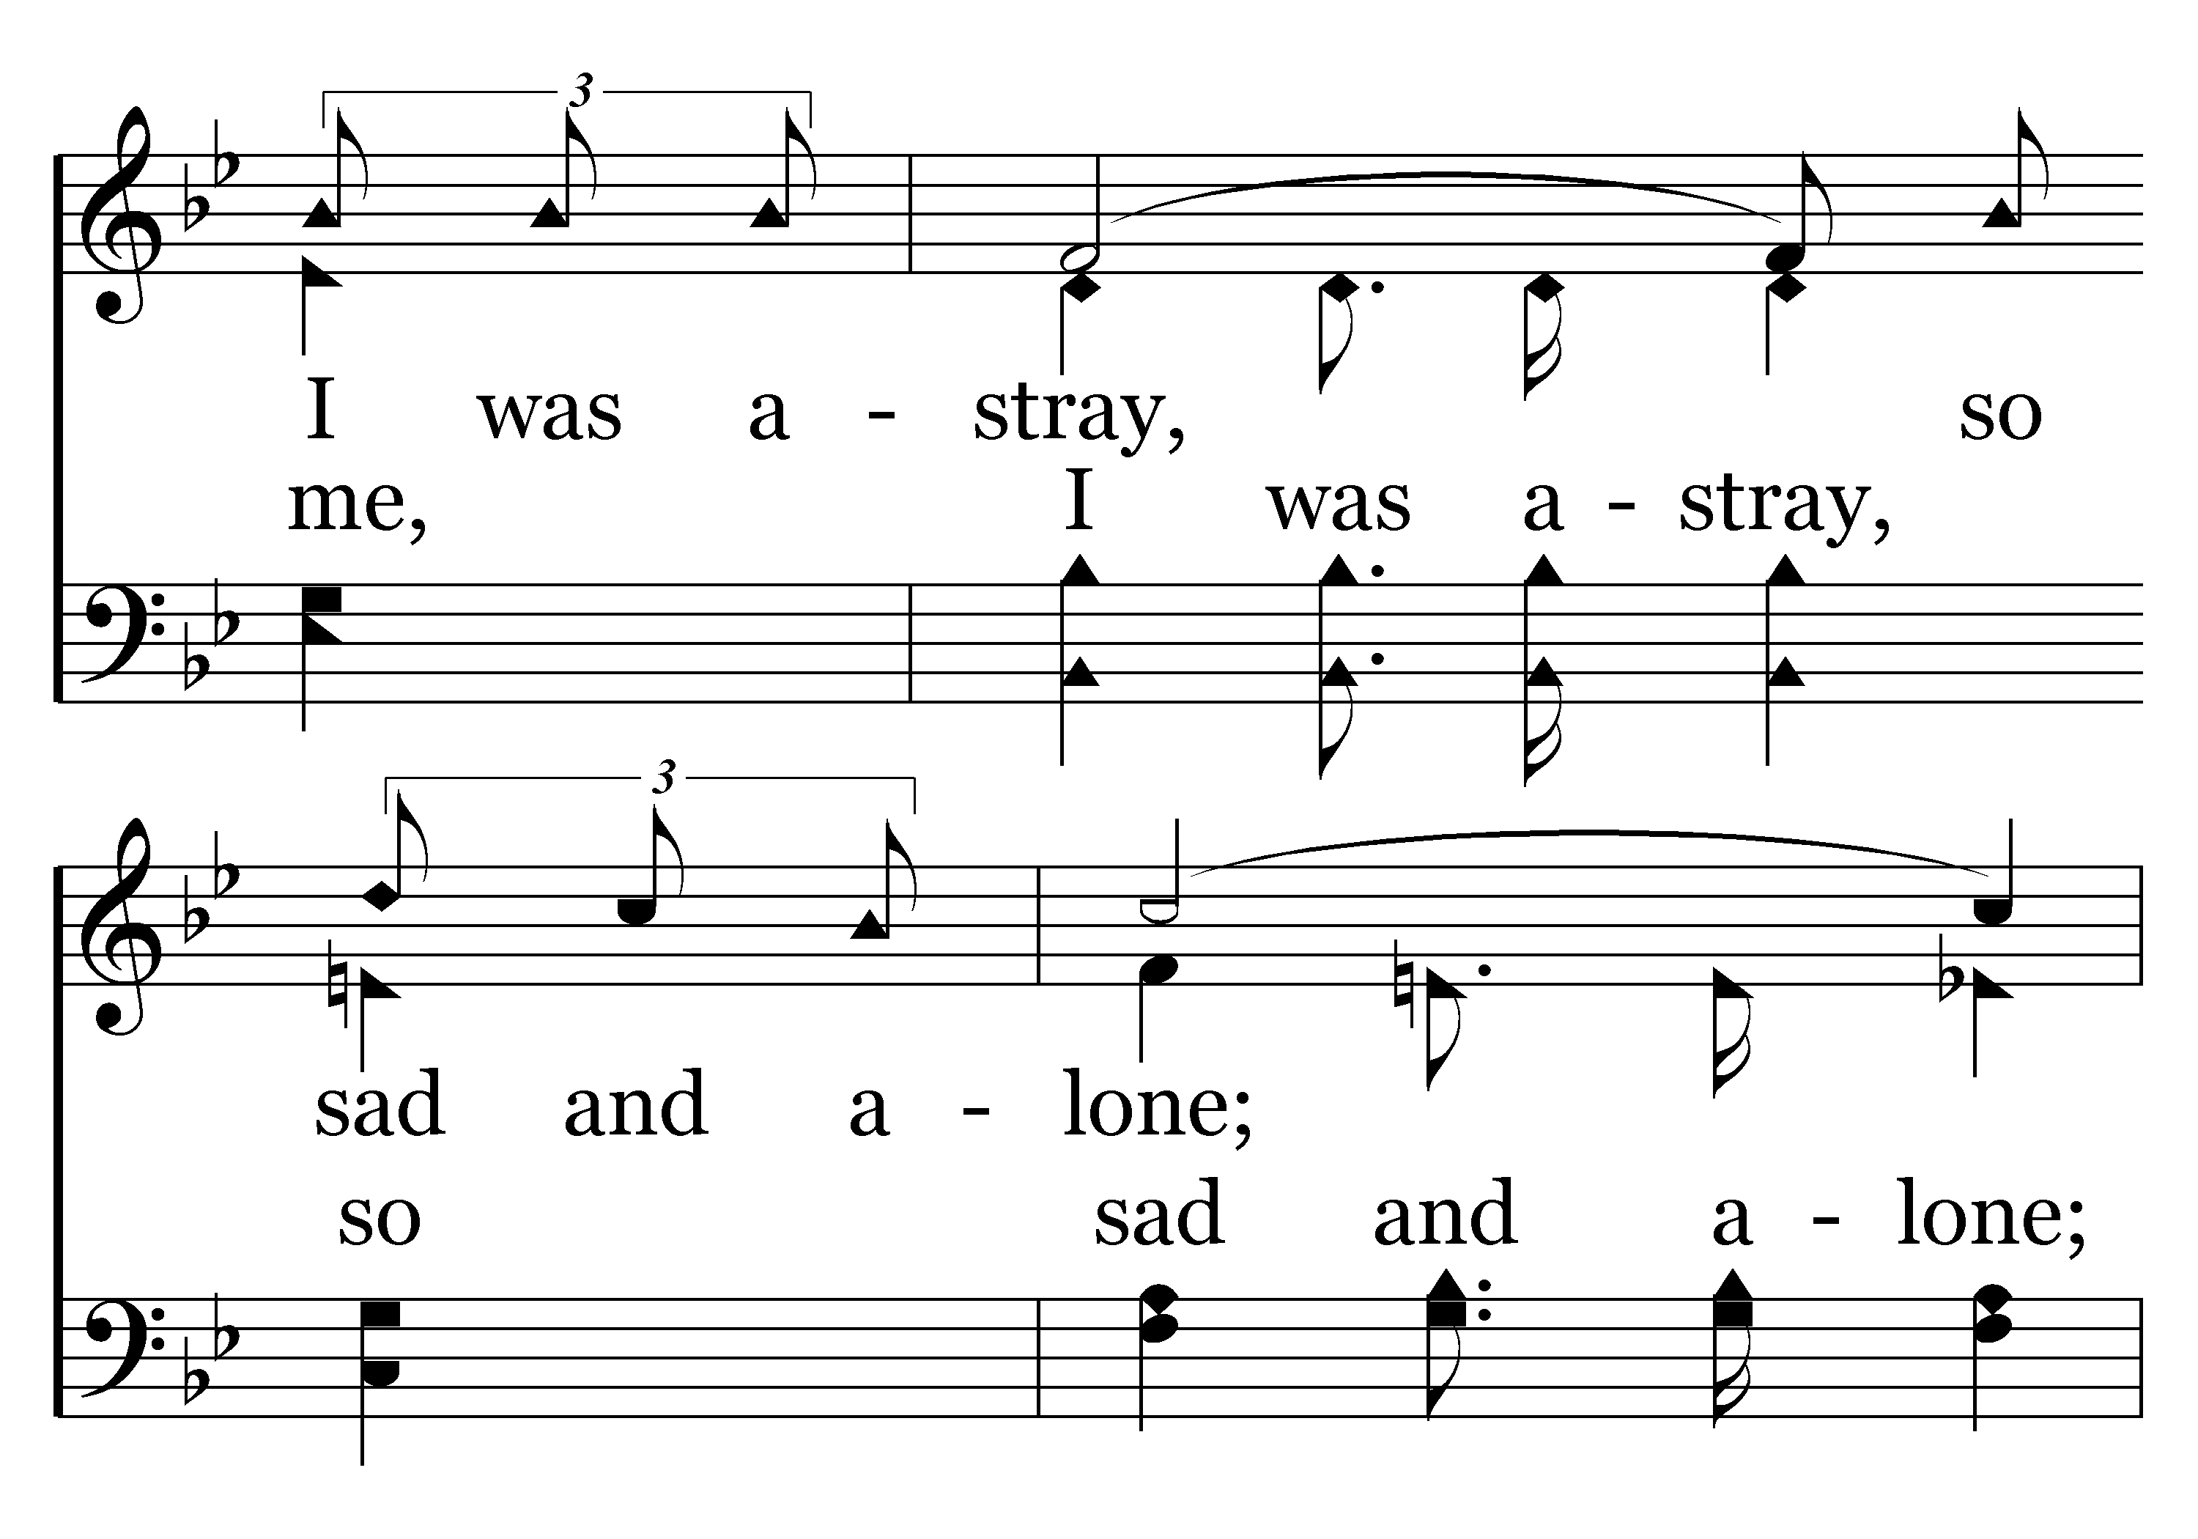
060 - Heavenly Love - 1.2

Slide 20
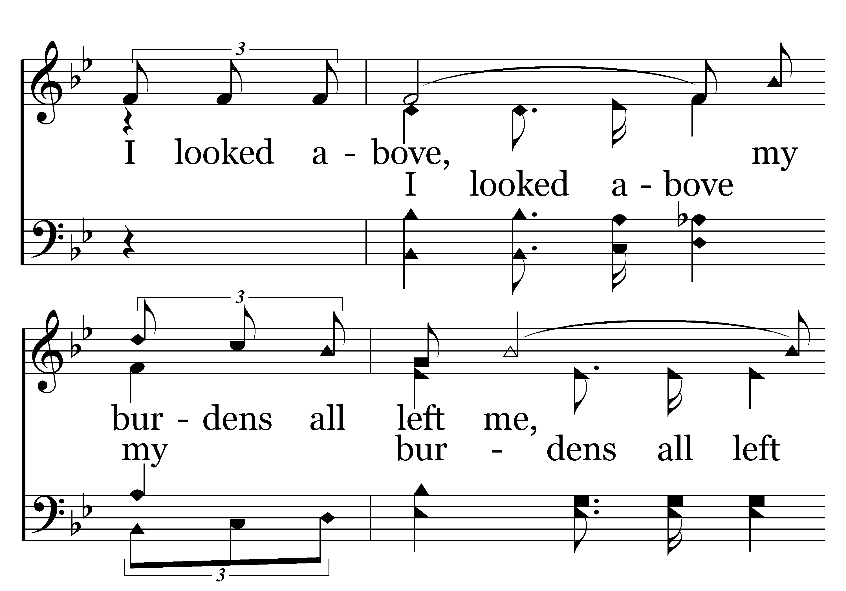
060 - Heavenly Love - 1.3

Slide 21
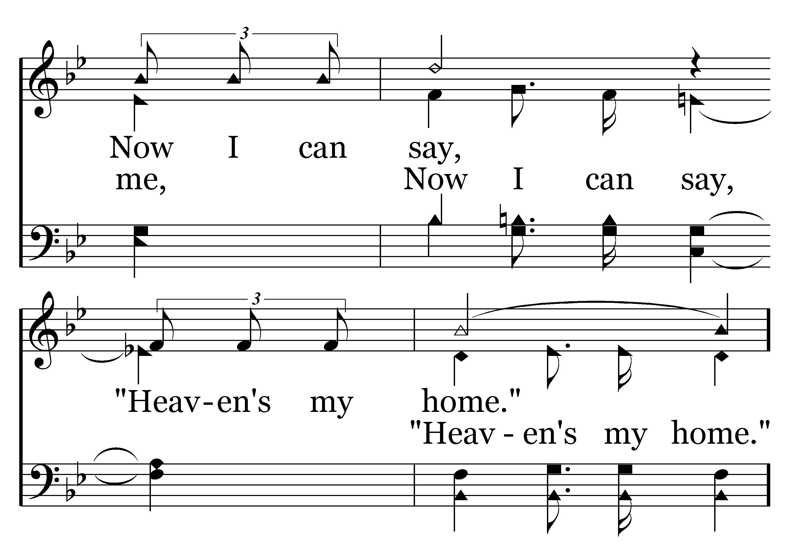
060 - Heavenly Love - 1.4

Slide 22
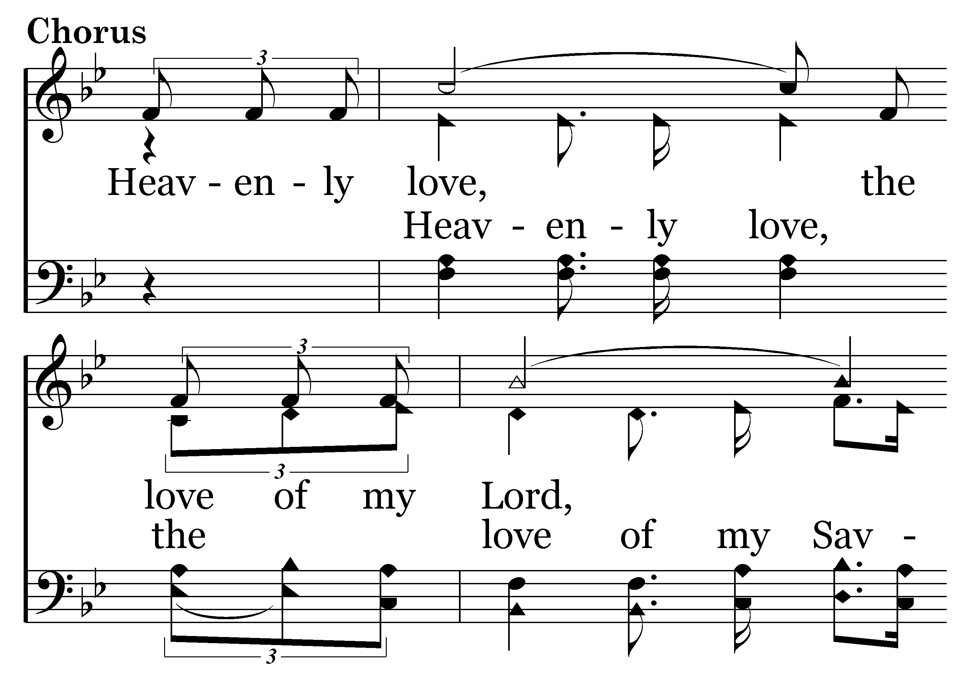
060 - Heavenly Love - C.1

Slide 23
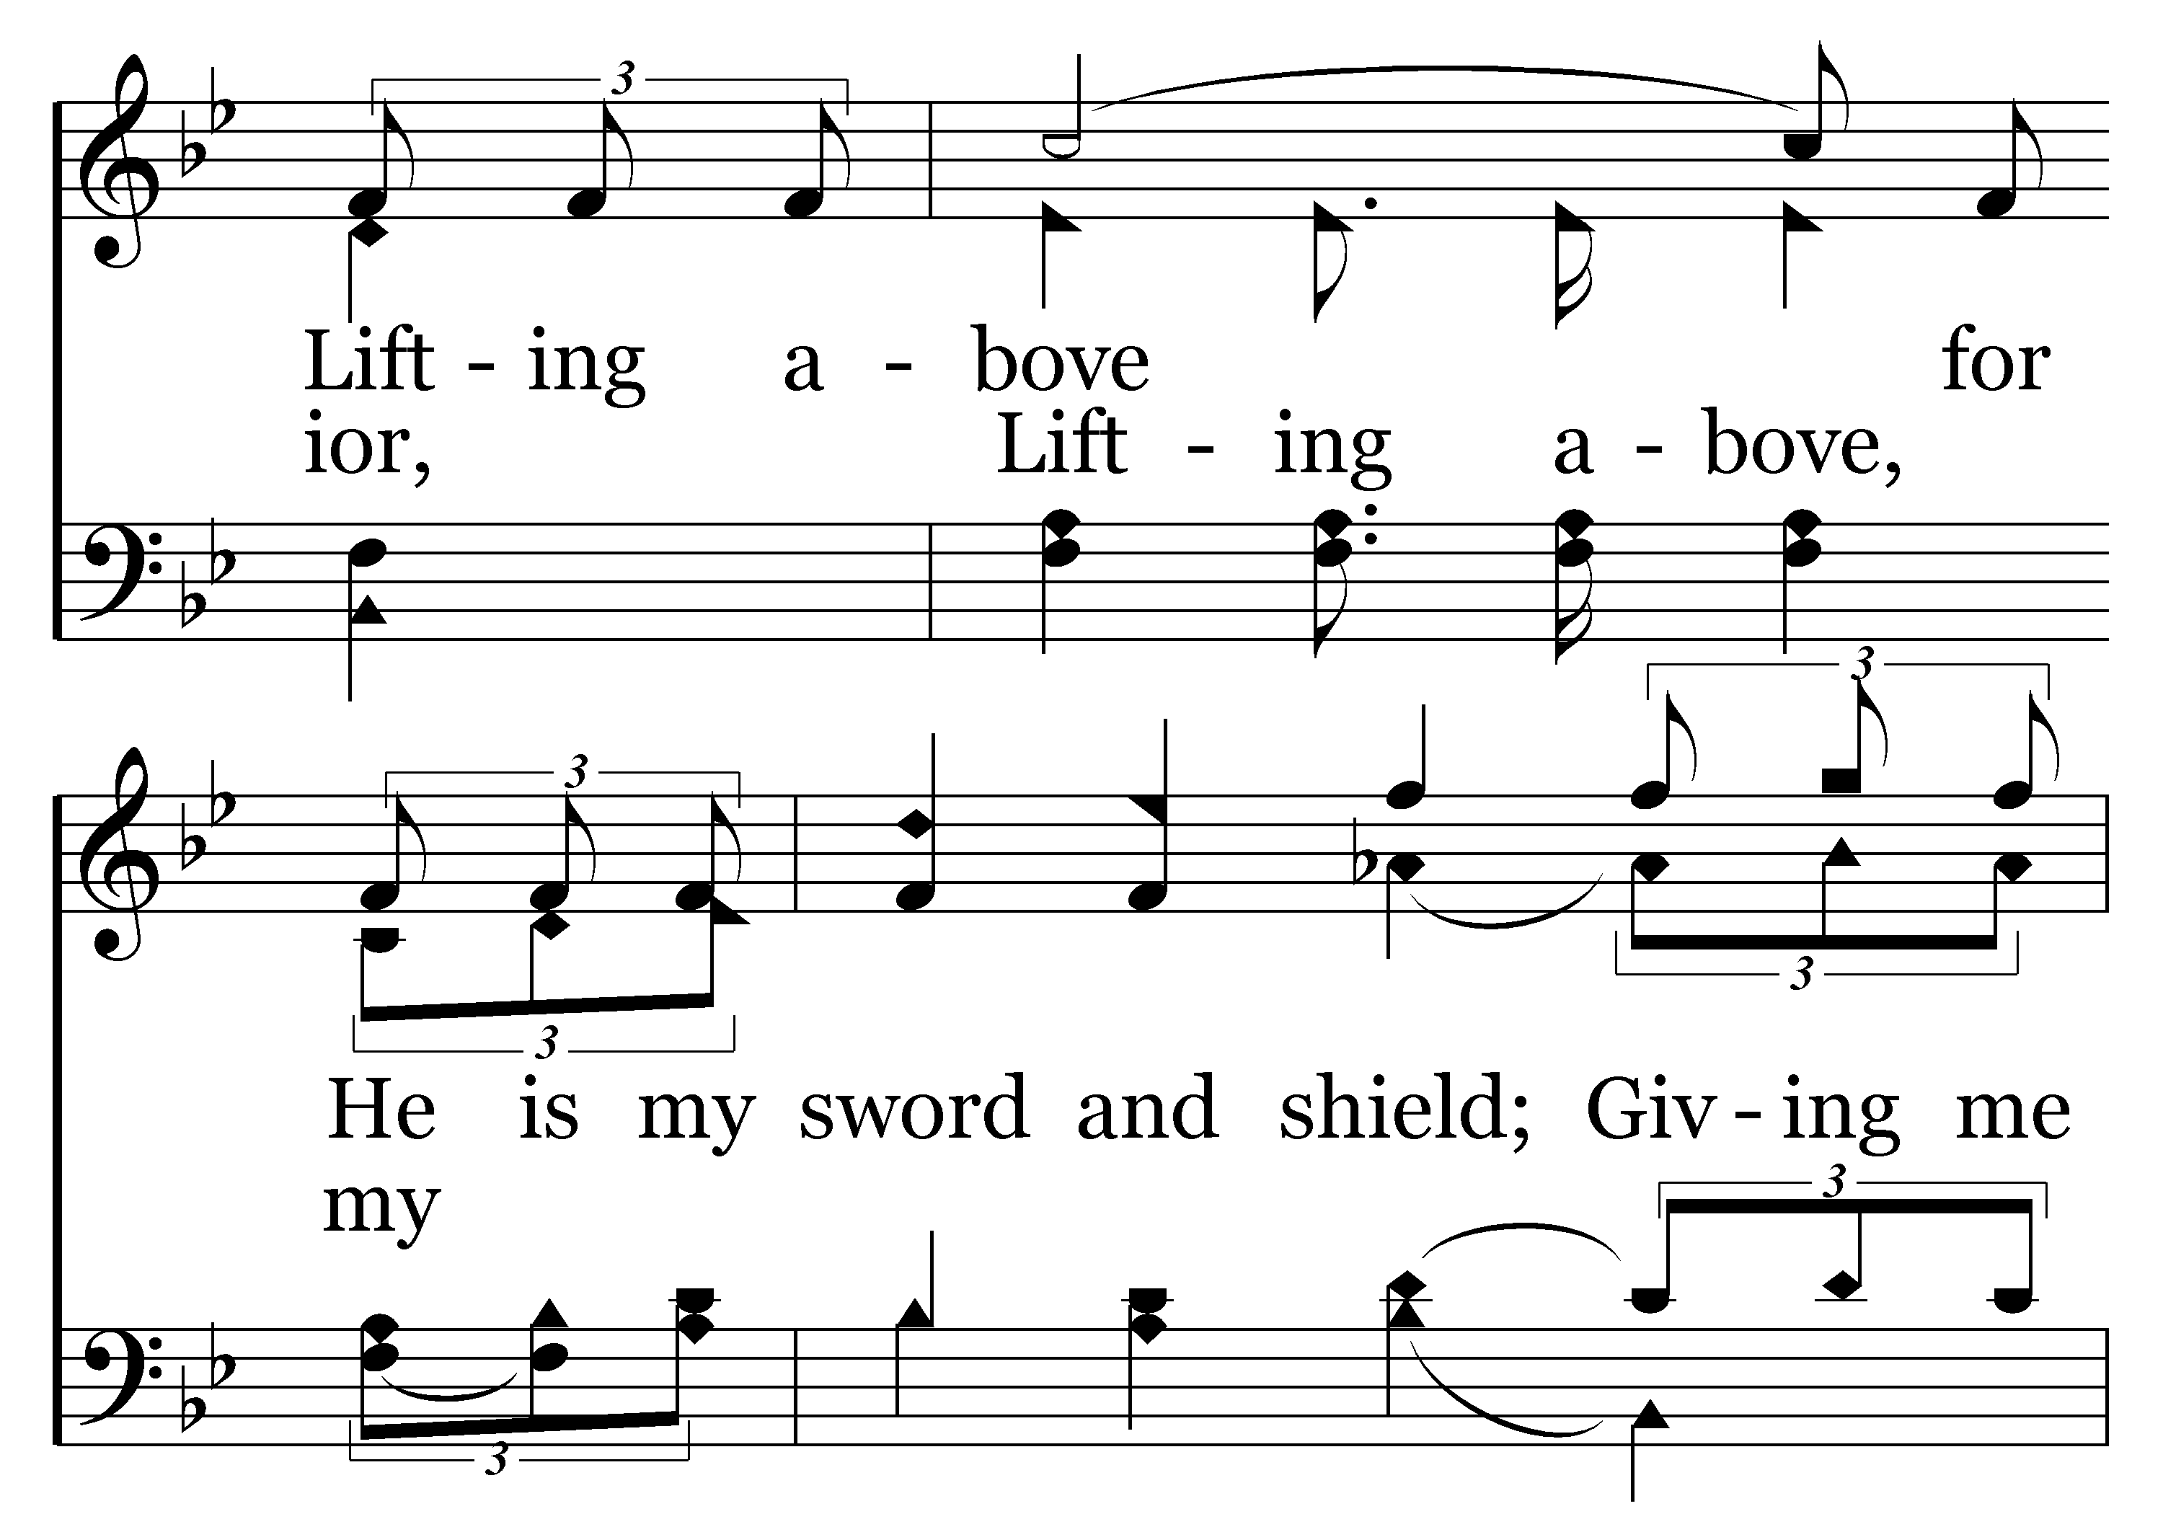
060 - Heavenly Love - C.2

Slide 24
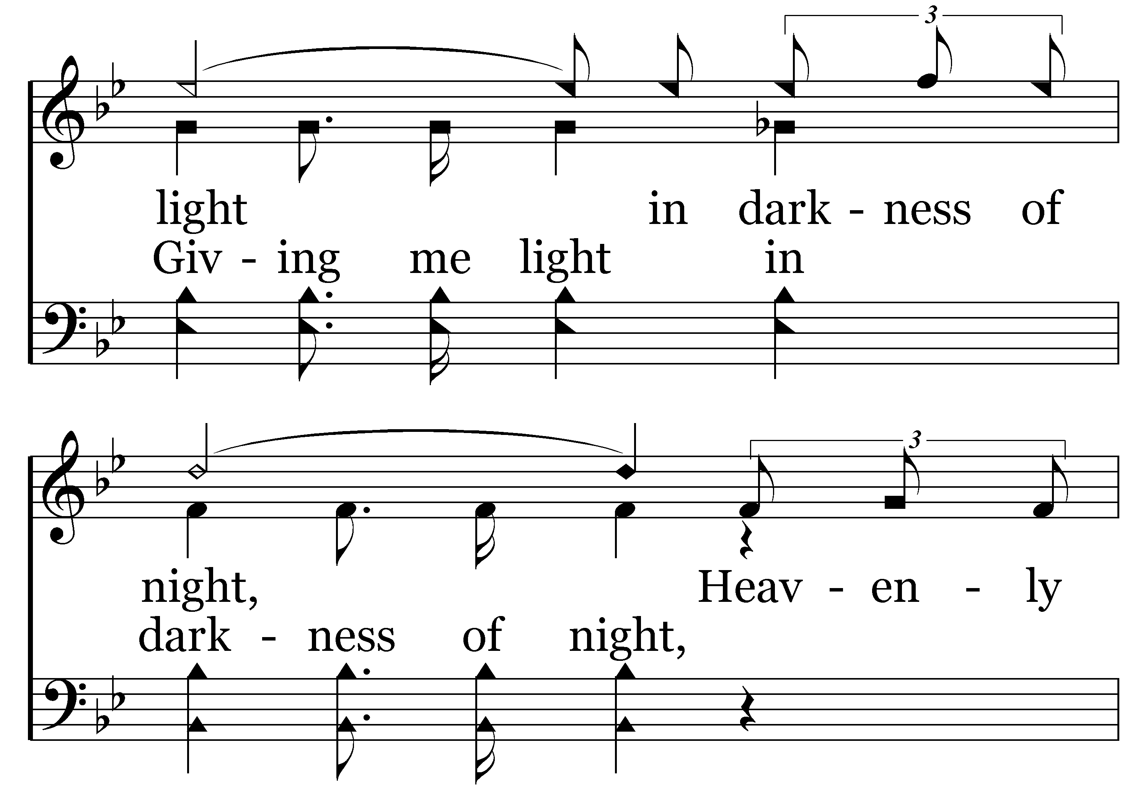
060 - Heavenly Love - C.3

Slide 25
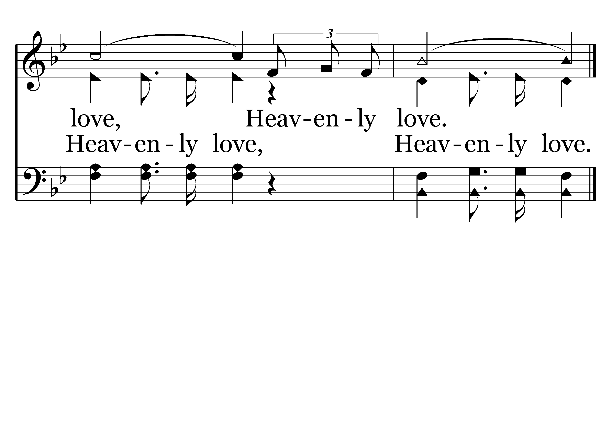
060 - Heavenly Love - C.4
End of Verse 1

Slide 26
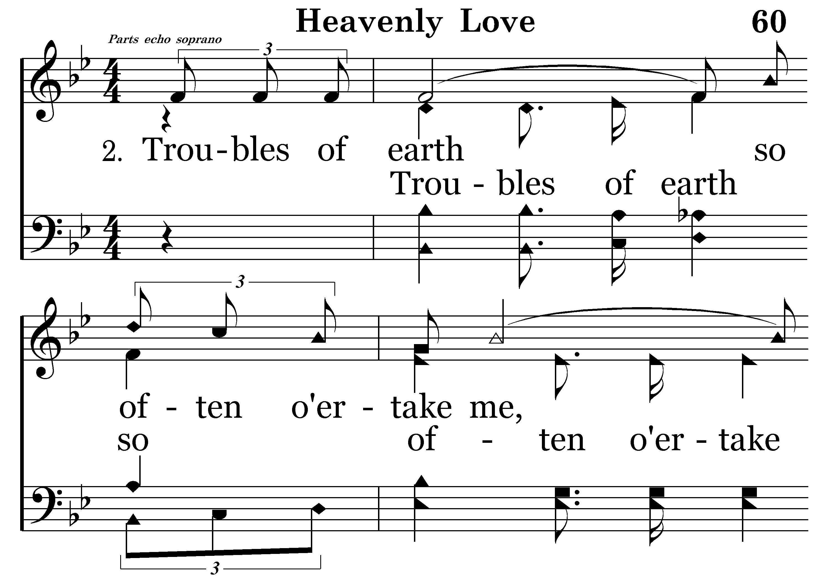
060 - Heavenly Love - 2.1

Slide 27
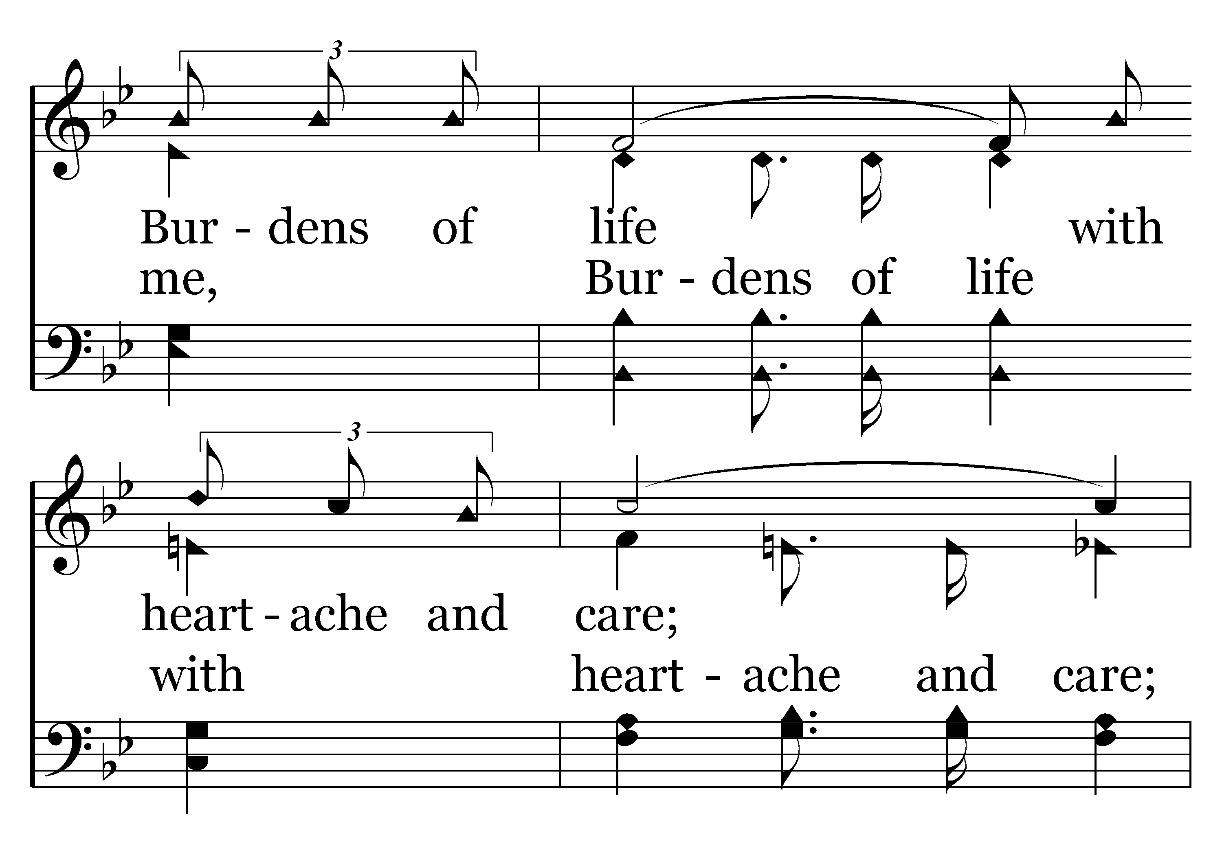
060 - Heavenly Love - 2.2

Slide 28
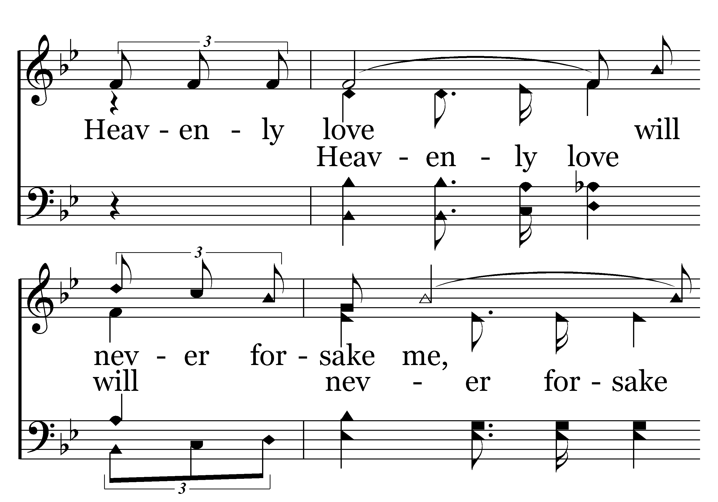
060 - Heavenly Love - 2.3

Slide 29
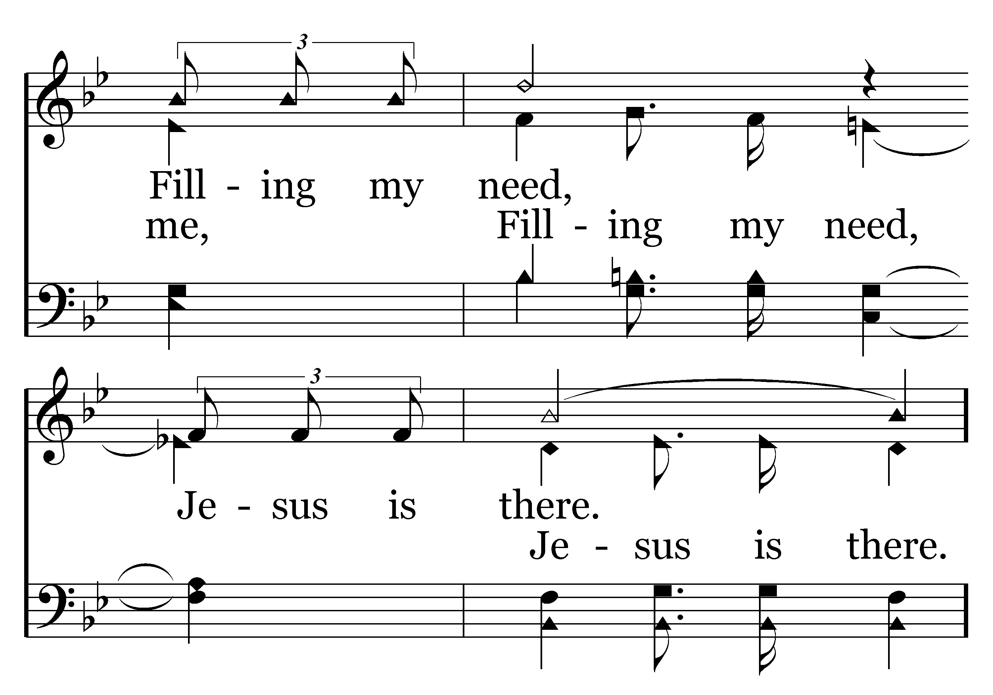
060 - Heavenly Love - 2.4

Slide 30
060 - Heavenly Love - C.1

Slide 31
060 - Heavenly Love - C.2

Slide 32
060 - Heavenly Love - C.3

Slide 33
060 - Heavenly Love - C.4
End of Verse 2

Slide 34
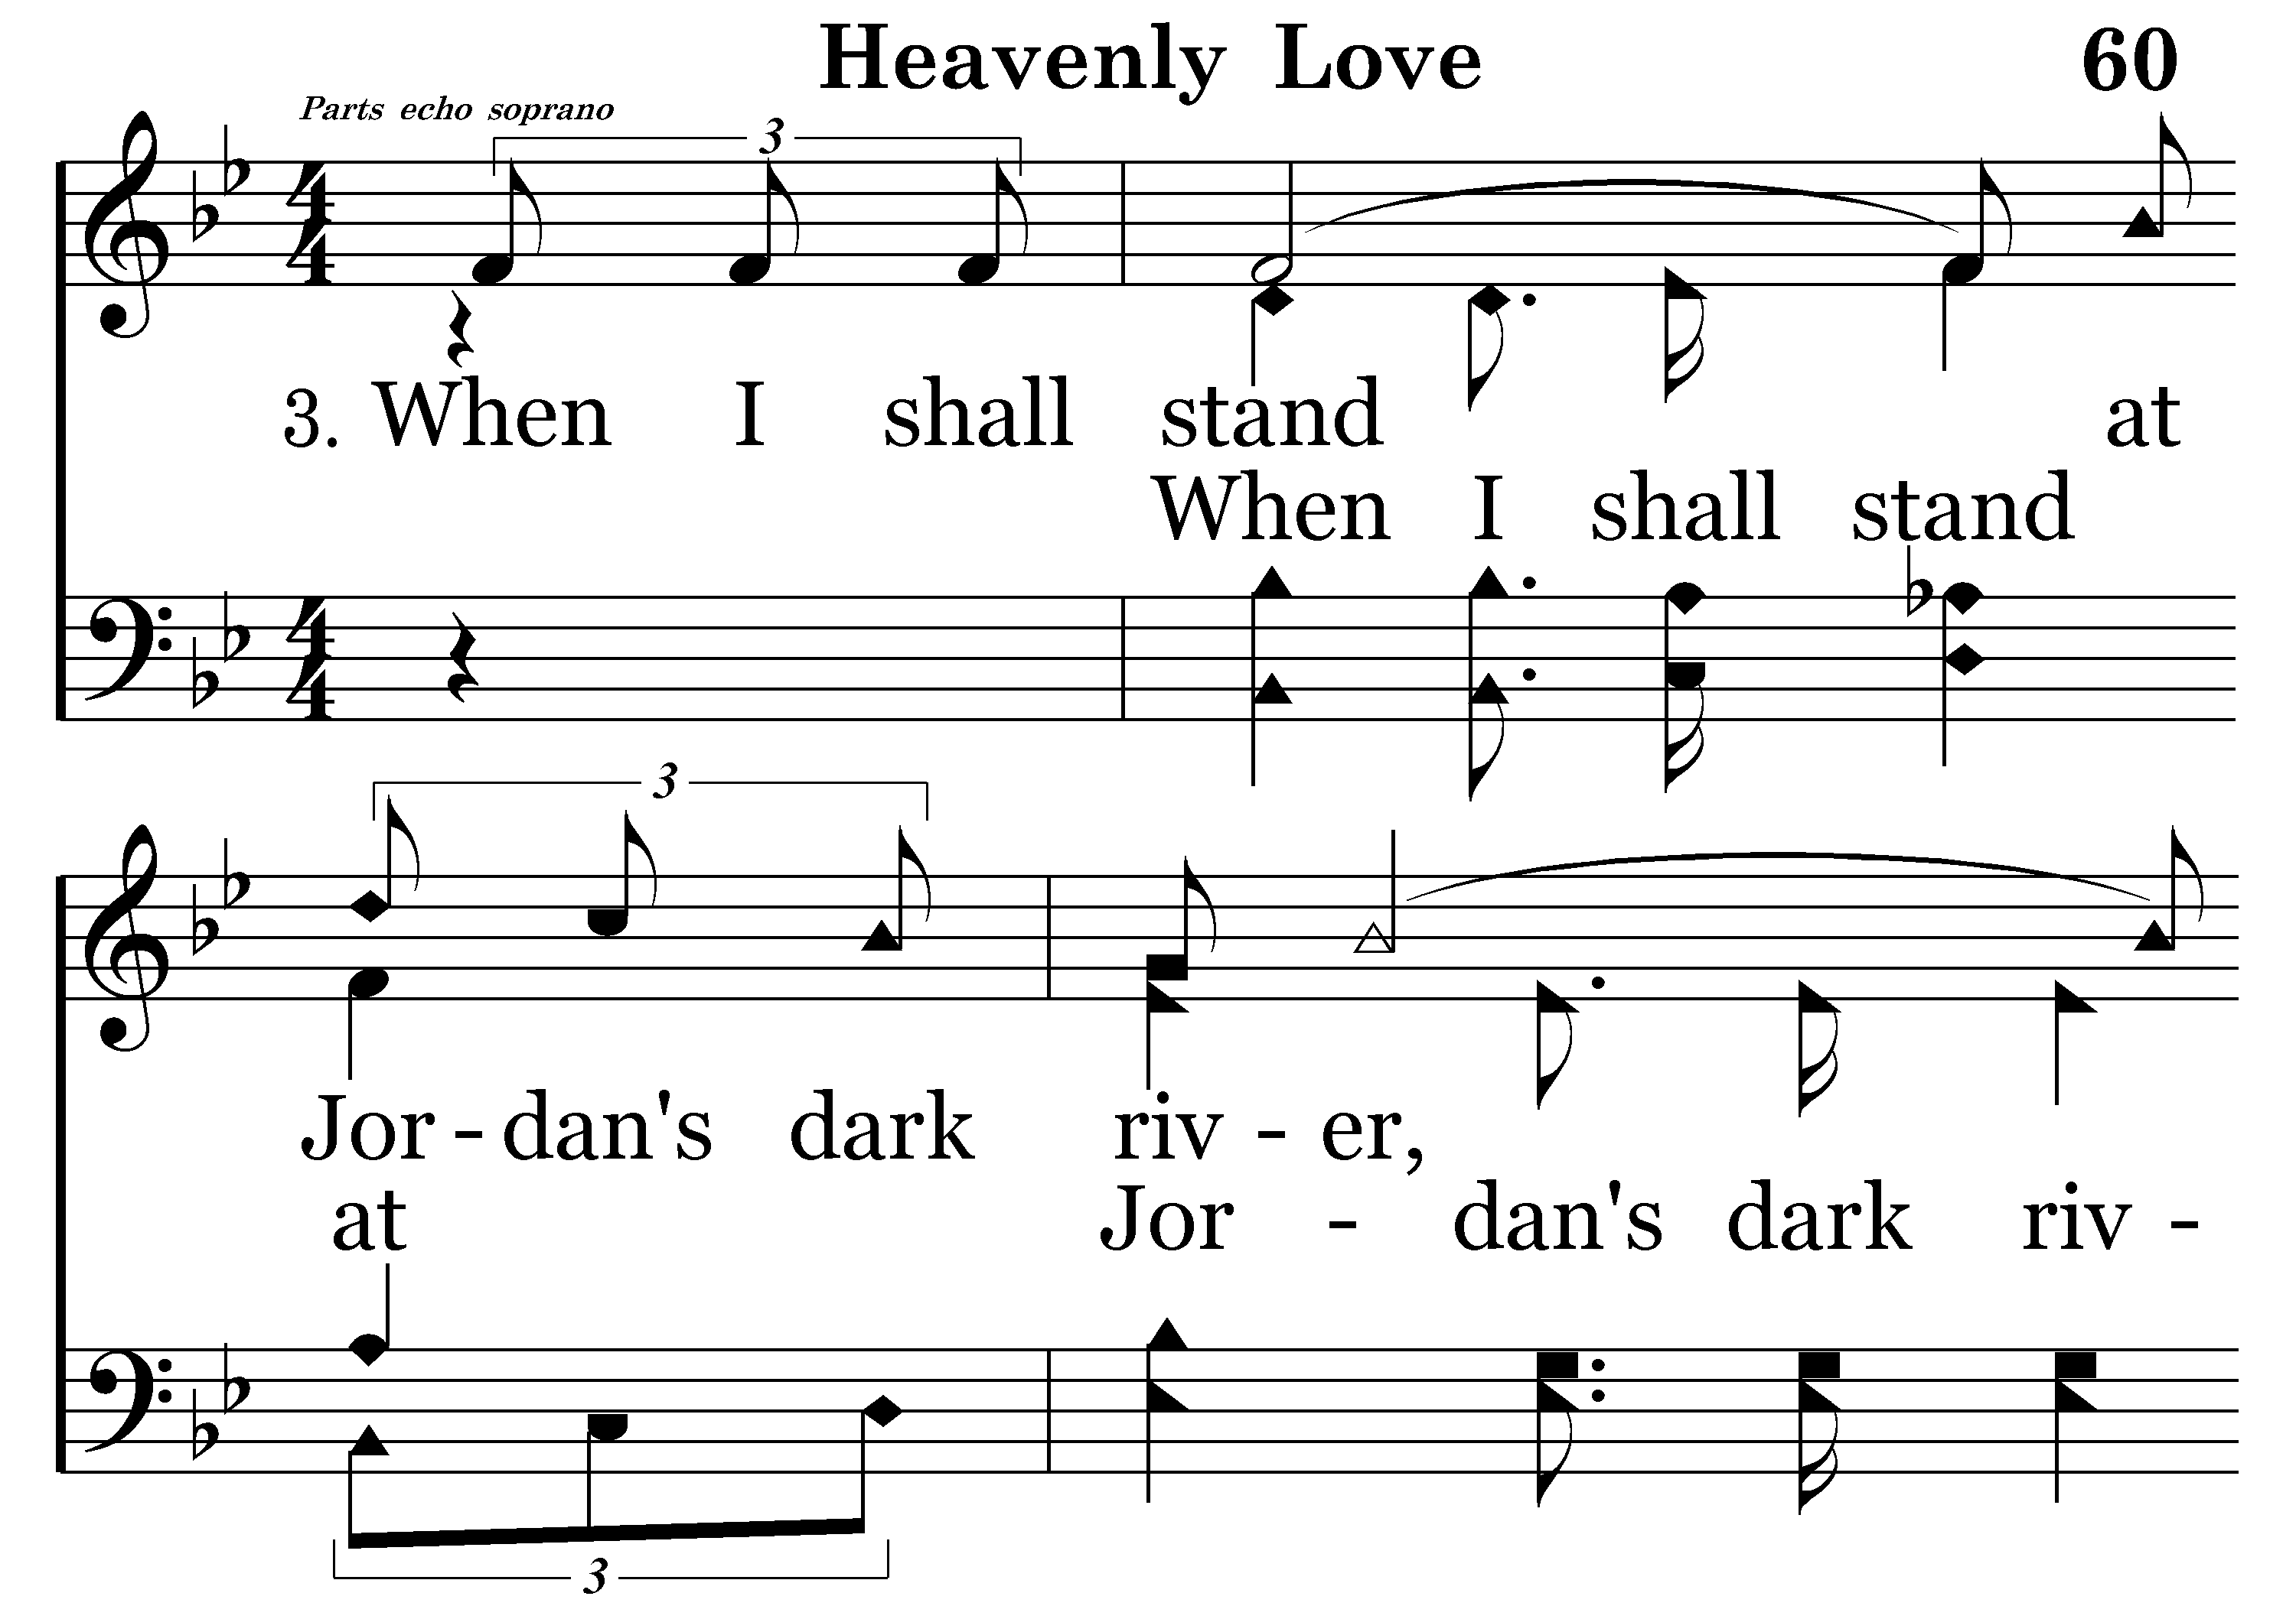
060 - Heavenly Love - 3.1

Slide 35
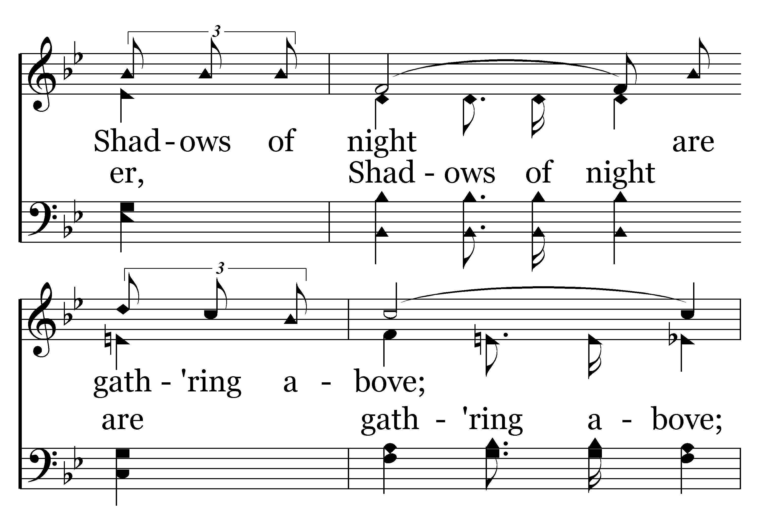
060 - Heavenly Love - 3.2

Slide 36
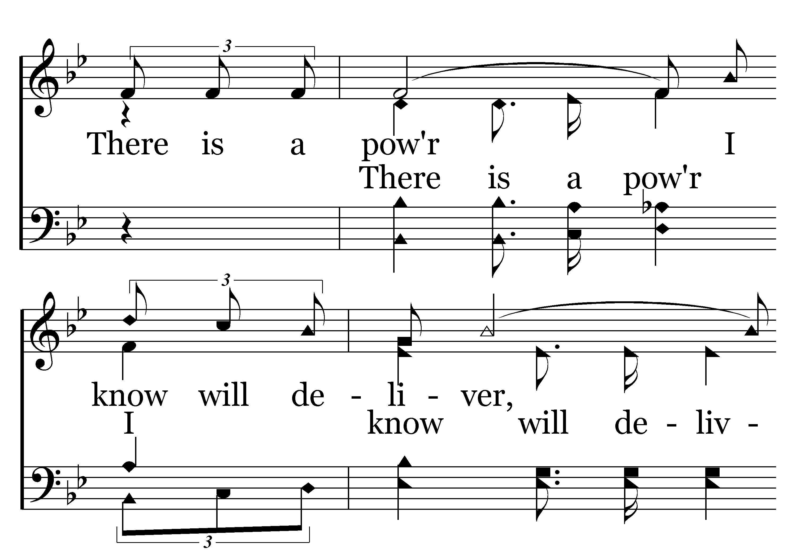
060 - Heavenly Love - 3.3

Slide 37
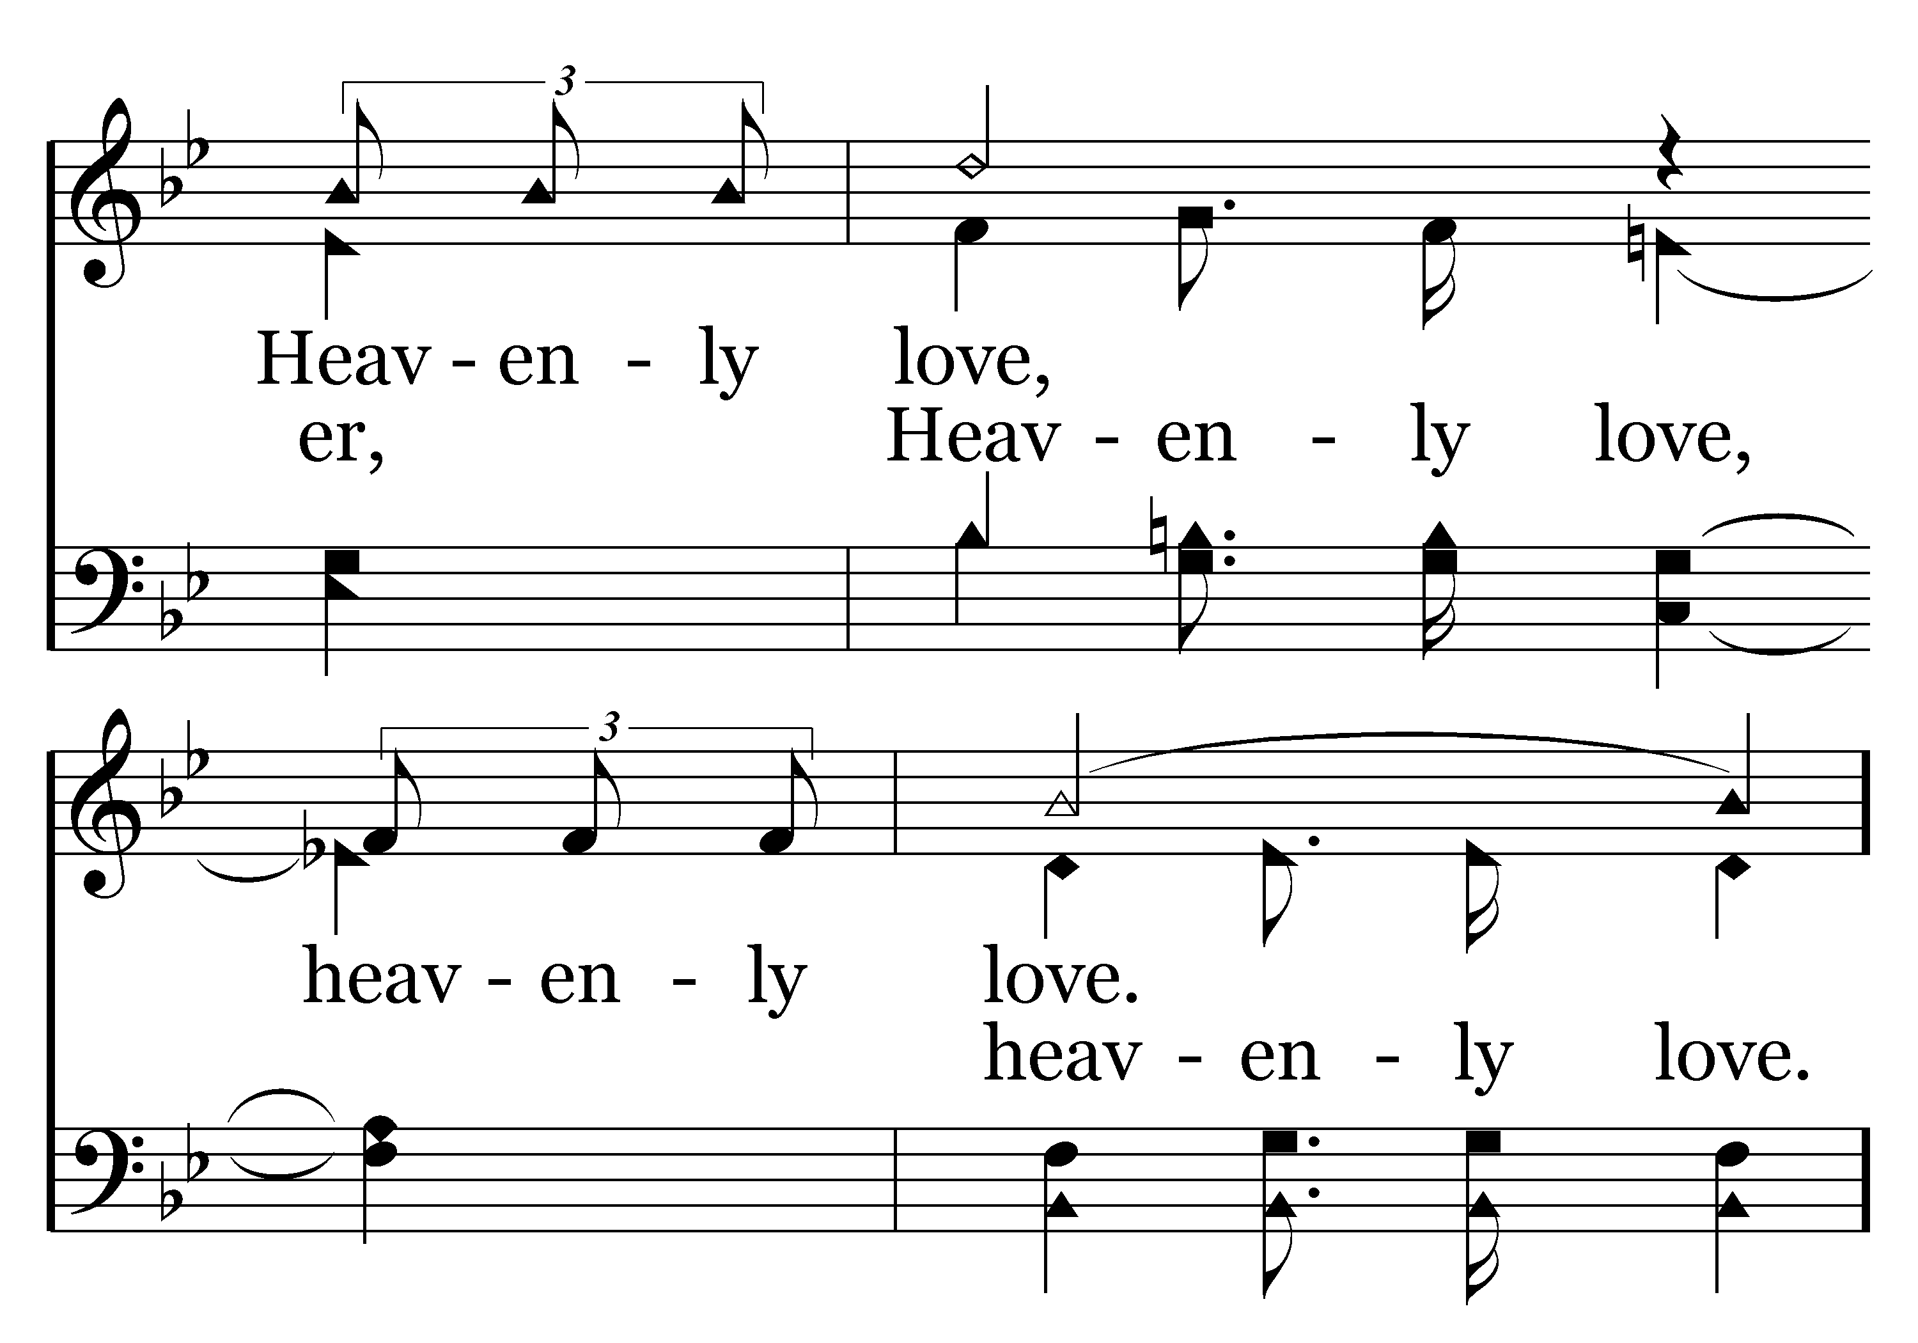
060 - Heavenly Love - 3.4

Slide 38
060 - Heavenly Love - C.1

Slide 39
060 - Heavenly Love - C.2

Slide 40
060 - Heavenly Love - C.3

Slide 41
060 - Heavenly Love - C.4
End of Song

