Slide 1
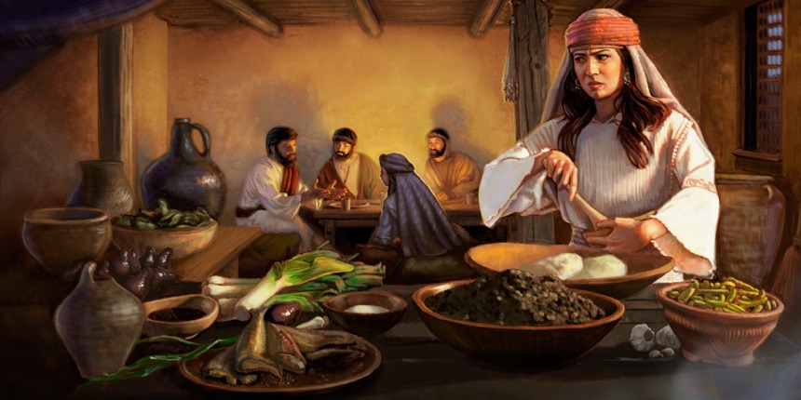
Being with Jesus: A Case Study of Mary & Martha
Luke 10:38-42

Slide 2
Luke 10:38-42
³⁸ Now it happened as they went that He entered a certain village; and a certain woman named Martha welcomed Him into her house. ³⁹ And she had a sister called Mary, who also sat at Jesus’ feet and heard His word. ⁴⁰ But Martha was distracted with much serving, and she approached Him and said, “Lord, do You not care that my sister has left me to serve alone? Therefore tell her to help me.” ⁴¹ And Jesus answered and said to her, “Martha, Martha, you are worried and troubled about many things. ⁴² But one thing is needed, and Mary has chosen that good part, which will not be taken away from her.”

Slide 3
Actions of Mary & Martha
Actions of Mary & Martha
Mary
Martha
Sat at Jesus’ feet and heard His word
Jesus said she “had chosen that good part which will not be taken away from her”
Welcomed Jesus into the house
Was distracted with much serving
Approached Jesus to correct Mary
Told she was “worried and troubled about many things”

Slide 4
Both were with Jesus, but…
only one was with Him for lasting good

Slide 5
Being with Jesus the Truly Good Way
It involves more than initially welcoming Him
Matthew 7:21-23; Hebrews 3:5-6; Hebrews 3:12-14
It demands the hearing of His word
John 6:60-69; Matthew 7:28-29; John 12:48; Luke 8:15
It necessitates an avoidance of distractions
Luke 8:14; Luke 21:34; Matthew 6:25-33 → Luke 12:29
It calls for critical evaluation of self
Galatians 6:3-5; James 4:11-12; 2 Corinthians 13:5
It requires a solitary focus on what is good & lasting
Matthew 6:24 → 6:33-34; Philippians 4:4-9; Psalm 27:4

Slide 6
Application to Us Being with Jesus
We are not truly being with Jesus if…
we have never welcomed Him into our life (initially obey)
we are not listening to all that He says through His word
we are distracted by the cares of world (not inherent sin)
we are thinking the problem is with everyone else
We can only truly be with Him if…
we have initially obeyed the gospel of Christ
we are continuing to hear Him & obey His word
we are constantly examining ourselves to detect faults
we have solitary focus on spiritual things, not carnal
Have we chosen that good part, can’t be taken away?

