Slide 1
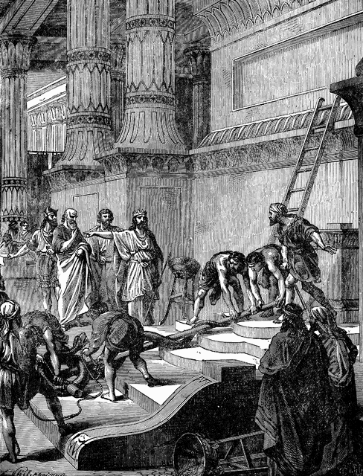
How to Cleanse a Defiled Temple
2nd Chronicles 29

Slide 2
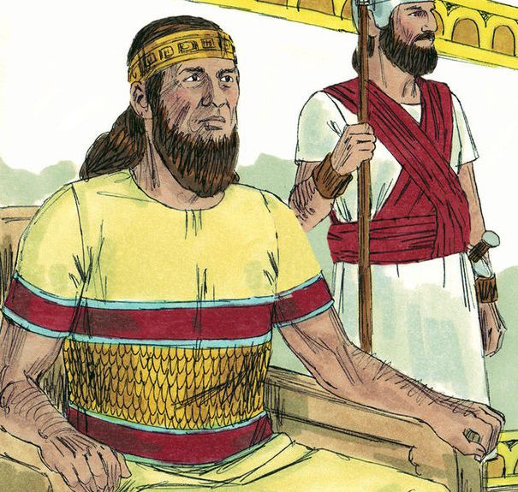
2nd Chronicles 29:1-10
¹ Hezekiah became king when he was twenty-five years old, and he reigned twenty-nine years in Jerusalem. His mother’s name was Abijah the daughter of Zechariah. ² And he did what was right in the sight of the Lord, according to all that his father David had done.

Slide 3
³ In the first year of his reign, in the first month, he opened the doors of the house of the Lord and repaired them. ⁴ Then he brought in the priests and the Levites, and gathered them in the East Square, ⁵ and said to them: “Hear me, Levites! Now sanctify yourselves, sanctify the house of the Lord God of your fathers, and carry out the rubbish from the holy place. ⁶ For our fathers have trespassed and done evil in the eyes of the Lord our God; they have forsaken Him, have turned their faces away from the dwelling place of the Lord, and turned their backs on Him. ⁷ They have also shut up the doors of the vestibule, put out the lamps, and have not burned incense or offered burnt offerings in the holy place to the God of Israel. ⁸ Therefore the wrath of the Lord fell upon Judah and Jerusalem, and He has given them up to trouble, to desolation, and to jeering, as you see with your eyes. ⁹ For indeed, because of this our fathers have fallen by the sword; and our sons, our daughters, and our wives are in captivity. ¹⁰ Now it is in my heart to make a covenant with the Lord God of Israel, that His fierce wrath may turn away from us…”
Action opposite of his father, Ahaz

Slide 4
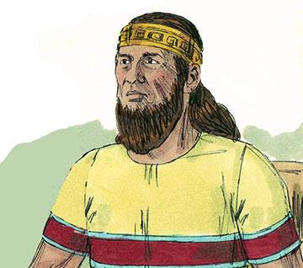
Hezekiah Instructed Priests & Levites Regarding Cleansing of the Temple
Then priests & Levites took action as instructed

Slide 5
2nd Chronicles 29:15-19
¹⁵ And they gathered their brethren, sanctified themselves, and went according to the commandment of the king, at the words of the Lord, to cleanse the house of the Lord. ¹⁶ Then the priests went into the inner part of the house of the Lord to cleanse it, and brought out all the debris that they found in the temple of the Lord to the court of the house of the Lord. And the Levites took it out and carried it to the Brook Kidron. ¹⁷ Now they began to sanctify on the first day of the first month, and on the eighth day of the month they came to the vestibule of the Lord. So they sanctified the house of the Lord in eight days, and on the sixteenth day of the first month they finished. ¹⁸ Then they went in to King Hezekiah and said, “We have cleansed all the house of the Lord, the altar of burnt offerings with all its articles, and the table of the showbread with all its articles. ¹⁹ Moreover all the articles which King Ahaz in his reign had cast aside in his transgression we have prepared and sanctified; and there they are, before the altar of the Lord.”

Slide 6
Steps to Cleansing a Defiled Temple
Identify the problem (vs. 3-9)
Set the mind to the task (v. 10)
Seek out the Lord’s will to cleanse (v. 15)
Carry the rubbish out of temple (v. 16a)
Put it far from the holy place (v. 16b)
Replace trash with holy things of Lord (vs. 18-19)
Seek the forgiveness of God (2 Chron. 29:20-24)
Do it all quickly (2 Chron. 29:36)

Slide 7
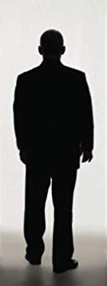
What Temple Must Be Cleansed Today?
“Or do you not know that your body is the temple of the Holy Spirit who is in you, whom you have from God, and you are not your own? For you were bought at a price; therefore glorify God in your body and in your spirit, which are God’s” (1 Cor. 6:19-20).
Each Individual Person

Slide 8
Steps to Cleansing Our Defiled Temple
Identify the problem (Matt. 7:3-5)
Set the mind to the task (Matt. 5:6)
Seek out the Lord’s will to cleanse (Acts 26:19-20)
Put the evil out of our life (Rom. 13:11-14)
Put sin far from our presence (Prov. 5:1-8)
Replace evil with holy things of Lord (Rom. 12:9)
Remember man after demon cast out (Lk. 11:24-26)
Seek the forgiveness of God (1 Jn. 1:8-10)
Do it all quickly (Acts 16:32-33; Lk. 19:1-10)

