Slide 1
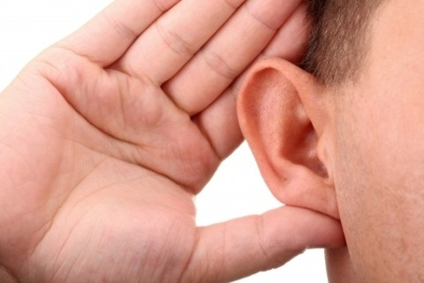
Proper Hearing
Mark 4:24 & Luke 8:18

Slide 2
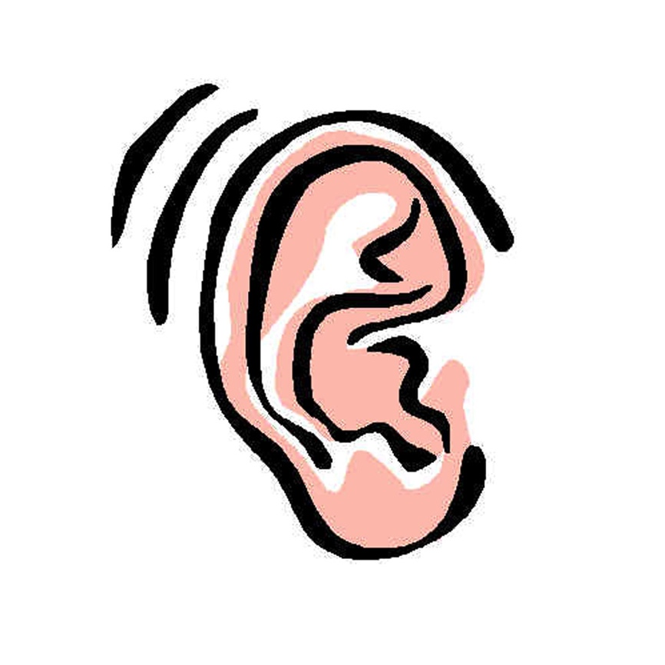
Mark 4:24
Then He said to them, “Take heed what you hear. With the same measure you use, it will be measured to you; and to you who hear, more will be given.”
Luke 8:18
Therefore take heed how you hear. For whoever has, to him more will be given; and whoever does not have, even what he seems to have will be taken from him.

Slide 3
Instruction on Hearing (James 1:19-20)
Previous verse shows proper source to hear (1:18)
Priority of Listening
”So then, my beloved brethren, let every man be swift to hear, slow to speak, slow to wrath; for the wrath of man does not produce the righteousness of God”(1:19-20)
Psa. 1:2
Purity and Meekness in Listening
"Therefore lay aside all filthiness and overflow of wickedness, and receive with meekness the implanted word, which is able to save your souls" (1:21)
1 Pet. 2:1-3
Active Listening
"But be doers of the word, and not hearers only, deceiving yourselves" (1:22)
Jas. 1:23-24 → Jas. 1:25 → Jas. 1:26-27
Heb. 4:12-13

Slide 4
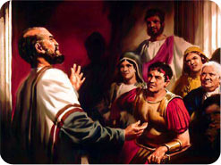
Example of Proper Hearing
“Now therefore, we are all present before God, to hear all things commanded you by God” (Acts 10:33)
First, they were all present
Second, they recognized the presence of God
Third, they wanted to hear all commanded by God
Cornelius & His Household

Slide 5
