Slide 2
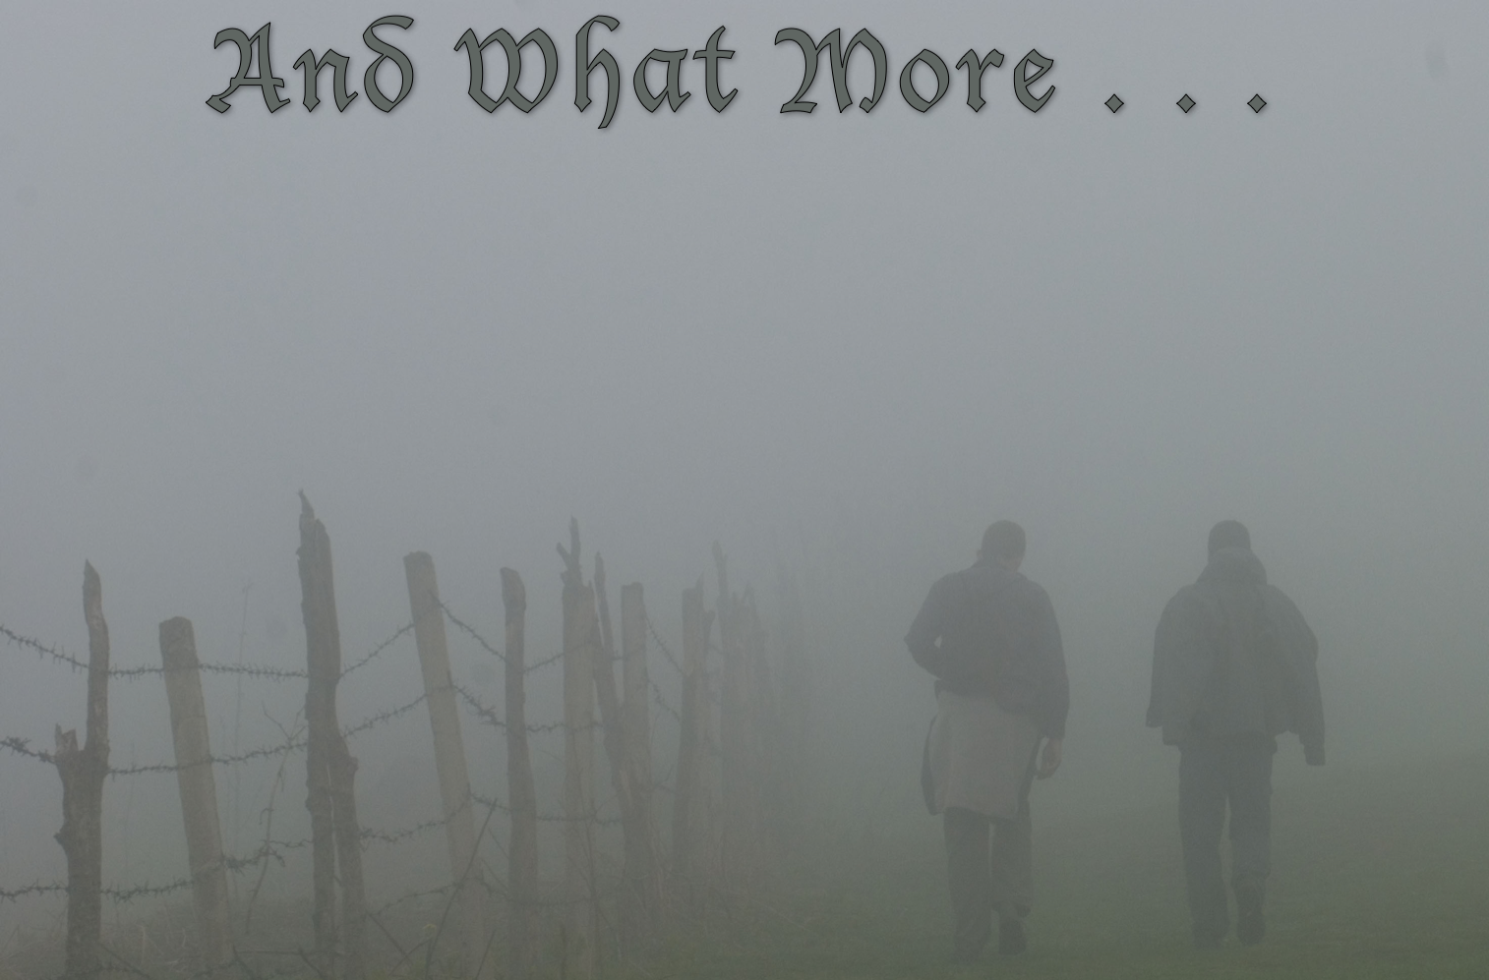
who through faith subdued kingdoms,
worked righteousness,
obtained promises,
stopped the mouths of lions,
quenched the violence of fire,
escaped the edge of the sword,
out of weakness were made strong,
became valiant in battle,
turned to flight the armies of the aliens,
women received their dead raised to life again,
tortured, not accepting deliverance,
others had trial of mockings and scourgings,
of chains and imprisonment,
stoned,
sawn in two,
were tempted,
were slain with the sword,
wandered about in sheepskins and goatskins,
being destitute, afflicted, tormented,
wandered in deserts and mountains, in dens and caves of the earth.

Slide 3

Now those who were scattered went from place to place preaching the word.
Acts 8:4
The Lord knows those who belong to him…
2 Timothy 2:19
Now the people who were scattered…went as far as Phoenicia, Cyprus, and Antioch, speaking the word... among them were some men from Cyprus and Cyrene, who came to Antioch and began proclaiming the Lord Jesus…
Acts 11:19-20

Slide 4
Those Nameless Godly Families—Nurturing Godly Homes
Ordinary Young Christians setting Extraordinary Examples
Average Older People Who Refuse to give in to Discouragement
Nondescript Church Members who Daily go the Extra Mile

