Slide 1
Temptation
James 1:1-12

Slide 2
Temptation is Inevitable
(v.2) Count it all joy WHEN we fall into temptation… Not if
(1 Tim. 3:12) If we want to be Christians temptation is inevitable
(Heb. 2:18) Even Christ was tempted allowing Him to sympathize with us (4:15-16)
(1 Cor. 10:13) Will never tempt beyond ability to endure
(Rom. 8:35-39) We conquer tribulations

Slide 3
Testing of Our Faith Produces Patience {v. 3}
(v. 4) We are complete if patience is made perfect
How?
(Col. 3:12-13) Clothe ourselves with patience
(Prov. 14:29) Allows us to have a great understanding
(Rom. 12:12) Patience in affliction
(Gal. 6:9) Being patient for the reward @ end of our trials
(Psa. 37:7) Be patient for good works to reward us
(Psa. 103:8) Lord is perfect in patience; need to imitate

Slide 4
Ask the Lord in Faith
(v. 6) With doubt in our minds, it does us no good to pray for help with afflictions
Must have faith to overcome temptations
(Matt. 26:41) Combat temptation by being watchful and praying
(Matt. 21:12-22) Faith is essential for our prayers to be answered
Prayer will help combat temptations, but faith must be present

Slide 5
Trials > Riches On Earth
(vv. 9-11) Lowly man glorified in his exaltations
Rich man will pass away as does a flower
Beautiful appearances perish as does the rich man and his pursuits
Pursuit of righteousness is not in vain. Pursuits of earthly glory and riches are in vain

Slide 6
“Blessed is the Man Who Endures Temptation”
“HE WILL RECEIVE THE CROWN OF LIFE!”

Slide 7
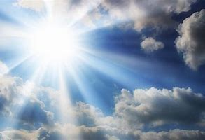
Come To The Father To Be Saved

