Slide 1
One Spirit, One Mind, One Faith, One Action
Philippians 1:27-30

Slide 2
Philippians 1:27-30
²⁷ Only let your conduct be worthy of the gospel of Christ, so that whether I come and see you or am absent, I may hear of your affairs, that you stand fast in one spirit, with one mind striving together for the faith of the gospel, ²⁸ and not in any way terrified by your adversaries, which is to them a proof of perdition, but to you of salvation, and that from God. ²⁹ For to you it has been granted on behalf of Christ, not only to believe in Him, but also to suffer for His sake, ³⁰ having the same conflict which you saw in me and now hear is in me.

Slide 3
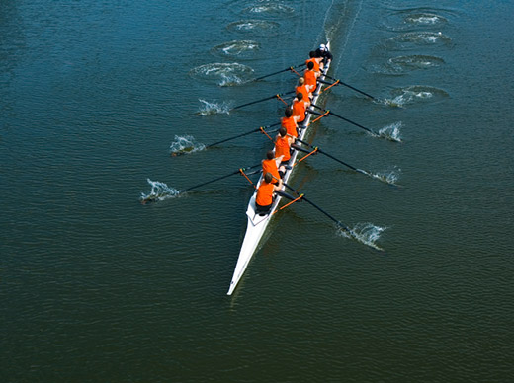
“Striving Together” (sunathleo)
Word used describes an intense effort that is undertaken with others
It portrays teammates who are jointly working with great effort to win
Not just the same group
Not just same stated aim
Not just doing something
Must have common aim, effort & intensity

Slide 4
Essentials for Striving Together in Gospel
One Spirit (Unity in Purpose)
Rom. 12:3-8 Variety of people & talents, but unity of purpose
1 Cor. 12:12-25 God placed each one in body as He pleased
One Mind (Unity in Will)
2 Cor. 13:11 Same instruction to Corinth (1 Cor. 1:10)
1 Pet. 3:8-12 If same resolve to do God’s will, we seek peace
One Faith (Unity in Standard)
Jude 3-4 The faith (the gospel) is our standard to maintain
Titus 1:9-13 Must involve rebuke & correction if we stray
One Action (Unity in Effort)
Neh. 2:17-18; 4:6, 17; 6:15-16 Example of united work
Eph. 4:11-16 All of us have our part to do (Heb. 10:19-25)
Lk. 13:24 Not just seek, must strive to enter by narrow way

