Slide 1
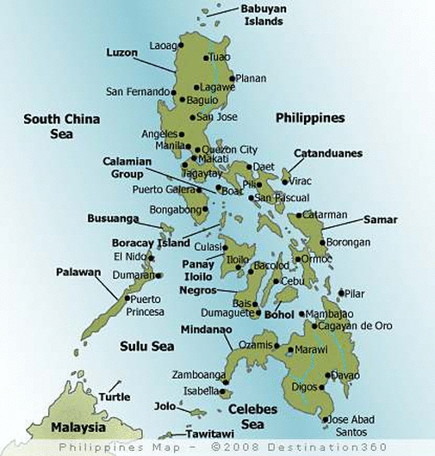
Report on Work in the Philippines
Tuguegarao

Slide 2
Tuguegarao

Slide 3
Work in Tuguegarao
Background of work – Rody Gumpad’s work
Month-long “Preacher Training” had great effect
Area had far less churches in about 2000
Over 150 churches now in the same area
Many meetings held in area with Rody & others
I had not held the week-long studies on book(s) of the Bible in Tuguegarao until this trip
1st & 2nd Peter
Premillennialism

Slide 4
Bible Teaching on Christ’s Coming at End
Bible Teaches Time of Christ’s Coming at End Is Unknown
2 Pet. 3:10-13 Day of Lord (end of world) will come as thief
1 Thess. 5:2-11 “Day of Lord will come as a thief in the night”
When were prophesies in book of Revelation to be fulfilled?
Rev. 1:1 Thing shown to John “must shortly come to pass”
Rev. 1:3 “The time is at hand”
Rev. 1:9 John “partaker with you in tribulation & kingdom”
Rev. 22:6 “to show… things which must shortly take place”
Rev. 22:10 “Do not seal the words… for the time is at hand”
Rev. 22:12 “Behold, I am coming quickly”
Rev. 22:20 “Surely I am coming quickly”
All said to John in 96 A.D. in midst of Roman persecution at that time
When were Matthew 24 prophecies fulfilled?
Matt. 24:23-31 Some apply this to coming of Christ at end of time
Matt. 24:34 “This generation will by no means pass away till all these things take place”
Matt. 24:34, Mark 13:30 & Luke 21:32 Everything spoken before these verses were fulfilled in A.D. 70 destruction of Jerusalem

Slide 5
Tuguegarao

Slide 6
Work in Angeles City
Background of work
Has had help from numerous American brethren being stationed there with Air Force (Clark Field)
Lordy Salunga very capable & has preached there for several years
Good growth over the past few years due to meetings held throughout the area
Have had numerous openings to institutional groups
First time to hold week-long classes on Bible books (1st & 2nd Timothy plus Titus)
Helped deal with error taught on eldership (U.S.)

Slide 7
Tuguegarao

