Slide 1
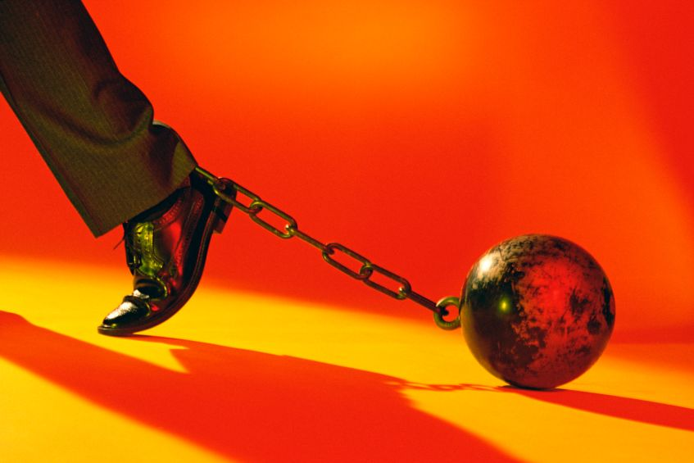
Encumbrances to Lay Aside
Hebrews 12:1-2

Slide 2
Hebrews 12:1-2
¹ Therefore we also, since we are surrounded by so great a cloud of witnesses, let us lay aside every weight, and the sin which so easily ensnares us, and let us run with endurance the race that is set before us, ² looking unto Jesus, the author and finisher of our faith, who for the joy that was set before Him endured the cross, despising the shame, and has sat down at the right hand of the throne of God.

Slide 3
Hebrews 12:1-2
¹ Therefore we also, since we are surrounded by so great a cloud of witnesses, let us lay aside every weight, and the sin which so easily ensnares us, and let us run with endurance the race that is set before us, ² looking unto Jesus, the author and finisher of our faith, who for the joy that was set before Him endured the cross, despising the shame, and has sat down at the right hand of the throne of God.
NASB: “…let us also lay aside every encumbrance and the sin…”

Slide 4
Encumbrances We Must Lay Aside
Sin Must Be Laid Aside
Eph. 4:17-22 Put off former manner of conduct
1 Pet. 2:11 Abstain from fleshly lusts
Rom. 13:11-14 Cast off the works of darkness
But Sin Is Not Only One – We Must Lay Aside…
Worldly Anxiety (Phil. 4:6; Matt. 6:33-34)
Overly Busy Routines (Luke 10:38-42)
Materialism (Matt. 6:19-21; 1 Tim. 6:6-10)
Unwise Use of Time (Eph. 5:15-16; Col. 4:5)
Perishable Crowns (1 Cor. 9:24-25; 1 Tim. 4:7-11)
Fear of Man (Prov. 29:25; 2 Tim. 3:12; Jn. 12:42-43)

Slide 5
Are There Things Distracting Me from Serving Christ?

