Slide 1
Into Our Hands
John 4:35
“Look, I tell you, lift up your eyes, and see that the fields are white for harvest.”

Slide 2
What’s Our Most Precious Resource?
Ephesians 5:15-16
¹⁵ See then that ye walk circumspectly, not as fools, but as wise, ¹⁶ Redeeming the time, because the days are evil.
Colossians 4:5-6
⁵ Walk in wisdom toward them that are without, redeeming the time. ⁶ Let your speech be always with grace, seasoned with salt, that ye may know how ye ought to answer every man.

Slide 3

“Time and tide wait for no man.”

Slide 4
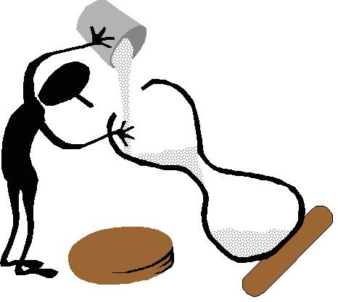
Luke 12:25
Who can add a single hour to his life?

Slide 5
“Lost time is never found again.” Benjamin Franklin

Slide 6

How Are We Using Our Time?

Slide 7
The Time Is Now
John 4:34-35
³⁴ Jesus said to them, “My food is to do the will of him who sent me and to accomplish his work. ³⁵ Do you not say, ‘There are yet four months, then comes the harvest’? Look, I tell you, lift up your eyes, and see that the fields are white for harvest.

Slide 8

Estimated Population in 2019
9,301,922,908

Slide 9
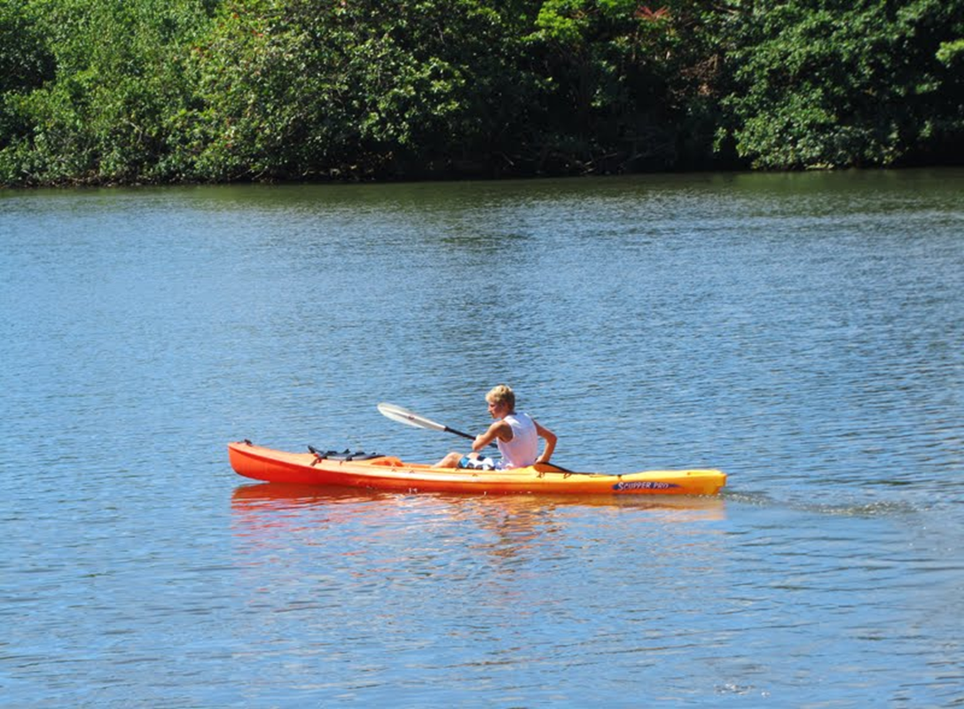
So many people are going down the stream of life, unaware of their spiritual condition and the danger ahead.

Slide 10
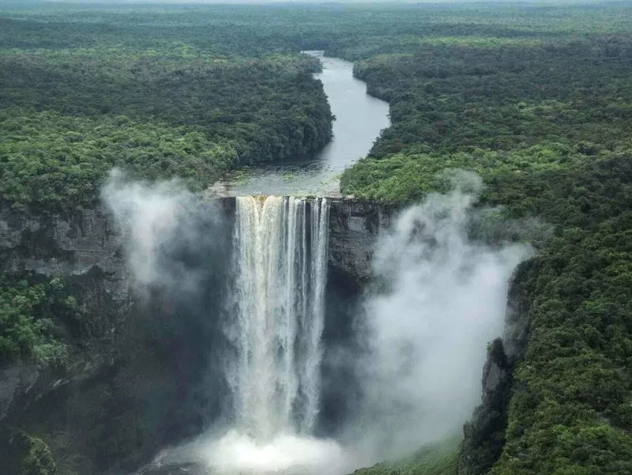
Romans 6:21
For the end of those things is death.

Slide 11

Hebrews 9:27
It is appointed unto men once to die.

Slide 12
The Second Death
Revelation 21:8
⁸ But as for the cowardly, the faithless, the detestable, as for murderers, the sexually immoral, sorcerers, idolaters, and all liars, their portion will be in the lake that burns with fire and sulfur, which is the second death.”

Slide 13
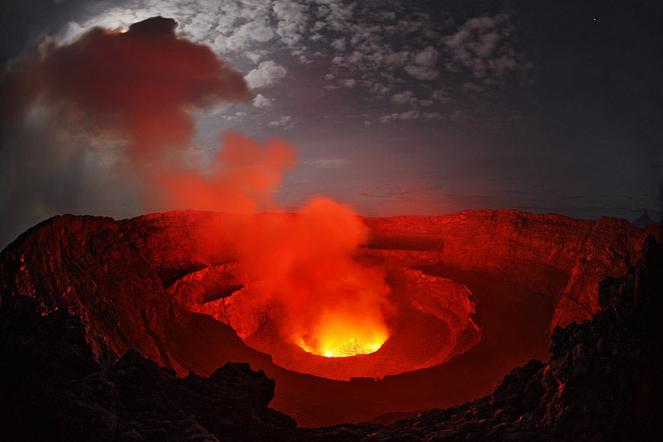
Mark 9:48
‘where their worm does not die and the fire is not quenched.’

Slide 14

Romans 10:14
And how are they to hear without someone preaching?

Slide 15

Romans 1:20
So they are without excuse.

Slide 16

Joshua 24:15
Choose this day whom you will serve.

Slide 17
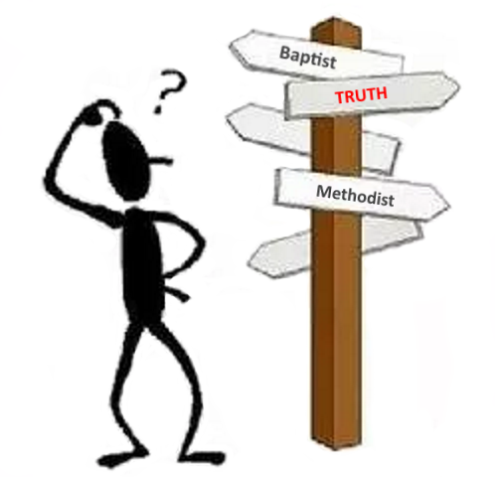
Matthew 7:21
“Not everyone who says to me, ‘Lord, Lord,’ will enter the kingdom of heaven”

Slide 18

What’s holding us back?

Slide 19

Are we waiting for the right time to tell them?

Slide 20
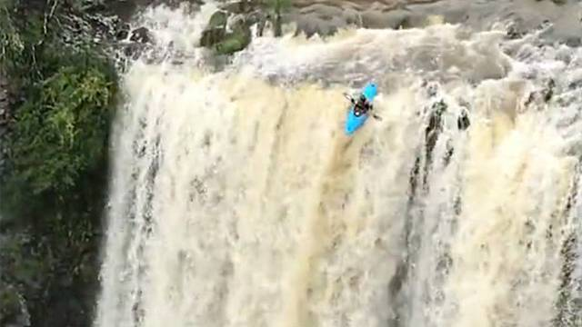
When we decide the time is right, it may be too late!

Slide 21

Are we afraid they won’t listen to us?

Slide 22

Are we too busy?

Slide 23

Too entertained?

Slide 24
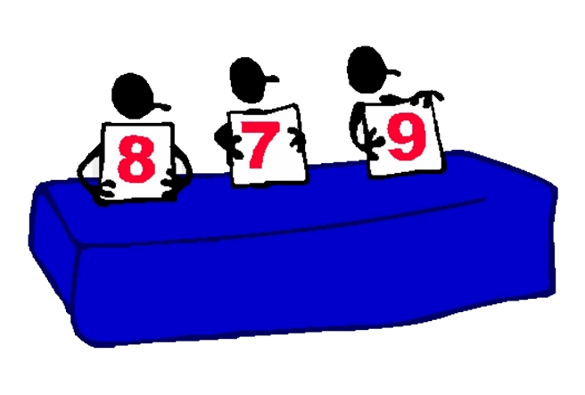
Are we prejudging the soil?

Slide 25

Our responsibility is to sow the seed.

Slide 26
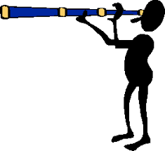
Are we looking for opportunities?

Slide 27
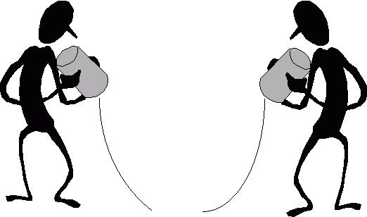
Technology offers us new ways to spread God’s word.

Slide 28

Most are right under our nose.

