Slide 2
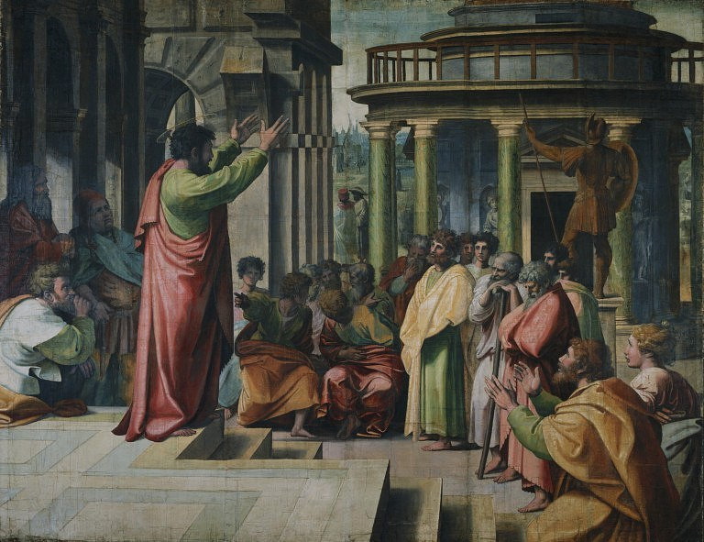
Judaizing Teachers
Who Are They?

Slide 3
Greek: “ioudaizein”
Galatians 2:14
“…live as do the Jews”
ἰουδαΐζειν
Judaizing Teachers
Who Are They?

Slide 4
Who are the Judaizers?
Compel Gentiles to be CIRCUMCISED (Acts 15:1, Gal. 6: 12-13)

Slide 5
Who are the Judaizers?
Compel Gentiles to be CIRCUMCISED (Acts 15:1, Gal. 6: 12-13)
Equate TRADITIONS to Jewish Religion (Gal. 1:14, 13, 23)

Slide 6
Who are the Judaizers?
Compel Gentiles to be CIRCUMCISED (Acts 15:1, Gal. 6: 12-13)
Equate TRADITIONS to Jewish Religion (Gal. 1:14, 13, 23)
Demand observance of DAYS, MONTHS, etc. (Acts 15:5, Gal. 4:9-10, Rom. 14:5-6)

Slide 7
Who are the Judaizers?
Compel Gentiles to be CIRCUMCISED (Acts 15:1, Gal. 6: 12-13)
Equate TRADITIONS to Jewish Religion (Gal. 1:14, 13, 23)
Demand observance of DAYS, MONTHS, etc. (Acts 15:5, Gal. 4:9-10, Rom. 14:5-6)
Refuse to EAT MEATS – EAT WITH GENTILES (Rom. 14, Lev. 11, Gal. 2:11-12)

Slide 8
Who are the Judaizers?
Compel Gentiles to be CIRCUMCISED (Acts 15:1, Gal. 6: 12-13)
Equate TRADITIONS to Jewish Religion (Gal. 1:14, 13, 23)
Demand observance of DAYS, MONTHS, etc. (Acts 15:5, Gal. 4:9-10, Rom. 14:5-6)
Refuse to EAT MEATS – EAT WITH GENTILES (Rom. 14, Lev. 11, Gal. 2:11-12)
Shut PEOPLE OUT so THEY SHALL BE SOUGHT (Gal. 4:17-18, Rom. 16:17-18, Titus 3:10)

Slide 9
Can’t You See…?
THE REALITY
Gal. 1:6-8; 2:16
The One Gospel Is Being Perverted!
Judaizers Are Troubling You – Called in God’s Grace!
Judaizers Are Under A Soul Damning Curse!

Slide 10
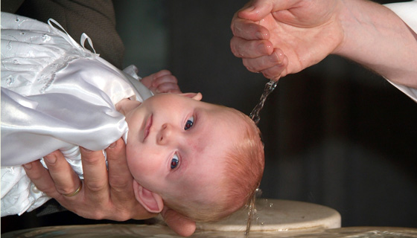
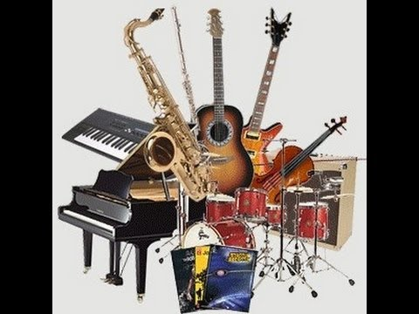
Infant Baptism???
Christian Sabbath???
Worship in the Church???

Slide 11
Infant Baptism???
Circumcision, 7th. Day Rest,
Christian Sabbath???
Old Testament Worship
Worship in the Church???

Slide 12
Infant Baptism???
Circumcision, 7th. Day Rest,
Christian Sabbath???
Colossians 2:14,16
Old Testament Worship
Worship in the Church???

Slide 13
Beware…
Of OUTWARD GLORY replacing the focus on THE INWARD REALITY (Rom. 2:28-29)

Slide 14
Beware…
Of OUTWARD GLORY replacing the focus on THE INWARD REALITY (Rom. 2:28-29, Gal. 3:1-5, 4:6, 5:22-25)

Slide 15
Beware…
Of OUTWARD GLORY replacing the focus on THE INWARD REALITY (Rom. 2:28-29, Gal. 3:1-5, 4:6, 5:22-25, Gal. 2:5, 2 Jn. 9-11)

Slide 16
Beware…
Of OUTWARD GLORY replacing the focus on THE INWARD REALITY (Rom. 2:28-29, Gal. 3:1-5, 4:6, 5:22-25, Gal. 2:5, 2 Jn. 9-11)
Of ZEAL without KNOWLEDGE (Rom. 10:2, Gal. 1:14, 4:17-18)

Slide 17
Beware…
Of OUTWARD GLORY replacing the focus on THE INWARD REALITY (Rom. 2:28-29, Gal. 3:1-5, 4:6, 5:22-25, Gal. 2:5, 2 Jn. 9-11)
Of ZEAL without KNOWLEDGE (Rom. 10:2, Gal. 1:14, 4:17-18)
Of the POWER OF PEER PRESSURE (Gal. 2:12-14)

