Slide 1
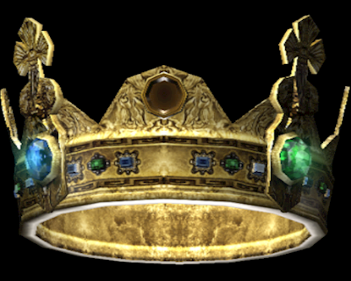
“Sin Shall Not Have Dominion”
Romans 6:12-14

Slide 2
Romans 6:12-14
¹² Therefore do not let sin reign in your mortal body, that you should obey it in its lusts. ¹³ And do not present your members as instruments of unrighteousness to sin, but present yourselves to God as being alive from the dead, and your members as instruments of righteousness to God. ¹⁴ For sin shall not have dominion over you, for you are not under law but under grace.

Slide 3
Romans 6:12-14
¹² Therefore do not let sin reign in your mortal body, that you should obey it in its lusts. ¹³ And do not present your members as instruments of unrighteousness to sin, but present yourselves to God as being alive from the dead, and your members as instruments of righteousness to God. ¹⁴ For sin shall not have dominion over you, for you are not under law but under grace.

Slide 4
Romans 6:12-14
¹² Therefore do not let sin reign in your mortal body, that you should obey it in its lusts. ¹³ And do not present your members as instruments of unrighteousness to sin, but present yourselves to God as being alive from the dead, and your members as instruments of righteousness to God. ¹⁴ For sin shall not have dominion over you, for you are not under law but under grace.

Slide 5
Romans 6:12-14
¹² Therefore do not let sin reign in your mortal body, that you should obey it in its lusts. ¹³ And do not present your members as instruments of unrighteousness to sin, but present yourselves to God as being alive from the dead, and your members as instruments of righteousness to God. ¹⁴ For sin shall not have dominion over you, for you are not under law but under grace.

Slide 6
Words of Text Regarding Rule
Reign (basileuo) - to prevail or predominate
Literally, to posses regal authority; to be a king
Connotes use of force or power by action taken
Obey (hupakouo) - to listen to another and obey; to render submissive acceptance
Describes one submitting to the rule of another upon hearing & accepting the instruction
Dominion (kurieuo) - to be lord over
State of being under settled dominance & control

Slide 7
Applying Words to Power of Sin
Sin “reigns” when actions of sin are allowed to prevail and predominate in our lives
May do such without great number of sins
Happens when any sin remains present in our lives without our repenting of it
We “obey” sin when we submit our will to it
Process is described in James 1:14-15
When our will submits to devil’s will, we sin
Sin has “dominion” when it has conquered our action & will

Slide 8
How Do We Stop Sin From Having Dominion Over Us?

Slide 9
Romans 6:12-14
¹² Therefore do not let sin reign in your mortal body, that you should obey it in its lusts. ¹³ And do not present your members as instruments of unrighteousness to sin, but present yourselves to God as being alive from the dead, and your members as instruments of righteousness to God. ¹⁴ For sin shall not have dominion over you, for you are not under law but under grace.

Slide 10
How Do We Prevent Dominion of Sin?
Do Not Present Ourselves to Sin & Unrighteousness
“Present” (paristemi) – stand beside; recommend; assist
We make the choice to allow sin into our lives
Cannot Let Sin Prevail or Continue in Our Actions
Romans 6:1-2, 11 Must not continue in sin, but die to it
Colossians 3:5-10 “Put off” or “put to death” old man
1 John 3:6-10 More we become like Christ, we reject sin
Must Not Let Our Will Submit to Sin’s Call
Galatians 5:16-17 Walking by Spirit & flesh are opposite
1 Thessalonians 4:3-8 Must be sanctified to God’s will
Romans 13:14 “Make no provision for the flesh…”
We Yield Self to Dominion of Either in Opposite Way

