Slide 1
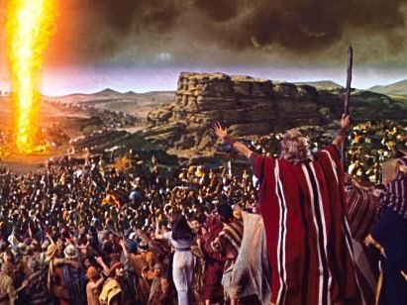
“Today, If You Will Hear His Voice…”
Hebrews 3:7-15

Slide 2
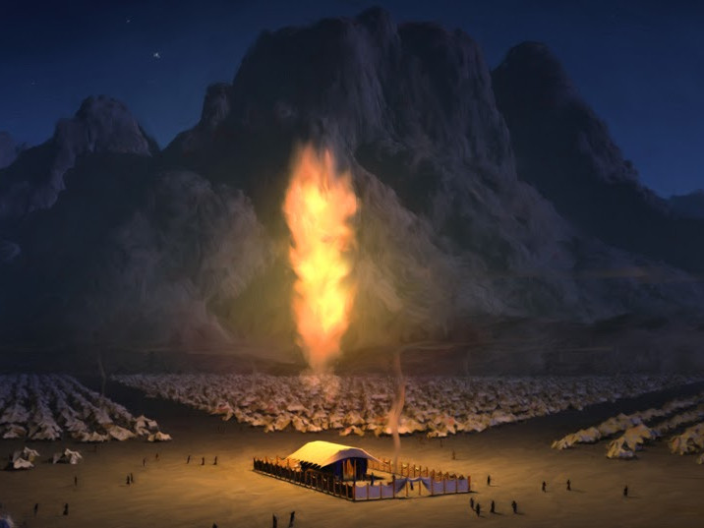
Hebrews 3:7-15
⁷ Therefore, as the Holy Spirit says: “Today, if you will hear His voice, ⁸ do not harden your hearts as in the rebellion, in the day of trial in the wilderness, ⁹ where your fathers tested Me, tried Me, and saw My works forty years. ¹⁰ Therefore I was angry with that generation, and said, ‘They always go astray in their heart, and they have not known My ways.’ ¹¹ So I swore in My wrath, ‘They shall not enter My rest.’”

Slide 3
¹² Beware, brethren, lest there be in any of you an evil heart of unbelief in departing from the living God; ¹³ but exhort one another daily, while it is called “Today,” lest any of you be hardened through the deceitfulness of sin. ¹⁴ For we have become partakers of Christ if we hold the beginning of our confidence steadfast to the end, ¹⁵ while it is said: “Today, if you will hear His voice, do not harden your hearts as in the rebellion.”

Slide 4
Hebrews 3:7-15
⁷ Therefore, as the Holy Spirit says: “Today, if you will hear His voice, ⁸ do not harden your hearts as in the rebellion, in the day of trial in the wilderness, ⁹ where your fathers tested Me, tried Me, and saw My works forty years. ¹⁰ Therefore I was angry with that generation, and said, ‘They always go astray in their heart, and they have not known My ways.’ ¹¹ So I swore in My wrath, ‘They shall not enter My rest.’”

Slide 5
Factors in Departing from God
“They always go astray in their heart”
Deut. 6:4-6 Uniqueness of God must be in heart
Prov. 4:23 Heart must be kept diligently as center
Matt. 22:34-38 First: Love Lord with all your heart
“They have not known My ways”
Isa. 55:7-9 Man’s ways & God’s ways are different
Matt. 22:29 “You err not knowing the Scriptures…”
Psa. 18:30 God’s way is “perfect”
Psa. 145:17
Dan. 4:37
Hos. 14:9
Rev. 15:3

Slide 6
Factors in Departing from God
“They always go astray in their heart”
Deut. 6:4-4 Uniqueness of God must be in heart
Prov. 4:23 Heart must be kept diligently as center
Matt. 22:34-37 First: Love Lord with all your heart
“They have not known My ways”
Isa. 55:7-9 Man’s ways & God’s ways are different
Matt. 22:29 “You err not knowing the Scriptures…”
Psa. 18:30 God’s way is “perfect”
They forget: “As the Holy Spirit says…”
When personal thoughts guide, God is forgotten
2 Tim. 3:16-17 “All Scripture is inspired by God…”
2 Pet. 1:21 “… spoke as they were moved by H.S.”

