Slide 1
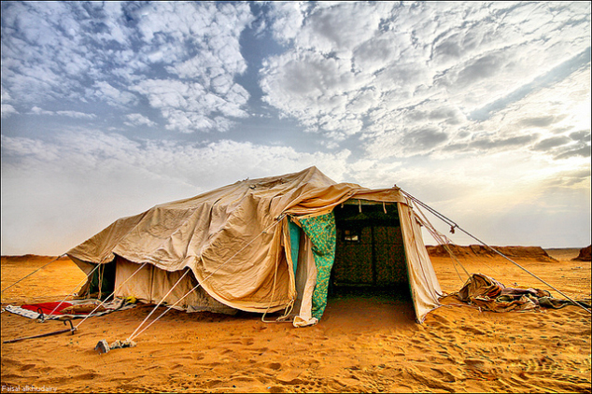
Resident Aliens
1 Peter 2:11-12

Slide 2
1 Peter 2:11-12
¹¹ Beloved, I beg you as sojourners and pilgrims, abstain from fleshly lusts which war against the soul, ¹² having your conduct honorable among the Gentiles, that when they speak against you as evildoers, they may, by your good works which they observe, glorify God in the day of visitation.

Slide 3
Words of Interest in Context
Sojourners – Gk. paroikos
One who has a home near; alien resident; neighbor; by-dweller
Living in place without rights of citizenship
Pilgrims – Gk. parepidēmos
An alien alongside; a resident foreigner
One who comes from a foreign country into a place he resides by the side of the natives
Both words emphasize the same point

Slide 4
Bible History of Resident Aliens
Old Testament Patriarchs
Hebrews 11:8-16
Returned to Ur for wives of patriarchs
Israel to Cast Out the Resident Aliens
Deuteronomy 7:1-6
Reason for separation shown as problem
Jews of the Diaspora in N.T. Times
1 Peter 1:1-2 → 2 Corinthians 6:14 – 7:1
1st century Christians lived in alien culture

Slide 5
How Jesus Wants Us to Live as Resident Aliens
Subject of Jesus’ Prayer for Disciples in John 17

Slide 6
Characteristics of Resident Aliens
Knowing God (John 17:1-5)

Slide 7
John 17:1-5
¹ Jesus spoke these words, lifted up His eyes to heaven, and said: “Father, the hour has come. Glorify Your Son, that Your Son also may glorify You, ² as You have given Him authority over all flesh, that He should give eternal life to as many as You have given Him. ³ And this is eternal life, that they may know You, the only true God, and Jesus Christ whom You have sent. ⁴ I have glorified You on the earth. I have finished the work which You have given Me to do. ⁵ And now, O Father, glorify Me together with Yourself, with the glory which I had with You before the world was.

Slide 8
Characteristics of Resident Aliens
Knowing God (John 17:1-5)
Identified by the Name of God (John 17:6-11)

Slide 9
John 17:6-11
⁶ “I have manifested Your name to the men whom You have given Me out of the world. They were Yours, You gave them to Me, and they have kept Your word. ⁷ Now they have known that all things which You have given Me are from You. ⁸ For I have given to them the words which You have given Me; and they have received them, and have known surely that I came forth from You; and they have believed that You sent Me. ⁹ I pray for them. I do not pray for the world but for those whom You have given Me, for they are Yours. ¹⁰ And all Mine are Yours, and Yours are Mine, and I am glorified in them. ¹¹ Now I am no longer in the world, but these are in the world, and I come to You. Holy Father, keep through Your name those whom You have given Me, that they may be one as We are.

Slide 10
Characteristics of Resident Aliens
Knowing God (John 17:1-5)
Identified by the Name of God (John 17:6-11)
Living in the World, Not of the World (John 17:13-16)

Slide 11
John 17:13-16
¹³ “But now I come to You, and these things I speak in the world, that they may have My joy fulfilled in themselves. ¹⁴ I have given them Your word; and the world has hated them because they are not of the world, just as I am not of the world.¹⁵ I do not pray that You should take them out of the world, but that You should keep them from the evil one. ¹⁶ They are not of the world, just as I am not of the world.

Slide 12
Characteristics of Resident Aliens
Knowing God (John 17:1-5)
Identified by the Name of God (John 17:6-11)
Living in the World, Not of the World (John 17:13-16)
Being Sanctified by the Truth – Gospel (John 17:17-19)

Slide 13
John 17:17-19
¹⁷ Sanctify them by Your truth. Your word is truth. ¹⁸ As You sent Me into the world, I also have sent them into the world. ¹⁹ And for their sakes I sanctify Myself, that they also may be sanctified by the truth.

Slide 14
Characteristics of Resident Aliens
Knowing God (John 17:1-5)
Identified by the Name of God (John 17:6-11)
Living in the World, Not of the World (John 17:13-16)
Being Sanctified by the Truth – Gospel (John 17:17-19)
United to Evangelize the World (John 17:20-23)

Slide 15
John 17:20-23
²⁰ “I do not pray for these alone, but also for those who will believe in Me through their word; ²¹ that they all may be one, as You, Father, are in Me, and I in You; that they also may be one in Us, that the world may believe that You sent Me. ²² And the glory which You gave Me I have given them, that they may be one just as We are one: ²³ I in them, and You in Me; that they may be made perfect in one, and that the world may know that You have sent Me, and have loved them as You have loved Me.

Slide 16
Characteristics of Resident Aliens
Knowing God (John 17:1-5)
Identified by the Name of God (John 17:6-11)
Living in the World, Not of the World (John 17:13-16)
Being Sanctified by the Truth – Gospel (John 17:17-19)
United to Evangelize the World (John 17:20-23)
Having a Hope of Eternal Glory (John 17:24-26)

Slide 17
John 17:24-26
²⁴ “Father, I desire that they also whom You gave Me may be with Me where I am, that they may behold My glory which You have given Me; for You loved Me before the foundation of the world. ²⁵ O righteous Father! The world has not known You, but I have known You; and these these have known that You sent Me. ²⁶ And I have declared to them Your name, and will declare it, that the love with which You loved Me may be in them, and I in them.”

Slide 18
Are We Truly Resident Aliens
…Knowing God?
…Identified by the Name of God?
…Living in the World, Not of the World?
…Being Sanctified by the Truth – Gospel?
…United to Evangelize the World?
…Having a Hope of Eternal Glory?

