Slide 1
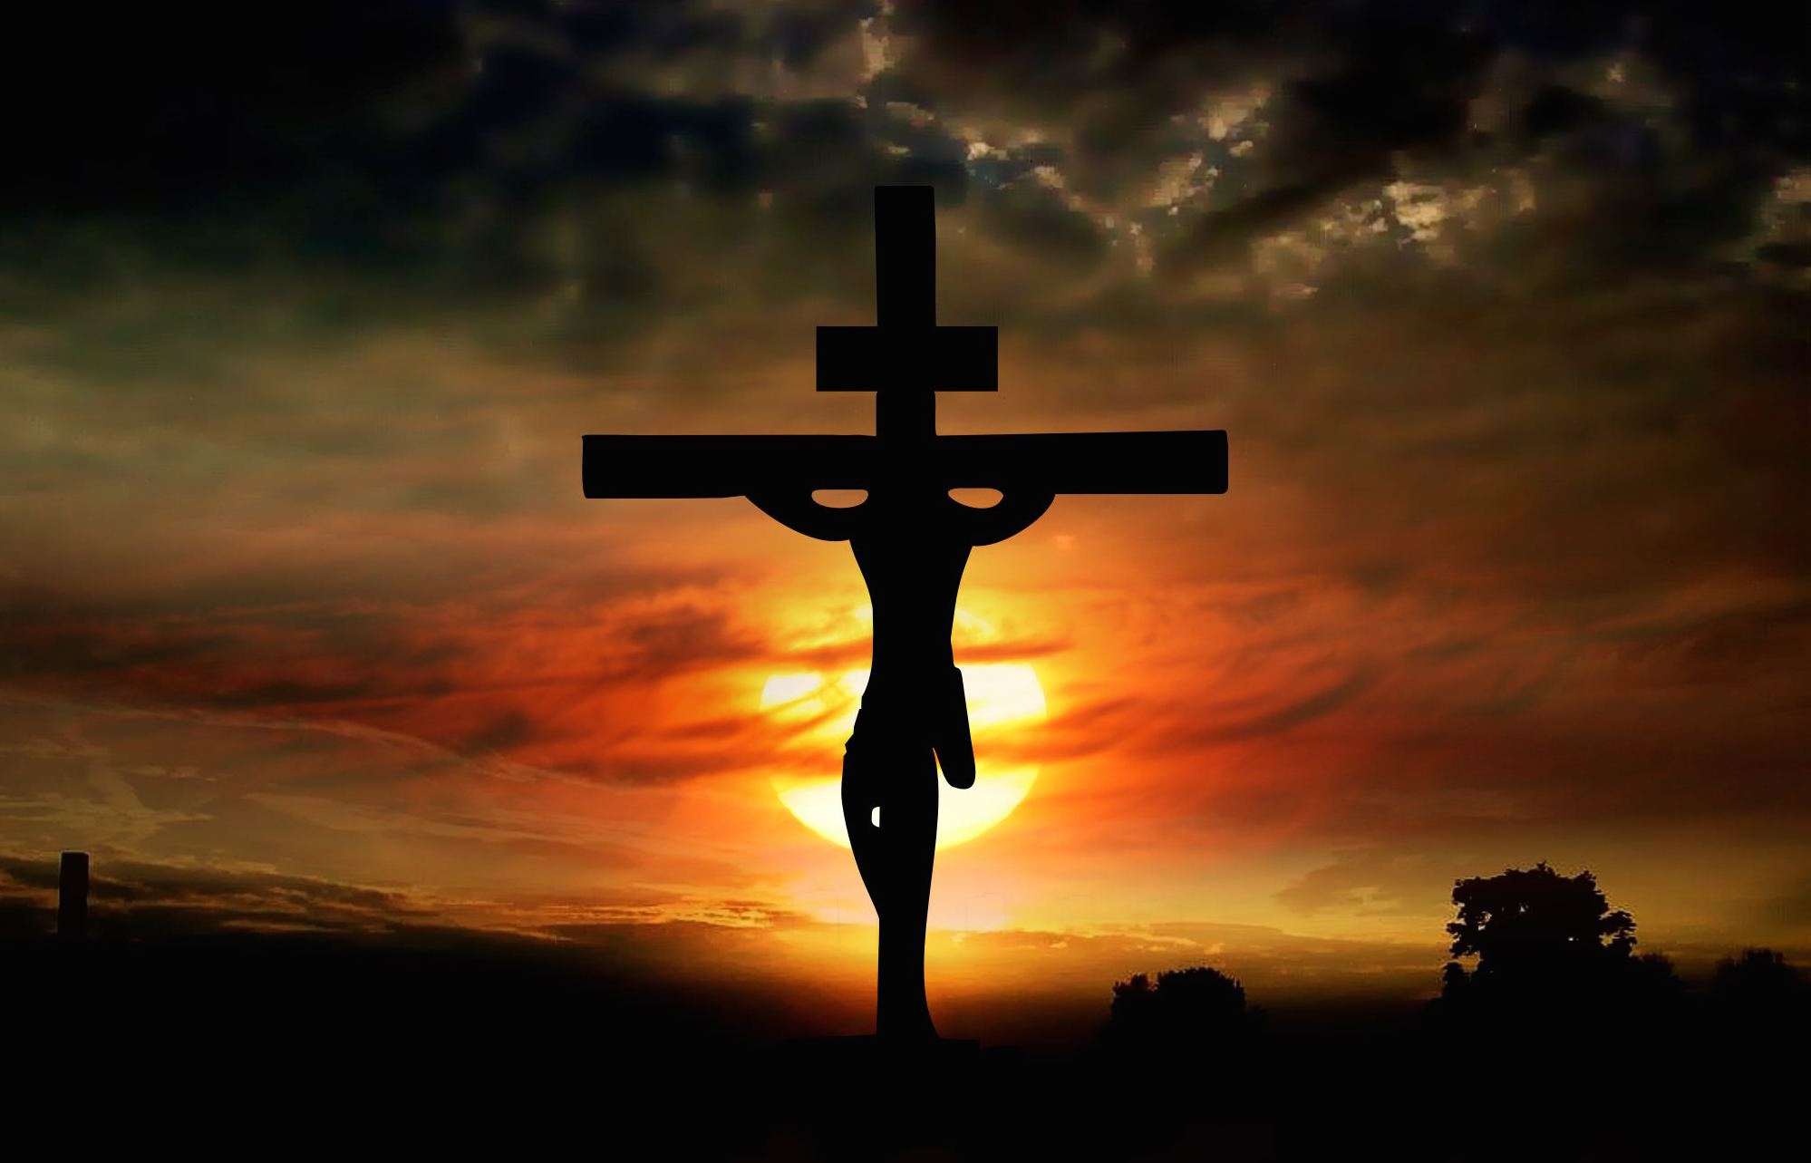
The Love of Christ Compels Us
2nd Corinthians 5:14-15

Slide 2
2 Corinthians 5:14-15
¹⁴ For the love of Christ compels us, because we judge thus: that if One died for all, then all died; ¹⁵ and He died for all, that those who live should live no longer for themselves, but for Him who died for them and rose again.

Slide 3
Love of Christ Must Compel Us…
To Keep His Commandments (John 14:15)
John 14:21-24
Colossians 3:12-17
To Abstain From Sin (1 John 2:15-17)
Ephesians 4:17-24
1 Peter 4:1-3
To Try Teachings If True or False (1 Jn. 4:1-6)
Jude 3-4
2 John 9-11

Slide 4
Love of Christ Must Compel Us…
To Love One Another (1 John 4:7-12, 19-21)
1 John 3:16
1 Thessalonians 3:12-13
1 Peter 1:22-23
To Spread the Gospel (2 Corinthians 5:11)
Acts 8:4
1 Timothy 1:12-17

