Slide 1
Let Us Not Grow Weary in Doing Good
Galatians 6:7-9

Slide 2
Galatians 6:7-9
⁷ Do not be deceived, God is not mocked; for whatever a man sows, that he will also reap. ⁸ For he who sows to his flesh will of the flesh reap corruption, but he who sows to the Spirit will of the Spirit reap everlasting life. ⁹ And let us not grow weary while doing good, for in due season we shall reap if we do not lose heart.

Slide 3
Galatians 6:7-9
⁷ Do not be deceived, God is not mocked; for whatever a man sows, that he will also reap. ⁸ For he who sows to his flesh will of the flesh reap corruption, but he who sows to the Spirit will of the Spirit reap everlasting life. ⁹ And let us not grow weary while doing good, for in due season we shall reap if we do not lose heart.

Slide 4
Galatians 6:7-9
⁷ Do not be deceived, God is not mocked; for whatever a man sows, that he will also reap. ⁸ For he who sows to his flesh will of the flesh reap corruption, but he who sows to the Spirit will of the Spirit reap everlasting life. ⁹ And let us not grow weary while doing good, for in due season we shall reap if we do not lose heart.

Slide 5
Weary: Meaning & Use
“Weary” is translation of Greek word enkakeo
“To lack courage, lose heart, be fainthearted”
Other uses of word in the New Testament
Luke 18:1-8 In prayer
2 Cor. 4:1 Concerning charge to preach gospel
2 Cor. 4:16 Regarding service amidst affliction
Eph. 3:13 At tribulation of faithful brethren
2 Thess. 3:13 In doing right while others do not
Regardless of reason, we cannot cease work

Slide 6
Exhortations to Endurance
Heb. 12:1, 12-13 Lay aside encumbrances
Rom. 2:7 Must pursue with patience
Heb. 3:14 Hold confidence firm to the end
2 Cor. 4:16 Focus on things eternal
2 Tim. 4:7-8 Remember security of hope
James 5:7-11 Wait for God’s deliverance
All necessary for continual endurance

Slide 7
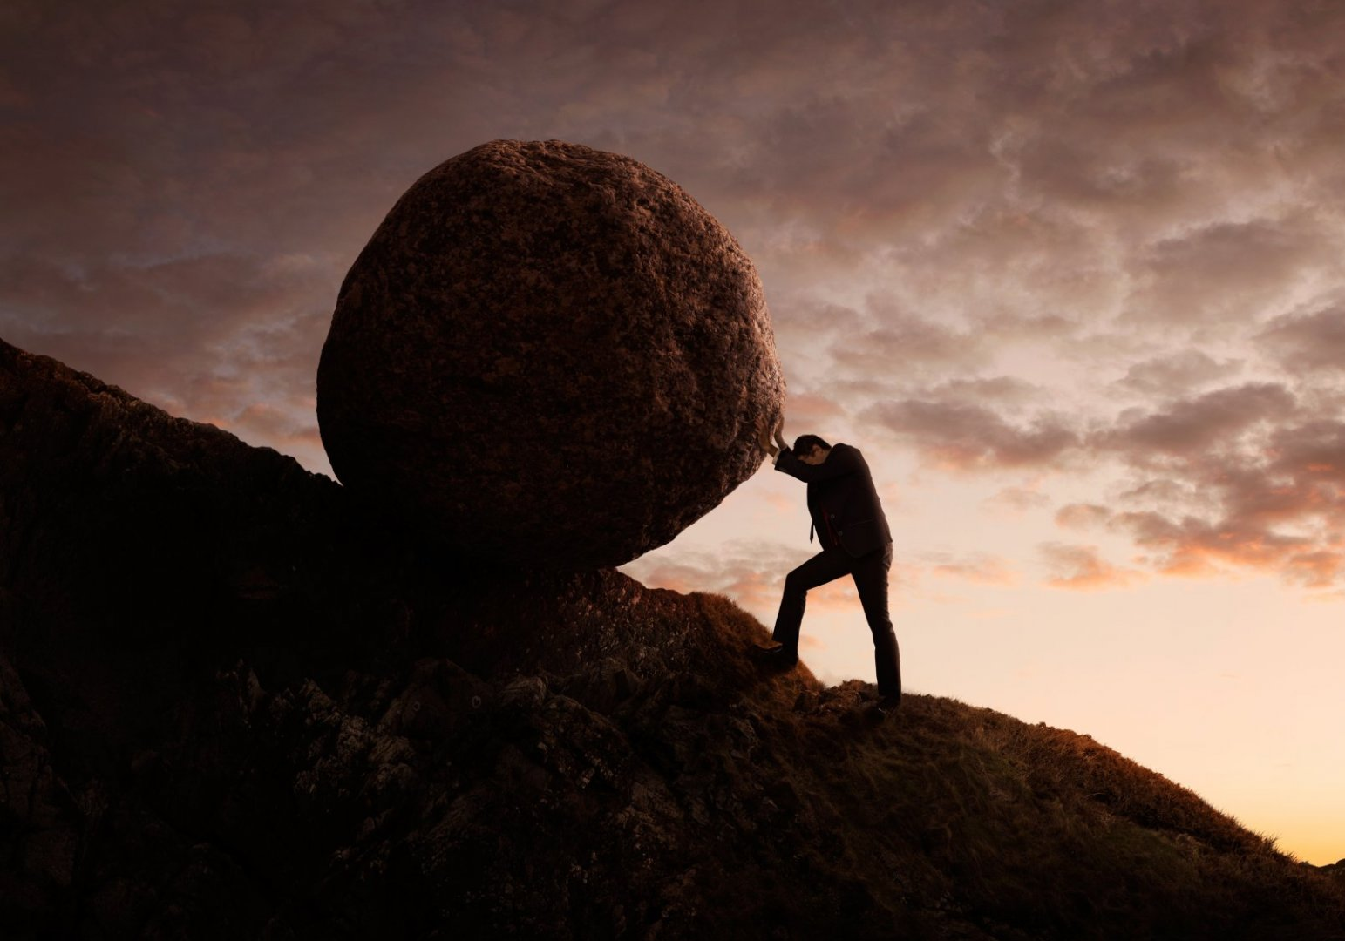
Examples to Imitate...
Noah
Abraham
Joseph
Jeremiah
Daniel
Paul

Slide 8
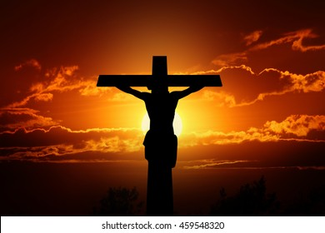
JESUS - Perfect Example
Endured bringing ultimate blessings despite greatest opposition ever faced
Heb. 2:14-18 Partook of humanity
Heb. 4:14-16 Touched with our infirmities
Heb. 5:7-9 Perfected through suffering
Heb. 12:2 Must look to Jesus’ endurance
Whatever our lot, no man has ever had to endure like Christ
Yet, He remained sinless urging us to imitate Him

