Slide 1
Receiving or Rejecting the Remedy:
Do I Really Have a Choice?
2nd Chronicles 36:14-16

Slide 2
2 Chronicles 36:14-16
¹⁴ Moreover all the leaders of the priests and the people transgressed more and more, according to all the abominations of the nations, and defiled the house of the Lord which He had consecrated in Jerusalem. ¹⁵ And the Lord God of their fathers sent warnings to them by His messengers, rising up early and sending them, because He had compassion on His people and on His dwelling place. ¹⁶ But they mocked the messengers of God, despised His words, and scoffed at His prophets, until the wrath of the Lord arose against His people, till there was no remedy.

Slide 3
2 Chronicles 36:14-16
¹⁴ Moreover all the leaders of the priests and the people transgressed more and more, according to all the abominations of the nations, and defiled the house of the Lord which He had consecrated in Jerusalem. ¹⁵ And the Lord God of their fathers sent warnings to them by His messengers, rising up early and sending them, because He had compassion on His people and on His dwelling place. ¹⁶ But they mocked the messengers of God, despised His words, and scoffed at His prophets, until the wrath of the Lord arose against His people, till there was no remedy.

Slide 4
2 Chronicles 36:14-16
¹⁴ Moreover all the leaders of the priests and the people transgressed more and more, according to all the abominations of the nations, and defiled the house of the Lord which He had consecrated in Jerusalem. ¹⁵ And the Lord God of their fathers sent warnings to them by His messengers, rising up early and sending them, because He had compassion on His people and on His dwelling place. ¹⁶ But they mocked the messengers of God, despised His words, and scoffed at His prophets, until the wrath of the Lord arose against His people, till there was no remedy.

Slide 5
2 Chronicles 36:14-16
¹⁴ Moreover all the leaders of the priests and the people transgressed more and more, according to all the abominations of the nations, and defiled the house of the Lord which He had consecrated in Jerusalem. ¹⁵ And the Lord God of their fathers sent warnings to them by His messengers, rising up early and sending them, because He had compassion on His people and on His dwelling place. ¹⁶ But they mocked the messengers of God, despised His words, and scoffed at His prophets, until the wrath of the Lord arose against His people, till there was no remedy.

Slide 6
2 Chronicles 36:14-16
¹⁴ Moreover all the leaders of the priests and the people transgressed more and more, according to all the abominations of the nations, and defiled the house of the Lord which He had consecrated in Jerusalem. ¹⁵ And the Lord God of their fathers sent warnings to them by His messengers, rising up early and sending them, because He had compassion on His people and on His dwelling place. ¹⁶ But they mocked the messengers of God, despised His words, and scoffed at His prophets, until the wrath of the Lord arose against His people, till there was no remedy.

Slide 7
2 Chronicles 36:14-16
¹⁴ Moreover all the leaders of the priests and the people transgressed more and more, according to all the abominations of the nations, and defiled the house of the Lord which He had consecrated in Jerusalem. ¹⁵ And the Lord God of their fathers sent warnings to them by His messengers, rising up early and sending them, because He had compassion on His people and on His dwelling place. ¹⁶ But they mocked the messengers of God, despised His words, and scoffed at His prophets, until the wrath of the Lord arose against His people, till there was no remedy.

Slide 8
2 Chronicles 36:14-16
¹⁴ Moreover all the leaders of the priests and the people transgressed more and more, according to all the abominations of the nations, and defiled the house of the Lord which He had consecrated in Jerusalem. ¹⁵ And the Lord God of their fathers sent warnings to them by His messengers, rising up early and sending them, because He had compassion on His people and on His dwelling place. ¹⁶ But they mocked the messengers of God, despised His words, and scoffed at His prophets, until the wrath of the Lord arose against His people, till there was no remedy.

Slide 9
Could Israel Have Been Saved?
Did They Have the Ability to Choose the Remedy?

Slide 10
Hebrews 3:12-19
¹² Beware, brethren, lest there be in any of you an evil heart of unbelief in departing from the living God; ¹³ but exhort one another daily, while it is called “Today,” lest any of you be hardened through the deceitfulness of sin. ¹⁴ For we have become partakers of Christ if we hold the beginning of our confidence steadfast to the end, ¹⁵ while it is said: “Today, if you will hear His voice, Do not harden your hearts as in the rebellion.” ¹⁶ For who, having heard, rebelled? Indeed, was it not all who came out of Egypt, led by Moses? ¹⁷ Now with whom was He angry forty years? Was it not with those who sinned, whose corpses fell in the wilderness? ¹⁸ And to whom did He swear that they would not enter His rest, but to those who did not obey? ¹⁹ So we see that they could not enter in because of unbelief.

Slide 11
Hebrews 3:12-19
¹² Beware, brethren, lest there be in any of you an evil heart of unbelief in departing from the living God; ¹³ but exhort one another daily, while it is called “Today,” lest any of you be hardened through the deceitfulness of sin. ¹⁴ For we have become partakers of Christ if we hold the beginning of our confidence steadfast to the end, ¹⁵ while it is said: “Today, if you will hear His voice, Do not harden your hearts as in the rebellion.” ¹⁶ For who, having heard, rebelled? Indeed, was it not all who came out of Egypt, led by Moses? ¹⁷ Now with whom was He angry forty years? Was it not with those who sinned, whose corpses fell in the wilderness? ¹⁸ And to whom did He swear that they would not enter His rest, but to those who did not obey? ¹⁹ So we see that they could not enter in because of unbelief.

Slide 12
Hebrews 3:12-19
¹² Beware, brethren, lest there be in any of you an evil heart of unbelief in departing from the living God; ¹³ but exhort one another daily, while it is called “Today,” lest any of you be hardened through the deceitfulness of sin. ¹⁴ For we have become partakers of Christ if we hold the beginning of our confidence steadfast to the end, ¹⁵ while it is said: “Today, if you will hear His voice, Do not harden your hearts as in the rebellion.” ¹⁶ For who, having heard, rebelled? Indeed, was it not all who came out of Egypt, led by Moses? ¹⁷ Now with whom was He angry forty years? Was it not with those who sinned, whose corpses fell in the wilderness? ¹⁸ And to whom did He swear that they would not enter His rest, but to those who did not obey? ¹⁹ So we see that they could not enter in because of unbelief.

Slide 13
Hebrews 3:12-19
¹² Beware, brethren, lest there be in any of you an evil heart of unbelief in departing from the living God; ¹³ but exhort one another daily, while it is called “Today,” lest any of you be hardened through the deceitfulness of sin. ¹⁴ For we have become partakers of Christ if we hold the beginning of our confidence steadfast to the end, ¹⁵ while it is said: “Today, if you will hear His voice, Do not harden your hearts as in the rebellion.” ¹⁶ For who, having heard, rebelled? Indeed, was it not all who came out of Egypt, led by Moses? ¹⁷ Now with whom was He angry forty years? Was it not with those who sinned, whose corpses fell in the wilderness? ¹⁸ And to whom did He swear that they would not enter His rest, but to those who did not obey? ¹⁹ So we see that they could not enter in because of unbelief.

Slide 14
Hebrews 3:12-19
¹² Beware, brethren, lest there be in any of you an evil heart of unbelief in departing from the living God; ¹³ but exhort one another daily, while it is called “Today,” lest any of you be hardened through the deceitfulness of sin. ¹⁴ For we have become partakers of Christ if we hold the beginning of our confidence steadfast to the end, ¹⁵ while it is said: “Today, if you will hear His voice, Do not harden your hearts as in the rebellion.” ¹⁶ For who, having heard, rebelled? Indeed, was it not all who came out of Egypt, led by Moses? ¹⁷ Now with whom was He angry forty years? Was it not with those who sinned, whose corpses fell in the wilderness? ¹⁸ And to whom did He swear that they would not enter His rest, but to those who did not obey? ¹⁹ So we see that they could not enter in because of unbelief.

Slide 15
Could Israel Have Been Saved?
Did They Have the Ability to Choose Faith?

Slide 17
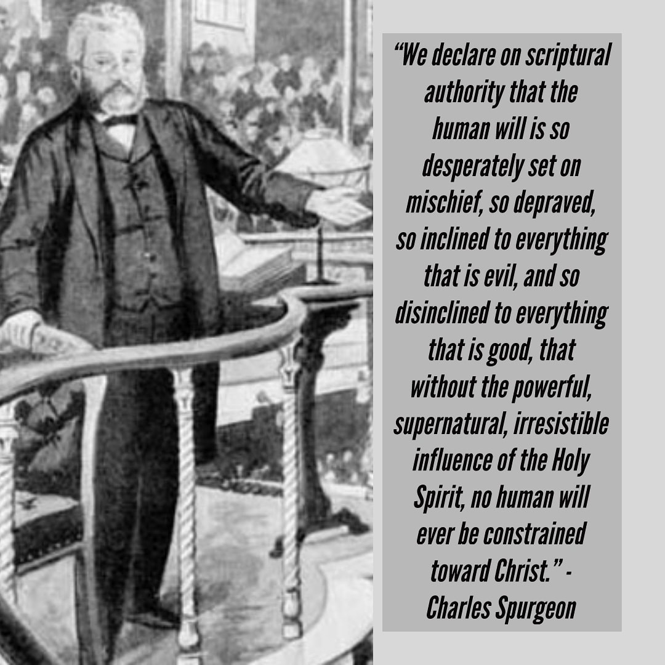

Slide 18
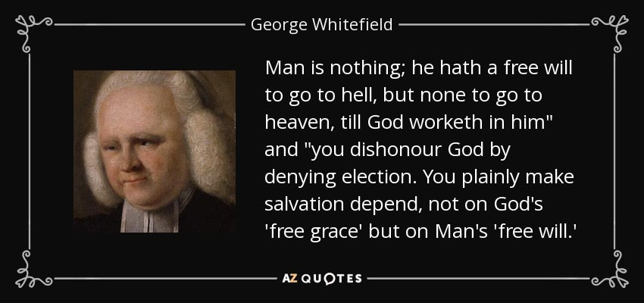

Slide 20
Facts About God’s Actions in Salvation
God Wants All To Be Saved
1 Timothy 2:3-4 God would have all to be saved - Desire
2 Peter 3:9 God does not want any to perish, but repent
Acts 10:34-35 God shows no partiality
Christ Died For All So They Could Be Saved
1 Timothy 2:5-6 Jesus gave Himself as ransom for all
1 John 2:1-2 He is propitiation for sins of the whole world
Hebrews 2:9 Christ Jesus tasted death for everyone
God Called All To Salvation By The Gospel
2 Thessalonians 2:13-15 Called to salvation by the gospel
1 Thessalonians 2:13 Word is of God & designed to work in us
Hebrews 4:12-13 Word discerns thoughts & intents of heart

Slide 21
Facts About Man’s Actions in Salvation
Each Person Is Responsible For His Own Sin
Ezekiel 18:20 Soul that sins shall die; Sin not charged to others
James 1:13-15 Sin is result of our own lust & actions
People Have The Ability To Choose To Do Good
Deuteronomy 30:19 Life & death set before them; “Choose life”
Joshua 24:15 Choose you this day whom ye will serve
1 Kings 18:21 Charged crowd to cease wavering in faith & action
Romans 6:12-19 “Present” members to serve right or sin
2 Timothy 2:22-26 One snared by devil may recover himself
The Human Will Is Challenged To Good By Gospel
John 5:38-47 Parallel effect between OT & Christ’s word
John 7:17 “If anyone wills to do His will…”
Revelation 22:17 He that will, may come & take water of life

