Slide 1
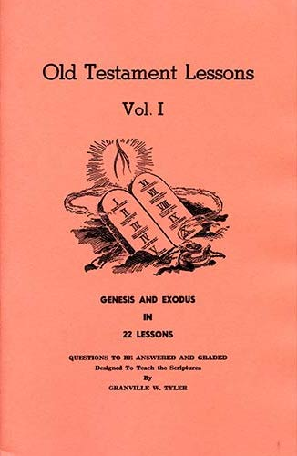
Genesis - Exodus
Lesson # 13
Exodus 5 - 7

Slide 2
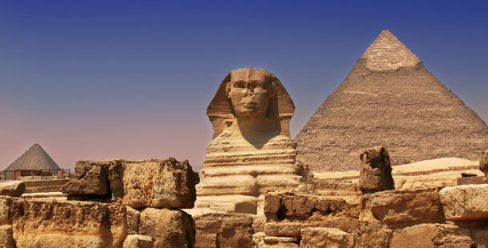
Lesson # 13 Exodus 5 - 7

Slide 3
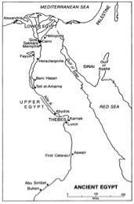
Land of Egypt

Slide 4
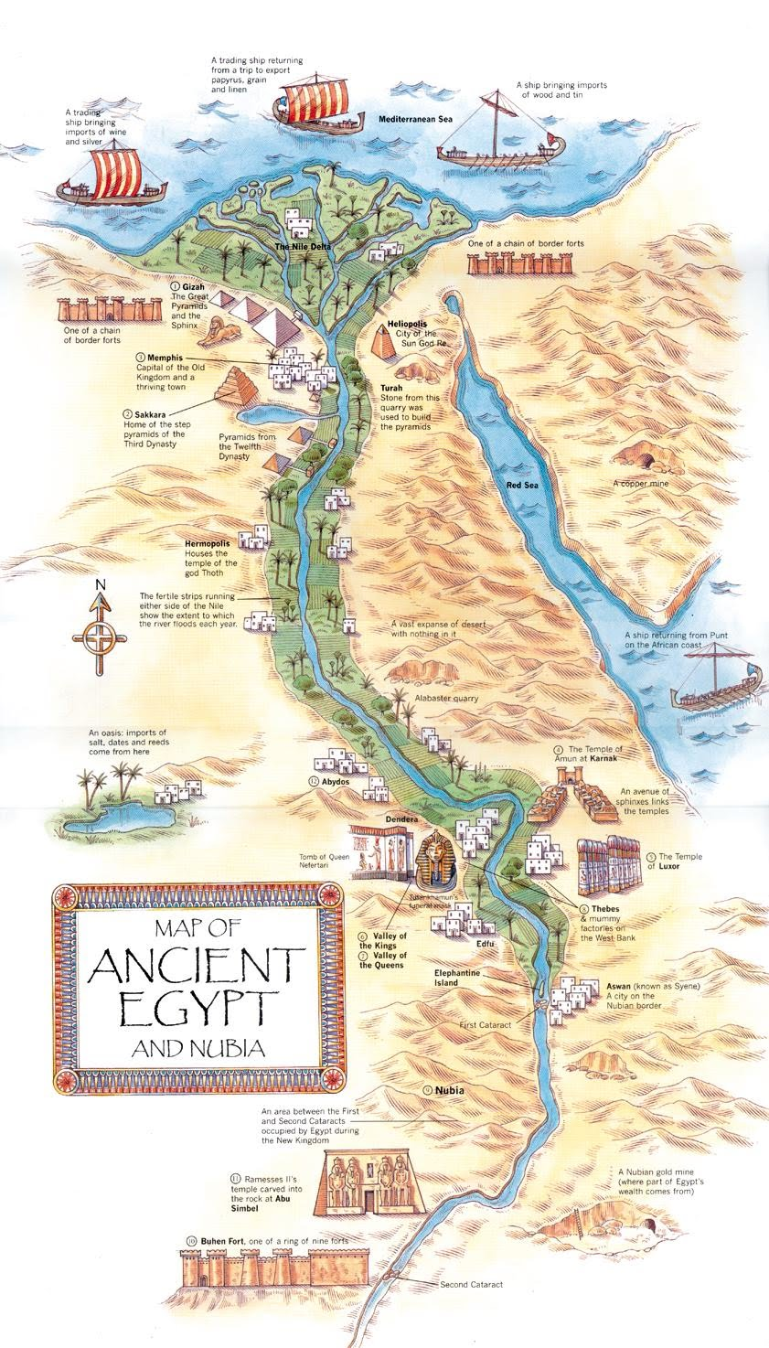
Ancient Egypt was always closely associated with the Nile River as it was the source of life and all activity

Slide 5
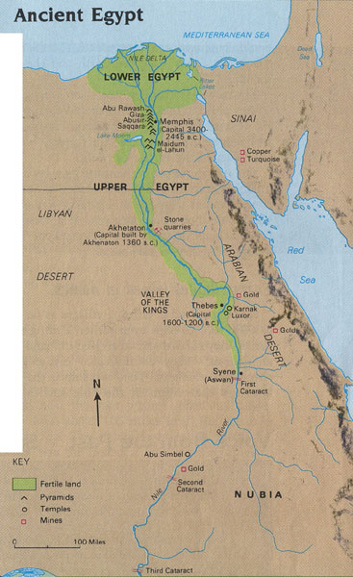
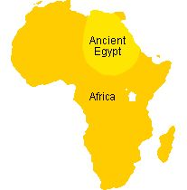

Slide 6
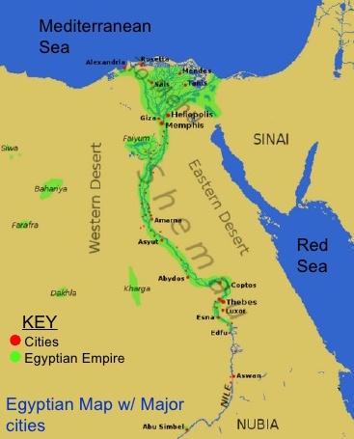

Slide 7
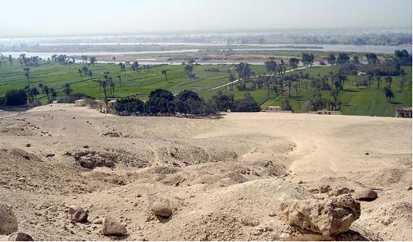

Slide 8
Outline of Exodus

Slide 9
I. Israel in Egypt ........................................................... 1:1 - 12:36
A. Israelites oppressed in Egypt................................ 1:1-22
B. Moses before his call ...................................... 2:1 - 2:25
1. Birth and early years of Moses .......................... 2:1-10
2. Murder of Egyptian and flight from Egypt…... 2:11-15
3. Journey from Egypt to Midian ......................... 2:16-20
4. Taking of Zipporah as wife............................... 2:21-25
C. Call of Moses .................................................. 3:1 - 4:31
1. Burning bush................................................. 3:1 - 4:18
2. Journey from Midian to Egypt ........................ 4:19-26
3. Meeting with Aaron and elders of Israel ……. 4:27-31
D. Moses & Pharaoh Meeting #1: straw taken ….... 5:1-23
E. God's covenant reminder...................................... 6:1-13
F. Genealogies of Moses and Aaron....................... 6:14-30
G. Moses & Pharaoh Meeting #2: rod to serpent...... 7:1-13

Slide 10
H. The Ten Plagues.................................... 7:13 - 12:36
1. River water turned to blood ..................... 7:13-25
2. Frogs .......................................................... 8:1-15
3. Lice .......................................................... 8:16-19
4. Flies ......................................................... 8:20-32
5. Cattle die...................................................... 9:1-7
6. Boils........................................................... 9:8-12
7. Hail ......................................................... 9:13-35
8. Locusts..................................................... 10:1-20
9. Darkness ............................................... 10:21-29
10. First-born killed ............................. 11:1 - 12:36
i) Preparation ........................................ 11:1-10
ii) Institution of Passover ..................... 12:1-28
iii) The Plague Itself............................ 12:29-36

Slide 11
II. Exodus from Egypt to Sinai................................. 12:37 - 18:27
A. Journey Egypt - Red Sea, Pillar of Cloud & Fire 12:37 - 14:20
B. Journey through the Red Sea............................ 14:21-31
C. Songs of Moses and Miriam ............................... 15:1-21
D. Journey from Red Sea to wilderness of Shur.... 15:22-26
1. Provision of water at Marah (the bitter waters)
E. Journey from Elim to wilderness of Sin .... 15:27 - 16:36
1. Provision of quail and manna
F. Journey from wilderness of Sin to Rephidim 17:1 - 18:27
1. Water from rock in Horeb (Massah, Meribah) ..17:1-7
2. War: Amalek in Rephidim (Moses’ arms upheld) 17:8-16
3. Jethro (father-in-law) meets and advises Moses 18:1-27

Slide 12
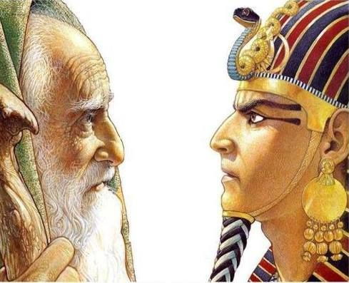
First Meeting with Pharoah (Exodus 5)

Slide 13
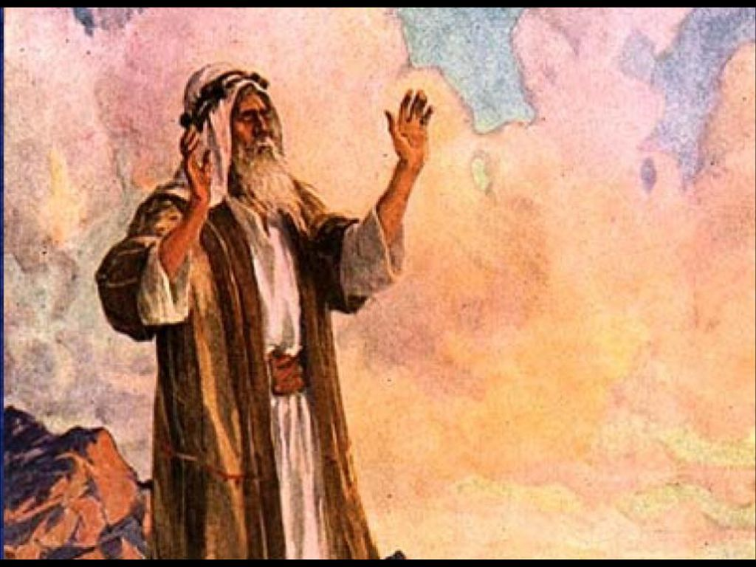
God Speaks to Moses (Exodus 6)

Slide 14
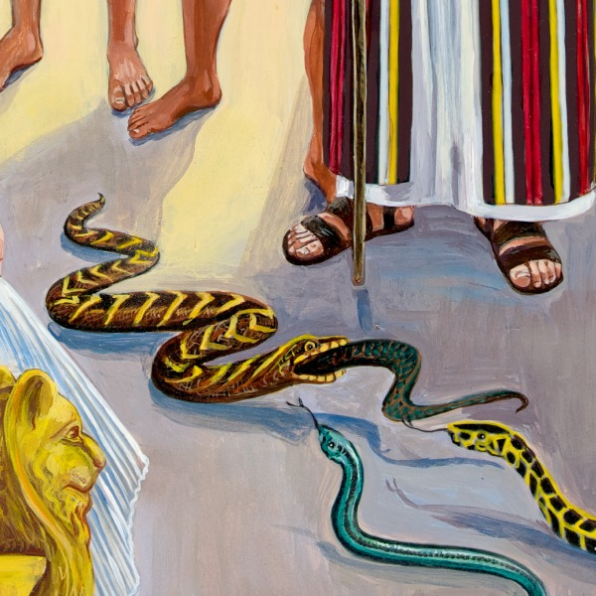
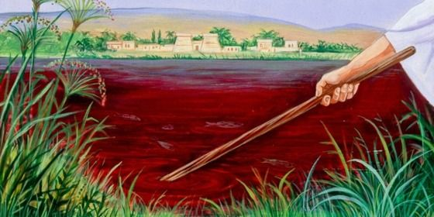
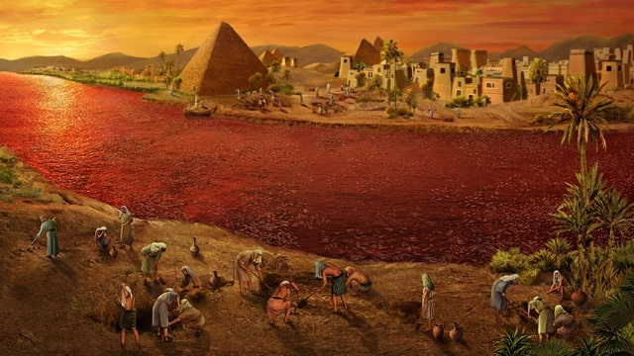
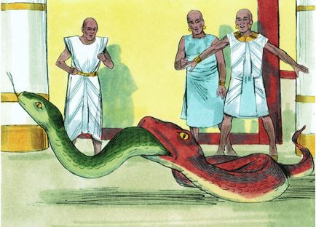
Second Meeting with Pharoah & First Plague (Exodus 7)

Slide 16
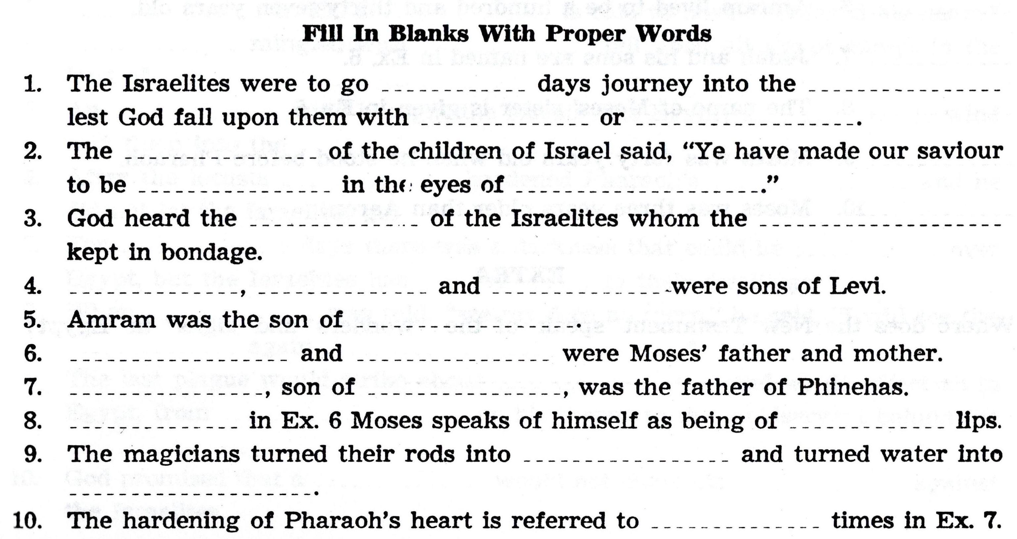

Slide 19
For Sunday (Oct. 24, 2021)
Lesson # 14
Exodus 8 - 11

