Slide 1
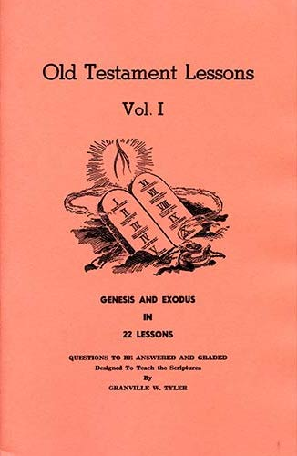
Genesis - Exodus
Lesson # 16
Exodus 16 - 20

Slide 2
OT Lessons Vol 1
Class | Date | Teacher | Lesson | Text
1 | Sunday, September 05, 2021 | Curt | Intro
2 | Wednesday, September 08, 2021 | Harry | 1 | Gen 1-5
3 | Sunday, September 12, 2021 | Curt | 2 | Gen 6-10
4 | Wednesday, September 15, 2021 | Harry | 3 | Gen 11-15
5 | Sunday, September 19, 2021 | Curt | 4 | Gen 16-19
6 | Wednesday, September 22, 2021 | Harry | 5 | Gen 20-24
7 | Sunday, September 26, 2021 | Curt | 6 | Gen 25-29
8 | Wednesday, September 29, 2021 | Harry | 7 | Gen 30-34
9 | Sunday, October 03, 2021 | Curt | 8 | Gen 35-39
10 | Wednesday, October 06, 2021 | Harry | 9 | Gen 40-45
11 | Sunday, October 10, 2021 | Curt | 10 | Gen 46-50
12 | Wednesday, October 13, 2021 | Harry | 11 | Gen 1-50
13 | Sunday, October 17, 2021 | Curt | 12 | Ex 1-4
14 | Wednesday, October 20, 2021 | Harry | 13 | Ex 5-7
15 | Sunday, October 24, 2021 | Curt | 14 | Ex 8-11
16 | Wednesday, October 27, 2021 | Harry | 15 | Ex 12-15
17 | Sunday, October 31, 2021 | Curt | 16 | Ex 16-20
18 | Wednesday, November 03, 2021 | Harry | Singing
19 | Sunday, November 07, 2021 | Curt | 17 | Ex 21-24
20 | Wednesday, November 10, 2021 | Harry | 18 | Ex 25, 35, 37
21 | Sunday, November 14, 2021 | Curt | 19 | Ex 26-27, 36, 38
22 | Wednesday, November 17, 2021 | Harry | 20 | Ex 28-30, 39
23 | Sunday, November 21, 2021 | Curt | 21 | Ex 31-34
24 | Wednesday, November 24, 2021 | Harry | 22 | Ex 40, 25-30, 35-39
25 | Sunday, November 28, 2021 | Curt | Review
Today : Lesson 16
Scriptures Covered: Exodus 16 - 20
Food provided
Rock smitten
Battle with Amalek
Jethro
Sinai and the Ten Commandments

Slide 3
I. Israel in Egypt ........................................................... 1:1 - 12:36
A. Israelites oppressed in Egypt .................................... 1:1-22
B. Moses before his call ............................................. 2:1 - 2:25
1. Birth and early years of Moses ............................... 2:1-10
2. Murder of Egyptian and flight from Egypt …..... 2:11-15
3. Journey from Egypt to Midian ............................. 2:16-20
4. Taking of Zipporah as wife ................................... 2:21-25
C. Call of Moses ......................................................... 3:1 - 4:31
1. Burning bush ...................................................... 3:1 - 4:18
2. Journey from Midian to Egypt ............................. 4:19-26
3. Meeting with Aaron and elders of Israel ………. 4:27-31
D. Moses & Pharaoh Meeting #1: straw taken …........ 5:1-23
E. God's covenant reminder .......................................... 6:1-13
F. Genealogies of Moses and Aaron ............................ 6:14-30
G. Moses & Pharaoh Meeting #2: rod to serpent ........ 7:1-13

Slide 4
H. The Ten Plagues .................................... 7:13 - 12:36
1. River water turned to blood ..................... 7:13-25
2. Frogs ............................................................. 8:1-15
3. Lice .............................................................. 8:16-19
4. Flies .............................................................. 8:20-32
5. Cattle die ......................................................... 9:1-7
6. Boils ............................................................... 9:8-12
7. Hail .............................................................. 9:13-35
8. Locusts......................................................... 10:1-20
9. Darkness ................................................... 10:21-29
10. First-born killed .................................. 11:1 - 12:36
i) Preparation ............................................. 11:1-10
ii) Institution of Passover .......................... 12:1-28
iii) The Plague Itself ................................. 12:29-36

Slide 5
II. Exodus from Egypt to Sinai ...................................... 12:37 - 18:27
A. Journey Egypt - Red Sea, Pillar of Cloud & Fire 12:37 - 14:20
B. Journey through the Red Sea ..................................... 14:21-31
C. Songs of Moses and Miriam ......................................... 15:1-21
D. Journey from Red Sea to wilderness of Shur ……... 15:22-26
1. Provision of water at Marah (the bitter waters)
E. Journey from Elim to wilderness of Sin ............. 15:27 - 16:36
1. Provision of quail and manna

Slide 6
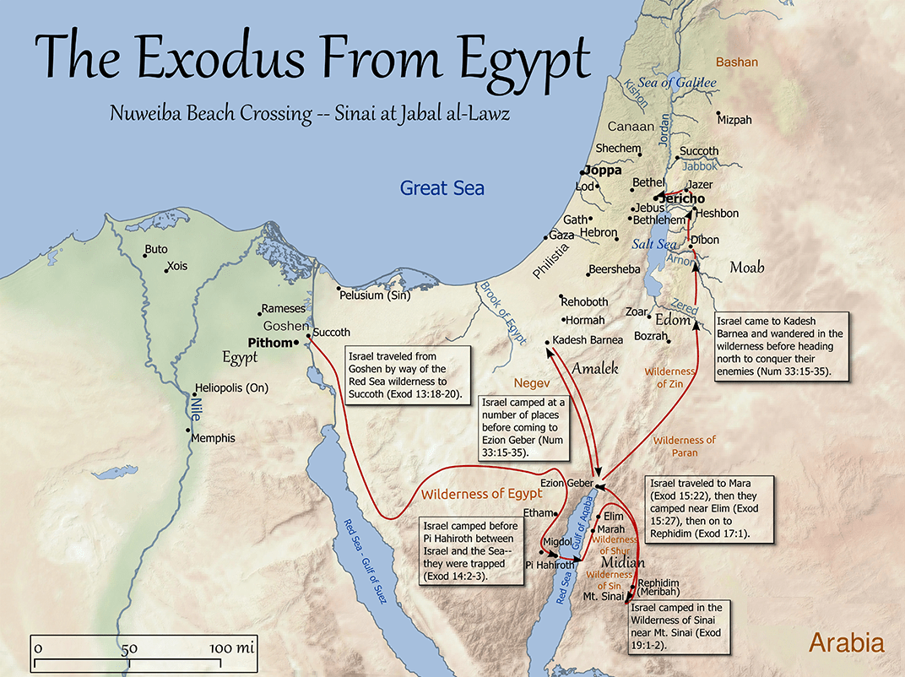

Slide 7
Chapter 16
Israel leaves Elim for the Wilderness of Sin. The people grumble about food
God provides quail in the evening and manna in the morning
God gives details about gathering manna including a provision for the Sabbath
Moses keeps a jar of manna for the Testimony

Slide 8
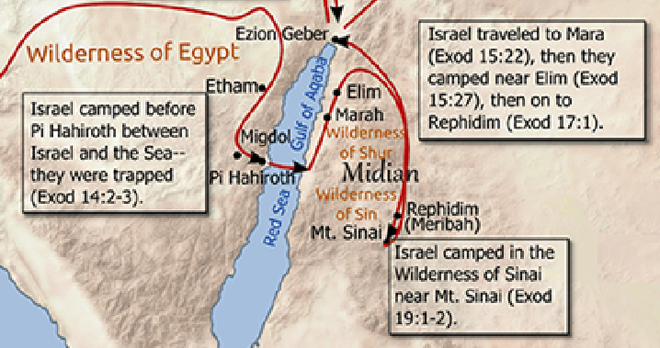

Slide 9
Chapter 17
Israel goes to Rephidim. Israel grumbles about water, quarrels with Moses
God provides water from the rock
Amelek comes to fight against Israel. Joshua choses to lead men to fight
Moses’ hands held up. Israel overwhelms Amalek
Moses builds an alter

Slide 10
Chapter 18
Jethro hears of what God has done and meets Moses in the wilderness
Moses sits to judge disputes between the people
Jethro suggests an alternate plan: able men to judge smaller issues
This structure works better for Moses and the people
Jethro returns to Midian

Slide 11
Chapter 19
Israel travels to the wilderness of Sinai and camps before the mountain
God calls the nation to obey him and become a holy nation. They agree
The people are consecrated and warned not to touch the mountain
God comes to the top of Mt. Sinai in a thick cloud

Slide 12
Chapter 20
God gives Moses the Ten Commandments:
You shall have no other gods before Me
You shall worship no image or likeness
You shall not take the Lord’s name in vain
Remember the Sabbath day, to keep it holy
Honor your father and your mother
You shall not murder
You shall not commit adultery
You shall not steal
You shall not bear false witness
You shall not covet

Slide 13
Chapter 20
Israel saw the lightning and smoke and heard the thunder and trumpet
They were afraid and asked Moses to (continue to) speak for God
God gives Moses additional instructions about alters for sacrifices

Slide 14
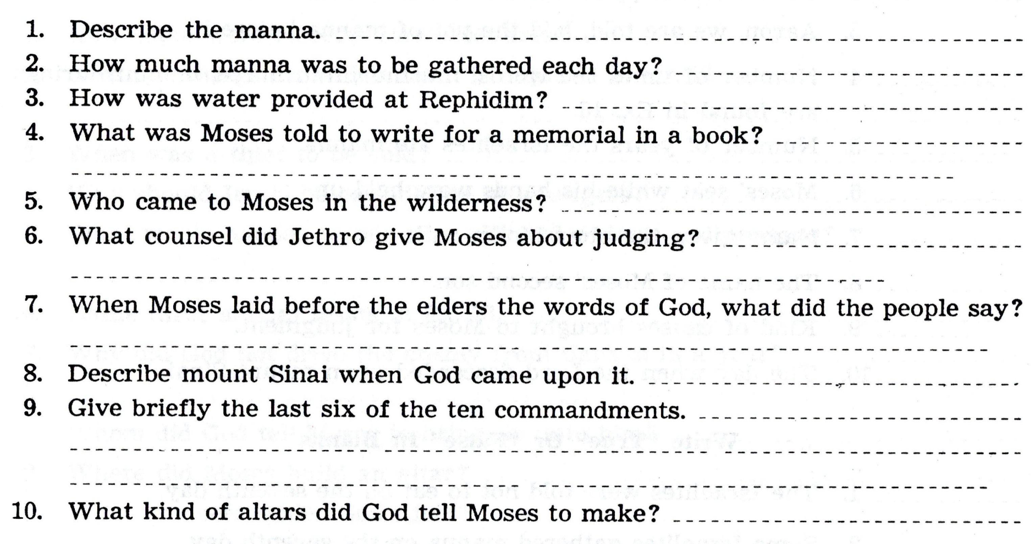

Slide 17
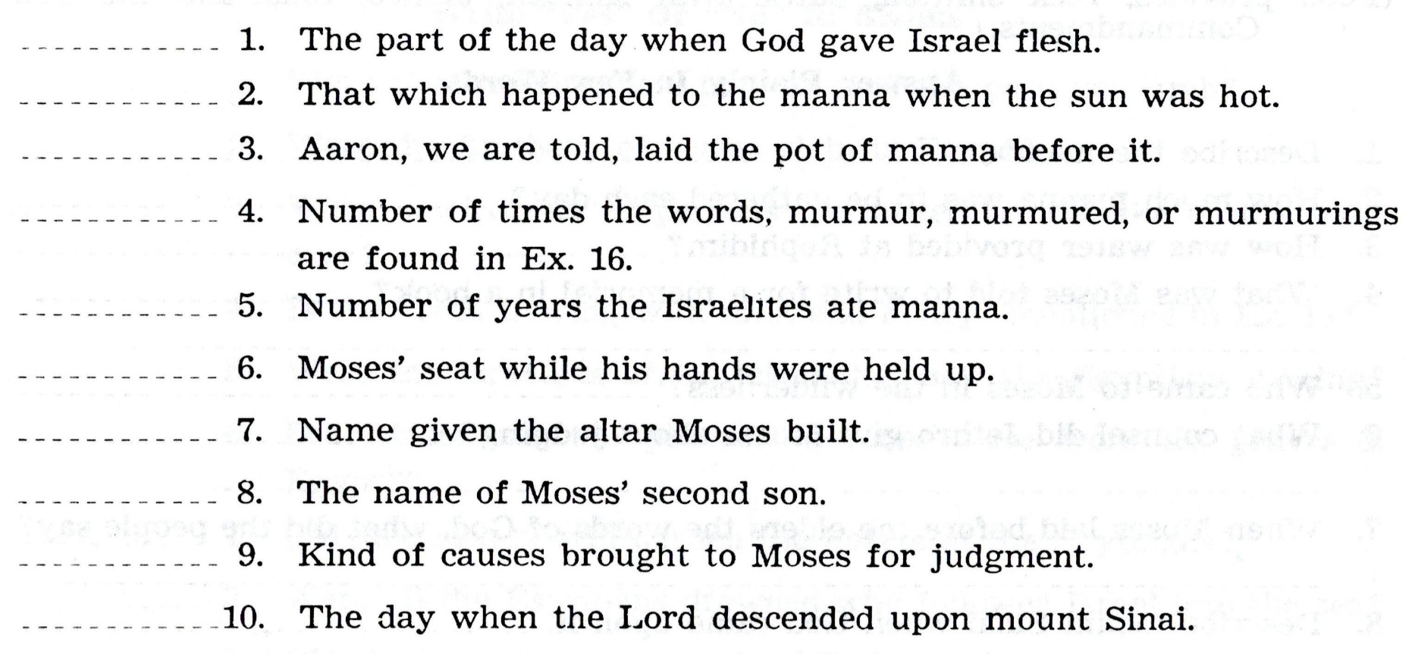

Slide 18
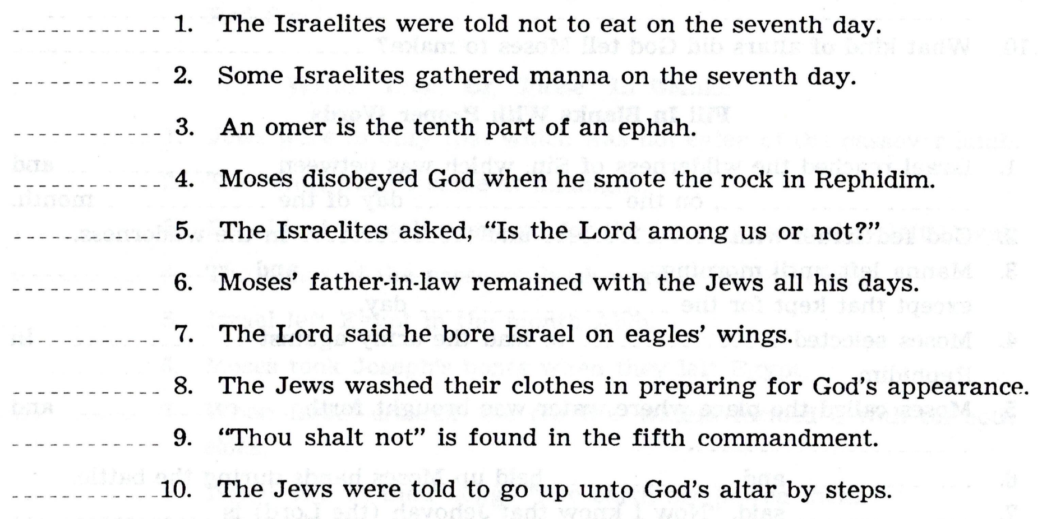

Slide 20
How Can I be Ready for the Next class?
Read the text before class. What text is that?
Study. By yourself or with your spouse / kids / gkids. Make it a family study
Fill out the answers in the book, as you read the scriptures, or afterwards
Add the verse(s) where you found the answer(s)
Come prepared to discuss the text and the answers

