Slide 1
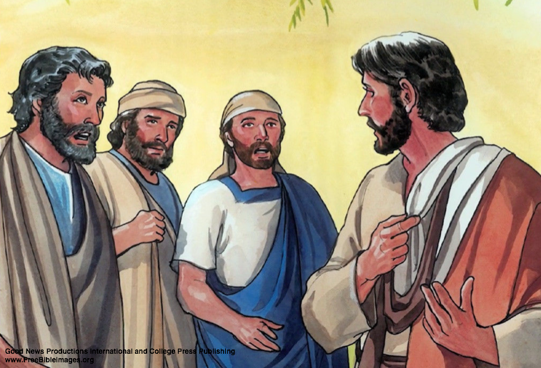
To Whom Shall We Go?
John 6:60-69

Slide 2
John 6:60-69
⁶⁰ Therefore many of His disciples, when they heard this, said, “This is a hard saying; who can understand it?” ⁶¹ When Jesus knew in Himself that His disciples complained about this, He said to them, “Does this offend you? ⁶² What then if you should see the Son of Man ascend where He was before? ⁶³ It is the Spirit who gives life; the flesh profits nothing. The words that I speak to you are spirit, and they are life. ⁶⁴ But there are some of you who do not believe.” For Jesus knew from the beginning who they were who did not believe, and who would betray Him. ⁶⁵ And He said, “Therefore I have said to you that no one can come to Me unless it has been granted to him by My Father.” ⁶⁶ From that time many of His disciples went back and walked with Him no more. ⁶⁷ Then Jesus said to the twelve, “Do you also want to go away?” ⁶⁸ But Simon Peter answered Him, “Lord, to whom shall we go? You have the words of eternal life. ⁶⁹ Also we have come to believe and know that You are the Christ, the Son of the living God.”

Slide 3
To Whom Shall We Go for Guidance?
Those who having the biggest following?
Exodus 23:2 “You shall not follow a crowd to do evil”
2 Corinthians 6:14 Not be “unequally yoked” to unbelievers
Those who agree with us & do not challenge us?
1 Kings 12:8 Rehoboam rejects elders counsel for his friends
Proverbs 12:15 Fool heeds own thoughts, wise heeds counsel
Those who persuade us by the way they speak?
Romans 16:17-18 By smooth words and flattering speech…
2 Peter 2:18 Great swelling words of emptiness
Those who make us feel best & comfort us?
Isaiah 30:10 People sought prophets to speak smooth things
2 Timothy 4:3-4 Itching ears will always seek soothing words
Things to remember about who kept following Jesus

Slide 4
Those Continuing to Follow Jesus…
Followed when many would not
John 6:66
Matthew 7:13-14 Righteousness will always be in minority
Followed when others were offended
John 6:60-61
Matthew 15:12-14 When truth offends, so be it
Followed because they kept hearing to understand
John 6:60, 68
Proverbs 19:20; 20:5 It is end product of Lord (Prov. 21:30)
Followed due to what they had come to believe & know
John 6:69
2 Timothy 1:8-13 Paul’s example used as lesson to follow (4:2)
To Whom Will You Go for Truth?

Slide 5
As We Are Deciding To Whom We Are Going For Advice…

Slide 6
Who Knows & Appeals to Modern Thought Best?

Slide 7
Who Knows & Appeals to the Word of God?

