Slide 1
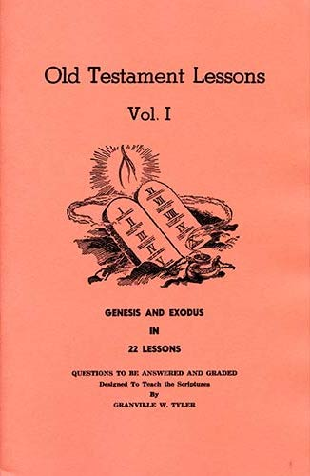
Genesis - Exodus
Lesson # 19
Exodus 26-27, 36, 38

Slide 2
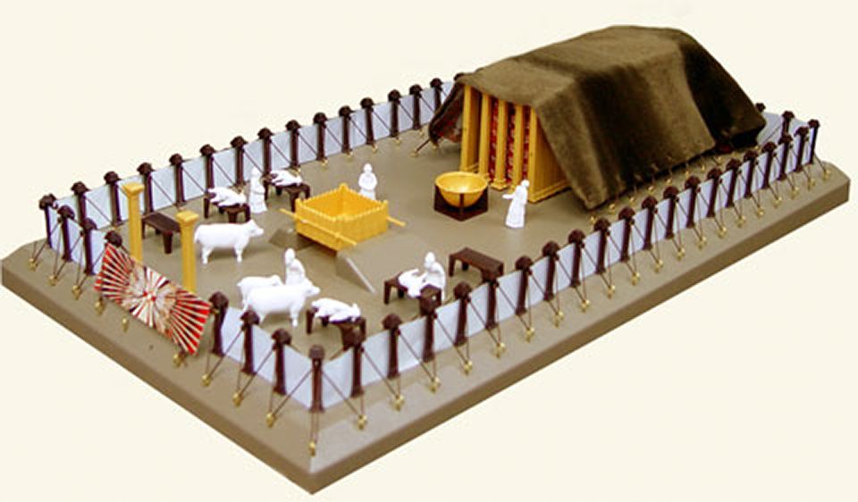
Lesson # 19 Exodus 26-27, 36 & 38

Slide 3
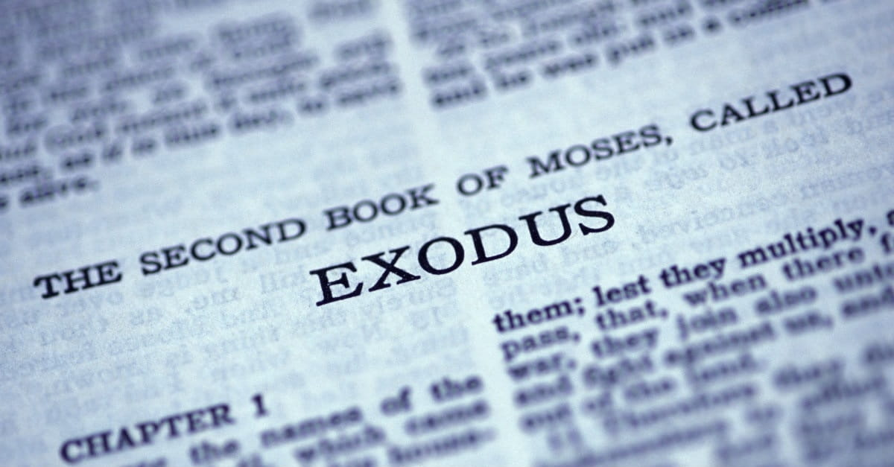
Outline of Exodus

Slide 4
I. Israel in Egypt ........................................................... 1:1 - 12:36
A. Israelites oppressed in Egypt................................ 1:1-22
B. Moses before his call ...................................... 2:1 - 2:25
1. Birth and early years of Moses .......................... 2:1-10
2. Murder of Egyptian and flight from Egypt…... 2:11-15
3. Journey from Egypt to Midian ......................... 2:16-20
4. Taking of Zipporah as wife............................... 2:21-25
C. Call of Moses .................................................. 3:1 - 4:31
1. Burning bush................................................. 3:1 - 4:18
2. Journey from Midian to Egypt ........................ 4:19-26
3. Meeting with Aaron and elders of Israel ……. 4:27-31
D. Moses & Pharaoh Meeting #1: straw taken ….... 5:1-23
E. God's covenant reminder...................................... 6:1-13
F. Genealogies of Moses and Aaron....................... 6:14-30
G. Moses & Pharaoh Meeting #2: rod to serpent...... 7:1-13

Slide 5
H. The Ten Plagues.................................... 7:13 - 12:36
1. River water turned to blood ..................... 7:13-25
2. Frogs .......................................................... 8:1-15
3. Lice .......................................................... 8:16-19
4. Flies ......................................................... 8:20-32
5. Cattle die...................................................... 9:1-7
6. Boils........................................................... 9:8-12
7. Hail ......................................................... 9:13-35
8. Locusts..................................................... 10:1-20
9. Darkness ............................................... 10:21-29
10. First-born killed ............................. 11:1 - 12:36
i) Preparation ........................................ 11:1-10
ii) Institution of Passover ..................... 12:1-28
iii) The Plague Itself............................ 12:29-36

Slide 6
II. Exodus from Egypt to Sinai................................. 12:37 - 18:27
A. Journey Egypt - Red Sea, Pillar of Cloud & Fire 12:37 - 14:20
B. Journey through the Red Sea............................ 14:21-31
C. Songs of Moses and Miriam ............................... 15:1-21
D. Journey from Red Sea to wilderness of Shur.... 15:22-26
1. Provision of water at Marah (the bitter waters)
E. Journey from Elim to wilderness of Sin .... 15:27 - 16:36
1. Provision of quail and manna
F. Journey from wilderness of Sin to Rephidim 17:1 - 18:27
1. Water from rock in Horeb (Massah, Meribah) ..17:1-7
2. War: Amalek in Rephidim (Moses’ arms upheld) 17:8-16
3. Jethro (father-in-law) meets and advises Moses 18:1-27

Slide 7
III. Israel at Sinai........................................................... 19:1 - 40:38
A. Journey from Rephidim to wilderness of Sinai .......... 19:1-2
B. Fifth Dispensation (Law) Instituted.......................... 19:3-25
1. Kingdom covenant given and ratified ................... 19:1-8
2. Appearance of God on Mt. Sinai ......................... 19:9-25
C. Giving of the Ten Commandments .......................... 20:1-26
D. Giving of the judgments and feasts ................... 21:1 - 23:33
E. Agreement of people to the words of the Lord ......... 24:1-18
1. Sprinkling of blood on altar and people ................. 24:3-8
2. Moses on Mt. Sinai for 40 days and nights .......... 24:9-18

Slide 8
F. Specification of the Tabernacle ............................... 25:1 - 31:11
1. Offering for supplies ...................................................... 25:1-9
2. Design of the ark ........................................................ 25:10-22
3. Design of the table for showbread ............................. 25:23-30
4. Design of the golden candlestick ............................... 25:31-40
5. Design of the tabernacle itself ...................................... 26:1-37
6. Design of the altar for burnt offering ............................. 27:1-8
7. Design of the court of the tabernacle ........................... 27:9-19
8. Tending of the lamp .................................................... 27:20-21
9. Design of priests' garments .......................................... 28:1-14
10. Design of the breastplate of judgment ..................... 28:15-30
11. Design of sacred vestments ...................................... 28:31-43
12. Description of consecration of Aaron and sons ……... 29:1-9
13. Description of sacrifices .......................................... 29:10-46
14. Design of the altar of incense .................................... 30:1-10
15. Atonement money .................................................... 30:11-16
16. Design of the brass laver .......................................... 30:17-21
17. Anointing oil and incense ......................................... 30:22-38
18. Appointing of workmen .............................................. 31:1-11

Slide 9
G. Between the Specification & Building of Tabernacle 31:12 - 35:3
1. Reminder of the Sabbath ............................................. 31:12-17
2. Giving of the two tablets .................................................. 31:18
3. The golden calf incident and judgment ......................... 32:1-35
4. God's command to go up to the promised land ............... 33:1-6
5. Tabernacle outside of camp; Moses speaks with God ... 33:7-11
6. Moses' request of assurance of God's presence ........... 33:12-23
7. Moses on Mt. Sinai Again for 40 days and nights ........ 34:1-28
i) Renewal of tablets, covenant ................................... 34:1-10
ii) Warnings ............................................................... 34:11-17
iii) Feasts ................................................................... 34:11-26
a) Unleavened bread (see 23:14-15) .................... 34:18-21
b) Feast of Weeks (see 23:16) ................................... 34:22
c) Feast of Ingathering (see 23:16) ........................... 34:22
d) Summary of requirements and their origin …. 34:23-28
8. The Shining and Veiling of Moses' face ...................... 34:29-35
9. Reminder of the Sabbath ................................................. 35:1-3

Slide 10
H. Building of the Tabernacle ..................................... 35:4 - 39:43
1. Command for offering ............................................... 35:4-9
2. Command for workmen ......................................... 35:10-19
3. Provision of offering .............................................. 35:20-29
4. Preparation of workmen .................................... 35:30 - 36:1
5. Completion of offering .............................................. 36:1-7
6. Making of the tabernacle itself ......................... 36:8 - 36:38
7. Making of the ark ...................................................... 37:1-9
8. Making of the table ................................................ 37:10-16
9. Making of candlestick ............................................ 37:17-24
10. Making of altar of incense ................................... 37:25-28
11. Making of anointing oil and incense ......................... 37:29
12. Making of altar of burnt offering ............................. 38:1-7
13. Making of brass laver .................................................. 38:8
14. Making of court of tabernacle ................................ 38:9-20
15. Total amount of supplies offered ......................... 38:21-31
16. Making of Priests garments ................................... 39:1-31
17. Work Finished on the Tabernacle ........................ 39:32-43

Slide 11
I. Assembly of the Tabernacle ........................................ 40:1-38
1. Setting up of Tabernacle ...................................... 40:1-12
2. Consecration of Aaron and sons ........................ 40:13-33
3. Glory of the Lord appears ................................. 40:34-38

Slide 12
Overall View of the Tabernacle

Slide 13
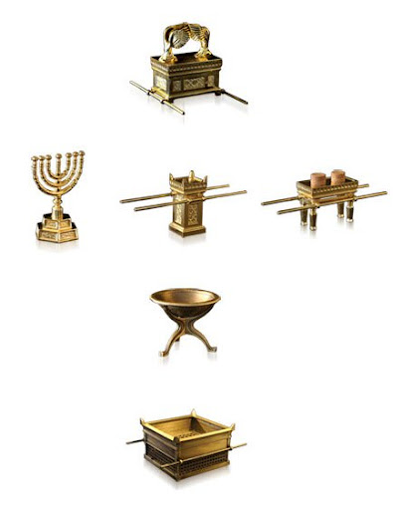
Furnishings of the Tabernacle
Inside
Outside

Slide 14
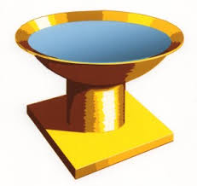
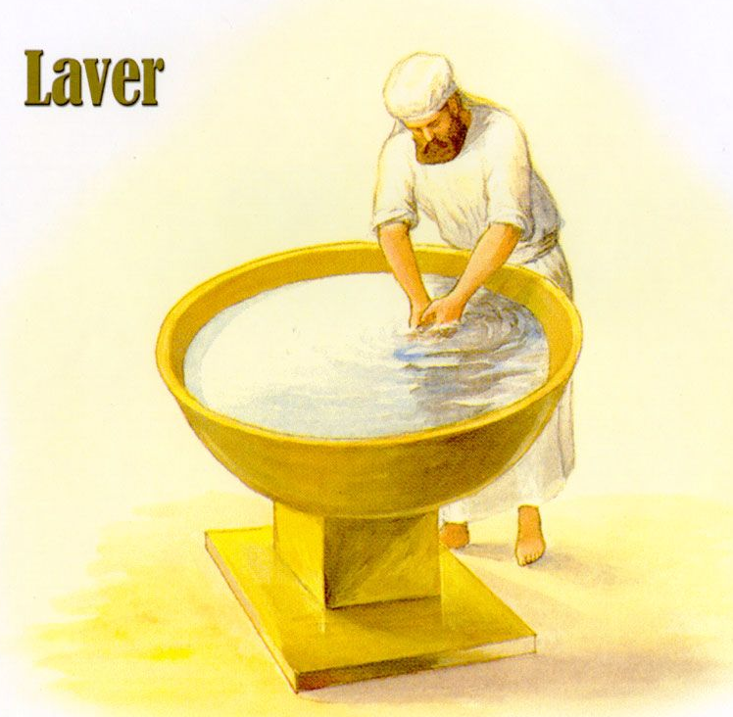
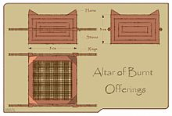
Furnishings on Outside of Tabernacle
Bronze Laver

Slide 15
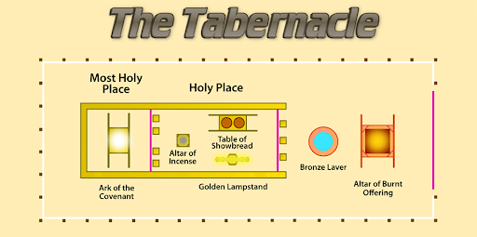
Furniture of the Tabernacle

Slide 16
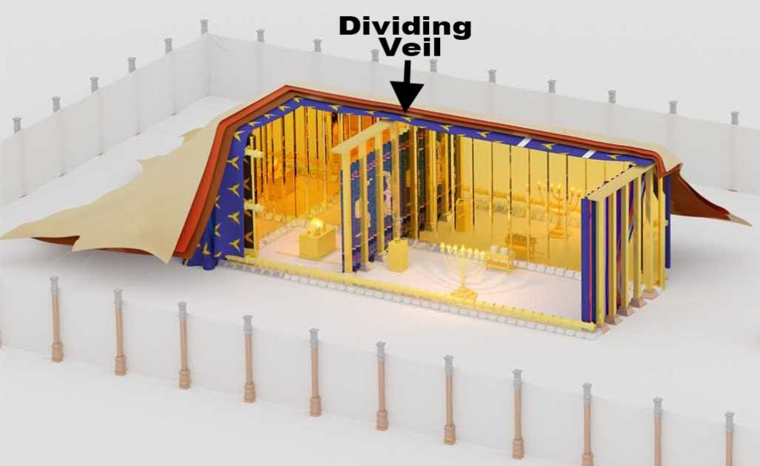
Construction of the Tabernacle

Slide 17
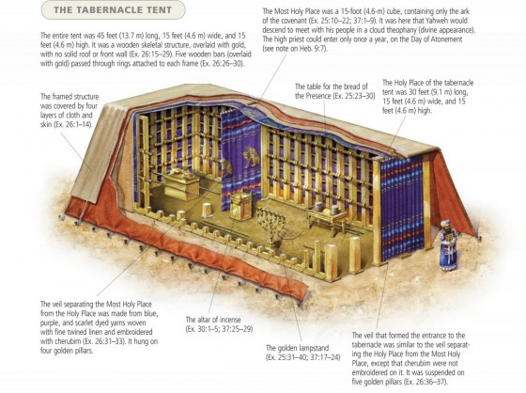
Overall View of the Tabernacle

Slide 19
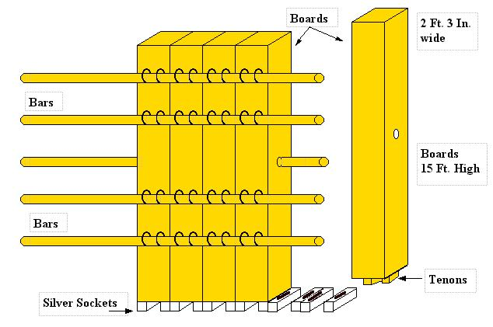

Slide 20
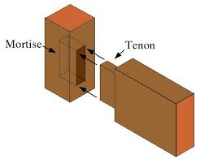

Slide 22
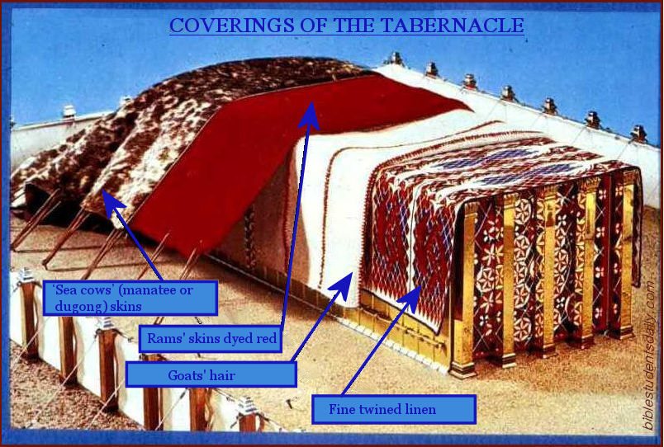
Outer Coverings of Tabernacle

Slide 23
Layout & Direction of Tabernacle

Slide 24
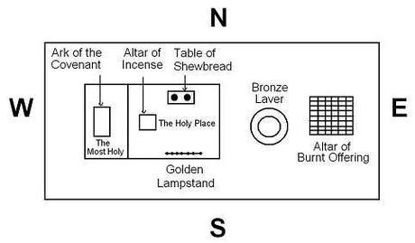

Slide 25
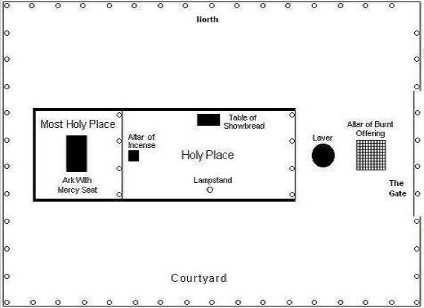

Slide 26
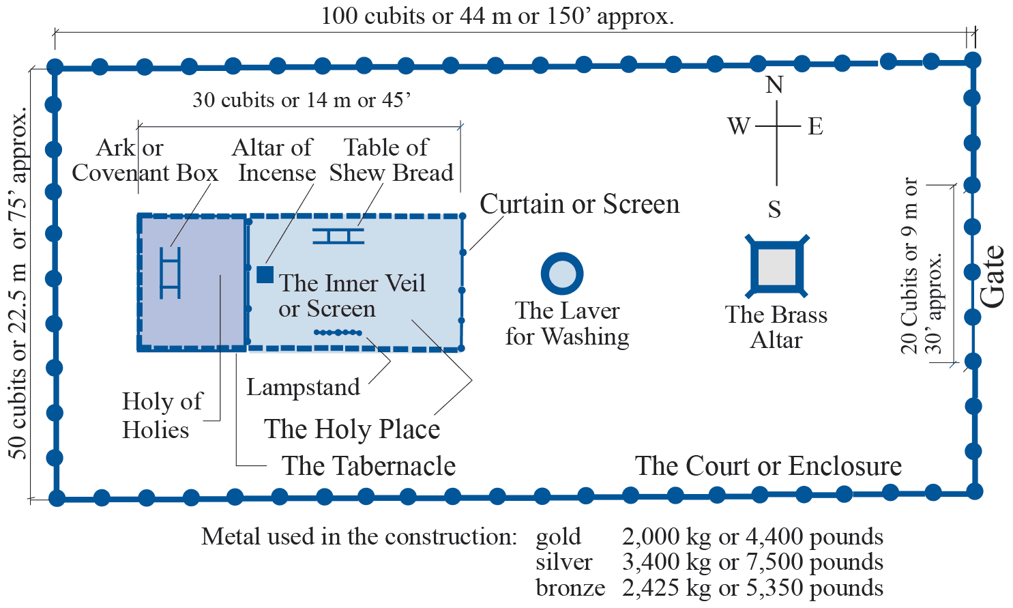

Slide 31
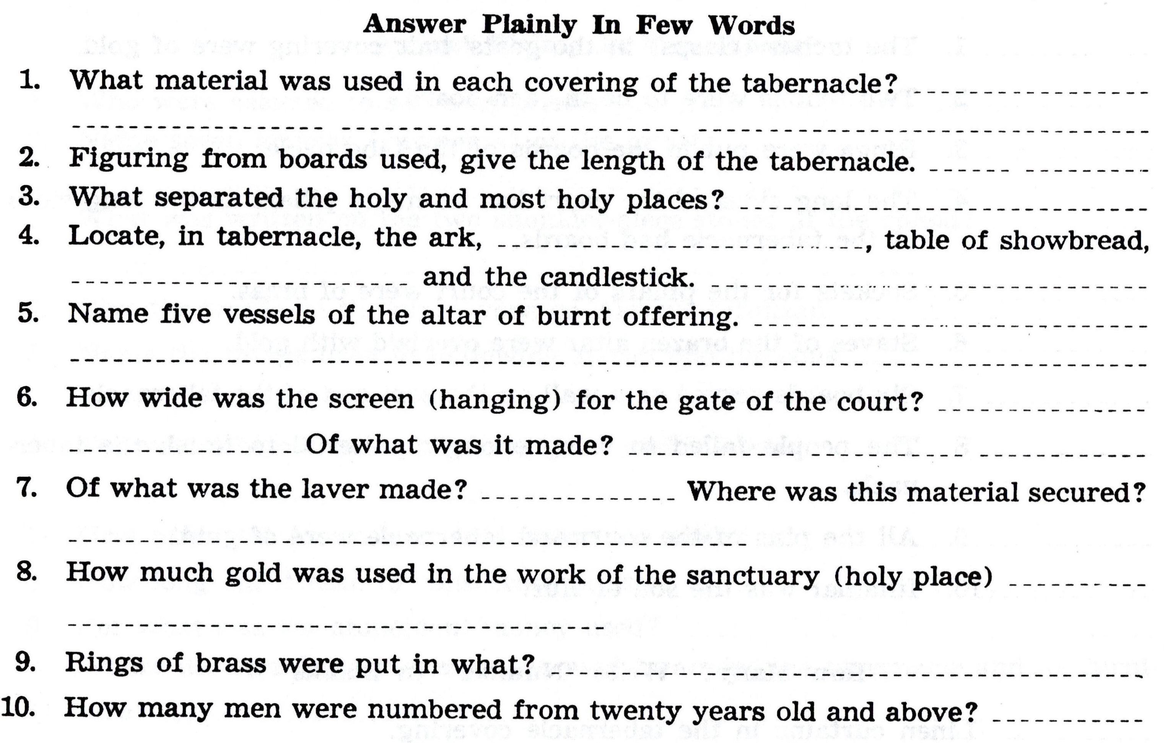

Slide 32
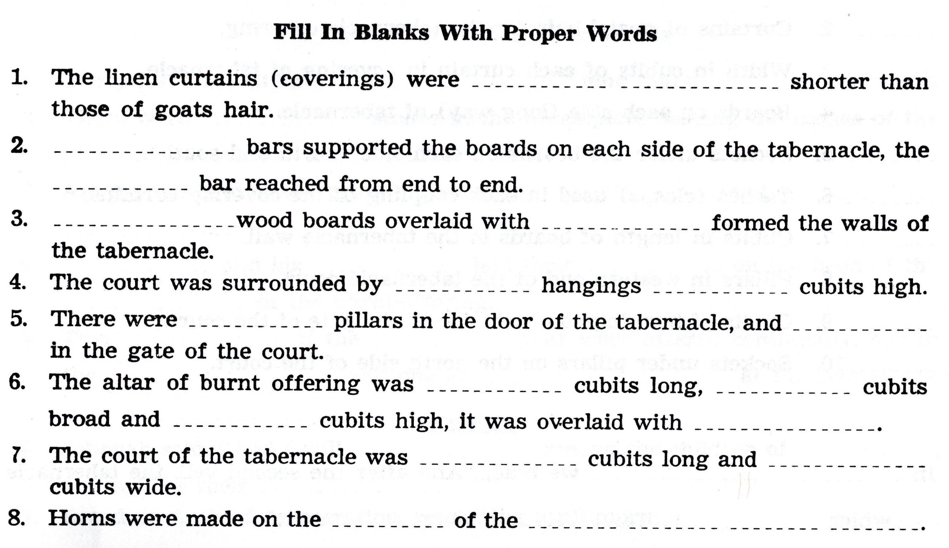

Slide 33
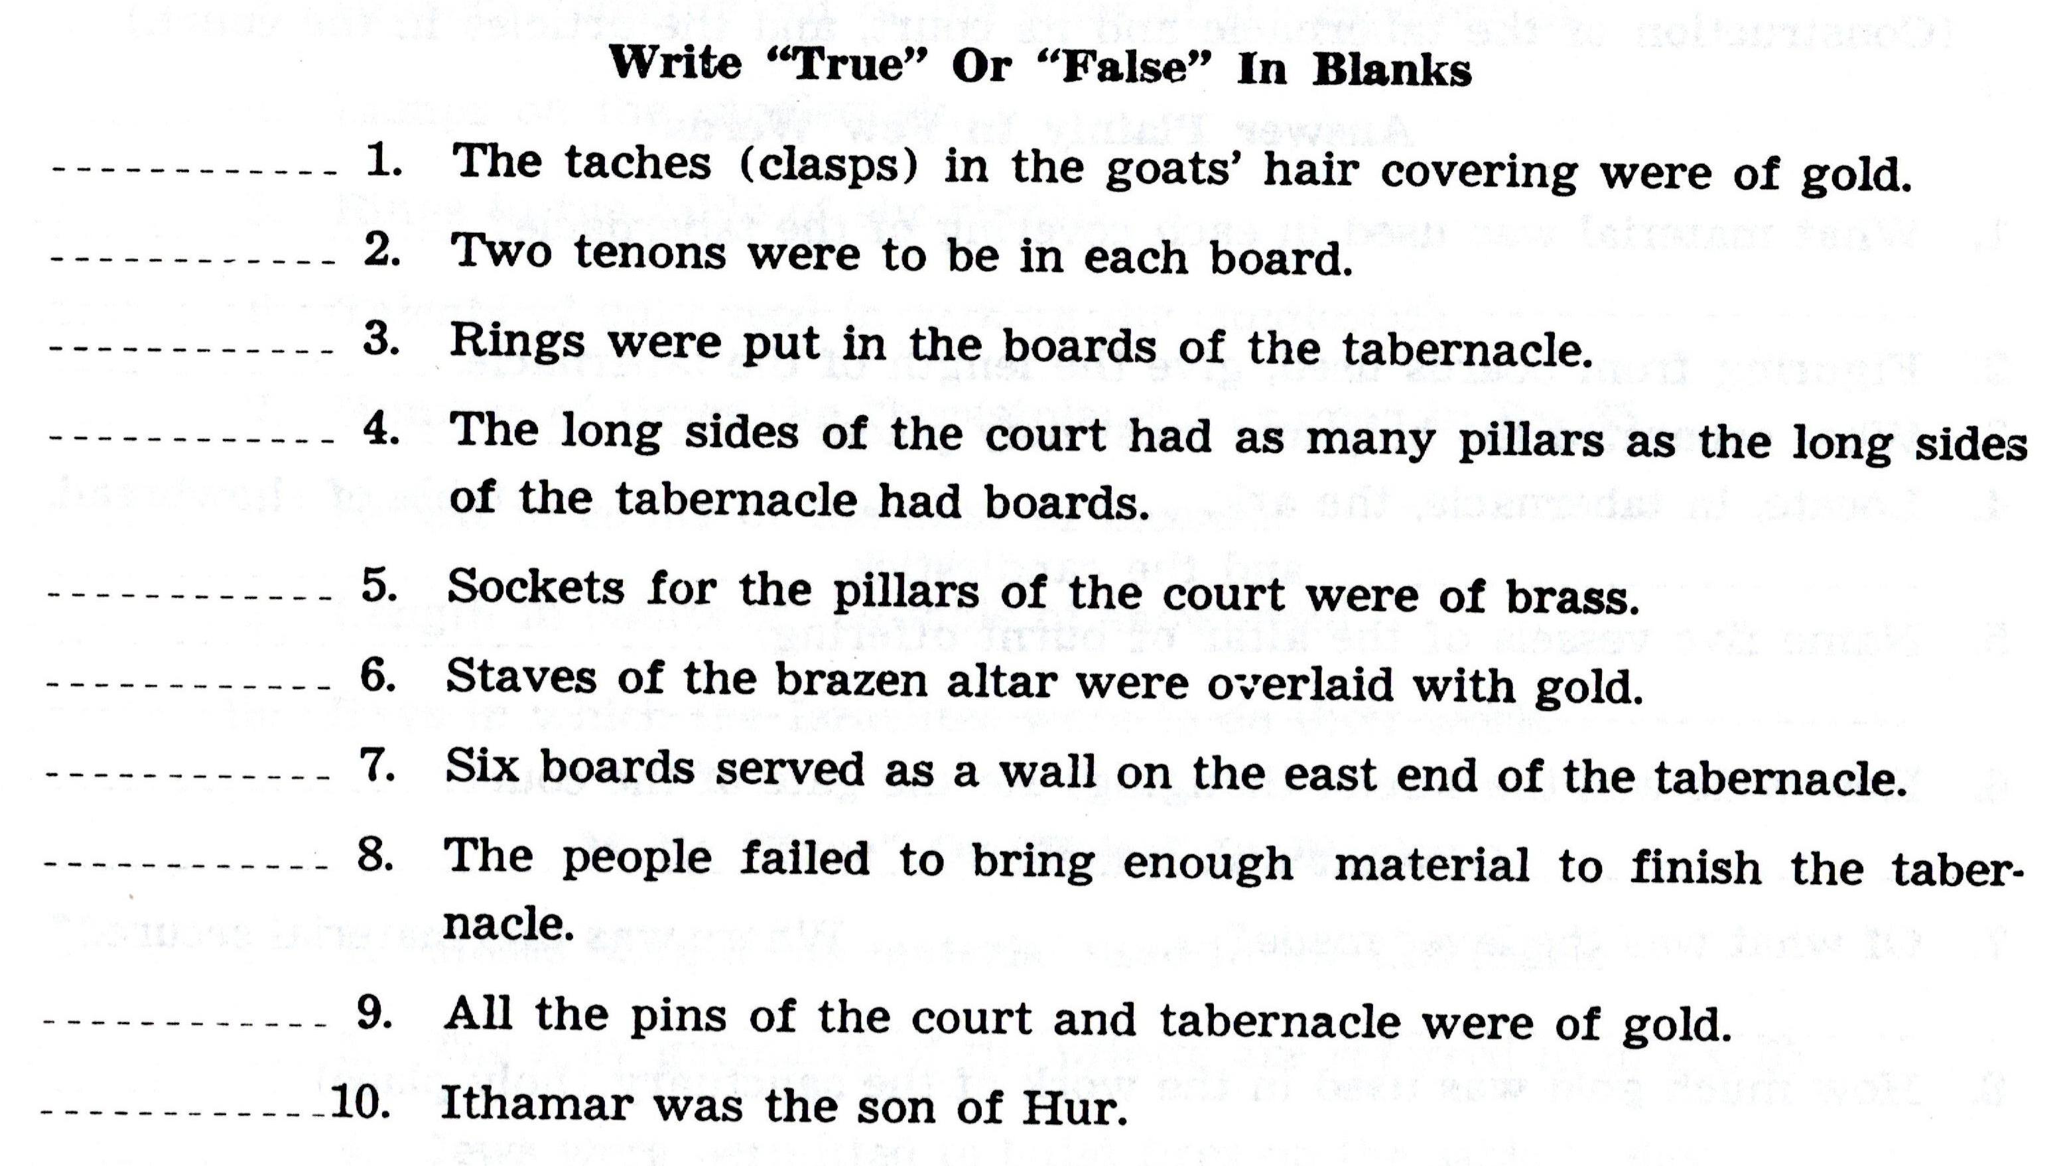

Slide 34
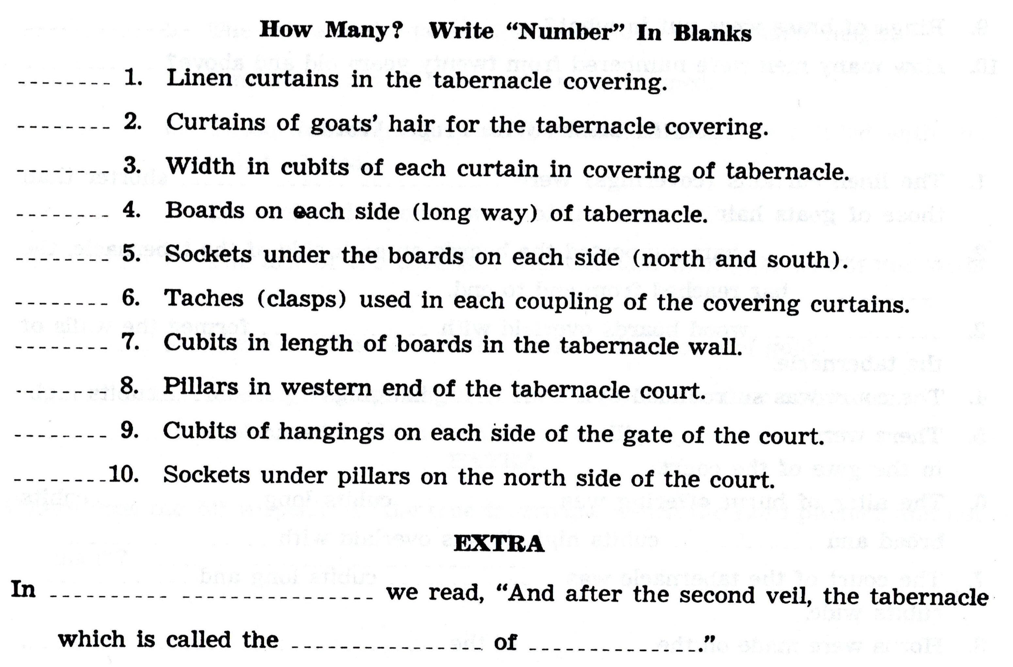

Slide 35
For Wednesday (Nov. 17, 2021)
Lesson # 20

