Slide 1
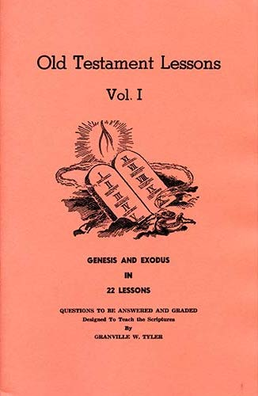
Genesis - Exodus
Concluding Study
2 Corinthians 3
Hebrews 6

Slide 2
2 Corinthians 3:7-16
⁷ But if the ministry of death, written and engraved on stones, was glorious, so that the children of Israel could not look steadily at the face of Moses because of the glory of his countenance, which glory was passing away, ⁸ how will the ministry of the Spirit not be more glorious? ⁹ For if the ministry of condemnation had glory, the ministry of righteousness exceeds much more in glory. ¹⁰ For even what was made glorious had no glory in this respect, because of the glory that excels. ¹¹ For if what is passing away was glorious, what remains is much more glorious. ¹² Therefore, since we have such hope, we use great boldness of speech — ¹³ unlike Moses, who put a veil over his face so that the children of Israel could not look steadily at the end of what was passing away. ¹⁴ But their minds were blinded. For until this day the same veil remains unlifted in the reading of the Old Testament, because the veil is taken away in Christ. ¹⁵ But even to this day, when Moses is read, a veil lies on their heart. ¹⁶ Nevertheless when one turns to the Lord, the veil is taken away.

Slide 3
Hebrews 9:1-8
¹ Then indeed, even the first covenant had ordinances of divine service and the earthly sanctuary. ² For a tabernacle was prepared: the first part, in which was the lampstand, the table, and the showbread, which is called the sanctuary; ³ and behind the second veil, the part of the tabernacle which is called the Holiest of All, ⁴ which had the golden censer and the ark of the covenant overlaid on all sides with gold, in which were the golden pot that had the manna, Aaron’s rod that budded, and the tablets of the covenant; ⁵ and above it were the cherubim of glory overshadowing the mercy seat. Of these things we cannot now speak in detail. ⁶ Now when these things had been thus prepared, the priests always went into the first part of the tabernacle, performing the services. ⁷ But into the second part the high priest went alone once a year, not without blood, which he offered for himself and for the people’s sins committed in ignorance; ⁸ the Holy Spirit indicating this, that the way into the Holiest of All was not yet made manifest while the first tabernacle was still standing.

Slide 4
Passages Showing Cessation of Old Law
Galatians 3:23-25
Romans 7:1-4, 7
Hebrews 8:6-13
Jeremiah 31:31-34
Hebrews 7:11-14

Slide 5
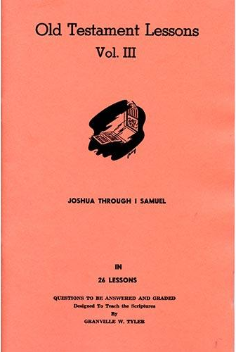
For Wednesday (Dec. 1, 2021)
Lesson # 1

