Slide 1
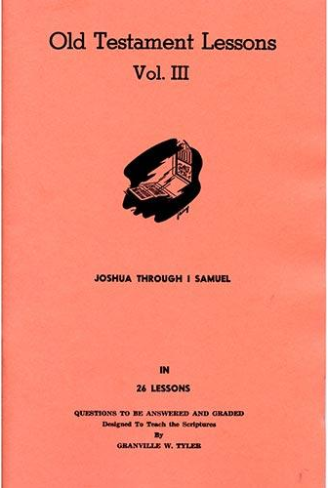
Joshua – 1st Samuel
Lesson #1
Joshua 1 - 4

Slide 2
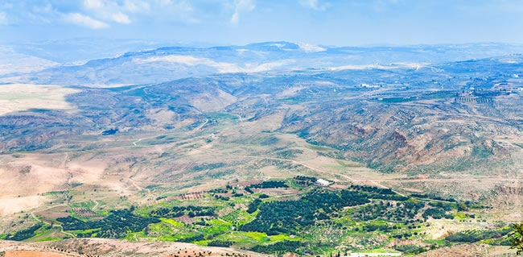
From Mount Nebo to Promise Land

Slide 3
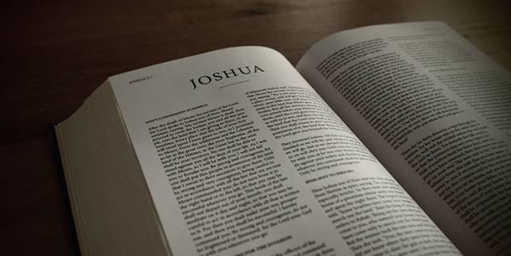
Overview of the Text

Slide 4
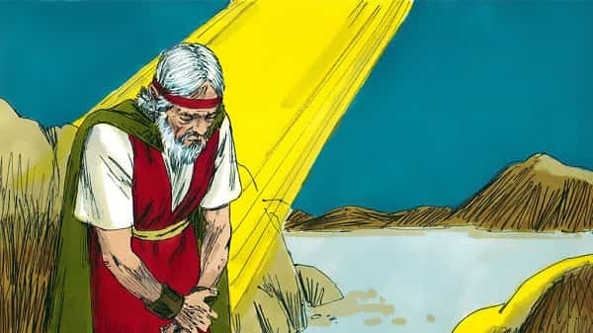
Joshua 1

Slide 5
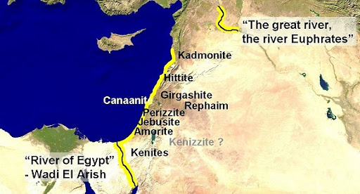
Land Promised to Abraham

Slide 6
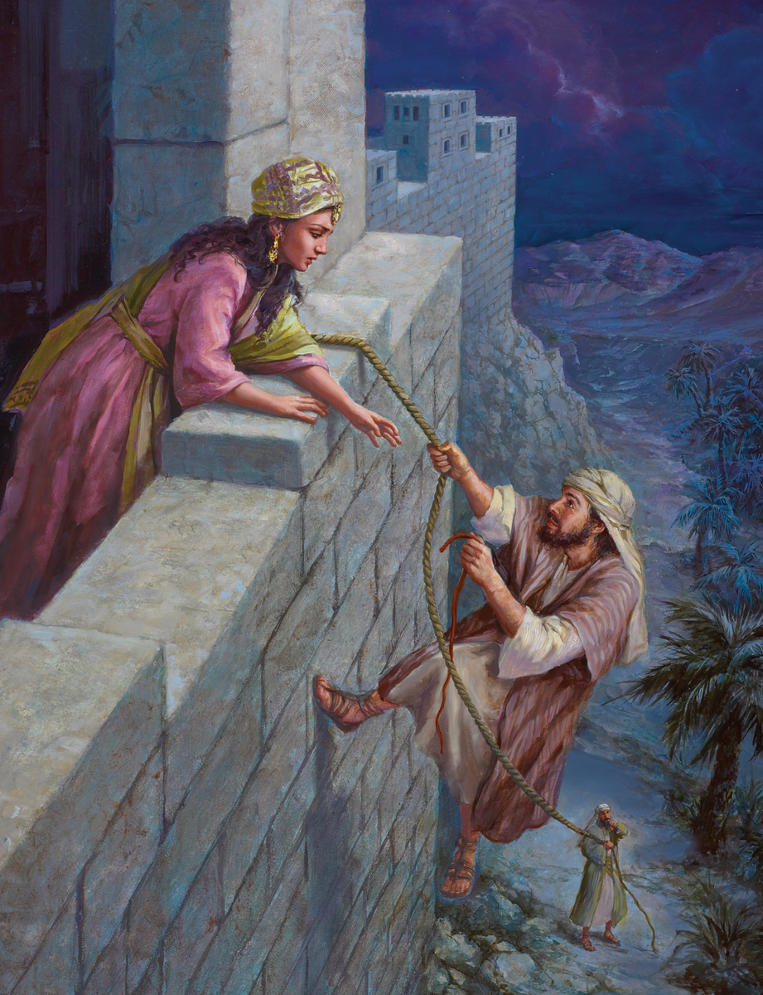
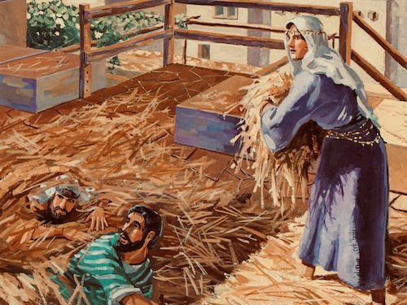
Joshua 2

Slide 7
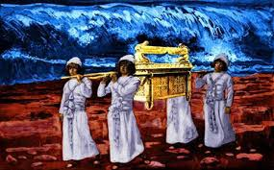
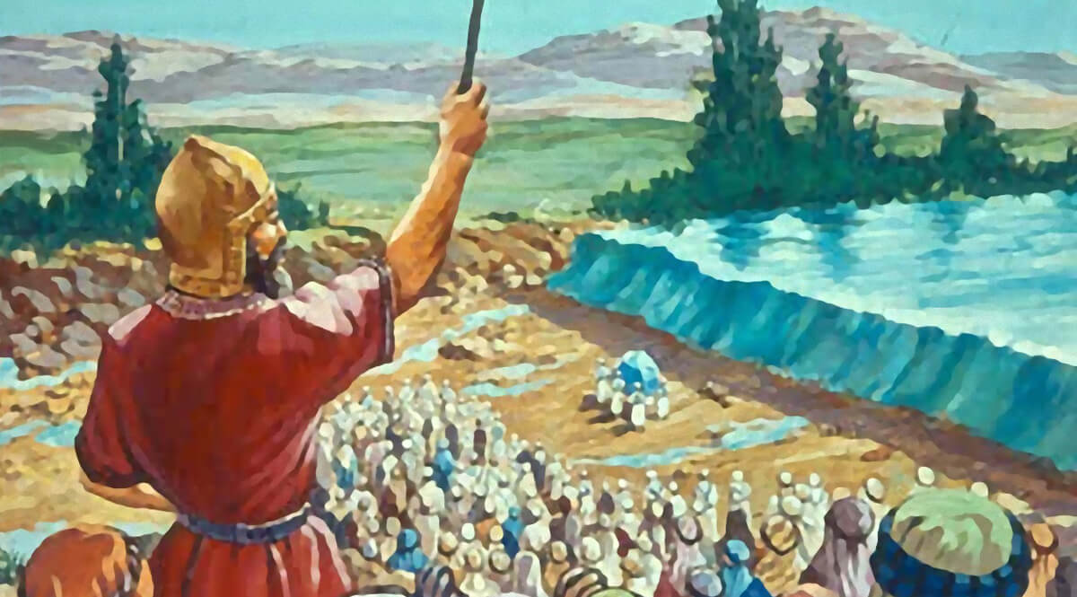
Joshua 3

Slide 8
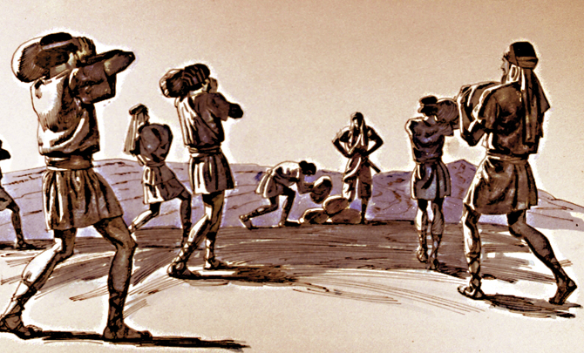
Joshua 4

Slide 9
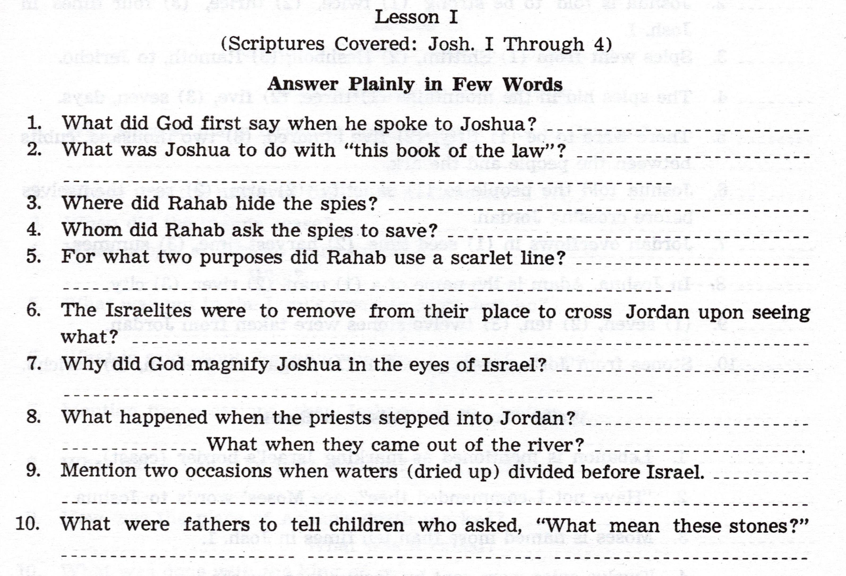

Slide 13
For Sunday (Dec. 5, 2021)
Lesson # 2

