Slide 1
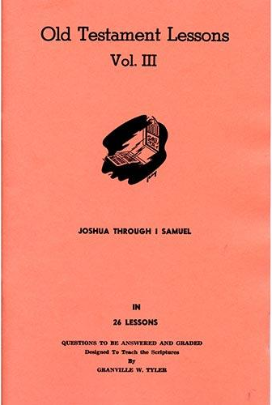
Joshua – 1st Samuel
Lesson # 12
Judges 17 - 19

Slide 2
Introduction to Judges
Basic Outline for Book of Judges
General Introduction to the Time of the Judges (1:1 – 3:6)
Campaigns in Period of the Judges (3:7 – 16:31)
Israel’s Religious & Moral Digression (17:1 – 21:25)
Connections Back to Book of Joshua
Compare Judges 2:7 with Joshua 24:31
Compare Judges 2:8-9 with Joshua 24:29-30
“Judges” – Hebrew word (shophetim)

Slide 3
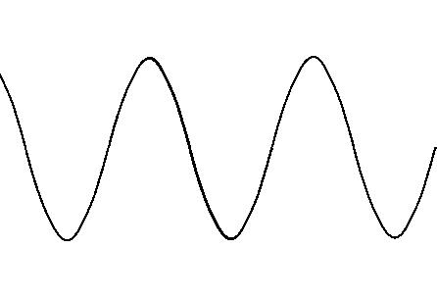
Introduction to Judges
AUTHOR:
No author is ever named for the book of Judges
TIME:
Covers from death of Joshua to a time before Eli
Length of this period is about 300 years
PURPOSE:
Actions recounted in the book establish a pattern of behavior that becomes habitual with Israel in the land
Cry to God for deliverance
Time of peace in righteousness
Generation arises not knowing God - Apostasy
God
delivers by Judge

Slide 4
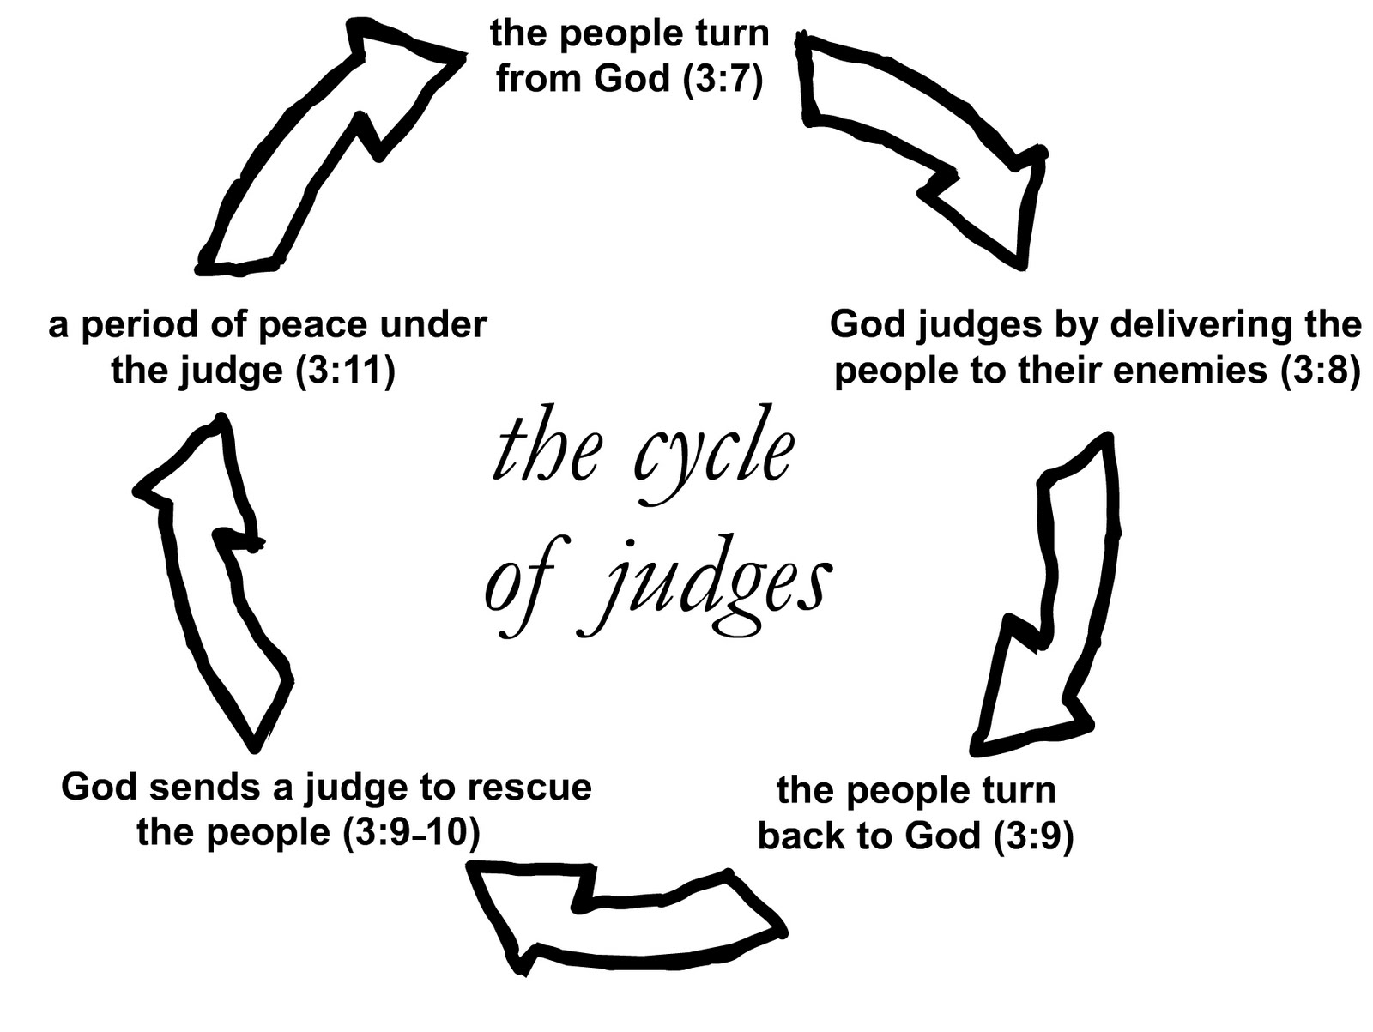

Slide 5
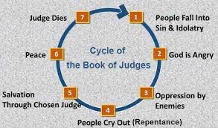
Cycles in Judges

Slide 6
Introduction to Judges
AUTHOR:
No author is ever named for the book of Judges
TIME:
Covers from death of Joshua to a time before Eli
Length of this period is about 300 years
PURPOSE:
Actions recounted in the book establish a pattern of behavior that becomes habitual with Israel in the land
Generation arises not knowing God - Apostasy

Slide 7
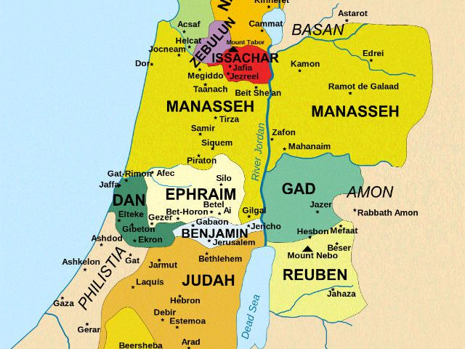
Benjaminites: Evil with Levite & Concubine

Slide 8
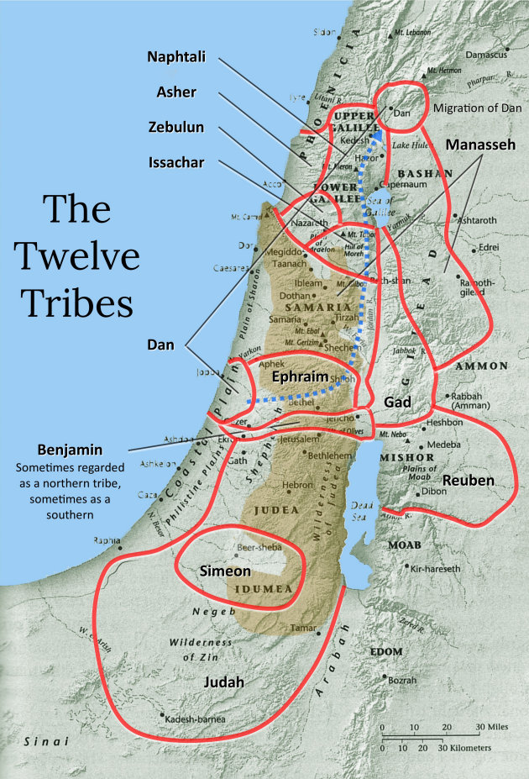

Slide 9
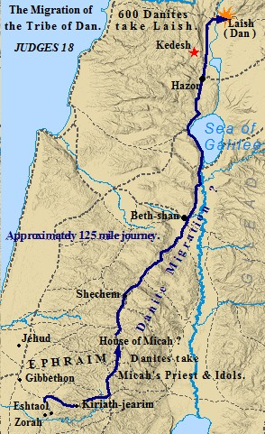

Slide 10
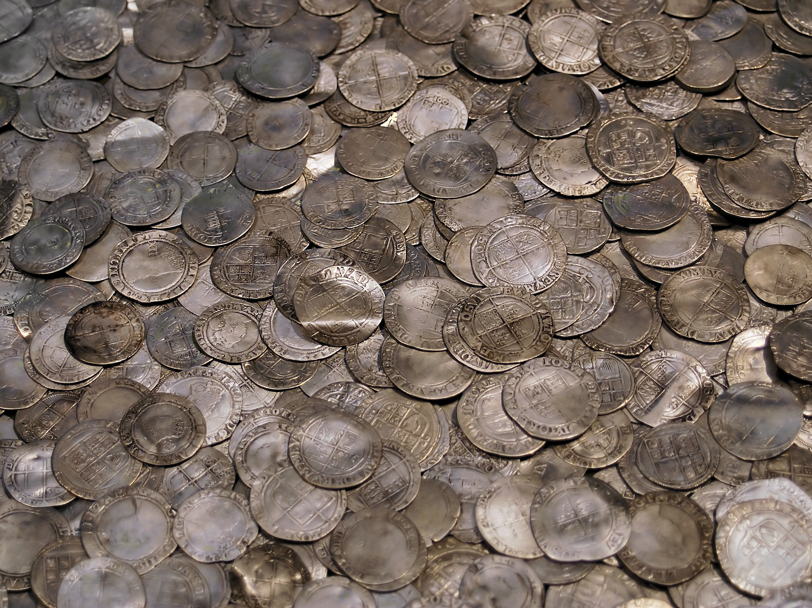
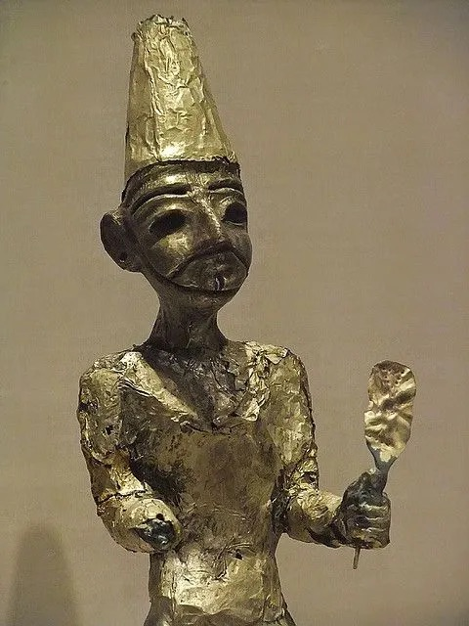
Judges 17

Slide 11
Judges 17

Slide 12
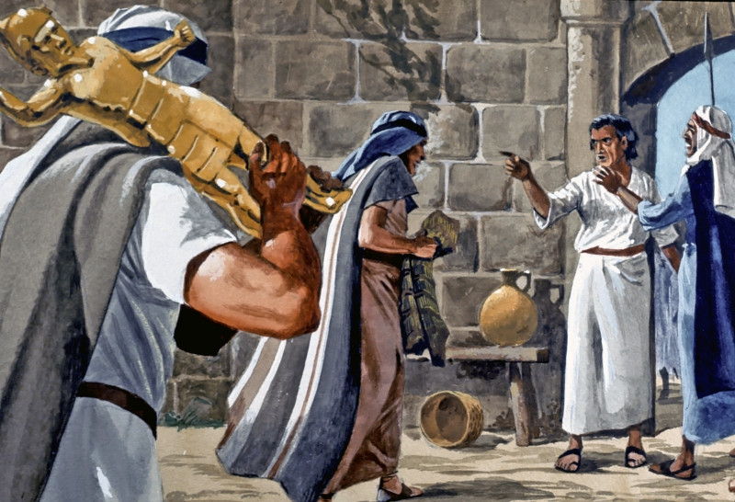
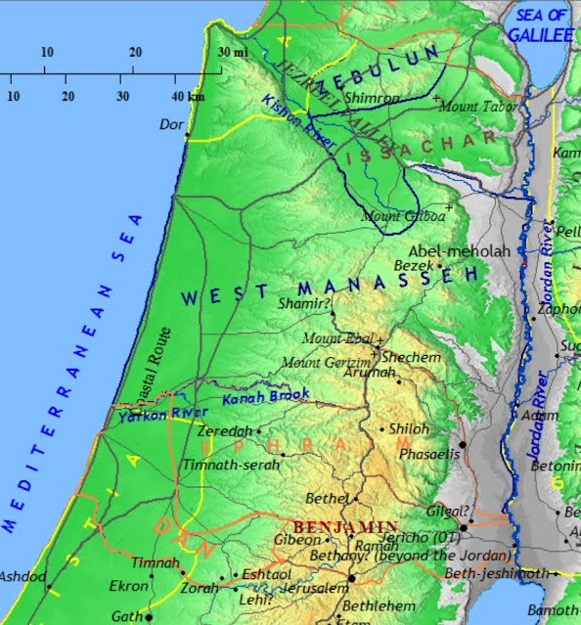
Judges 17

Slide 13
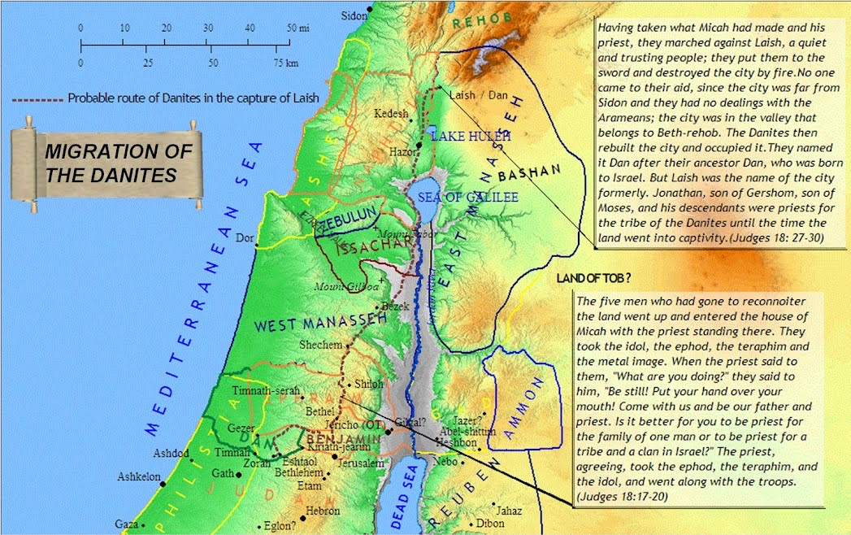
Judges 18

Slide 14
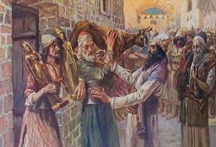
Judges 18

Slide 15
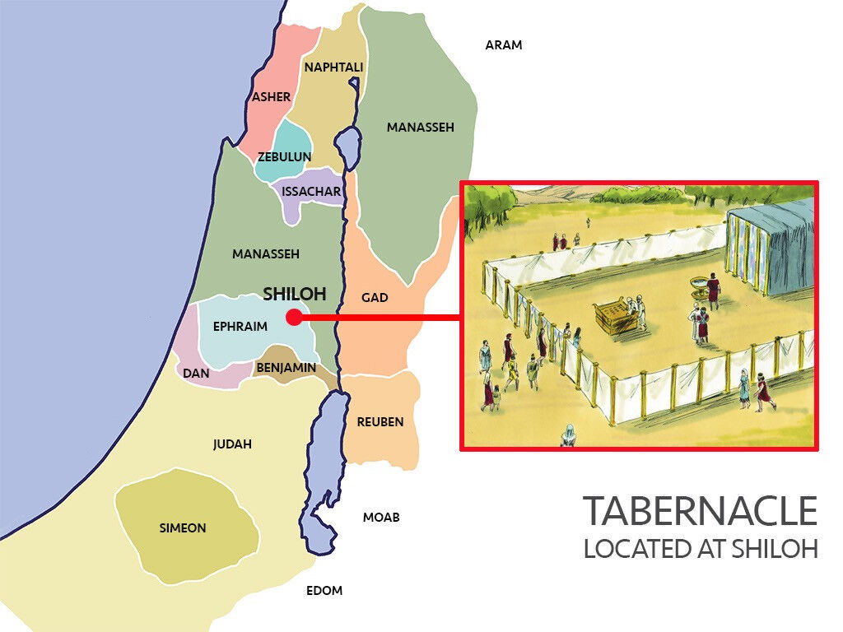
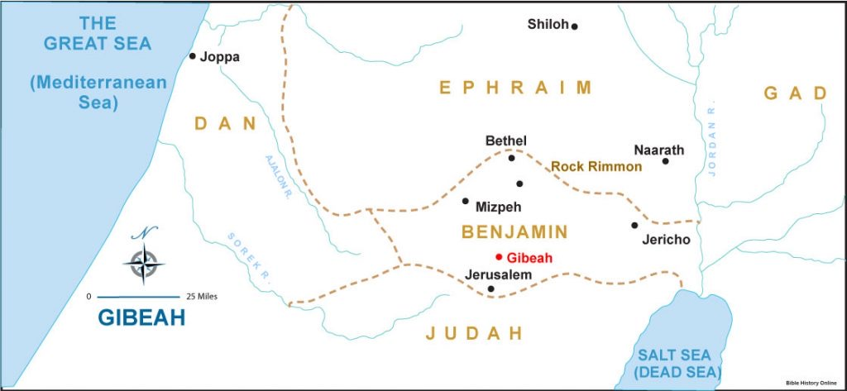
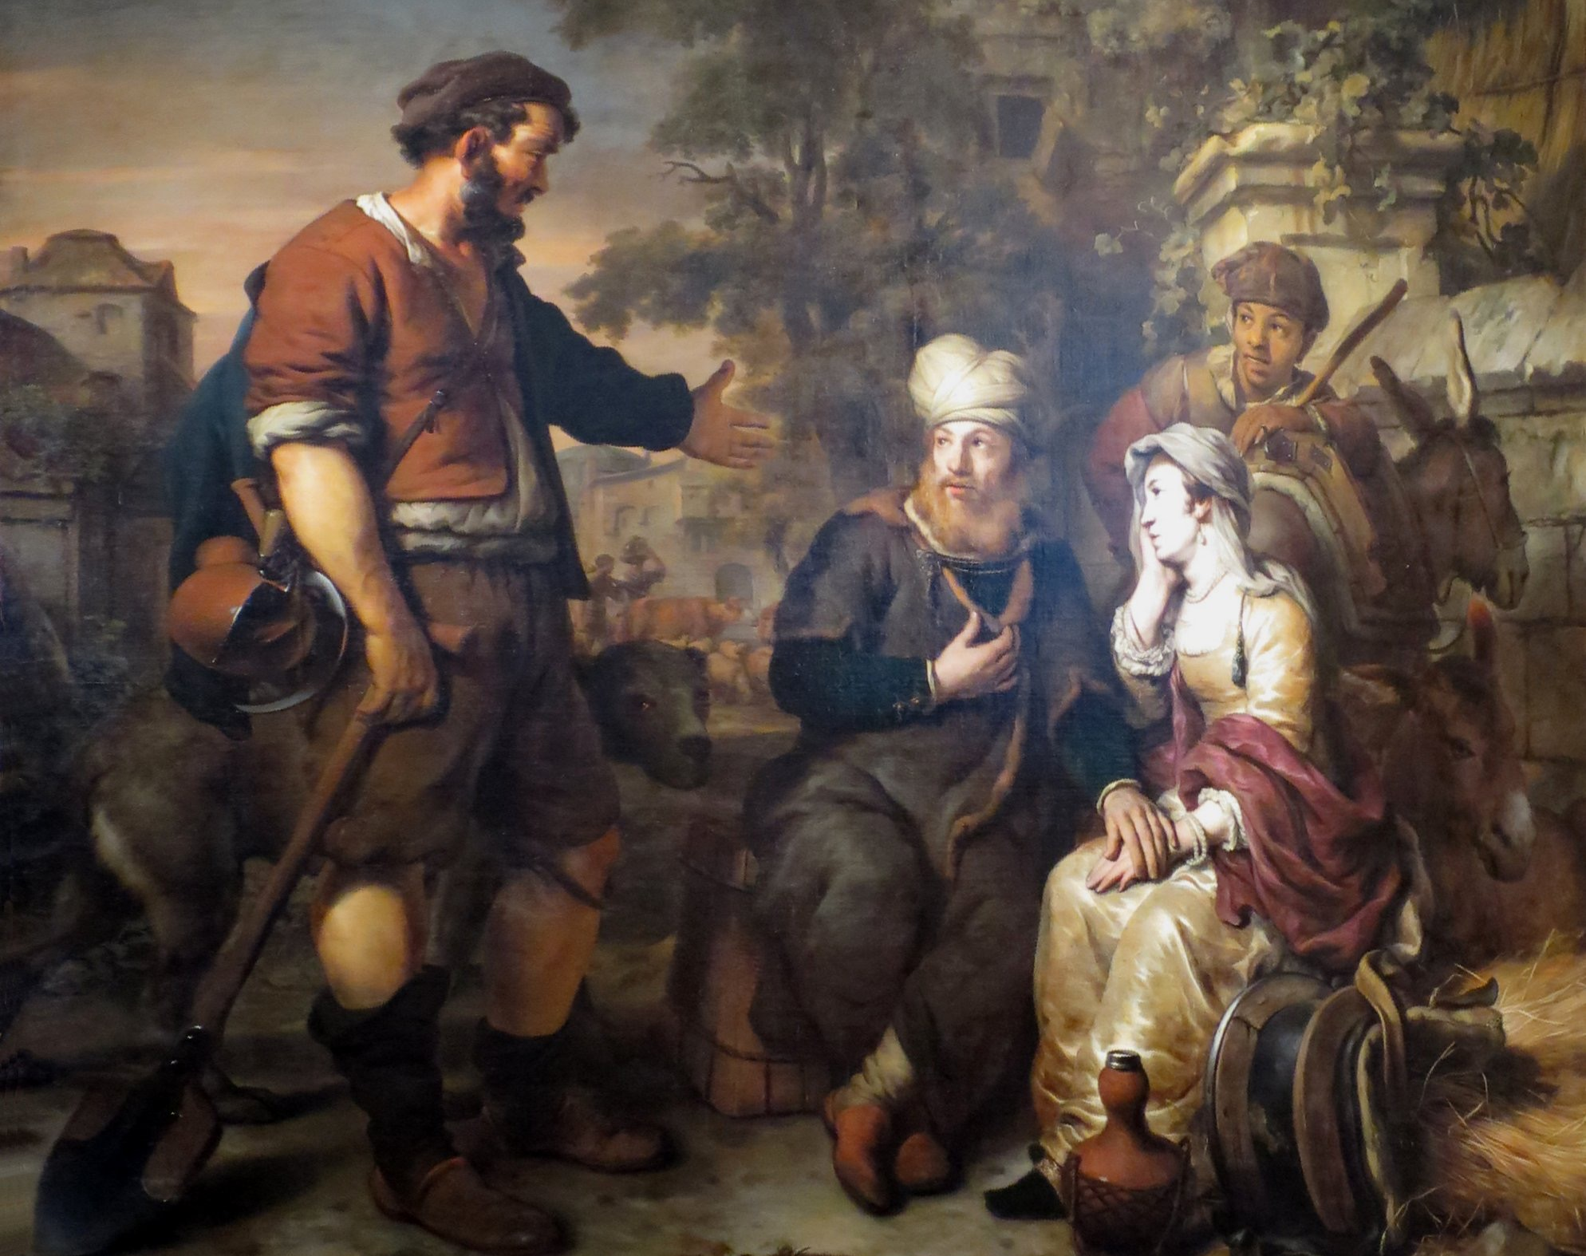
Judges 19

Slide 16
Judges 19

Slide 17
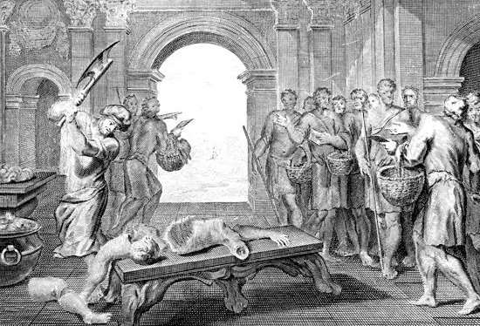
What Is The Main Point?
Evil Had Sunken To An All New Low

Slide 18
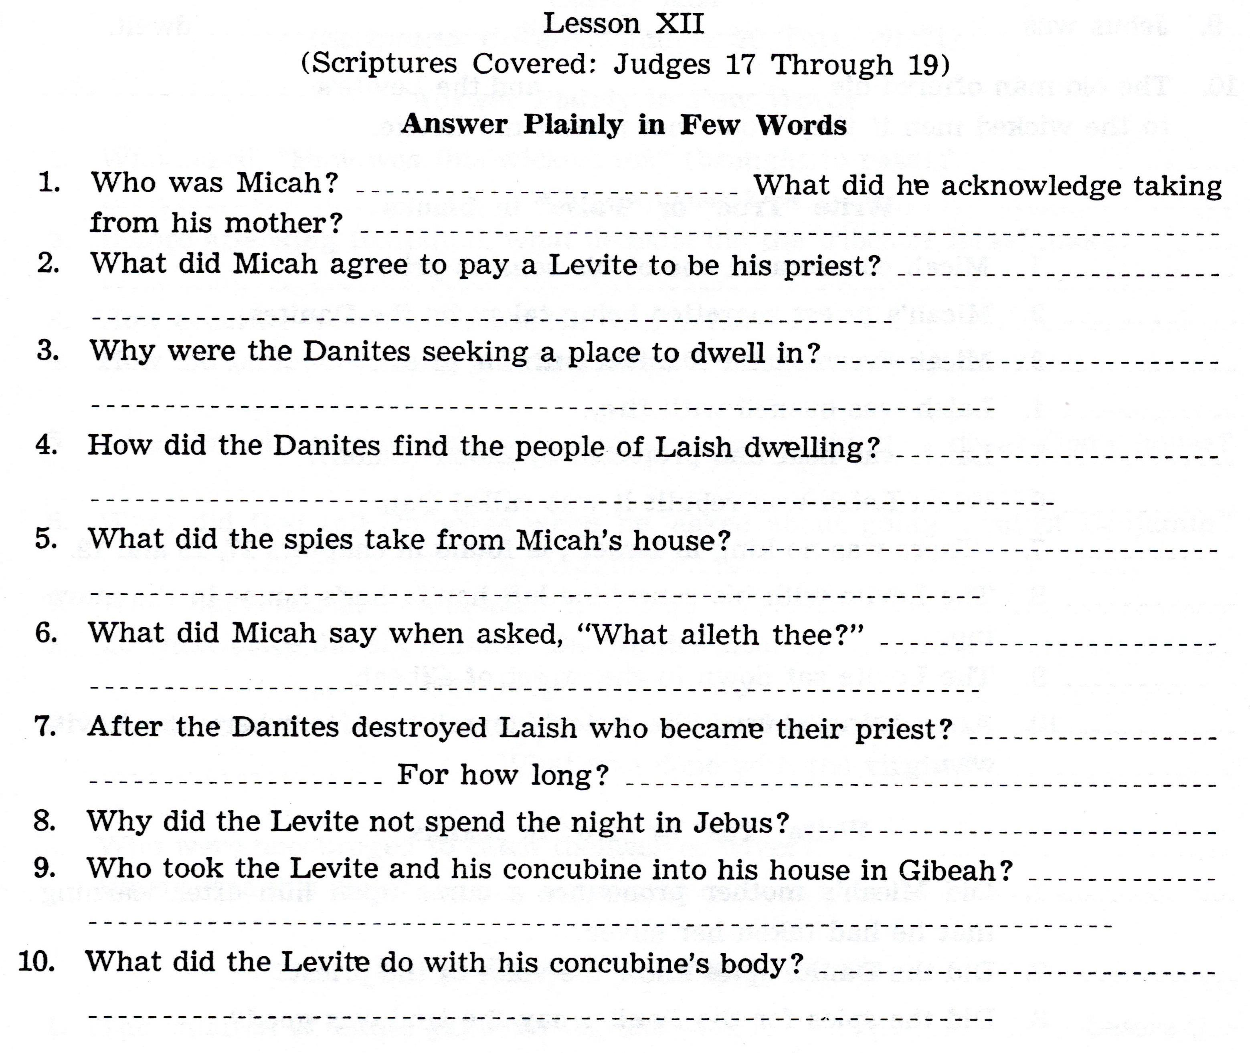

Slide 19
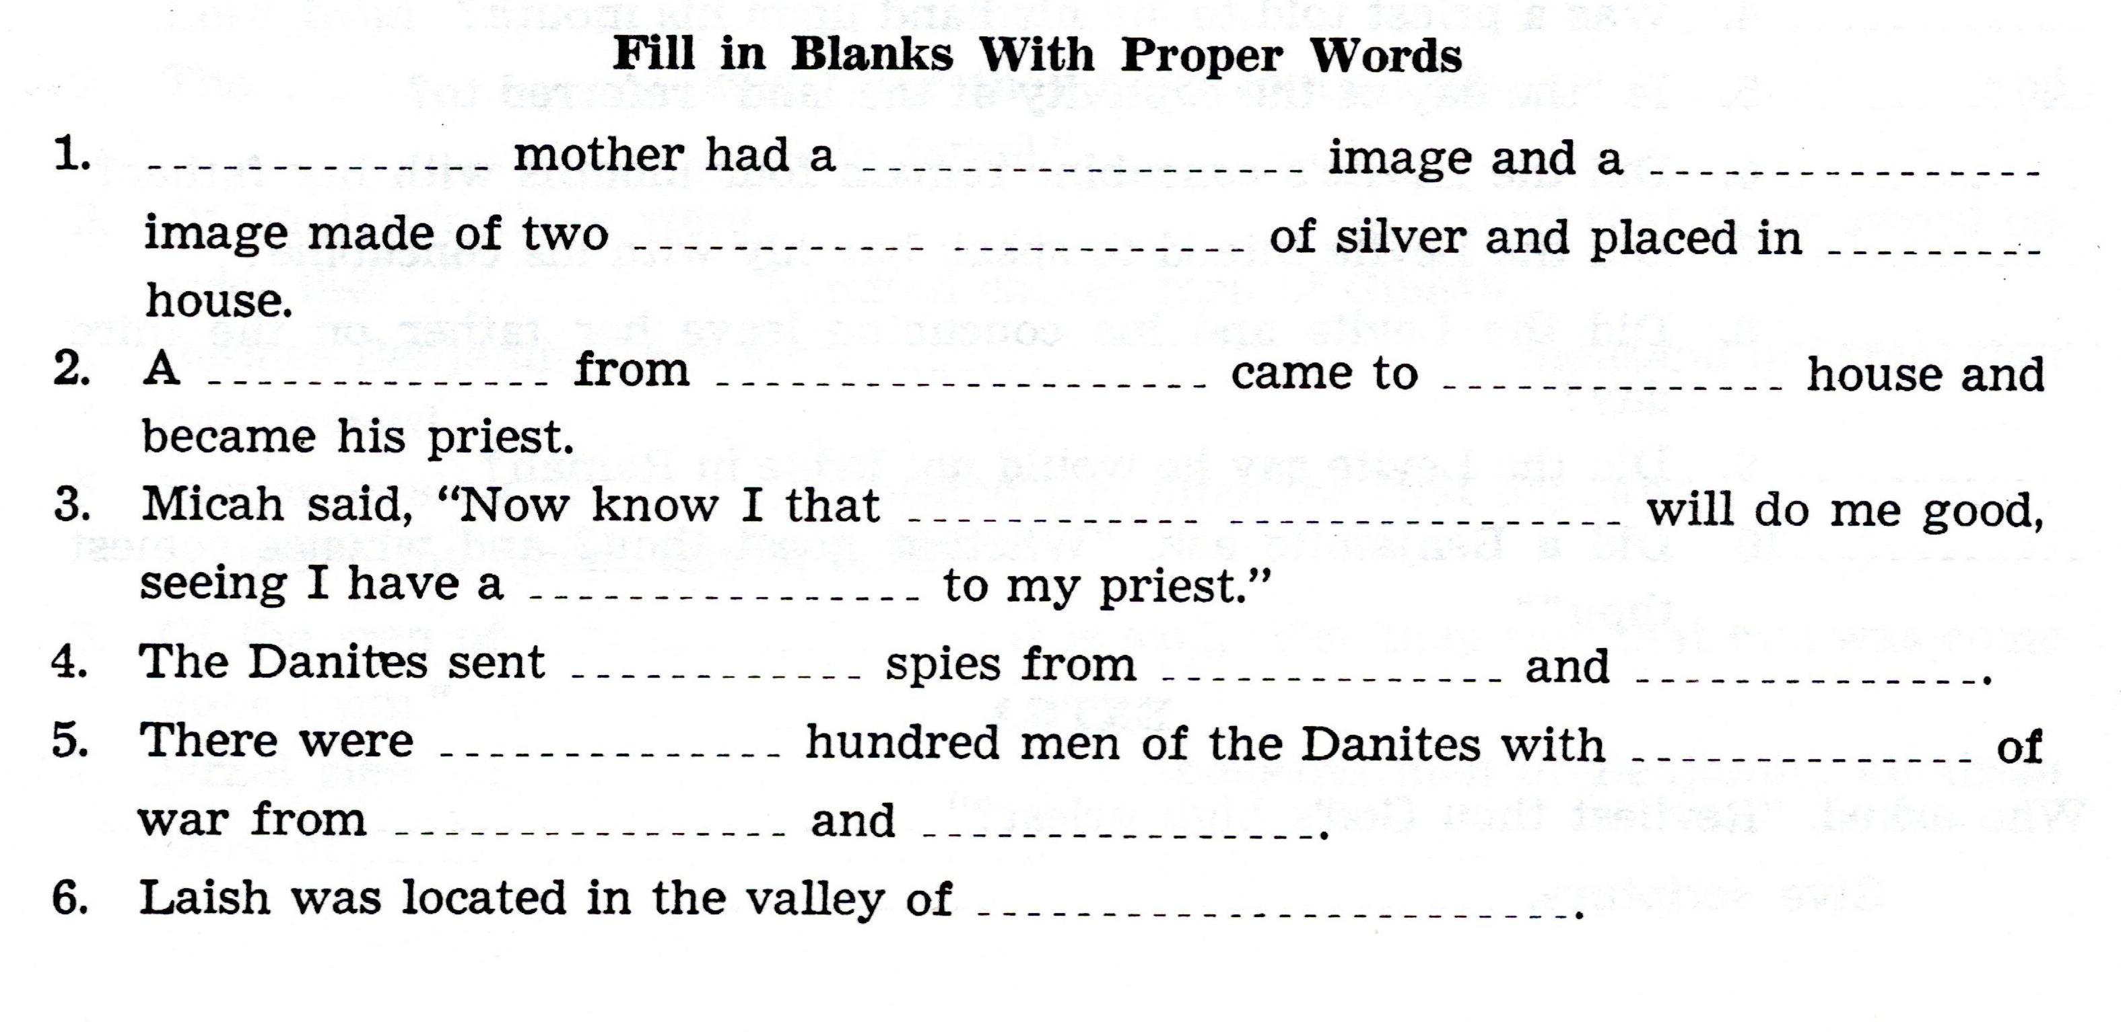

Slide 20
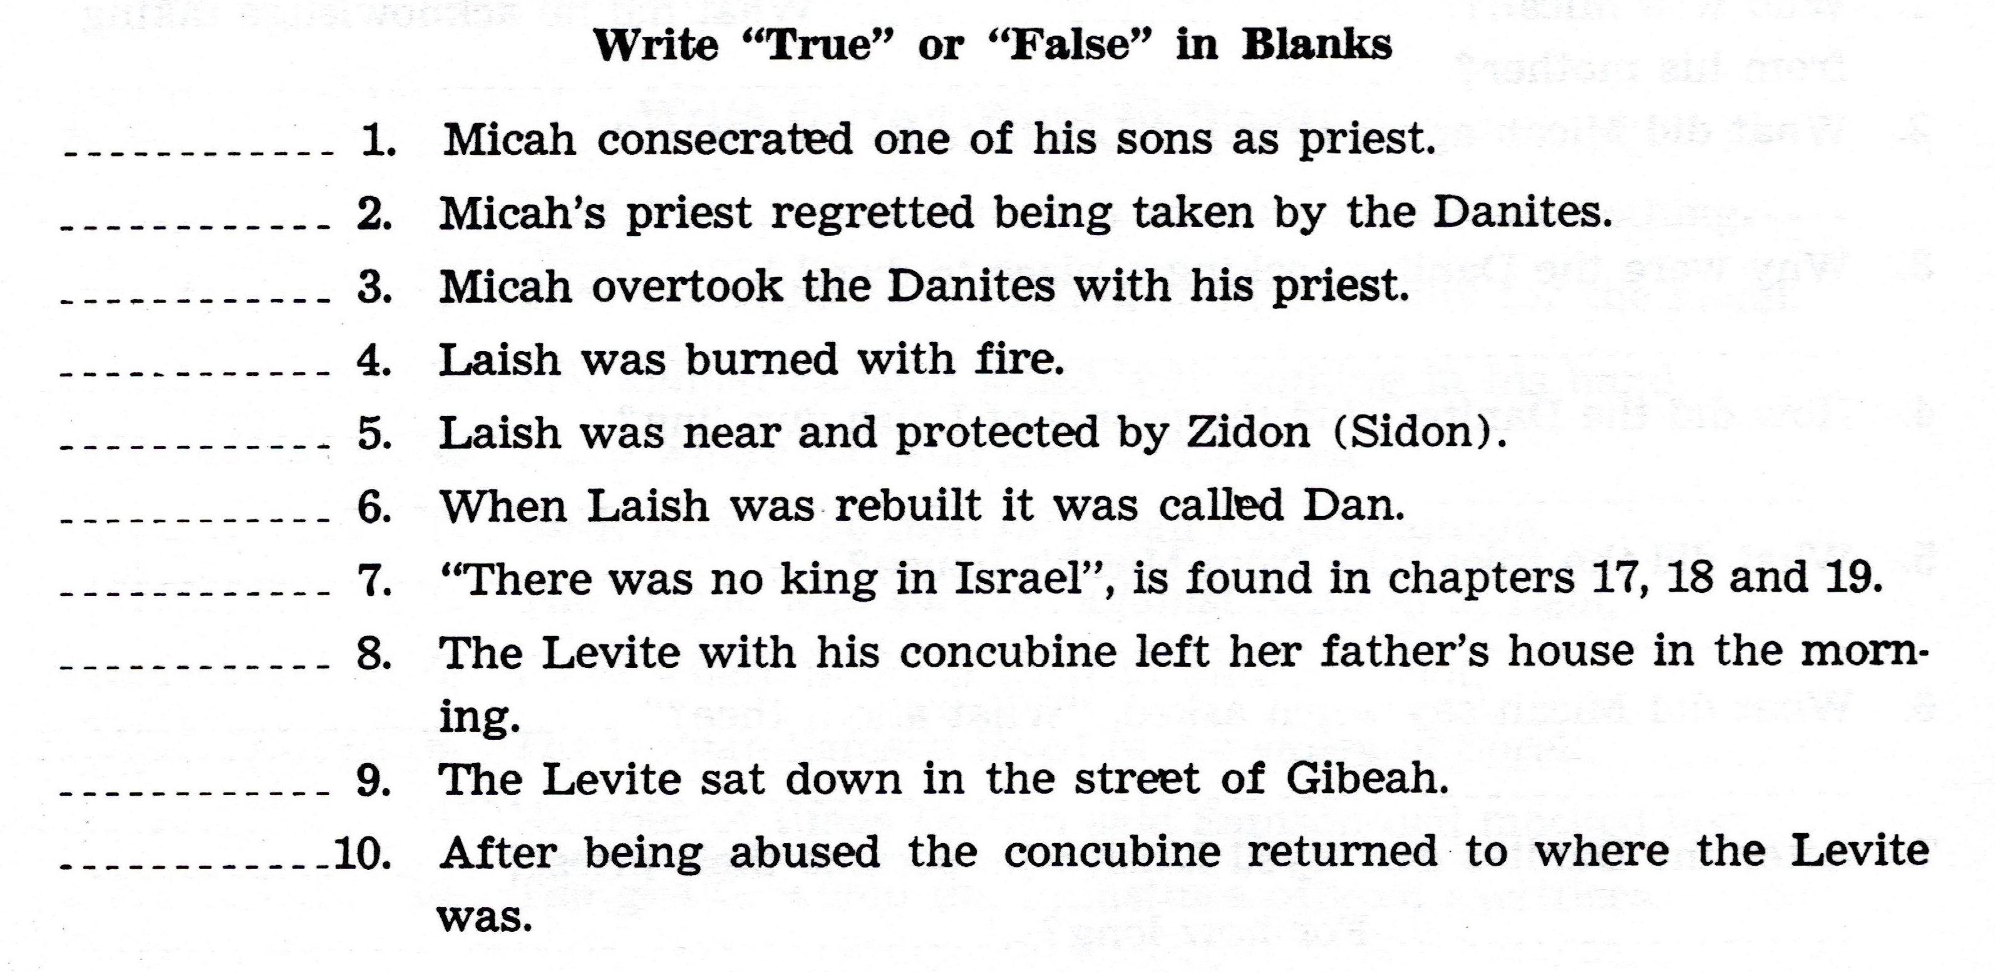

Slide 21
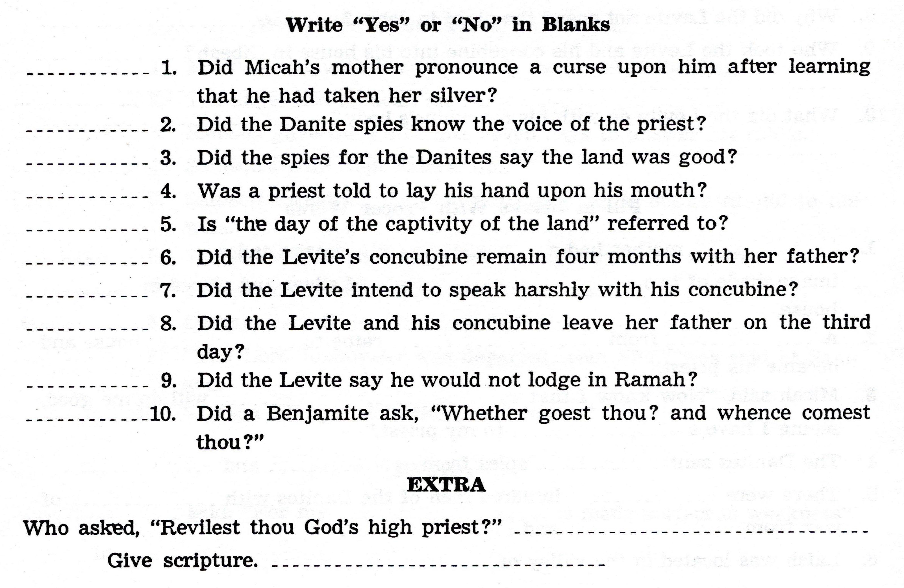

Slide 22
For Sunday (January 16, 2022)
Lesson # 13
Judges 20 - 21

