Slide 1
Punishment on House of Eli
Lesson # 17
1st Samuel 3 - 5

Slide 2
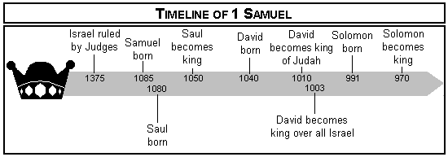
Timeline of Events

Slide 3
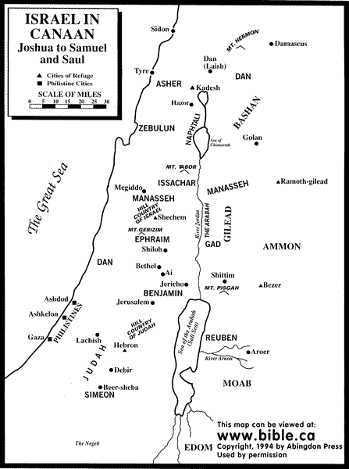
Map of Israel & Philistia

Slide 4
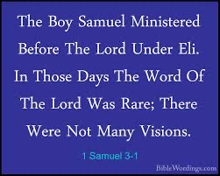
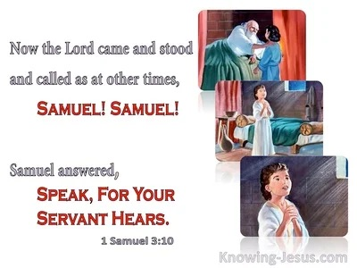
1 Samuel 3
¹⁹ And Samuel grew, and the Lord was with him and let none of his words fall to the ground. ²⁰ And all Israel from Dan to Beersheba knew that Samuel was established as a prophet of the Lord. ²¹ And the Lord appeared again at Shiloh, for the Lord revealed himself to Samuel at Shiloh by the word of the Lord.

Slide 5
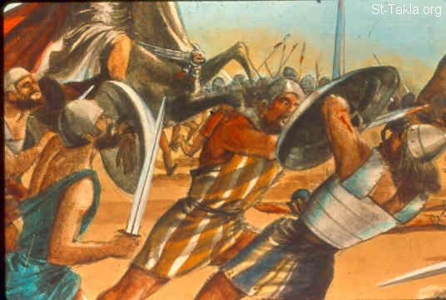
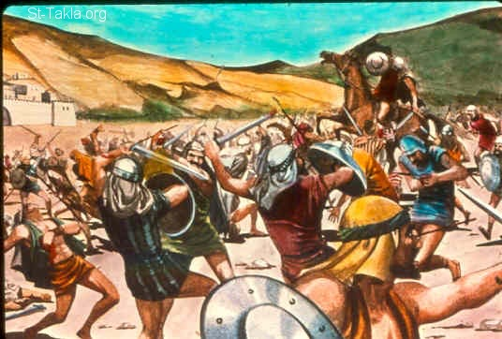
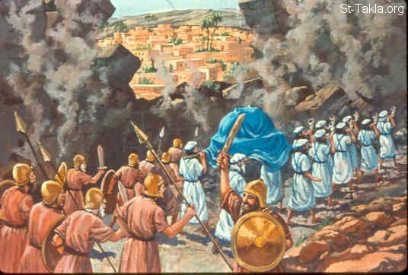
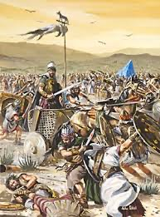
1 Samuel 4

Slide 6
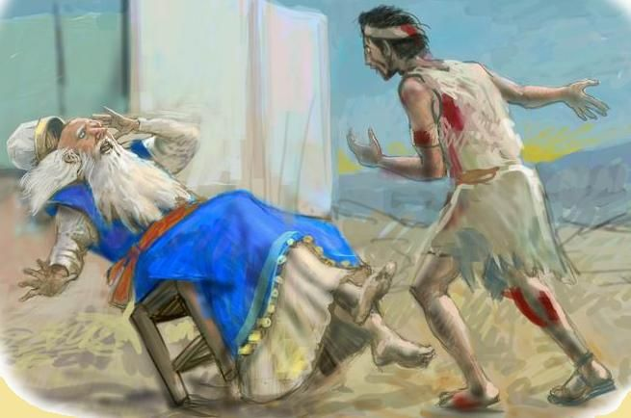
1 Samuel 4

Slide 7
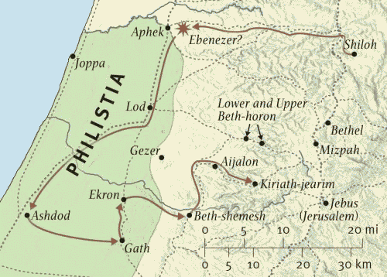
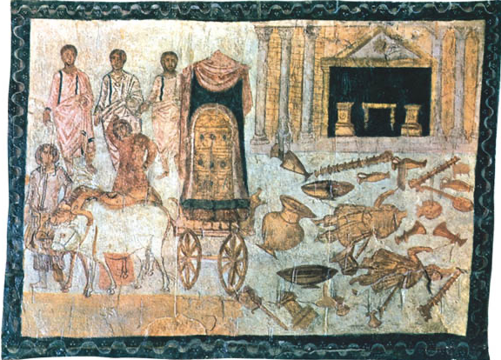
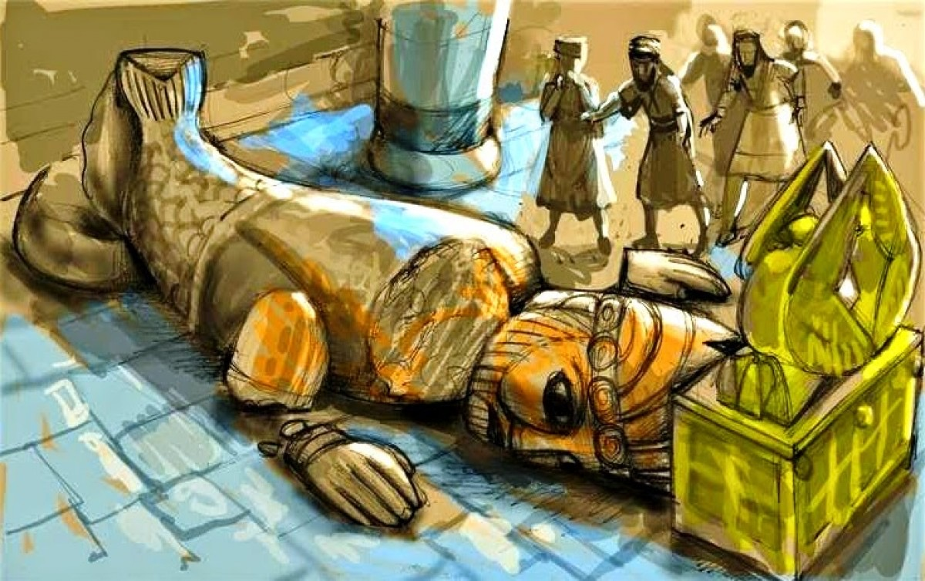
1 Samuel 5

Slide 8
What Are Main Points?

Slide 10
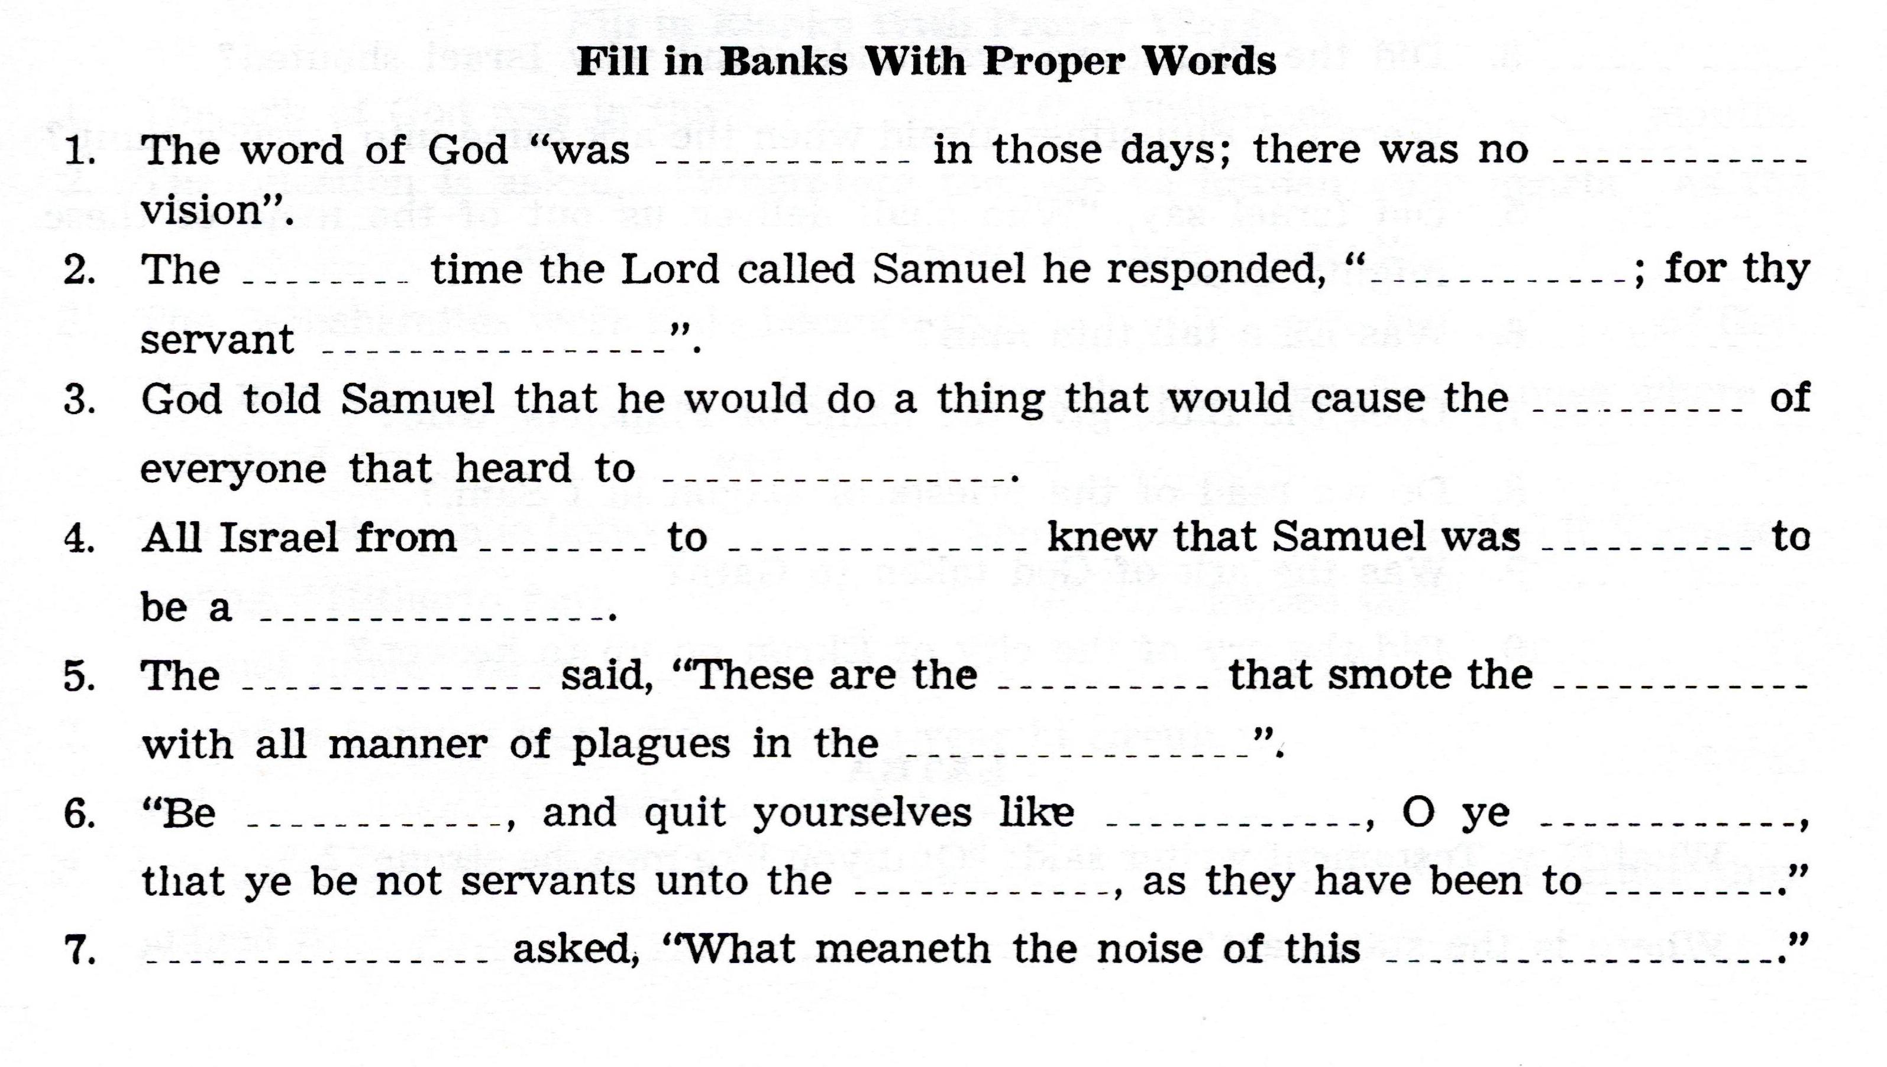

Slide 13
For Sunday (January 30, 2022)
Lessons # 18
1st Samuel 6 - 8

