Slide 1
Joshua – 1st Samuel
Lesson #18
1 Samuel 6-8

Slide 2
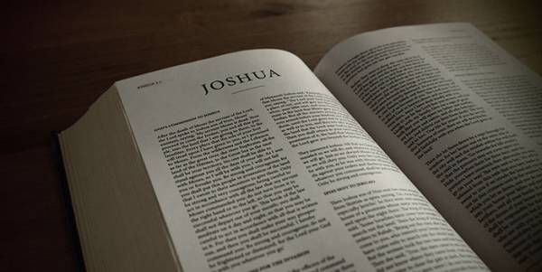
Review
Joshua – Conquest, conquering, and allotment of the promised land
Judges – A cycle of rebellion, oppression, repentance, deliverance, and faithfulness
Samuel 1-5 – Samuel is born, works with Eli, the ark of God is taken by the Philistines, and Eli dies

Slide 3
Overview of the Text
1 Samuel 6 – The ark retuned by the Philistines
1 Samuel 7 – Israel returns to God and defeat the Philistines at Mizpah
1 Samuel 8 – Israel rejects God and demands a king

Slide 4
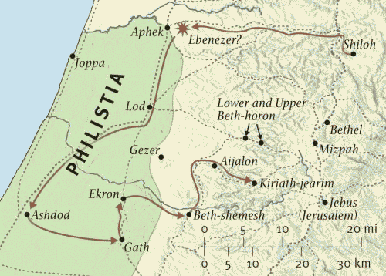
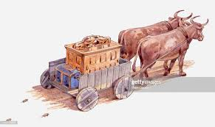
1 Samuel 6

Slide 5
1 Samuel 6-7

Slide 6
1 Samuel 7

Slide 7
1 Samuel 7:3-4
³ Then Samuel spoke to all the house of Israel, saying, “If you return to the Lord with all your hearts, then put away the foreign gods and the Ashtoreths from among you, and prepare your hearts for the Lord, and serve Him only; and He will deliver you from the hand of the Philistines.” ⁴ So the children of Israel put away the Baals and the Ashtoreths, and served the Lord only.

Slide 8
1 Samuel 7

Slide 9
1 Samuel 7:5-6
⁵ And Samuel said, “Gather all Israel to Mizpah, and I will pray to the Lord for you.” ⁶ So they gathered together at Mizpah, drew water, and poured it out before the Lord. And they fasted that day, and said there, “We have sinned against the Lord.” And Samuel judged the children of Israel at Mizpah.

Slide 10
1 Samuel 7

Slide 11
1 Samuel 7
Gilgal
Ramah

Slide 12
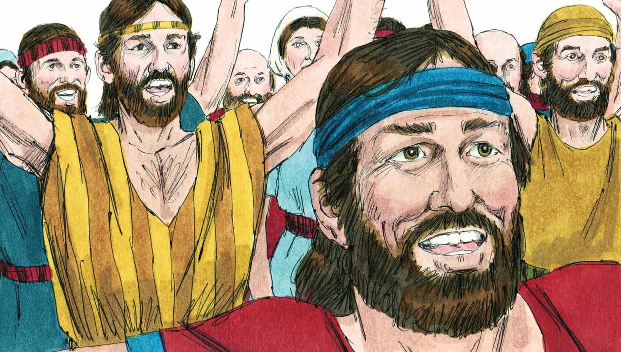
1 Samuel 8

Slide 13
1 Samuel 8:1-4
¹Now it came to pass when Samuel was old that he made his sons judges over Israel. ² The name of his firstborn was Joel, and the name of his second, Abijah; they were judges in Beersheba. ³ But his sons did not walk in his ways; they turned aside after dishonest gain, took bribes, and perverted justice.
⁴ Then all the elders of Israel gathered together and came to Samuel at Ramah, ⁵ and said to him, “Look, you are old, and your sons do not walk in your ways. Now make us a king to judge us like all the nations.”

Slide 14
1 Samuel 8:7-9
⁷ And the Lord said to Samuel, “Heed the voice of the people in all that they say to you; for they have not rejected you, but they have rejected Me, that I should not reign over them. ⁸ According to all the works which they have done since the day that I brought them up out of Egypt, even to this day—with which they have forsaken Me and served other gods—so they are doing to you also. ⁹ Now therefore, heed their voice. However, you shall solemnly forewarn them, and show them the behavior of the king who will reign over them

Slide 15
1 Samuel 8:10-18
¹⁰ So Samuel told all the words of the Lord to the people who asked him for a king. ¹¹ And he said, “This will be the behavior of the king who will reign over you: He will take your sons and appoint them for his own chariots and to be his horsemen, and some will run before his chariots. ¹² He will appoint captains over his thousands and captains over his fifties, will set some to plow his ground and reap his harvest, and some to make his weapons of war and equipment for his chariots. ¹³ He will take your daughters to be perfumers, cooks, and bakers.

Slide 16
1 Samuel 8:10-18
¹⁴ And he will take the best of your fields, your vineyards, and your olive groves, and give them to his servants. ¹⁵ He will take a tenth of your grain and your vintage, and give it to his officers and servants. ¹⁶ And he will take your male servants, your female servants, your finest young men, and your donkeys, and put them to his work. ¹⁷ He will take a tenth of your sheep. And you will be his servants. ¹⁸ And you will cry out in that day because of your king whom you have chosen for yourselves, and the Lord will not hear you in that day.”

Slide 17
1 Samuel 8

Slide 18
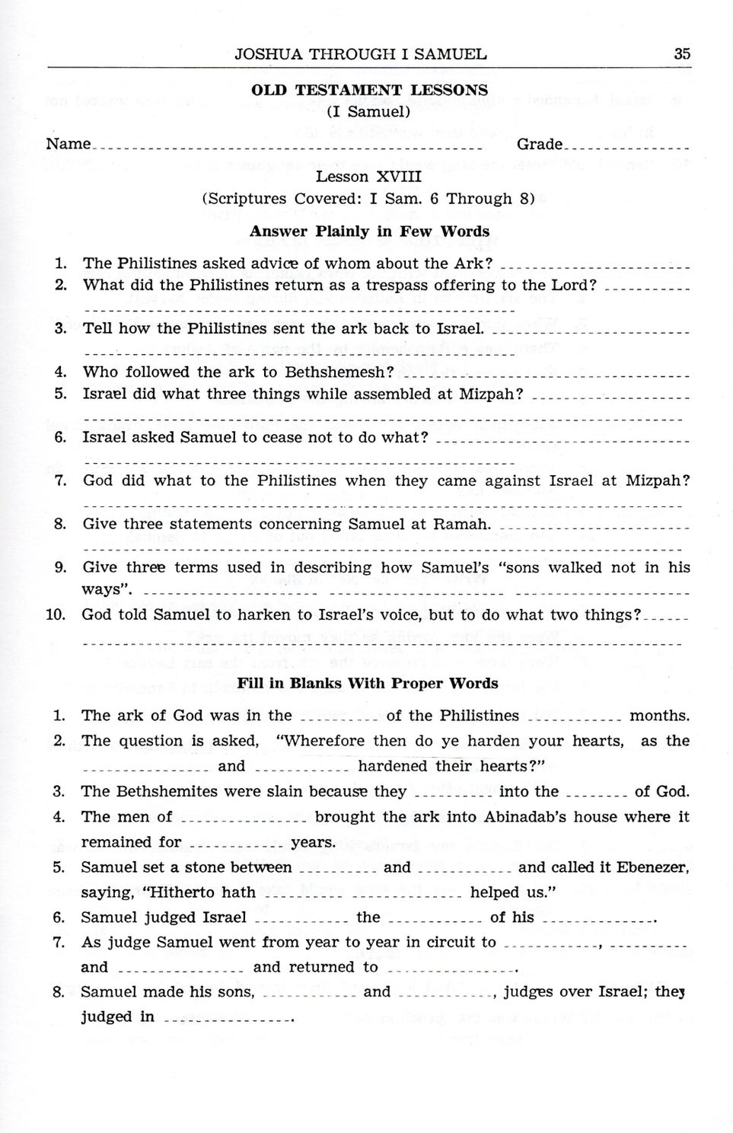

Slide 19
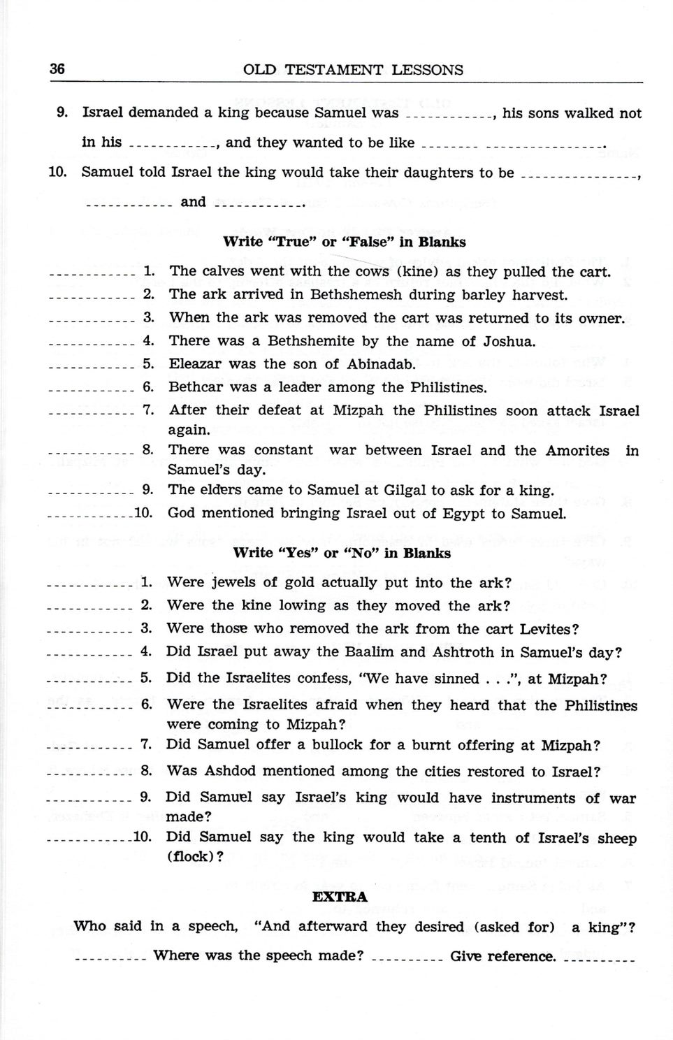

Slide 20
For Wednesday (Feb. 2nd, 2022)
Lesson #19

