Slide 1
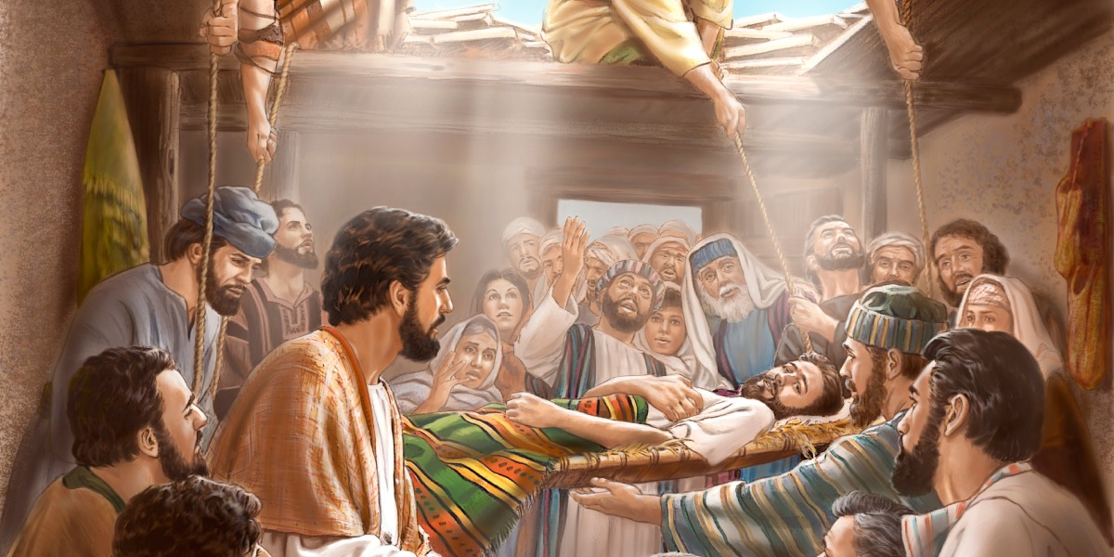
Claim - Power - Proof
Mark 2:1-12

Slide 2
Mark 2:1-12
¹ And again He entered Capernaum after some days, and it was heard that He was in the house. ² Immediately many gathered together, so that there was no longer room to receive them, not even near the door. And He preached the word to them. ³ Then they came to Him, bringing a paralytic who was carried by four men. ⁴ And when they could not come near Him because of the crowd, they uncovered the roof where He was. So when they had broken through, they let down the bed on which the paralytic was lying. ⁵ When Jesus saw their faith, He said to the paralytic, “Son, your sins are forgiven you.”

Slide 3
Mark 2:1-12
¹ And again He entered Capernaum after some days, and it was heard that He was in the house. ² Immediately many gathered together, so that there was no longer room to receive them, not even near the door. And He preached the word to them. ³ Then they came to Him, bringing a paralytic who was carried by four men. ⁴ And when they could not come near Him because of the crowd, they uncovered the roof where He was. So when they had broken through, they let down the bed on which the paralytic was lying. ⁵ When Jesus saw their faith, He said to the paralytic, “Son, your sins are forgiven you.”

Slide 4
⁶ And some of the scribes were sitting there and reasoning in their hearts, ⁷ “Why does this Man speak blasphemies like this? Who can forgive sins but God alone?” ⁸ But immediately, when Jesus perceived in His spirit that they reasoned thus within themselves, He said to them, “Why do you reason about these things in your hearts? ⁹ Which is easier, to say to the paralytic, ‘Your sins are forgiven you,’ or to say, ‘Arise, take up your bed and walk’? ¹⁰ But that you may know that the Son of Man has power on earth to forgive sins” — He said to the paralytic, ¹¹ “I say to you, arise, take up your bed, and go to your house. ¹² Immediately he arose, took up the bed, and went out in the presence of them all, so that all were amazed and glorified God, saying, “We never saw anything like this!”

Slide 5
⁶ And some of the scribes were sitting there and reasoning in their hearts, ⁷ “Why does this Man speak blasphemies like this? Who can forgive sins but God alone?” ⁸ But immediately, when Jesus perceived in His spirit that they reasoned thus within themselves, He said to them, “Why do you reason about these things in your hearts? ⁹ Which is easier, to say to the paralytic, ‘Your sins are forgiven you,’ or to say, ‘Arise, take up your bed and walk’? ¹⁰ But that you may know that the Son of Man has power on earth to forgive sins” — He said to the paralytic, ¹¹ “I say to you, arise, take up your bed, and go to your house. ¹² Immediately he arose, took up the bed, and went out in the presence of them all, so that all were amazed and glorified God, saying, “We never saw anything like this!”

Slide 6
⁶ And some of the scribes were sitting there and reasoning in their hearts, ⁷ “Why does this Man speak blasphemies like this? Who can forgive sins but God alone?” ⁸ But immediately, when Jesus perceived in His spirit that they reasoned thus within themselves, He said to them, “Why do you reason about these things in your hearts? ⁹ Which is easier, to say to the paralytic, ‘Your sins are forgiven you,’ or to say, ‘Arise, take up your bed and walk’? ¹⁰ But that you may know that the Son of Man has power on earth to forgive sins” — He said to the paralytic, ¹¹ “I say to you, arise, take up your bed, and go to your house. ¹² Immediately he arose, took up the bed, and went out in the presence of them all, so that all were amazed and glorified God, saying, “We never saw anything like this!”

Slide 7
⁶ And some of the scribes were sitting there and reasoning in their hearts, ⁷ “Why does this Man speak blasphemies like this? Who can forgive sins but God alone?” ⁸ But immediately, when Jesus perceived in His spirit that they reasoned thus within themselves, He said to them, “Why do you reason about these things in your hearts? ⁹ Which is easier, to say to the paralytic, ‘Your sins are forgiven you,’ or to say, ‘Arise, take up your bed and walk’? ¹⁰ But that you may know that the Son of Man has power on earth to forgive sins” — He said to the paralytic, ¹¹ “I say to you, arise, take up your bed, and go to your house.” ¹² Immediately he arose, took up the bed, and went out in the presence of them all, so that all were amazed and glorified God, saying, “We never saw anything like this!”

Slide 8
⁶ And some of the scribes were sitting there and reasoning in their hearts, ⁷ “Why does this Man speak blasphemies like this? Who can forgive sins but God alone?” ⁸ But immediately, when Jesus perceived in His spirit that they reasoned thus within themselves, He said to them, “Why do you reason about these things in your hearts? ⁹ Which is easier, to say to the paralytic, ‘Your sins are forgiven you,’ or to say, ‘Arise, take up your bed and walk’? ¹⁰ But that you may know that the Son of Man has power on earth to forgive sins” — He said to the paralytic, ¹¹ “I say to you, arise, take up your bed, and go to your house.” ¹² Immediately he arose, took up the bed, and went out in the presence of them all, so that all were amazed and glorified God, saying, “We never saw anything like this!”

Slide 9
What Happened & What Did It Prove?
Claim: Forgives a man’s sins – Could only be done by divine power
Power: Jesus manifests His own power by saying, “I say to you, arise, take up your bed, and go to your house”
Not done by calling on name or power of Father or Holy Spirit
Acts 4:7-12 By what power – In whose name – By what means
Proof: Jesus demonstrates divine power while on earth and those looking on acknowledge that proof of power
Not a gradual healing that might have been attributed to Jesus’ appeal for providential healing in prayer (James 5:14-18)
It was instantaneous & beyond normal human experience
Proof – Inescapable conclusion; No other reasonable deduction
Conclusion: Jesus showed Himself to be deity in flesh

Slide 10
CLAIM
POWER
PROOF

Slide 11
CLAIM
POWER
PROOF

Slide 12
Same Point in Other Passages
Mark 16:15-20
Command to preach message of Gospel to whole world
Signs given to go along with that preaching to give proof
Went everywhere, preached message & confirm by signs
John 20:30-31
Jesus did many signs, but ones written are sufficient as proof
We can have certain faith by confirmed Gospel message
Proof not limited to original viewer, but for all readers
John 14 - 16
H.S. to bear witness as proof of message from God (15:24f)
H.S. protected message by providing full recall (14:25-26)
H.S. given for advantage of declaring truth (16:7-14)
Acts 3 – Healing of Lame man → Acts 4:1-12
Acts 19:8-12

Slide 13
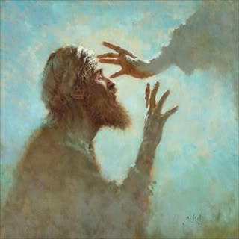
Duration of Miraculous Action

Slide 14
1st Corinthians 13:8-13
⁸ Love never fails. But whether there are prophecies, they will fail; whether there are tongues, they will cease; whether there is knowledge, it will vanish away. ⁹ For we know in part and we prophesy in part. ¹⁰ But when that which is perfect has come, then that which is in part will be done away. ¹¹ When I was a child, I spoke as a child, I understood as a child, I thought as a child; but when I became a man, I put away childish things. ¹² For now we see in a mirror, dimly, but then face to face. Now I know in part, but then I shall know just as I also am known. ¹³ And now abide faith, hope, love, these three; but the greatest of these is love.

Slide 15
1st Corinthians 13:8-13
Love is always required as motivation for all acceptable action (see Matt. 22:34-40)
Love distinguished from gifts in that “love never fails” but gifts will be “done away”
When are gifts to be done away?
“When that which is perfect (whole) has come, then that which is in part (partial) will be done away”
What are the parts & the whole?

Slide 16
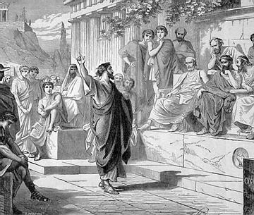
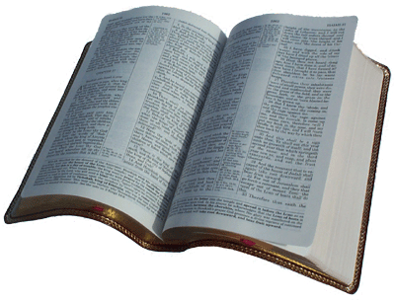
Part (Partial) & Perfect (Whole)

Slide 17
When Partial Revelation Ceases, Product of Revelation Continues
If “part” is one form of revelation, then “perfect” is complete or full revelation
Complete revelation instructs & requires that we be motivated by love
At the completion of revelation, faith & hope also abide on foundation of truth
Full revelation merely compiled the same truth given orally in parts by inspired men
No provision or requirement was changed

Slide 18
“That Which Is Perfect” Could Not Be Second Coming of Christ
Makes no correlation between “part” (partial) & “perfect” (whole)
Would be insertion into text of a subject neither introduced nor explained in text
Would contradict other Scripture in that “faith” & “hope” cease at 2nd coming
If “faith, hope & love” continue after end of gifts, must be before 2nd coming

Slide 19
Conclusion

Slide 20
Miraculous Action Has Ceased
No miracles of the nature recorded in Bible are taking place now
Purpose was completed when all truth was revealed & confirmed
We have complete & final revelation from God, needing no further confirmation
At death of last person empowered by laying on of apostles’ hands, miraculous action ceased

Slide 21
CLAIM
POWER
PROOF

