Slide 1
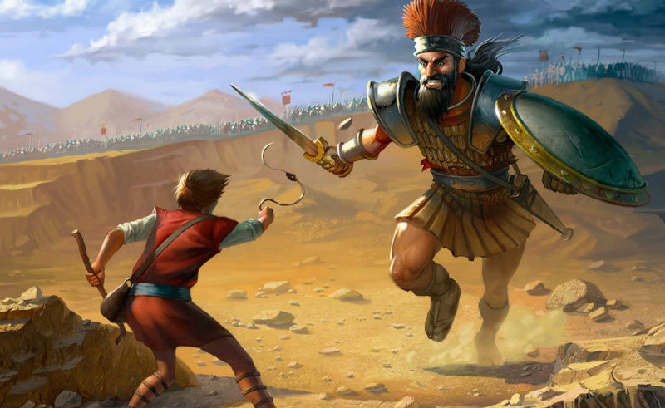
Facing Your Goliath
1st Samuel 17

Slide 2
1 Samuel 17:45-50
⁴⁵ Then David said to the Philistine, “You come to me with a sword, with a spear, and with a javelin. But I come to you in the name of the Lord of hosts, the God of the armies of Israel, whom you have defied. ⁴⁶ This day the Lord will deliver you into my hand, and I will strike you and take your head from you. And this day I will give the carcasses of the camp of the Philistines to the birds of the air and the wild beasts of the earth, that all the earth may know that there is a God in Israel. ⁴⁷ Then all this assembly shall know that the Lord does not save with sword and spear; for the battle is the Lord’s, and He will give you into our hands.” ⁴⁸ So it was, when the Philistine arose and came and drew near to meet David, that David hurried and ran toward the army to meet the Philistine. ⁴⁹ Then David put his hand in his bag and took out a stone; and he slung it and struck the Philistine in his forehead, so that the stone sank into his forehead, and he fell on his face to the earth. ⁵⁰ So David prevailed over the Philistine with a sling and a stone, and struck the Philistine and killed him.

Slide 3
Facing Your Own Goliath of…
Rejecting Faith in God
Hebrews 3:4 → Genesis 1:1
Romans 1:18-20
Denying the Divine Pattern of Scripture
Matthew 28:18-20
2 Timothy 1:13 → 1 Timothy 1:18 → 2 Timothy 3:16-17
Being Carried Away by False Doctrines
Ephesians 4:14
Matthew 7:15; 16:6, 12 → Colossians 2:8 → Rev. 2:14-15
Allowing Sin to Gain Dominion
Romans 6:17
Romans 13:14
Being Distracted by Things of World
Matthew 13:22
Hebrews 12:1

