Slide 1
Saul Selected as First King
Lesson #19
1st Samuel 9 - 12

Slide 2
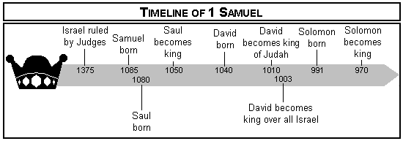
Timeline of Events

Slide 3
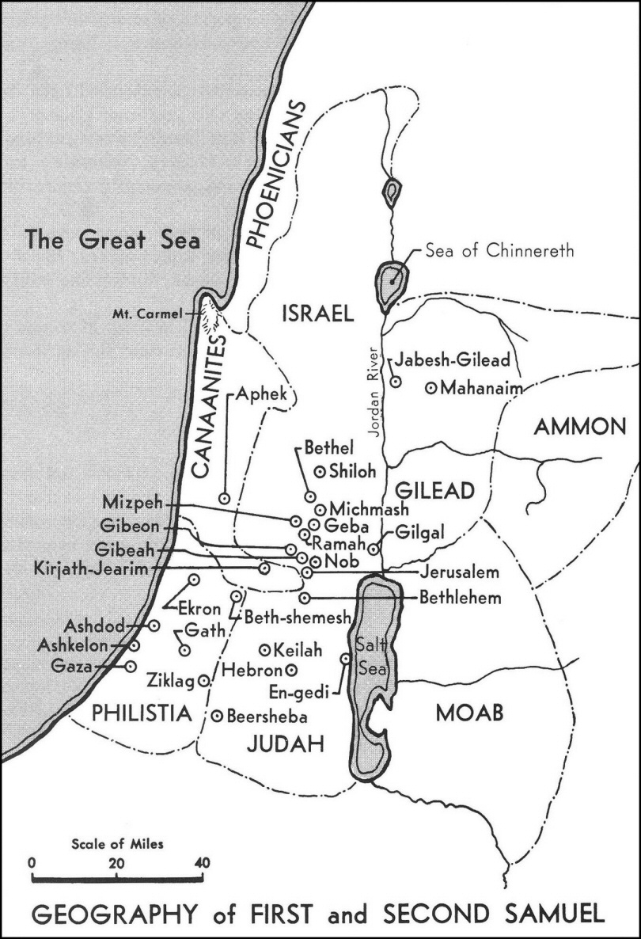
Map of Palestine in 1 & 2 Samuel

Slide 4
Review of 1st Samuel 8 – Asking for King
Having a king was not inherently sinful
Israel’s reason for wanting king & kind they wanted was evil
When Samuel warned what king would do, quoted from law
Deuteronomy 17:14-20
Though the people sinned in their desire for a king, God used it to his purpose for good of Israel & coming Messiah
Efforts at centralization often sound better at start than end
Judges were local & responded to local need
Further away government is, less efficient & accountable
Centralization often eases path of apostasy

Slide 5
Saul Searches for Donkeys, Meets Samuel & Is Anointed

Slide 6
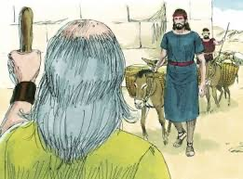
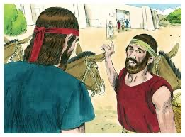
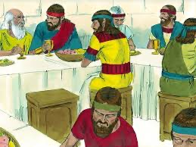
1 Samuel 9
1 Sam. 9:23-24
Saul given chosen portion of “thigh” (also "shoulder”)

Slide 7
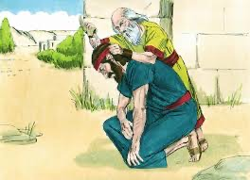
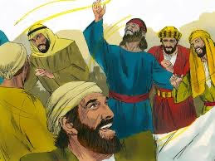
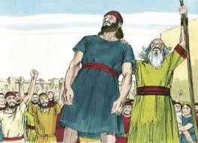
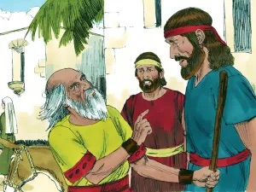
1 Samuel 10
Saul Prophecies as Spirit upon him

Slide 8
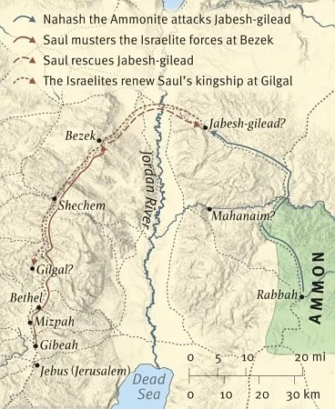
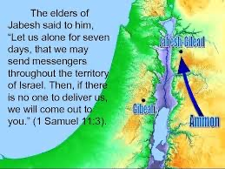
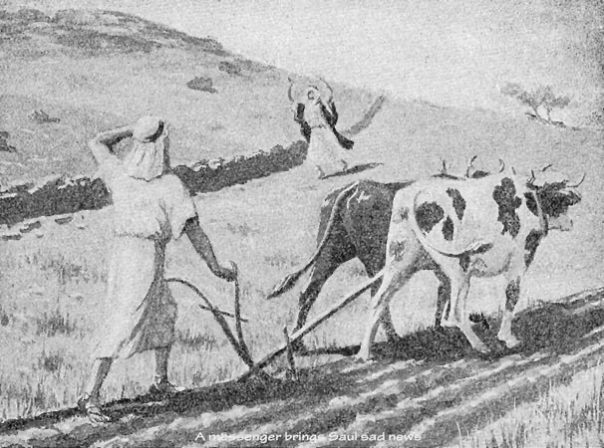
1 Sam. 11

Slide 9
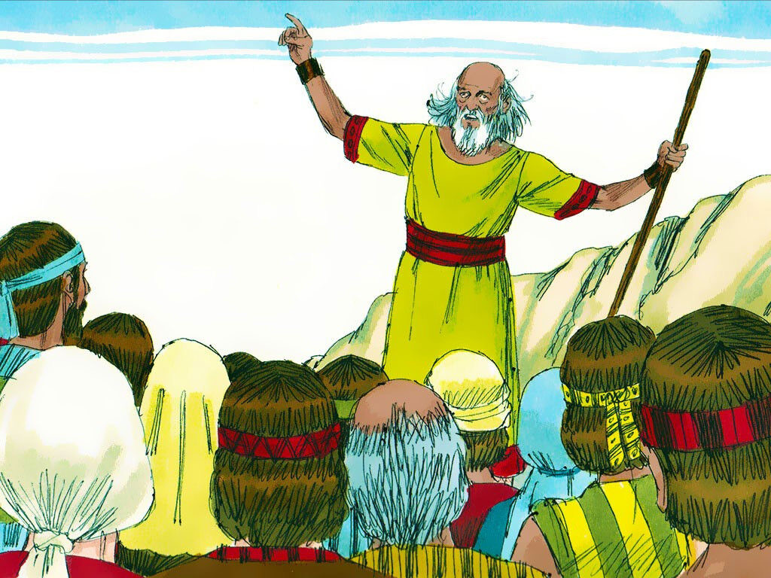
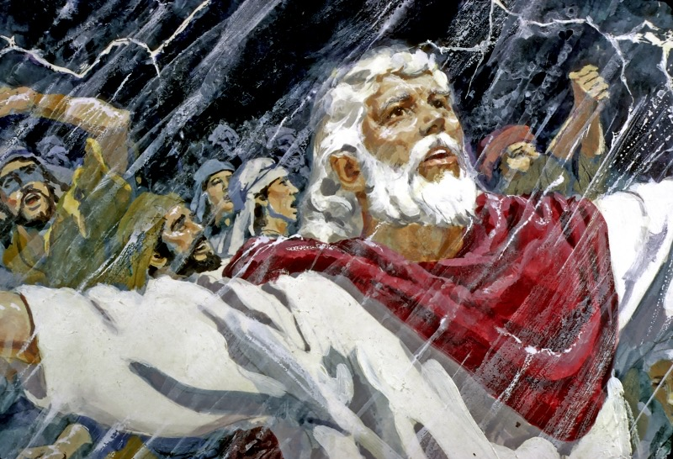
1 Samuel 12

Slide 10
1 Samuel 12
²⁰ Then Samuel said to the people, “Do not fear. You have done all this wickedness; yet do not turn aside from following the Lord, but serve the Lord with all your heart. ²¹ And do not turn aside; for then you would go after empty things which cannot profit or deliver, for they are nothing. ²² For the Lord will not forsake His people, for His great name’s sake, because it has pleased the Lord to make you His people. ²³ Moreover, as for me, far be it from me that I should sin against the Lord in ceasing to pray for you; but I will teach you the good and the right way. ²⁴ Only fear the Lord, and serve Him in truth with all your heart; for consider what great things He has done for you. ²⁵ But if you still do wickedly, you shall be swept away, both you and your king.”

Slide 11
What Are Main Points?

Slide 12
For Sunday (February 6, 2022)
Lessons # 20
1st Samuel 13 - 15

