Slide 1
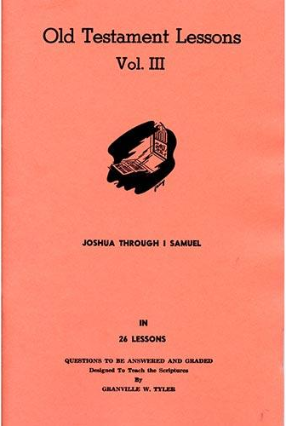
Anointing & Early Days of David
Lesson # 21
1st Samuel 16 – 18:16

Slide 2
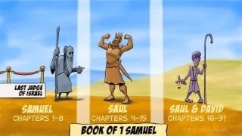
Characters & Book of 1 Samuel

Slide 3
Bridge from Last Lesson to This One
1 Samuel 15
³⁴ Then Samuel went to Ramah, and Saul went up to his house at Gibeah of Saul. ³⁵ And Samuel went no more to see Saul until the day of his death. Nevertheless Samuel mourned for Saul, and the Lord regretted that He had made Saul king over Israel.
1 Samuel 16
¹ Now the Lord said to Samuel, “How long will you mourn for Saul, seeing I have rejected him from reigning over Israel? Fill your horn with oil, and go; I am sending you to Jesse the Bethlehemite. For I have provided Myself a king among his sons.” ² And Samuel said, “How can I go? If Saul hears it, he will kill me.”

Slide 4
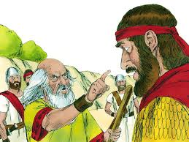
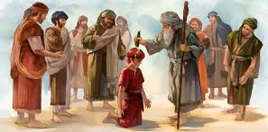
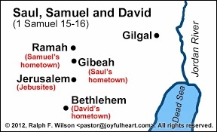
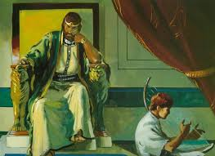
1 Samuel 16

Slide 5
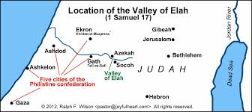
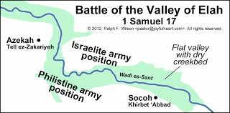
Maps for 1 Samuel 17

Slide 6
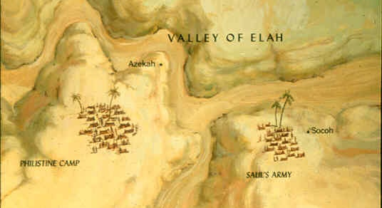
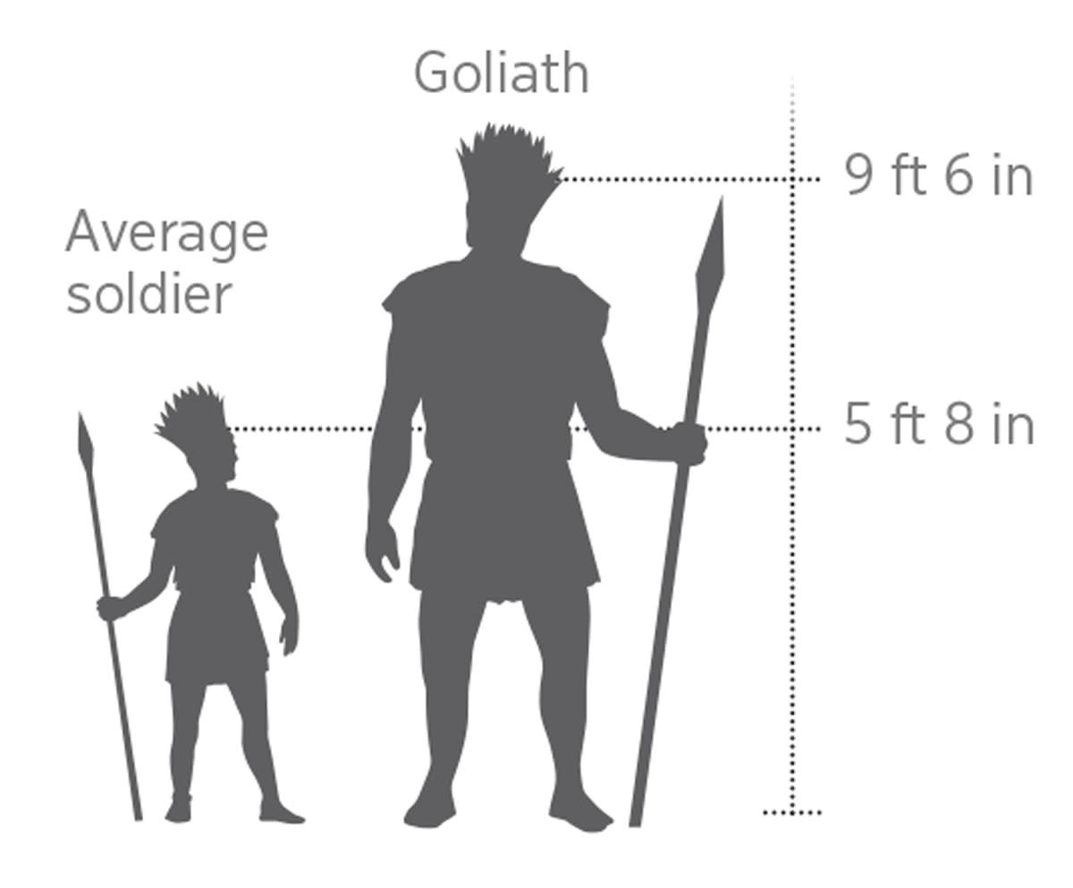
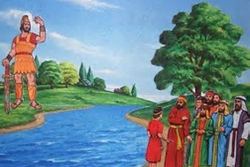
1 Samuel 17
1

Slide 7
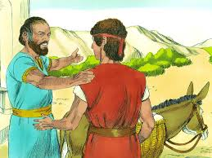
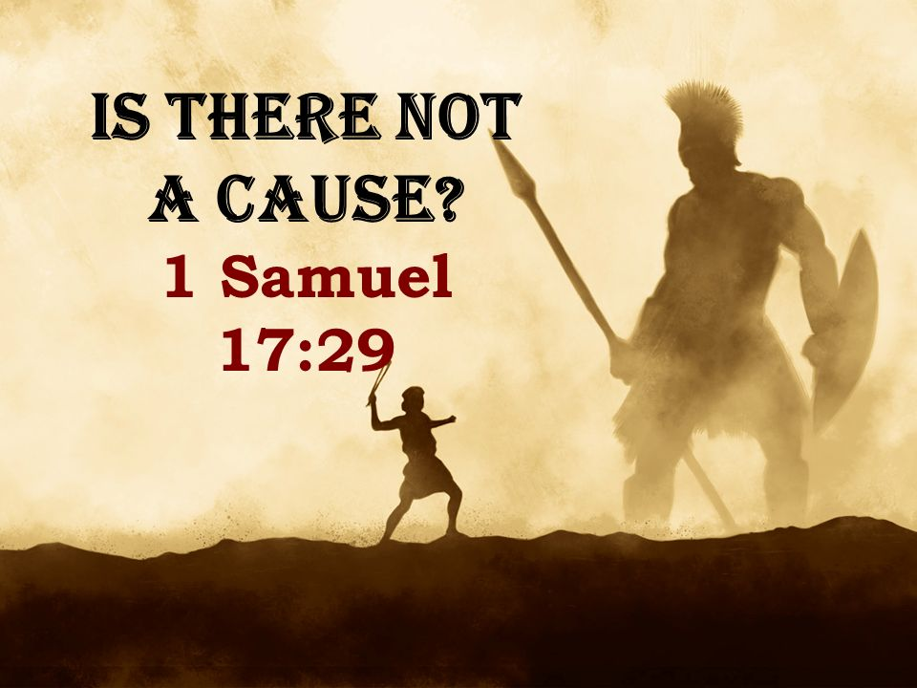
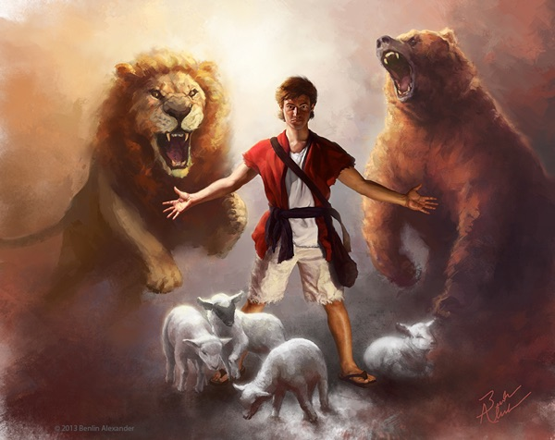
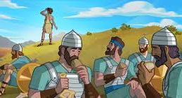
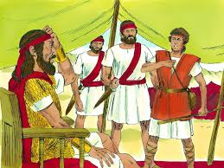
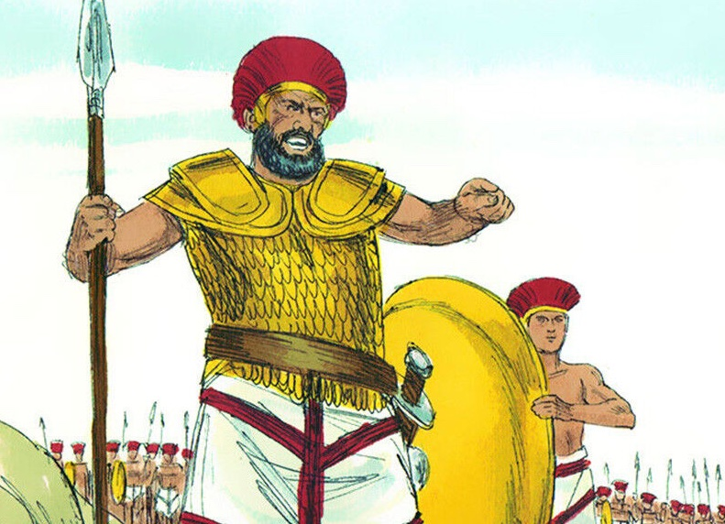
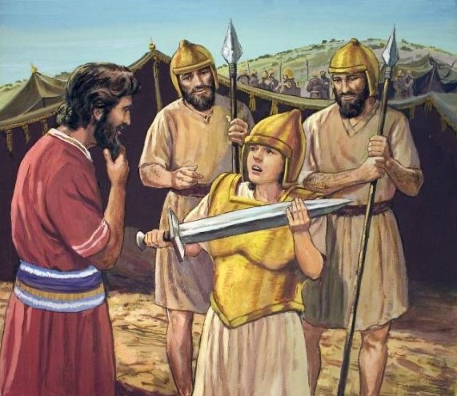
1 Samuel 17
2

Slide 8
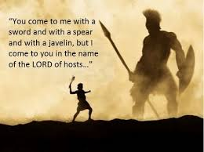
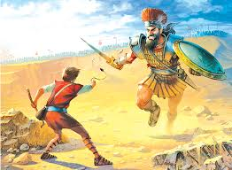
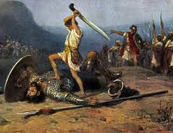
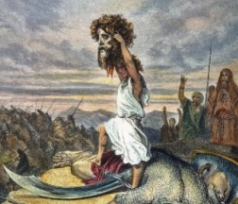
1 Samuel 17
3

Slide 9
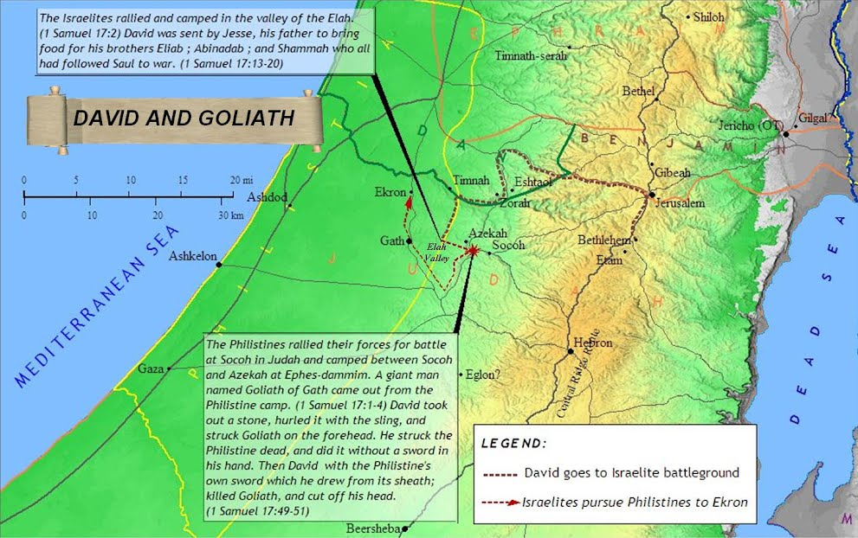

Slide 10
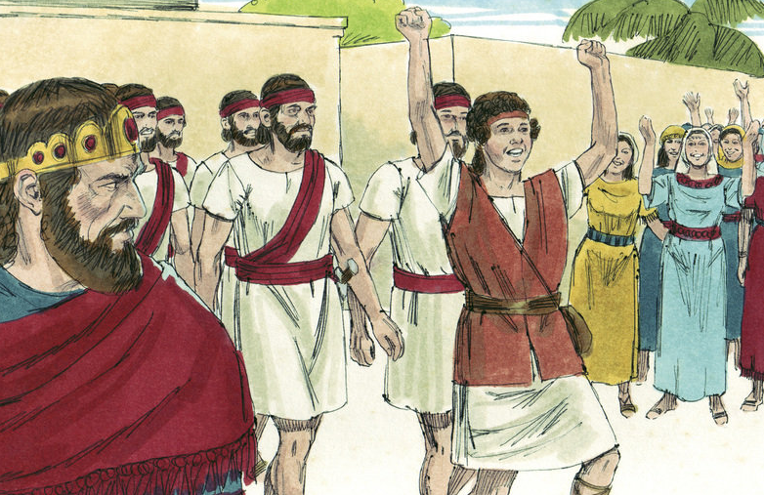
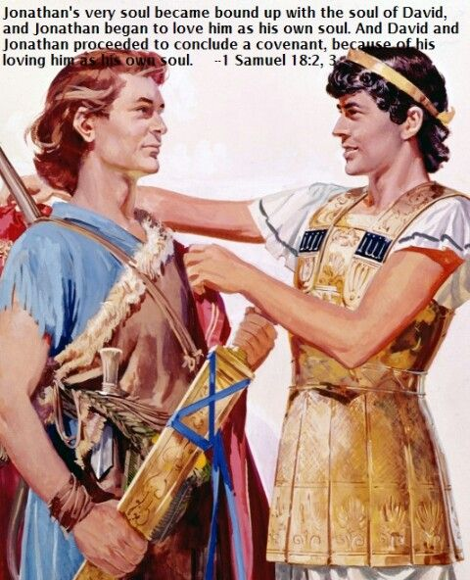
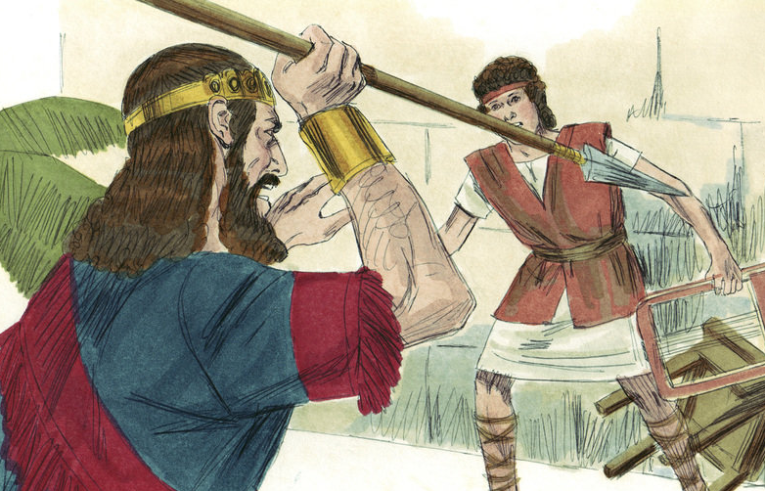
1 Samuel 18:1-16

Slide 11
What Are Main Points?

Slide 13
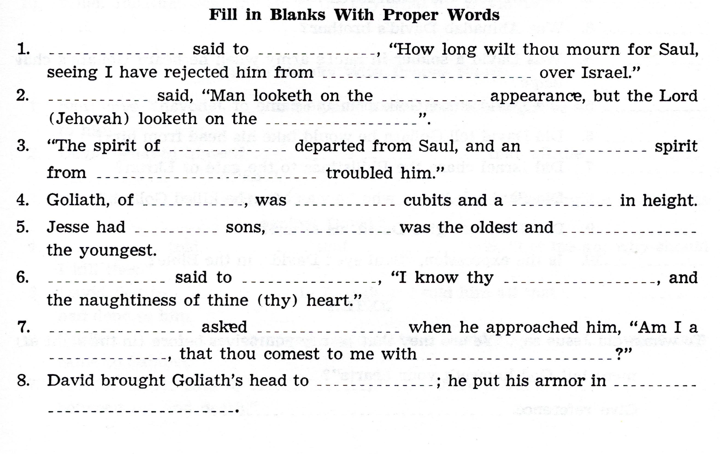

Slide 14
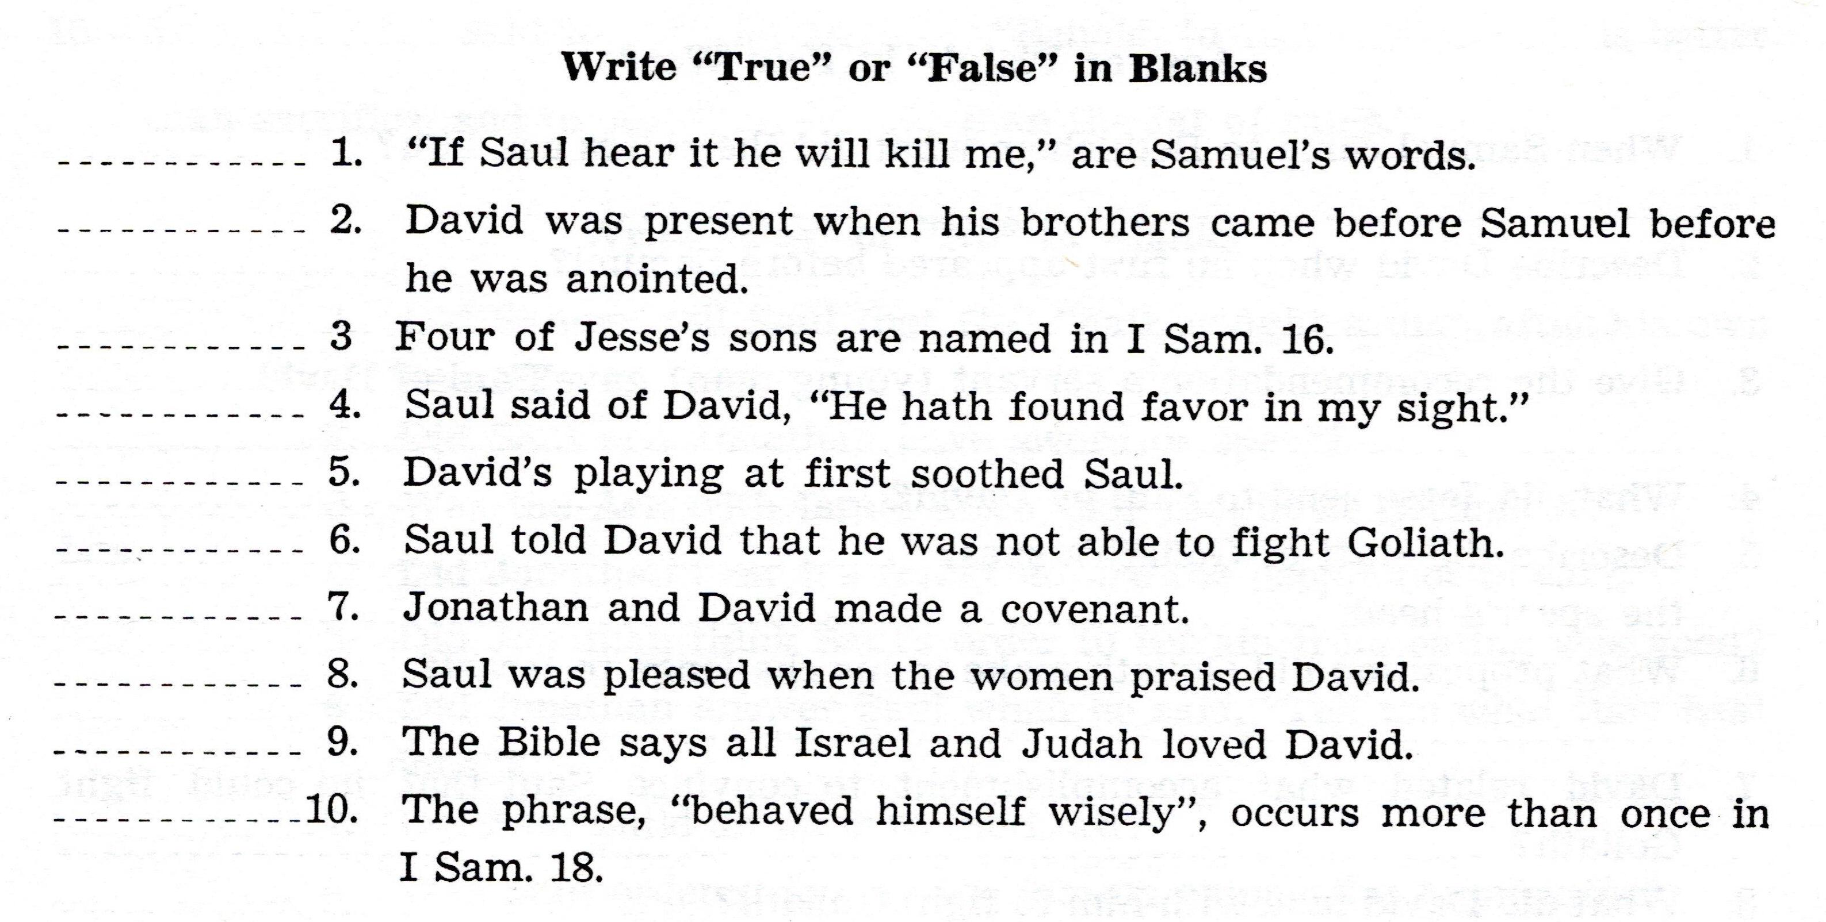

Slide 15
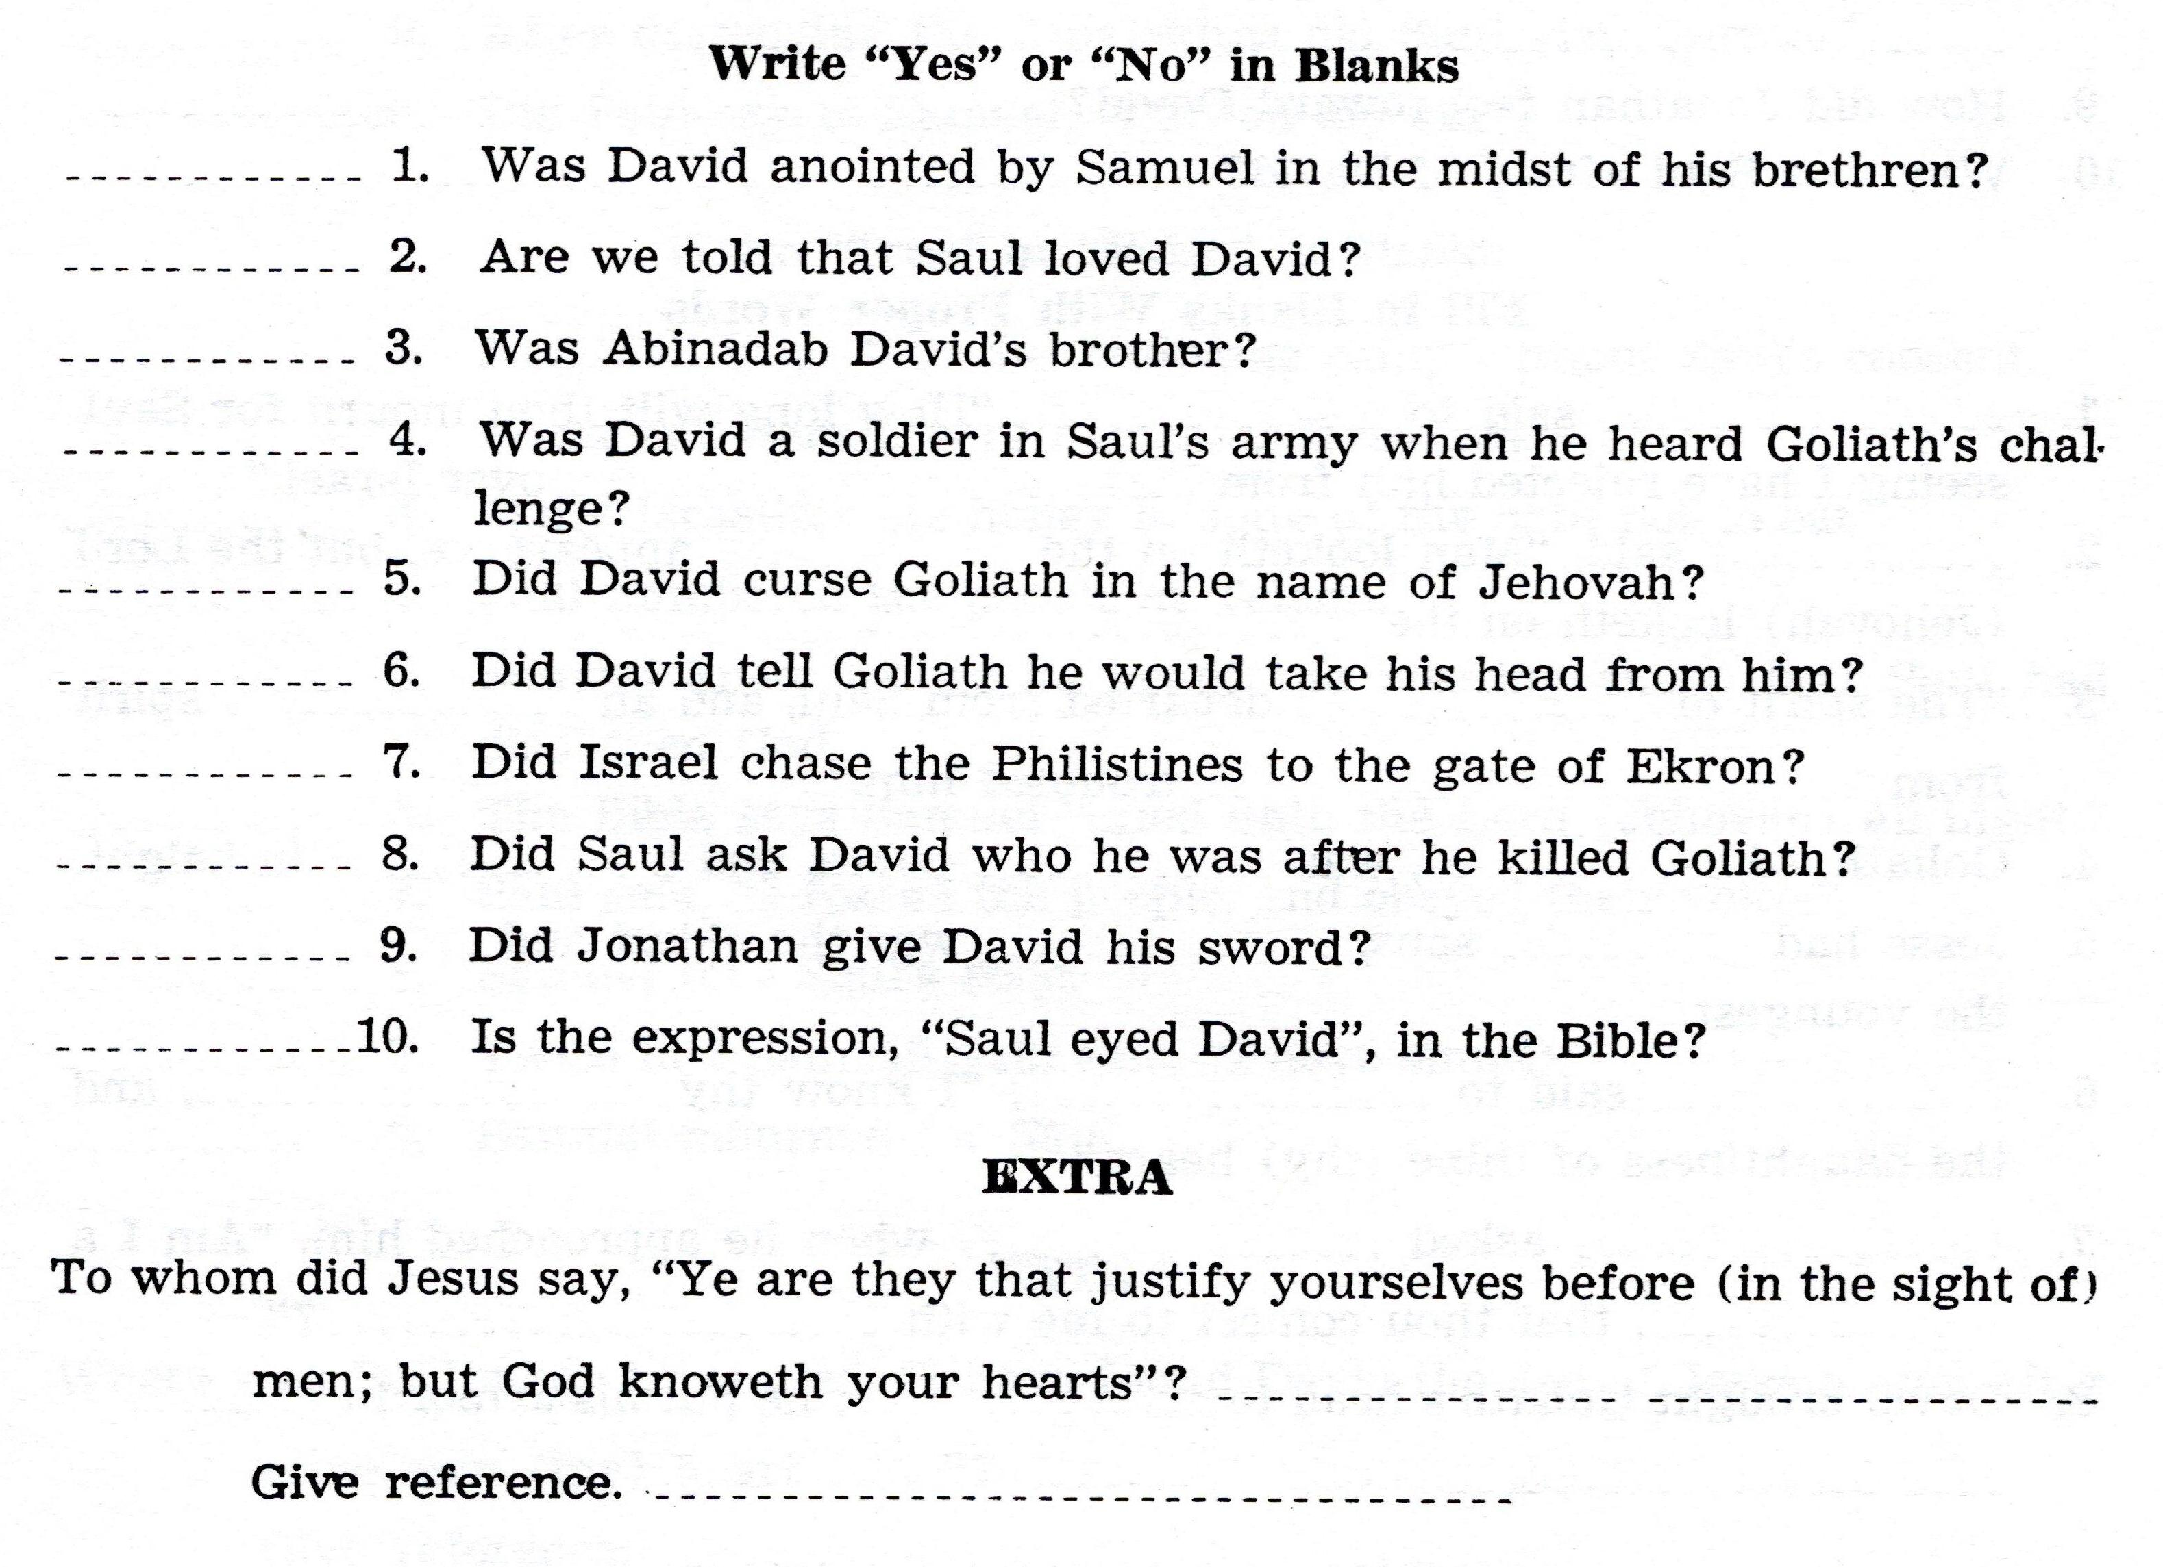

Slide 16
For Sunday (February 13, 2022)
Lessons # 22
1st Samuel 18:17 - 20

